Slide 1








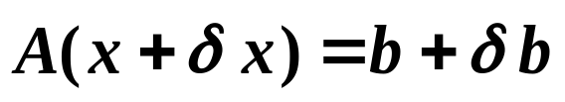
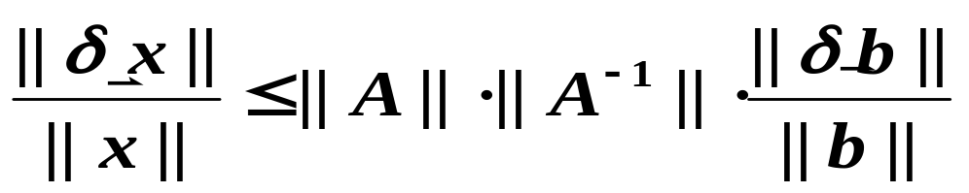
Chapter 7 Iterative Techniques in Matrix Algebra -- Error Bounds and Iterative Refinement
☑ 7.4 Error Bounds and Iterative Refinement
How will the errors of A and affect the solution of ?
➢ Assume that A is accurate, and has the error . Then the solution with error can be written as . That is,
Relative amplification factor
1/6

Slide 2
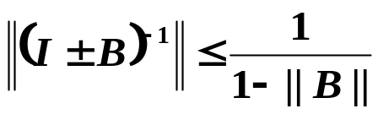

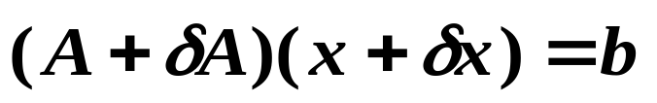
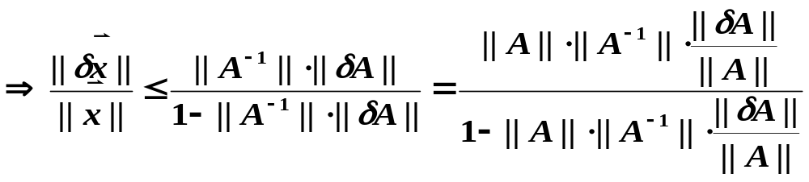

Chapter 7 Iterative Techniques in Matrix Algebra -- Error Bounds and Iterative Refinement
Theorem: If a matrix B satisfies ||B|| < 1 for some natural norm, then
① I ± B is nonsingular; and ② .
➢ Assume that is accurate, and A has the error . Then the solution with error can be written as . That is,
is the key factor of error amplification, and is called the condition number K(A). The the condition number is, the harder to obtain accurate solution.
larger
2/6

Slide 3
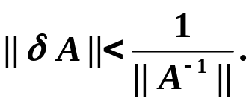



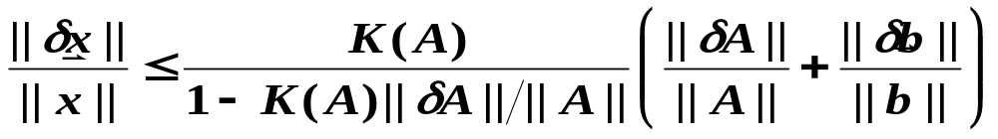

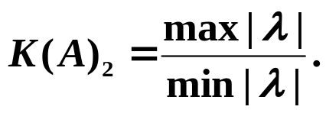
Chapter 7 Iterative Techniques in Matrix Algebra -- Error Bounds and Iterative Refinement
Theorem: Suppose A is nonsingular and
The solution to approximates the solution of with the error estimate
Note:
☞ If A is symmetric, then
☞ K(A)_{p} ≥ 1 for all natural norm || · ||_{p}.
☞ K(α A) = K(A) for any α ∈ R.
☞ K(A)₂=1 if A is orthogonal ( A^{–1}= A^{t} ).
☞ K(RA)₂ = K(AR)₂ = K(A)₂ for all orthogonal matrix R.
3/6

Slide 4
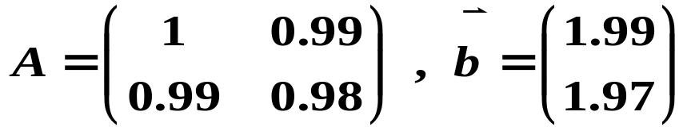
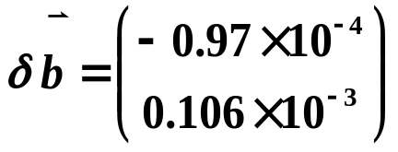

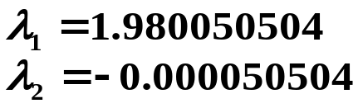

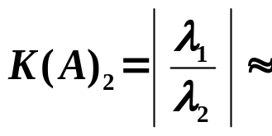
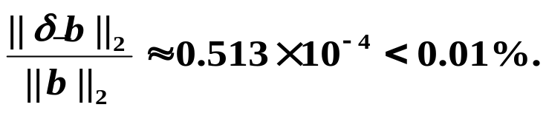
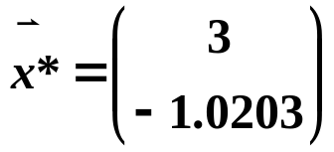
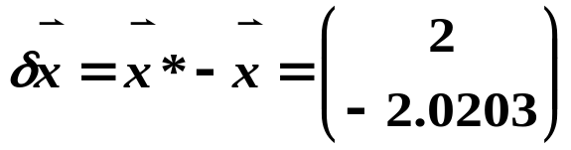
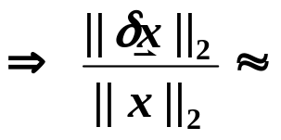
Chapter 7 Iterative Techniques in Matrix Algebra -- Error Bounds and Iterative Refinement
Discussion 15: Given
Compute K(A)₂ ;
Give a small perturbation . What will happen to the solution?
Solution: First find the eigenvalues of A.
39206 >> 1
 How ill-conditioned can it be?
The accurate solution is:
2.0102 > 200%
4/6

Slide 5

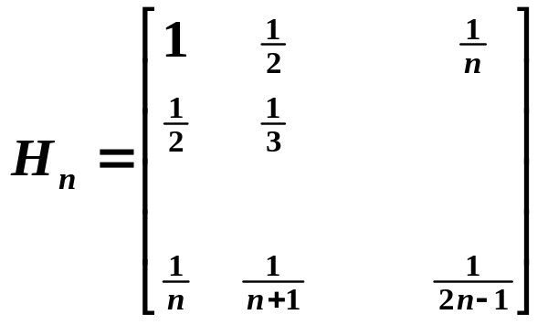
Chapter 7 Iterative Techniques in Matrix Algebra -- Error Bounds and Iterative Refinement
Research topic 7:
Analyze the well-known Hilbert Matrix
See how its condition number (with the infinity norm) behaves while n increases.
5/6

Slide 6





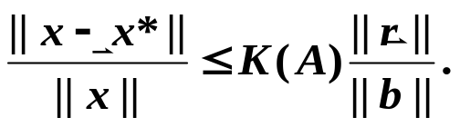








Chapter 7 Iterative Techniques in Matrix Algebra -- Error Bounds and Iterative Refinement
➢ Iterative Refinement:
Theorem: Suppose that is an approximation to the solution of
, A is a nonsingular matrix, and is the residual vector of . Then for any natural norm,
And if and
 Refinement
Step 1: approximation
Step 2:
If is accurate, then
is accurate.
Step 3:
Step 4:
6/6

