Slide 1
General Physics I
Final Review

Slide 2
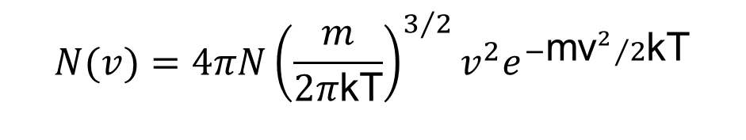
The Scope
Classical Mechanics (or Newtonian Mechanics); Wave physics
Einstein's Theory of Relativity
Thermal Physics
When to use what?
e.g. v → infinity?
$$N(v)=4πN{\left(\frac{m}{2π\text{kT}}\right)}^{3/2}v^{2}e^{{−{\text{mv}}^{2}}/2\text{kT}}$$

Slide 3
The Scope
Classical Mechanics
when the speed is small (compared to the speed of light)
when we do not need super-high precision (e.g., of time), and
when the number of objects is small (unless we have a computer to help)
Einstein's Theory of Relativity
when there is no classical counterpart (such as fission)
when the speed is close to the speed of light, or
when we do need super-high precision (e.g., for GPS)
Thermal Physics
when we have many microscopic particles (e.g. in gases), and
when we are interested in macroscopic properties

Slide 4
Calculate, Estimate, or Guesstimate
Based on exact or perturbatively exact formulas, you can calculate velocity, acceleration, work, heat, entropy, etc.
You can often determine the dependence of a physical quantity (e.g., the wave velocity for the wave on a string) on a few other parameters (e.g., tension and linear density) by dimension analysis. The prefactor may not be fixed, but you can estimate the value of the quantity.
Guesstimate requires you to come up with a simple model or reasoning to estimate the approximate order of magnitude of a certain quantity, often with guessing.

Slide 5


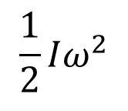
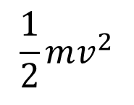



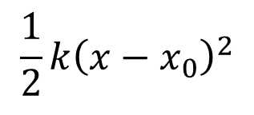

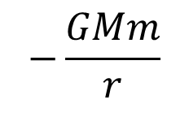
Energy: Various Forms
$$\frac{1}{2}mv^{2}$$
$$FΔx$$
$$−\frac{GMm}{r}$$
$$k_{B}T$$
$$\frac{1}{2}Iω^{2}$$
$$W=pΔV$$
$$γmc^{2}$$
$$Q=TΔS$$
$$\frac{1}{2}k{\left(x−x_{0}\right)}^{2}$$
$$mgh$$

Slide 6
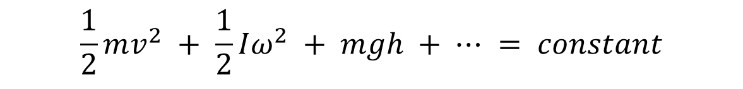

Conservation of Energy
Broader sense: The first law of thermodynamics
Narrower sense: The conservation of mechanical energy
$$ΔU = Q − PΔV$$
$$\frac{1}{2}mv^{2} + \frac{1}{2}Iω^{2} + mgh + ⋯ = constant$$

Slide 7
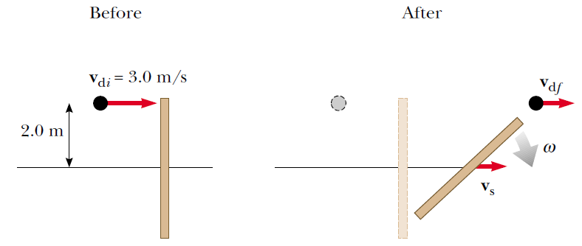
Linear vs Angular Momentum
Symmetry & conservation law
Translational invariance → conservation of linear momentum
Rotational invariance → conservation of angular momentum

Slide 8
Motion
Describe the motion. Figure out whether you have a problem of translation, rotation, vibration, or combined motion, such as pure rolling motion.
Whenever you can use the conservation laws, use them first.
Write down Newton's law if necessary (use torque, moment of inertia, and angular acceleration in a rotation problem).
Integrate the acceleration, then the velocity, to obtain the motion of the object(s).

Slide 9
Equilibrium
Mechanical equilibrium: An object is in equilibrium means that both the linear acceleration and the angular acceleration are zero.
Thermal equilibrium: After two objects have been in contact long enough (such that their macroscopic properties no longer change), we say that they are in thermal equilibrium (microscopic properties still change).

Slide 10
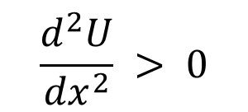
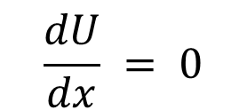
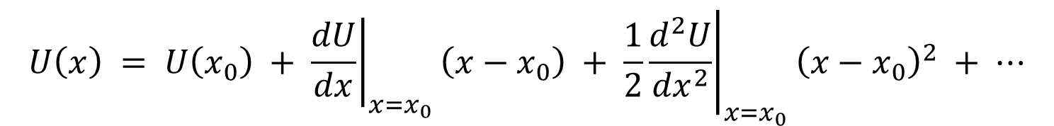
Motion Near Stable Equilibrium
Equilibrium (F = 0)
U(x)
$$\frac{dU}{dx} = 0$$
Stable
x
$$\frac{d^{2}U}{{dx}^{2}} > 0$$
$$x_{0}$$
$$U\left(x\right) = U\left(x_{0}\right) + {\left.\frac{dU}{dx}\right|}_{x=x_{0}}\left(x−x_{0}\right) + \frac{1}{2}{\left.\frac{d^{2}U}{{dx}^{2}}\right|}_{x=x_{0}}{\left(x−x_{0}\right)}^{2} + ⋯$$
simple harmonic motion

Slide 11
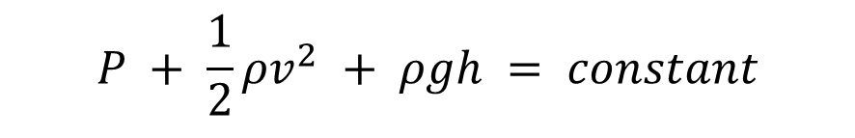


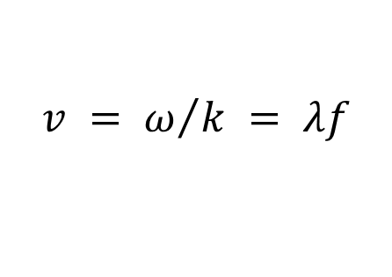
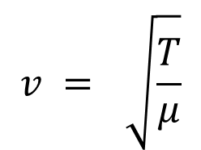
Continuous Medium
The philosophy is to pick a piece of the continuous medium, such as a string segment or a liquid cube, and treat it as a particle like in the Newtonian mechanics.
$$A_{1}v_{1} = A_{2}v_{2}$$
$$P + \frac{1}{2}ρv^{2} + ρgh = constant$$
$$v = \sqrt{\frac{T}{μ}}$$
$$v = ω/k = λf$$
$$y = Asin\left(kx − ωt + φ\right)$$

Slide 12
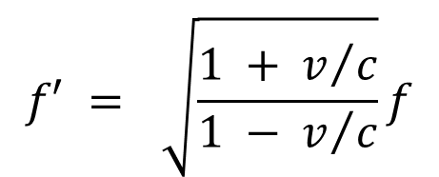

Doppler Effect
Classically, if both source and observer are in motion, we find the following general relationship for the observed frequency:
In the theory of relativity,
$$f′ = \frac{v+v_{O}}{v−v_{S}}f$$
$$f′ = \sqrt{\frac{1 + v/c}{1 − v/c}}f$$

Slide 13
Wave Interference
Same frequency, wavelength, amplitude, direction. Different phase.
Beats (temporal interference): Different frequency.
Standing waves: Same frequency, wavelength, amplitude. Different direction.

Slide 14
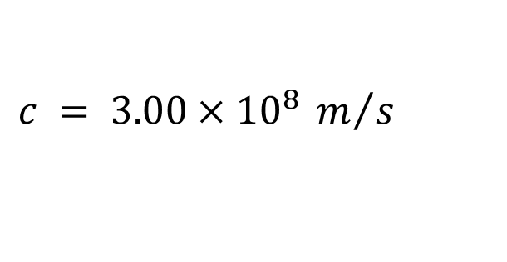
Summary on Relativity
The two basic postulates of the special theory of relativity are
The laws of physics must be the same in all inertial reference frames.
The speed of light in vacuum has the same value in all inertial frames, regardless of the velocity of the observer or the velocity of the source emitting the light.
$$c = 3.00×{10}^{8} m/s$$

Slide 15
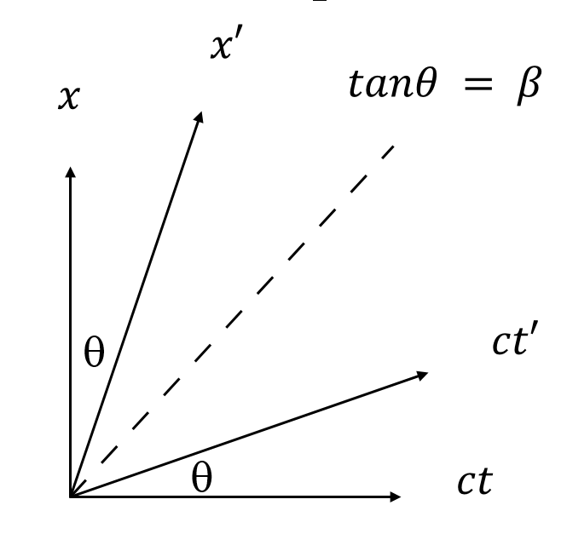


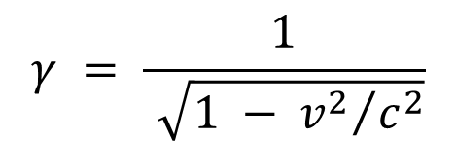


Summary on Relativity
To satisfy the postulates of special relativity, the Galilean transformation equations must be replaced by the Lorentz transformation equations:
$$t′ = γ\left(t − {vx}/{c^{2}}\right)$$
$$x′ = γ\left(x − vt\right)$$
$$y′ = y$$
$$z′ = z$$
where
$$γ = \frac{1}{\sqrt{1 − {v^{2}}/{c^{2}}}}$$

Slide 16
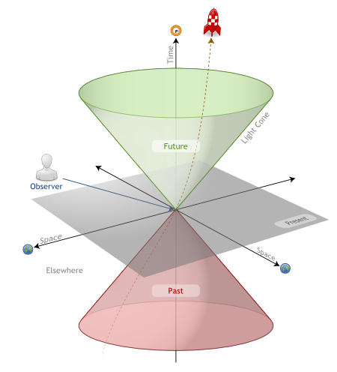
Invariant Interval
Under Lorentz transformation, the interval between events is invariant.
$${\left(Δs\right)}^{2} = c^{2}{\left(Δt\right)}^{2} − {\left(Δx\right)}^{2} − {\left(Δy\right)}^{2} − {\left(Δz\right)}^{2}$$
time
Events inside the future light cone of E are those affected by a material particle emitted at E.
Events inside the past light cone of E are those that can emit a material particle and affect what is happening at E.
All other events are in the (absolute) elsewhere of E and are those that cannot affect or be affected by E.
light cone
observer
future
present
space
space
elsewhere
past

Slide 17


Summary on Relativity
Three consequences of the special theory of relativity are
Events that are simultaneous for one observer are not simultaneous for another observer who is in motion relative to the first.
Clocks in motion relative to an observer appear to be slowed down by a factor . This phenomenon is known as time dilation.
The length of objects in motion appears to be contracted in the direction of motion by a factor
. This phenomenon is known as
length contraction.
$$γ = {\left(1−{v^{2}}/{c^{2}}\right)}^{{−1}/2}$$
$$1/γ = {\left(1−{v^{2}}/{c^{2}}\right)}^{1/2}$$

Slide 18
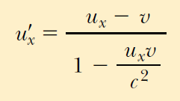
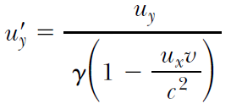
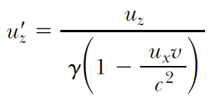
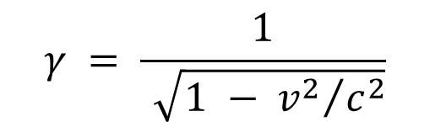
Summary on Relativity
The relativistic form of the velocity transformation equation is
where
$$γ = \frac{1}{\sqrt{1 − {v^{2}}/{c^{2}}}}$$
u_{x} is the speed of an object as measured in the K frame and u'_{x} is its speed measured in the K' frame.

Slide 19



Summary on Relativity
The relativistic expression for the linear momentum of a particle moving with a velocity u is
The relativistic expression for the total energy of a particle is
$$p = γmu = \frac{mu}{\sqrt{1−\frac{u^{2}}{c^{2}}}}$$
Not the relative v of K & K'
$$E = γmc^{2} = \frac{{mc}^{2}}{\sqrt{1−\frac{u^{2}}{c^{2}}}}$$
$$E^{2}−p^{2}c^{2} = m^{2}c^{4}$$
Mass is an invariant

Slide 20

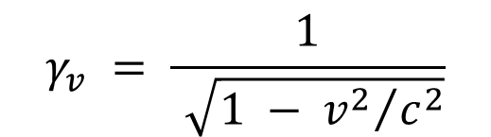
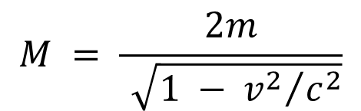
Energy Point of View
$$u = \frac{2v}{1 + {v^{2}}/{c^{2}}}$$
v
-v
v
m
m
m
m
v
v
M
M
$$γ_{v} = \frac{1}{\sqrt{1 − {v^{2}}/{c^{2}}}}$$
$$M = \frac{2m}{\sqrt{1 − {v^{2}}/{c^{2}}}}$$
$$γ_{v}mc^{2} + γ_{−v}mc^{2} = γ_{0}Mc^{2}$$

Slide 21
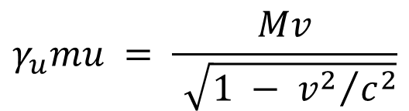
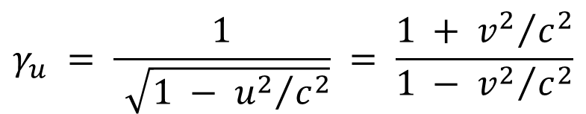
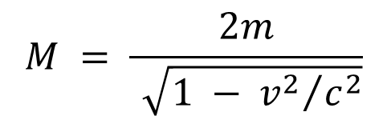
Momentum Point of View
$$u = \frac{2v}{1 + {v^{2}}/{c^{2}}}$$
v
-v
v
m
m
m
m
v
v
M
M
$$γ_{u} = \frac{1}{\sqrt{1 − {u^{2}}/{c^{2}}}} = \frac{1 + {v^{2}}/{c^{2}}}{1 − {v^{2}}/{c^{2}}}$$
$$γ_{u}mu = \frac{Mv}{\sqrt{1 − {v^{2}}/{c^{2}}}}$$
$$M = \frac{2m}{\sqrt{1 − {v^{2}}/{c^{2}}}}$$

Slide 22
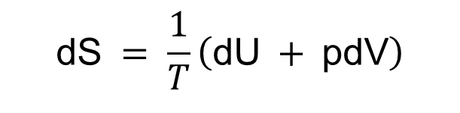
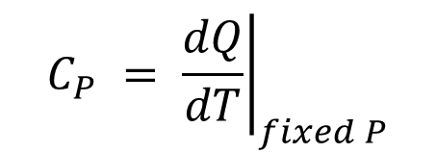
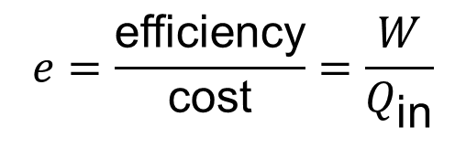
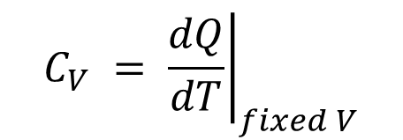
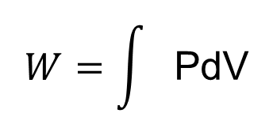


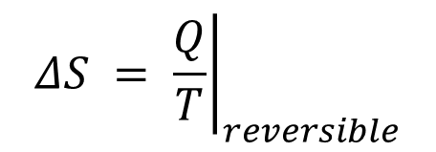

Thermodynamics Laws
$$W=\int{\text{PdV}}$$
$$ΔU = Q − W$$
$$C_{V} = {\left.\frac{dQ}{dT}\right|}_{fixed V}$$
$$C_{P} = {\left.\frac{dQ}{dT}\right|}_{fixed P}$$
$$ΔS = {\left.\frac{Q}{T}\right|}_{reversible}$$
$$\text{dS} = \frac{1}{T}\left(\text{dU} + \text{pdV}\right)$$
$$e=\frac{\text{efficiency}}{\text{cost}}=\frac{W}{Q_{\text{in}}}$$
$$U=U\left(T,V\right)$$
$$p=p\left(T,V\right)$$

Slide 23
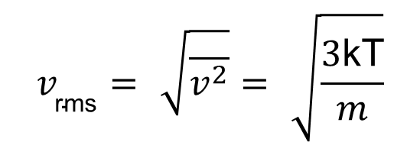

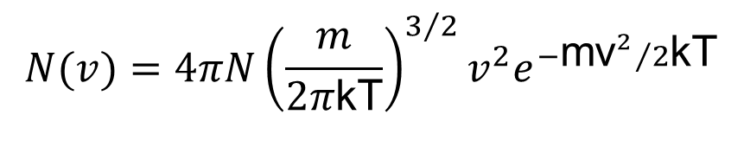

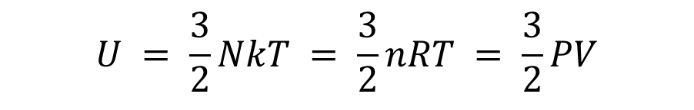
Properties of an Ideal Gas
$$N(v)=4πN{\left(\frac{m}{2π\text{kT}}\right)}^{3/2}v^{2}e^{{−{\text{mv}}^{2}}/2\text{kT}}$$
$$v_{\text{rms}}=\sqrt{\overline{v^{2}}}=\sqrt{\frac{3\text{kT}}{m}}$$
$$\text{PV}=\text{nRT}$$
$$U = \frac{3}{2}NkT = \frac{3}{2}nRT = \frac{3}{2}PV$$
Adiabatic process
$${\text{PV}}^{γ}=\text{const}$$

Slide 24
Practice
Work out the internal energy, work, heat and entropy for an ideal gas in the following processes:
Isovolumetric, isobaric, isothermal, adiabatic, and adiabatic free expansion.
Be sure you understand the key to each process and can figure out any quantity of any process in less than a minute.

Slide 25
About the Final Exam?
Total 10 multiple choices + 4 comprehensive questions. Pick easier ones to solve first.
You are allowed to bring a calculator and a paper dictionary+ruler.
Intermediate results may have credits. So don't be lazy. But in case you guess the result, state the reason(s) why you guess so; otherwise, no points will be given to your guess.

Slide 26
Thank you for your support
during this semester!
路欣
紫金港东四—317;
电话：15869155961
邮件：xinluphy@zju.edu.cn

