Slide 1

Municipal Library
EPItech International
Management System
Scrum-Based Software Development Project
👤 [Name 1] • [Name 2]
🎓 4th Year — Software Engineering | April 2026
⏱ Estimated Presentation Time: ~8 minutes
01 / 10

Slide 2
Project Context & Objectives
Why a digital library management system?
A network of municipal libraries needs a unified digital platform to manage their daily operations — book catalogues, member subscriptions, loans, reservations and transfers between branches. The system must support multiple user roles with secure, role-based access.
🎯
🔐
📊
Digitize Operations
Secure Access
Agile Delivery
Replace manual processes with a unified web platform covering all library branches.
Role-based authentication for Staff, Librarians, Central Service & Readers.
Structured into 4 Sprints using Scrum methodology with strict velocity control (≤32 SP).
02
[Name 1] | [Name 2]

Slide 3
Scrum Team & Methodology
Roles, ceremonies and sprint cadence
🧭
🔧
💻
Product Owner
Scrum Master
Dev Team (×4)
Defines priorities, validates increments, represents stakeholders.
Facilitates ceremonies, removes blockers, ensures Scrum compliance.
Analysis · Modelling · Design · Documentation
Scrum Ceremonies
◆ Sprint Planning
◆ Daily Stand-up
◆ Sprint Review
◆ Retrospective
📅 Sprint duration: 2 weeks | Velocity target: ≤ 32 SP / Sprint | 4 Sprints total
03
[Name 1] | [Name 2]

Slide 4
Case Study Overview
5 functional domains extracted from the requirements document
🏛️
📚
🪪
Library Network
Catalogue
Memberships
Create branches, hire staff, assign managers, attribute unique book IDs.
Manage books, authors, publishers, editions, prices and genres.
Online card creation for residents, professional reader registration.
🔄
📦
Loans & Returns
Transfers
Borrow/return tracking, 3-book limit enforcement, late fees.
Inter-branch book transfers, deficit detection, transfer slips.
04
[Name 1] | [Name 2]

Slide 5
Product Backlog
39 User Stories · 124 Story Points · MoSCoW prioritization
39
124
4
32
User Stories
Story Points
Sprints
Max SP/Sprint
MoSCoW Breakdown:
M Must Have
S Should Have
C Could Have
22 stories · 72 SP
16 stories · 50 SP
1 stories · 2 SP
✅ All Must Have stories are completed in Sprints 1 & 2 before any Should Have is started.
05
[Name 1] | [Name 2]

Slide 6
Sprint Planning & Distribution
Strict MoSCoW ordering — Must Haves completed first
S1
S2
S3
S4
Authentification & Foundations
Acquisitions & Loans
Reservations & Catalogue
Quality & Transfers
31 SP
All M
32 SP
All M
31 SP
M + S
30 SP
S + C
US-01→13 10 stories
US-14,20,22→25,29,30,34 9 stories
US-35,36,39 + US-04,07,10,15,16,18,19,21 11 stories
US-26→28,31→33,37,38,17 9 stories
Authentication, network setup, authors, publishers, professional readers.
Book purchasing, distribution, copy numbering, borrowing limits.
Online reservations, transfers, catalogue enrichment.
Conflict management, statistics, book condition, comments.
06
[Name 1] | [Name 2]

Slide 7
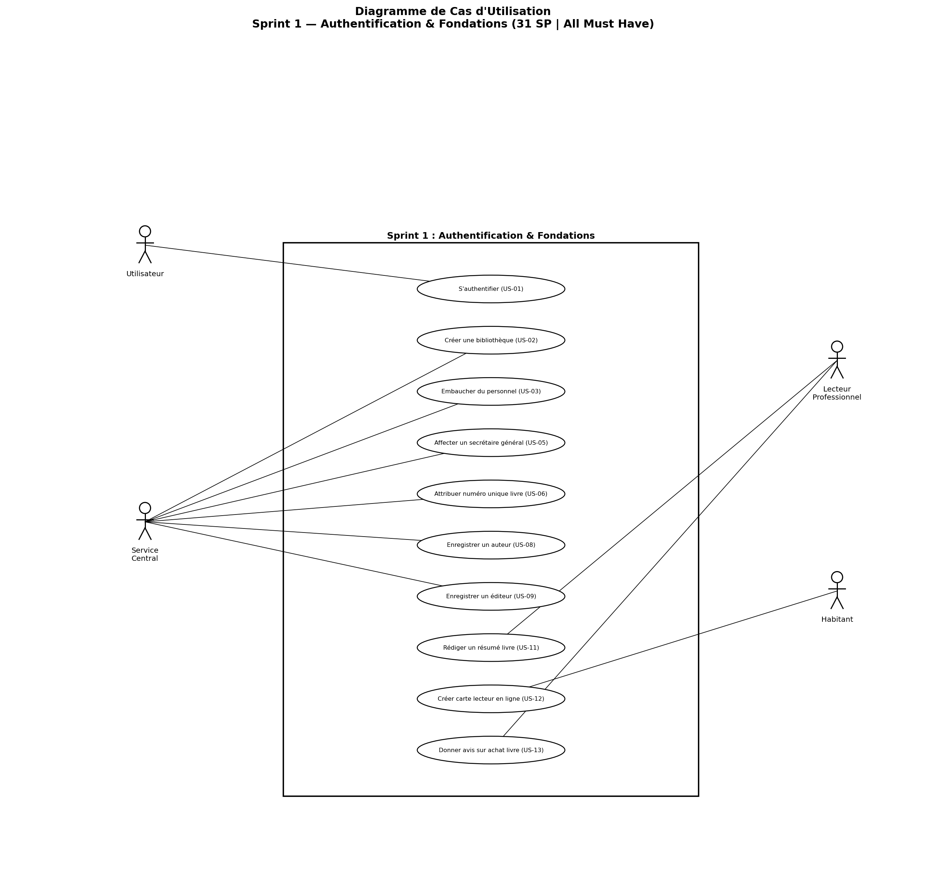
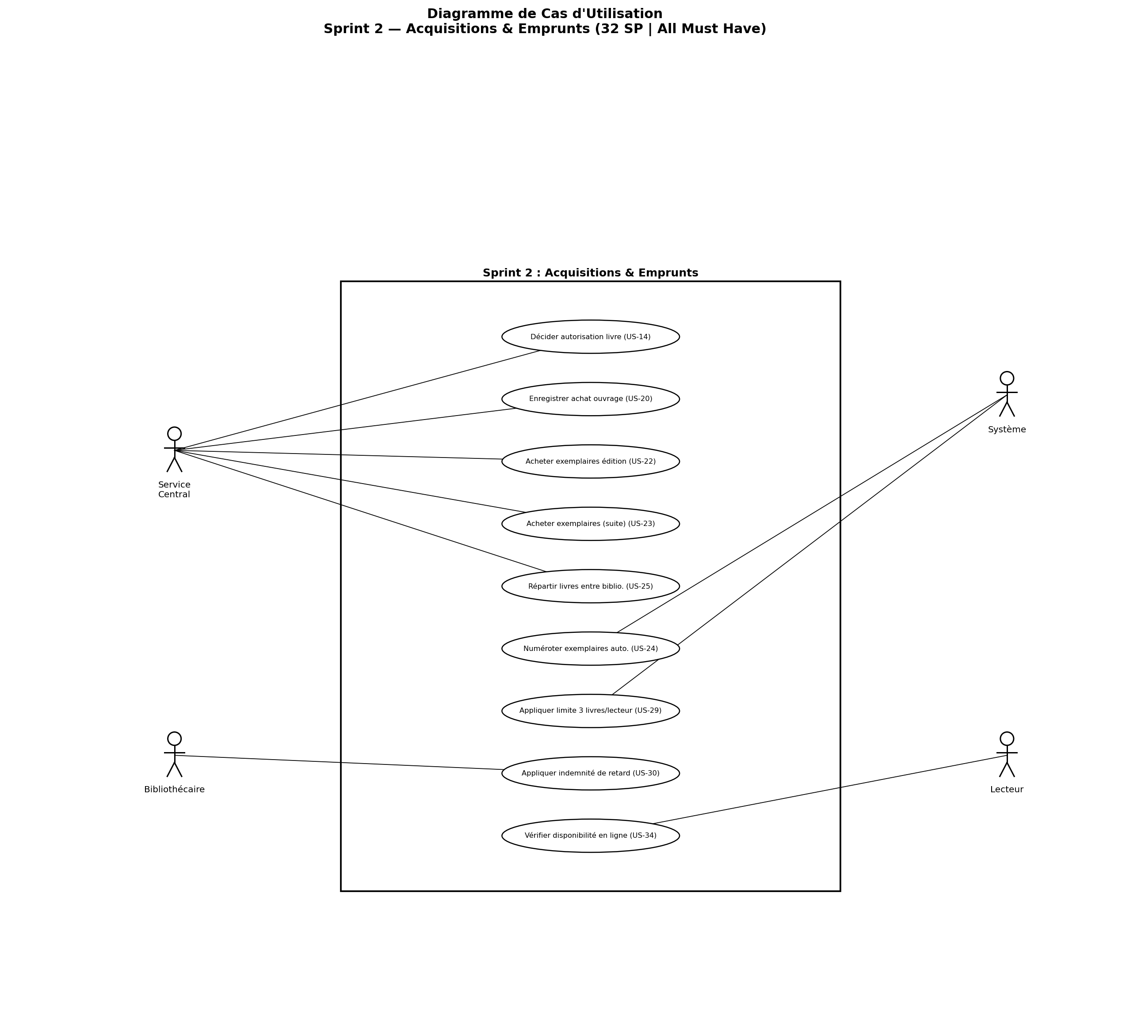
Use Case Diagrams — Sprint 1 & 2
All Must Have stories · 63 SP completed
Sprint 1 — Authentification & Foundations (31 SP | All M)
Sprint 2 — Acquisitions & Loans (32 SP | All M)
07
[Name 1] | [Name 2]

Slide 8
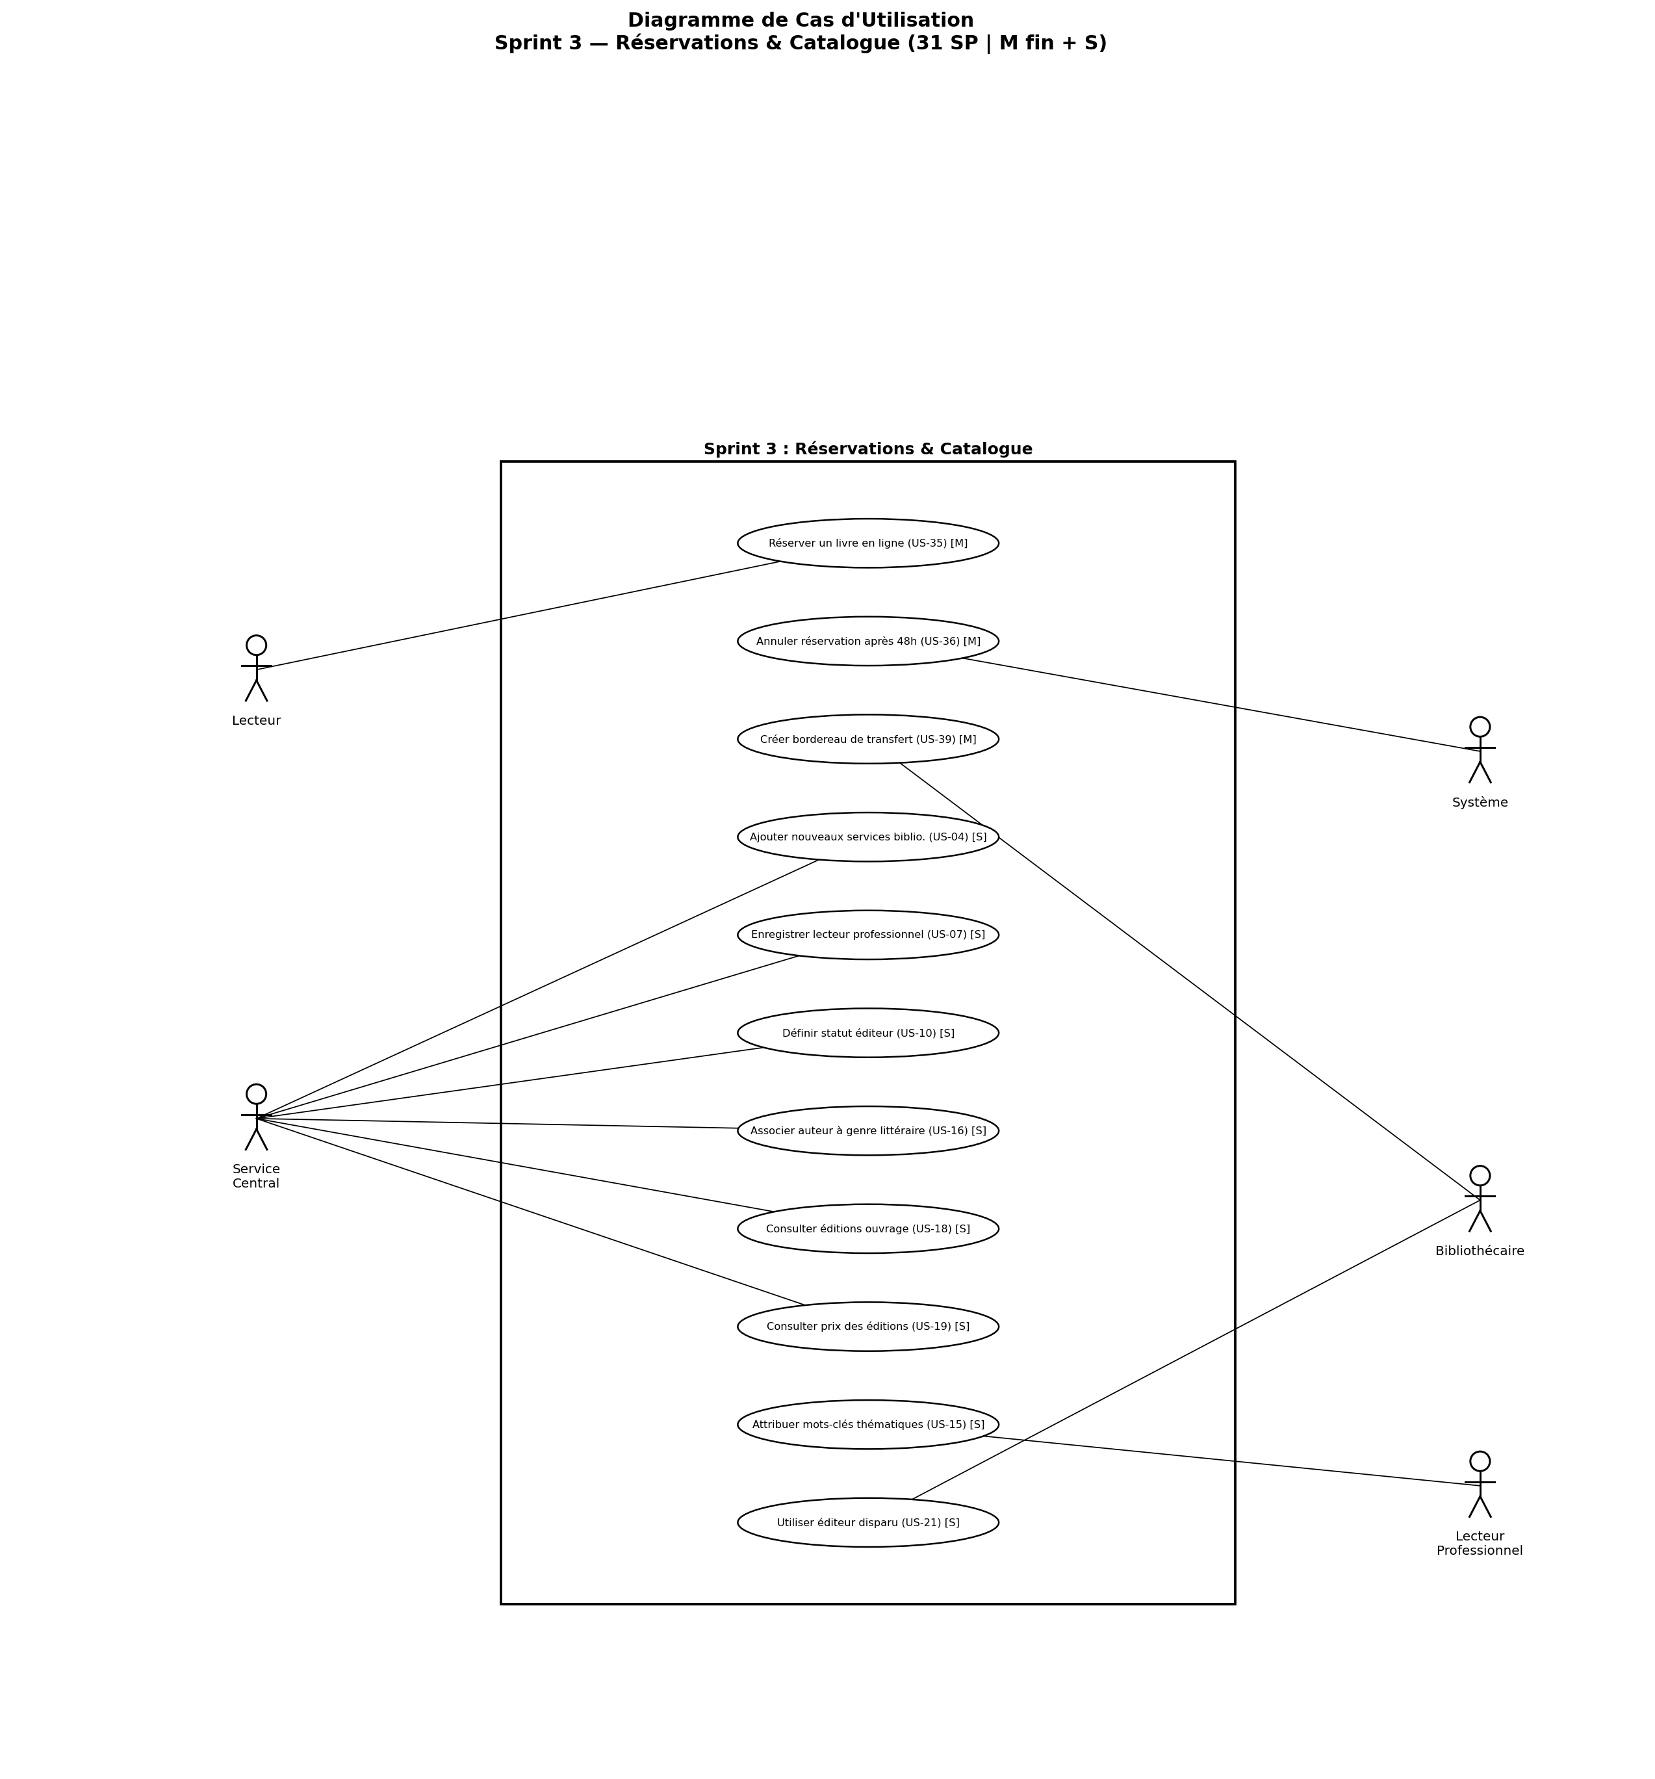
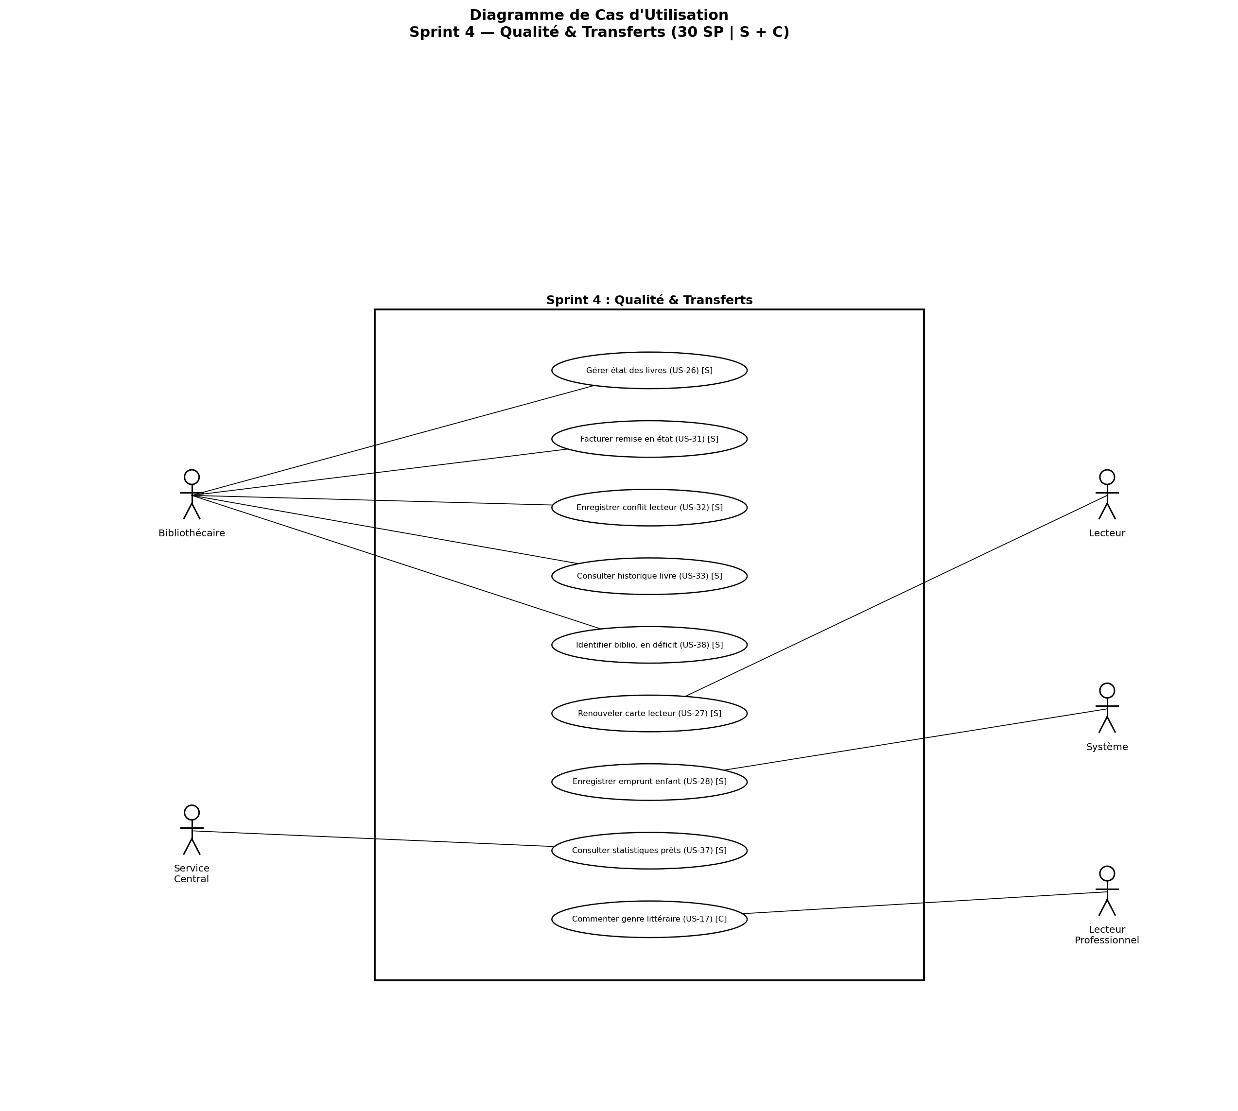
Use Case Diagrams — Sprint 3 & 4
Should Have & Could Have stories · 61 SP completed
Sprint 3 — Reservations & Catalogue (31 SP | M+S)
Sprint 4 — Quality & Transfers (30 SP | S+C)
08
[Name 1] | [Name 2]

Slide 9
Non-Functional Requirements
ISO/IEC 25010 quality model — 12 critical requirements
⚡
🔒
🕐
Performance
Security
Availability
Response time < 3s 50+ concurrent users
Mandatory auth Personal data protection (GDPR)
99% uptime (business hrs) 24/7 online services
🖥️
💾
🔗
Usability
Reliability
Compatibility
Intuitive UI Responsive design
Daily backups Atomic transfers
Integrates with existing library systems
09
[Name 1] | [Name 2]

Slide 10
Conclusion
Key takeaways from the Library Management System project
39
124
22
16+1
User Stories
Story Points
Must Have ✓
Should + Could
✅ Strict Scrum methodology with 4 Sprints and velocity ≤ 32 SP/Sprint
✅ All 22 Must Have stories delivered in Sprints 1 & 2
✅ 4 Use Case Diagrams — one per sprint, actors aligned with backlog
✅ Non-functional requirements aligned with ISO/IEC 25010 standard
✅ Full traceability: Product Backlog → Sprint Backlog → UML Diagrams
10
[Name 1] | [Name 2] | EPItech International | April 2026

