Slide 1
A Systematic Literature Review of Techniques to Reduce the Cost of Mutation Testing
Notes:
Hello!
In this presentation, I’ll walk through a systematic literature review I did on mutation testing.
Specifically, I’ll be focusing on the different techniques researchers have developed to make mutation testing faster and less expensive.

Slide 2
What is mutation testing
x - y
x ^ y
x >= y
x / y
x > y
x + y
x | y
x < y
x <= y
x ** y
x & y
x != y
x - y
“x” + “y”
~x
y - x
x
“y” + “x”
!x
-x
Notes:
So – what’s mutation testing?
It’s a way to check how strong your tests are by making small changes, or ‘mutations,’ to your code. For example, a + might be changed to a - or /, or a > might become >=. If your test suite catches that something has changed and fails, that’s good—it means it’s doing its job.
Even small things like flipping the order—x + y to y + x—can count as a mutation, and this applies to both numbers and strings

Slide 3
Examples of mutations
If x == y:
foo(z)
While x == y:
foo(z)
None
[42]
42.1
foo(z)
[]
42
“42”
Math.infinity
43
-42
41
Notes:
Here are more examples of mutations.
Mutations can remove entire conditions—like turning an if or while statement into just the body—so it always runs.
They can also change constants, like turning 42 into a float, a string, None, a list, or even infinity.
This shows how quickly the number of possible mutations grows, even for small pieces of code. That’s why mutation testing can get really expensive.

Slide 4
Equivalent mutant or just difficult to kill?
def is_even(n):
return n % 2 == 0
def is_even_m1(n):
return (n + 1) % 2 == 0
def is_even_m4(n):
return (n & 1) == 0
assert is_even(6) == True
assert is_even(6) == True
assert is_even(8) == True
def is_even_m2(n):
return n % 2 != 0
def is_even_m3(n):
return n % 3 == 0
assert is_even(6) == True
assert is_even(6) == True
assert is_even(8) == True
Notes:
Another big issue is that not all mutants are helpful.
For example, m1 and m2 are clearly wrong and will always fail - so they don’t really teach us anything.
m3 is more interesting. It’s wrong, but our current test doesn't catch it. That means it’s a 'hard-to-kill' mutant - these are valuable because they show us where we need better tests.
Finally, m4 is an 'equivalent mutant.' It looks different from the original code but behaves exactly the same, so no test can ever catch it. The problem is, in real code, it's very hard to detect these automatically

Slide 5
Review of the techniques found
Notes:
Here is a short review of the techniques we found that help reduce the costs.

Slide 6
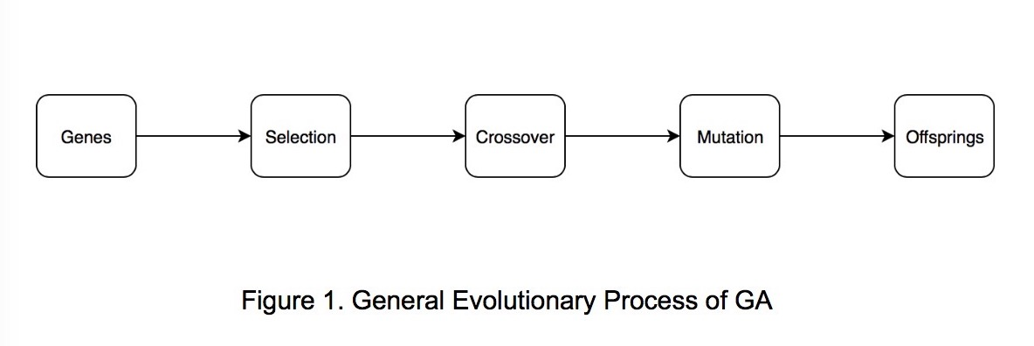
Reducing the number of mutants
” An Approach for the Generation of Higher Order Mutants Using Genetic Algorithms ”
Notes:
One way to reduce the number of useless mutants is to focus on harder-to-kill ones.
This paper uses a genetic algorithm to evolve better mutants. Each candidate mutant is encoded—kind of like DNA—with 1s and 0s showing which mutations are included. Then the algorithm uses selection, crossover, and mutation to improve the pool.
Over time, weaker mutants are replaced by stronger, more useful ones

Slide 7

Reducing the number of mutants
“ Efficiency of Mutation Operators and Selective Mutation Strategies: an Empirical Study “
Redundant Mutations
DER
GLR
RSR
CAR
AOR
do statement end
goto label
return statement
constant for array reference
arithmetic operator
Notes:
Another way to reduce the number of mutants is to simply avoid mutation types that don’t give us useful information.
This paper looked at which mutation operators often create trivial mutants—ones that are too easy to kill.
These include things like replacing return statements, goto labels, or the end of a loop.
The authors found that skipping these kinds of operators helps cut down on useless mutants and saves a lot of time.

Slide 8
Automatically detecting equivalent mutants
“ Using Program Slicing to Assist in the Detection of Equivalent Mutants “
Mutated
Equivalence
def foo(x, y):
z = x / y
return z + 5
x * y == x / y
def foo(x, y):
z = x * y
return z + 5
[z = x * y, return z + 5]
[z = x / y, return z + 5]
Original
Slice
Notes:
Another way to cut costs is by automatically spotting equivalent mutants—ones that behave exactly the same as the original.
This paper uses something called program slicing to do that. It focuses only on the parts of the code that affect the output. If those parts are the same in both versions—even if the code looks different—then the mutant is equivalent.
For example, if multiplying and dividing give the same result for all your test inputs, the mutant doesn’t actually change anything.

Slide 9
Executing Faster
“ Towards Incremental Mutation Testing “
1
2
3
4
5
initial mutation test
identify modifications (git diff)
test modifications only
record survivors
update code
Notes:
Another way to speed things up is by avoiding unnecessary retesting.
This approach, called incremental mutation testing, focuses only on the parts of the code that actually changed.
First, you run a full mutation test and record which mutants survive. Later, when the code changes, you use something like git diff to find only the modified parts.
Then, you retest just those changes—plus any surviving mutants from before—saving a lot of time.

Slide 10
Reducing the number of test cases or executions
“ An empirical evaluation of weak mutation “
def calculate_discount(price, is_member):
if price > 100: # from > to >=
discount = 0.2
else:
discount = 0.1
if is_member:
discount += 0.05
final_price = price * (1 - discount)
return final_price
def calculate_discount(price, is_member):
if price >= 100:
discount = 0.2
Notes:
This last technique is called weak mutation.
The idea is to stop the test early—as soon as we know the mutant would behave differently.
For example, if the original code runs certain lines and sets specific values, and the mutant changes any of that, we already know it’s been caught.
So instead of running the full test to the end, we just compare states and stop early, saving time.

Slide 11
Thank you!
Notes:
And that was it! Thank you!

