Slide 1



FINALS
DOCUMENTATION

Slide 2

MEMBERS:
Soreda,Rovilyn Shaine
Menodiado,Jiselle Ann
Flores,Sherry Mae
Alipio,Rachelle Ann
Bermudez,Marc Jayr
Nantiza, Mark John Ally
Sonio,John Paul
www.reallygreatsite.com

Slide 3
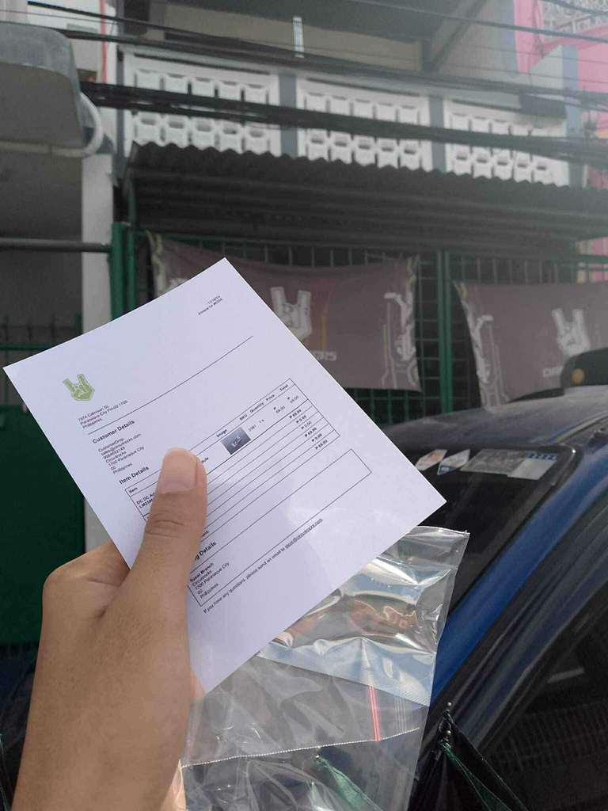
PURCHASING THE NECESSARY MATERIALS
First, we bought all the materials needed for our Arduino project, ensuring they were complete and suitable.

Slide 4
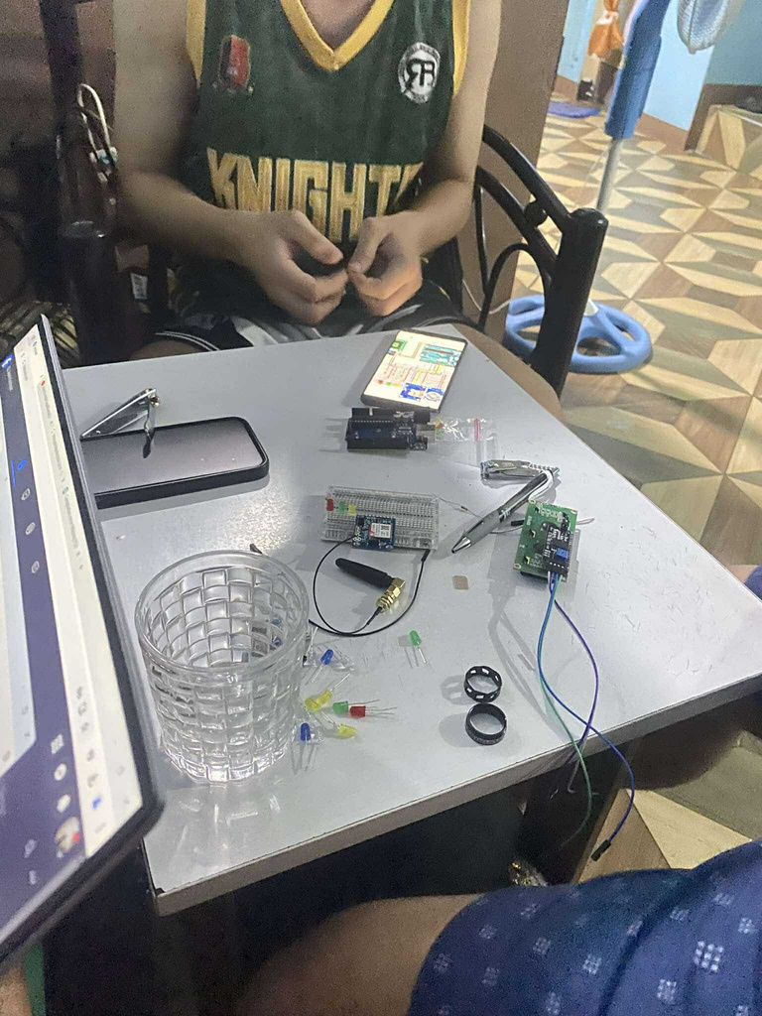
STARTING OUR ARDUINO PROJECT
Next, we started our gas leakage alarm project by watching tutorials and connecting wires to the breadboard and Arduino board.

Slide 5
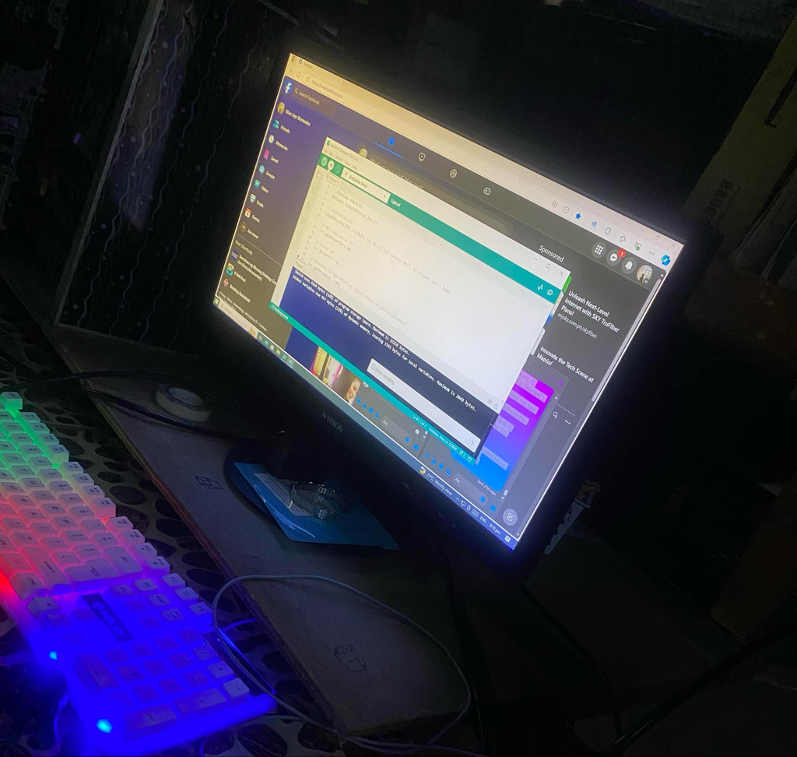
DOWNLOADING ARDUINO IDE AND TESTING CODE
We downloaded the Arduino IDE and tested various codes on the Arduino Uno.

Slide 6
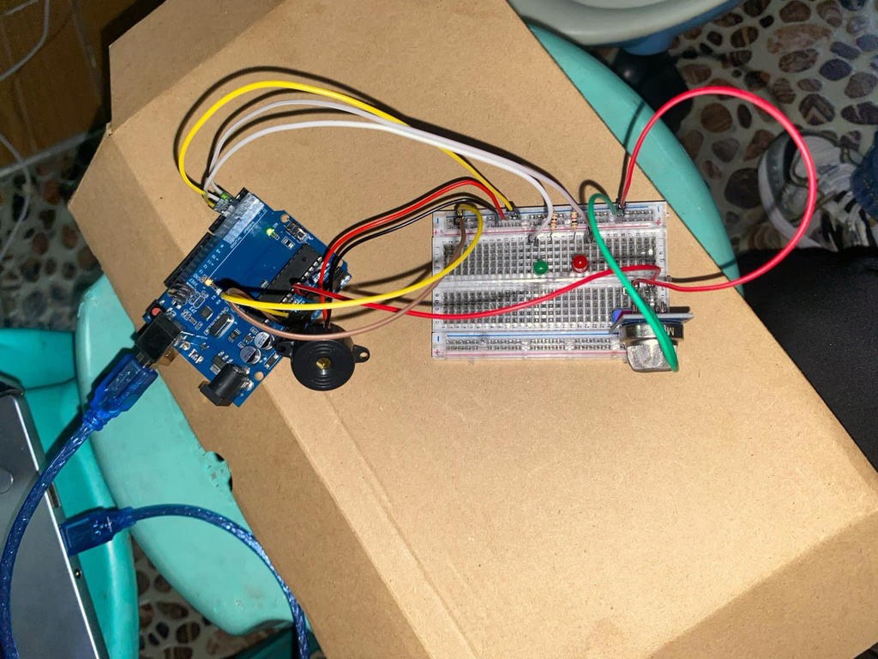
ENCOUNTERING AND RESOLVING ERRORS
We faced an error uploading code due to a defective Arduino Uno, which we identified after troubleshooting.

Slide 7
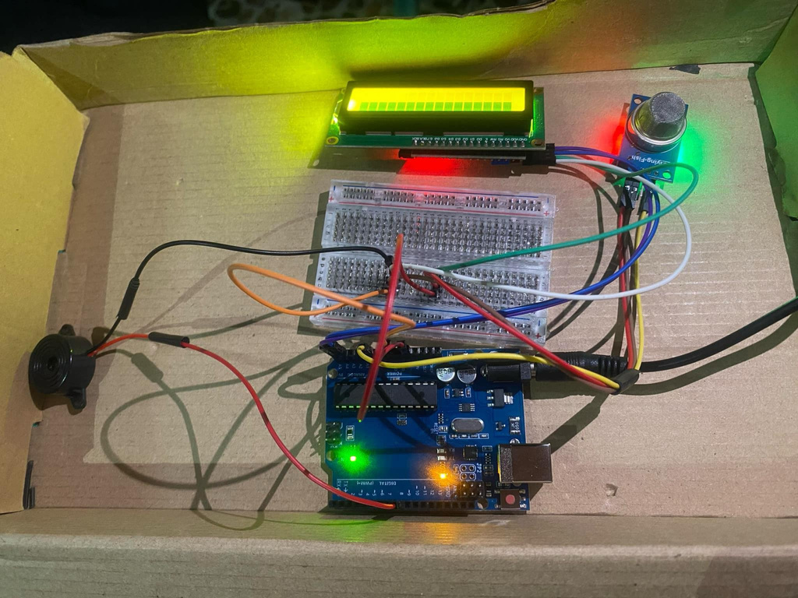
REBUILDING THE GAS LEAKAGE ALARM SYSTEM
We rebuilt the gas leakage alarm system with a new Arduino Uno, successfully uploading the code and making it work perfectly.

Slide 8
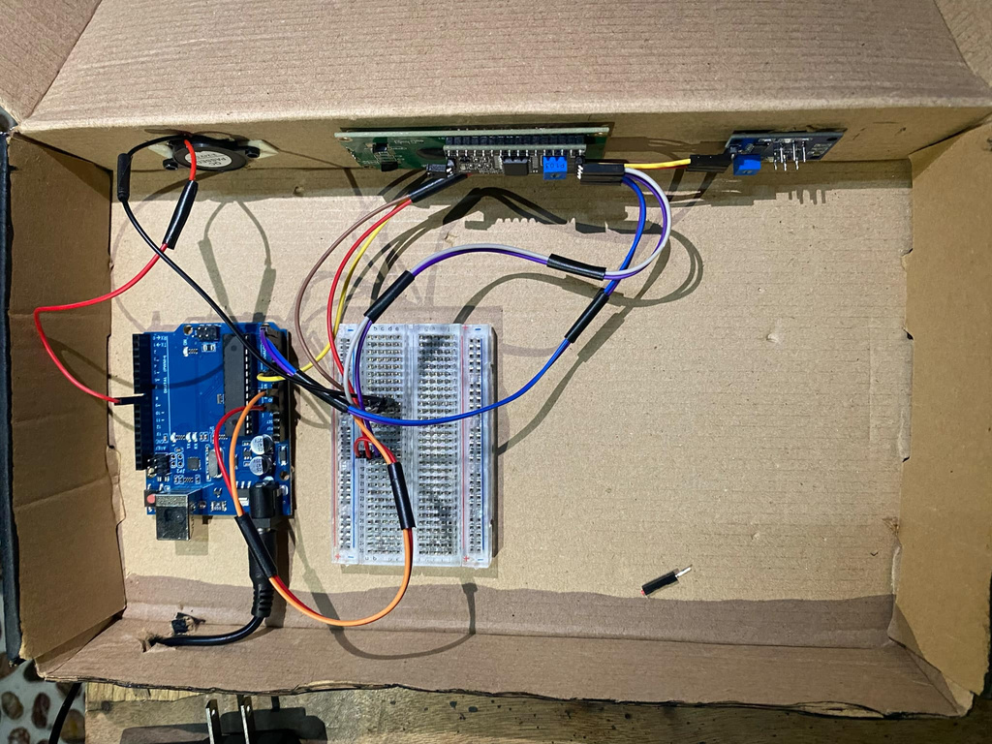
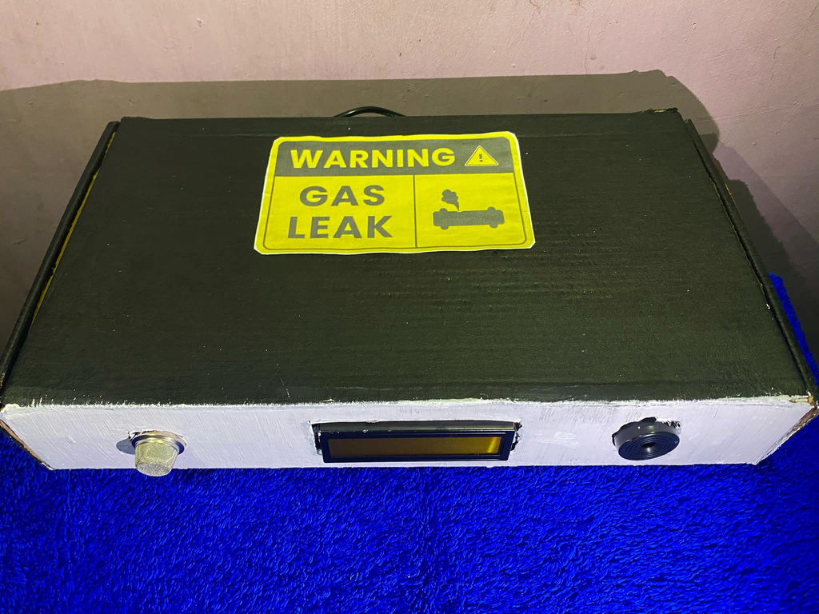
COMPLETION OF THE GAS LEAKAGE ALARM SYSTEM

Slide 9
COMPONENTS OF GAS LEAKAGE ALARM SYSTEM

Slide 10
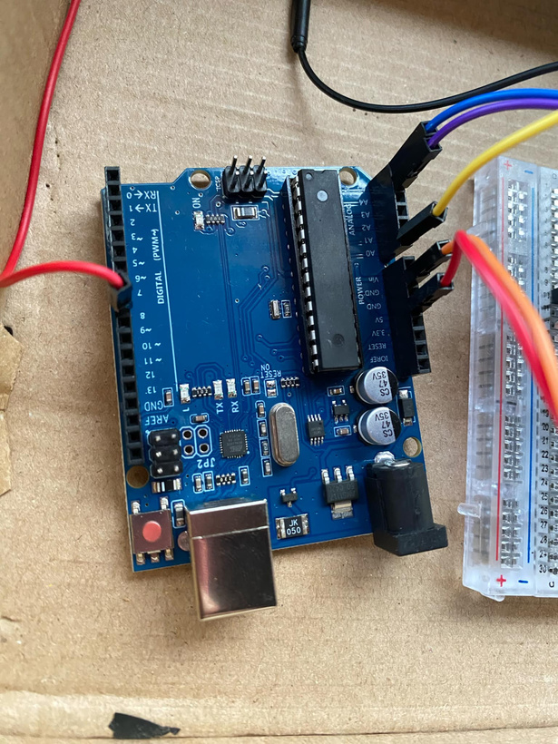
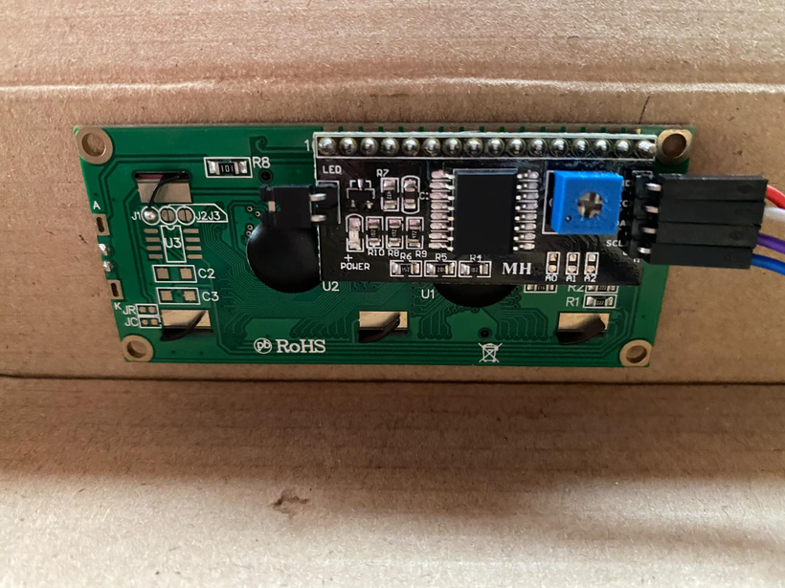
Arduino uno
lcd

Slide 11
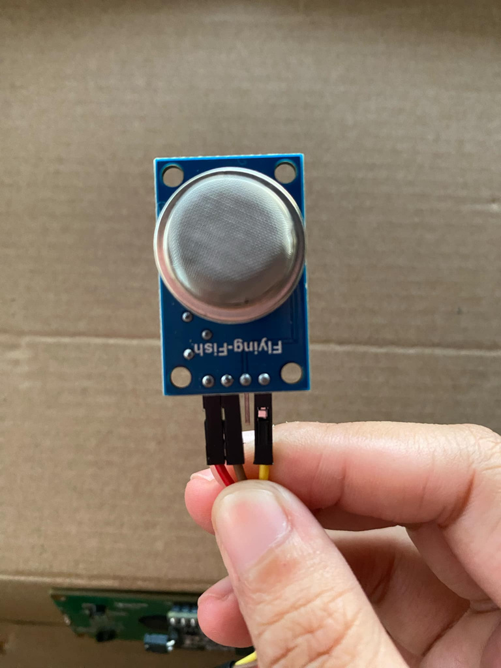
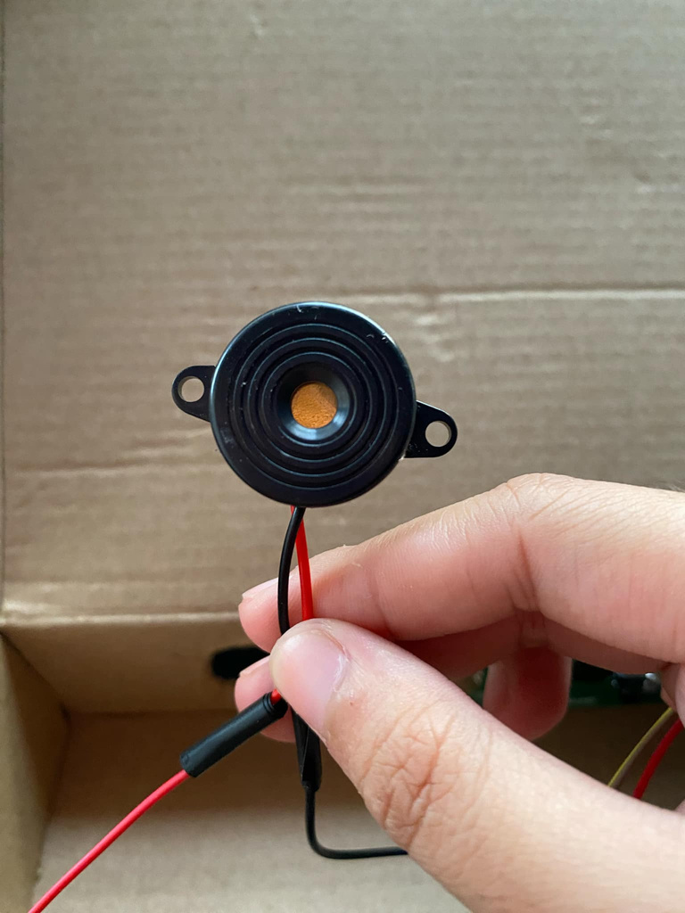
mq-5 sensor
buzzer

Slide 12
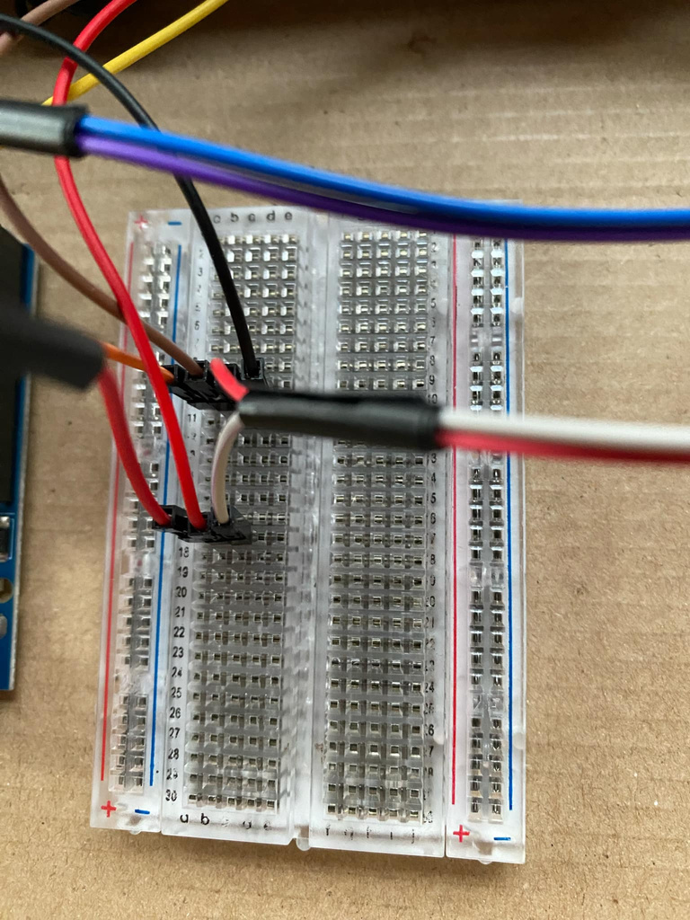
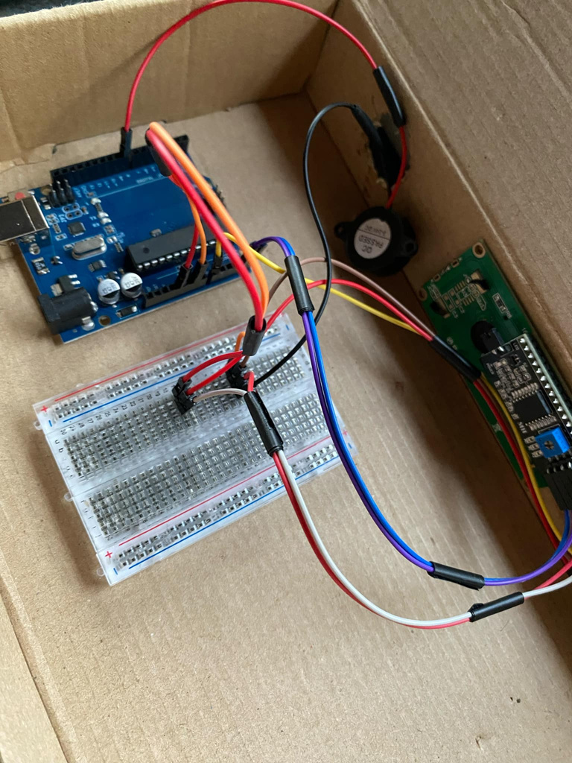
bread board
wires

Slide 13
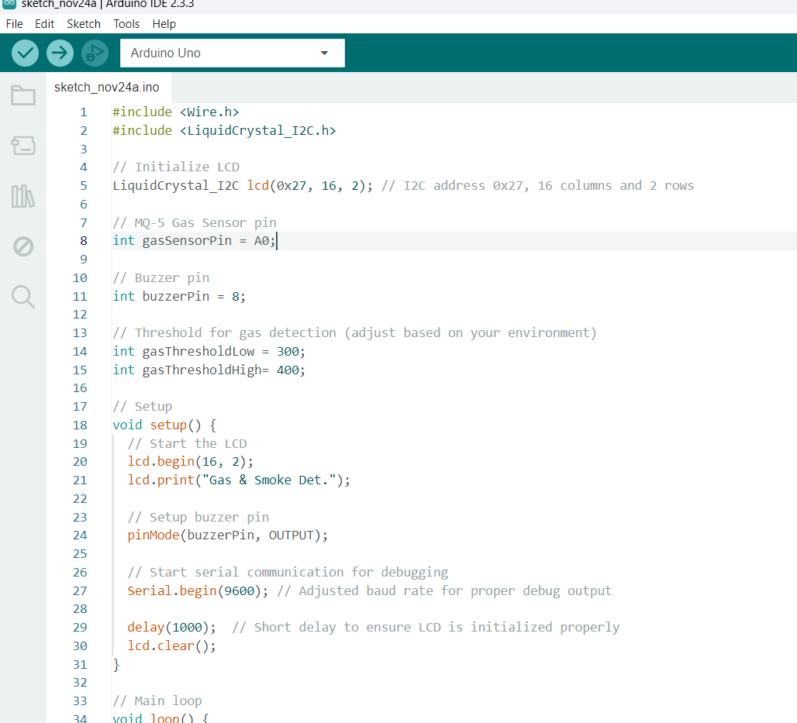
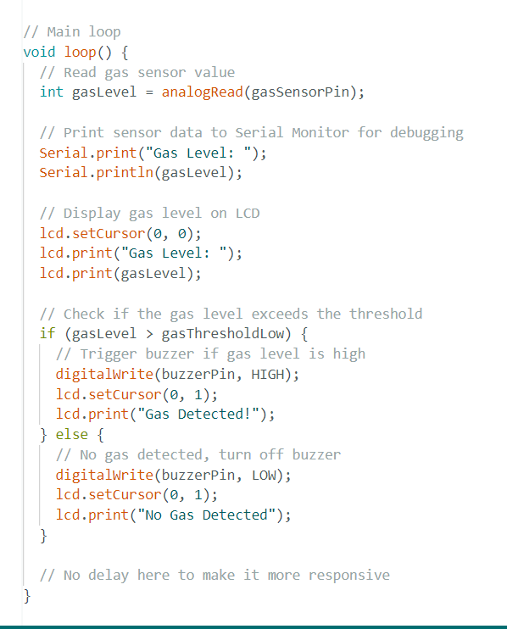
CODES

