Slide 1
Improving Complexity Measurement with Topic-Specific Dictionaries
University of Maryland, College Park
SoRelle Wyckoff Gaynor
Methods Paper Oral Defense
February 22, 2021

Slide 2
Agenda
Overview of changes from first edition
Summary of updated project
Next steps
Q&A

Slide 3
Changes to new edition
Clarified that “complexity” can be considered “policy familiarity”.
Viewing complexity or sophistication as familiarity directly connects this method to literature on congressional expertise.
Clarified discussion of the frequency measure, used to develop the dictionary, as well as the formula of the dictionary-complexity score.
Spent additional time discussing the results and how they reflect proposed and existing theories of congressional expertise.
Included a discussion on how complexity scores reflect expectations about the audience (constituents and fellow members of Congress) and proposed future areas of research.

Slide 4
Changes, continued
Included a new introduction that more clearly emphasizes the importance of studying complexity, popular usage of Dale-Chall and FRE scores, and the expanded contribution to dictionaries in computational text analysis.
Placed the dictionary-complexity vs. Dale-Chall comparison in the Appendix.
Edits and extended explanation throughout.

Slide 5
Summary of updated project
This project proposes a new dictionary-complexity score to more accurately measure text complexity and better capture legislative expertise.
Dictionaries are created via word frequency and merged with an existing complexity formula into convenient R function.
This method produces a complexity score that more accurately captures legislators’ policy familiarity.
This research highlights a new way to use dictionaries in computational text analysis.
Lastly, the application of this research adds to our understanding of complexity and expertise, an important area of research in legislative studies (ex: Curry 2015, Hall 1998).

Slide 6
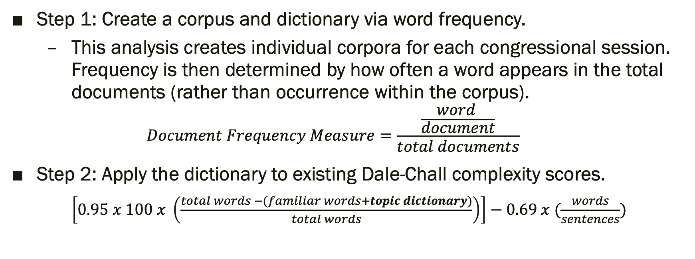
Application
Step 1: Create a corpus and dictionary via word frequency.
This analysis creates individual corpora for each congressional session. Frequency is then determined by how often a word appears in the total documents (rather than occurrence within the corpus).
$$Document Frequency Measure=\frac{\frac{word }{document}}{total documents}$$
Step 2: Apply the dictionary to existing Dale-Chall complexity scores.
$\left[0.95 x 100 x \left(\frac{total words −(familiar words+topic dictionary)}{total words}\right)\right]−0.69 x (\frac{words}{sentences})$

Slide 7
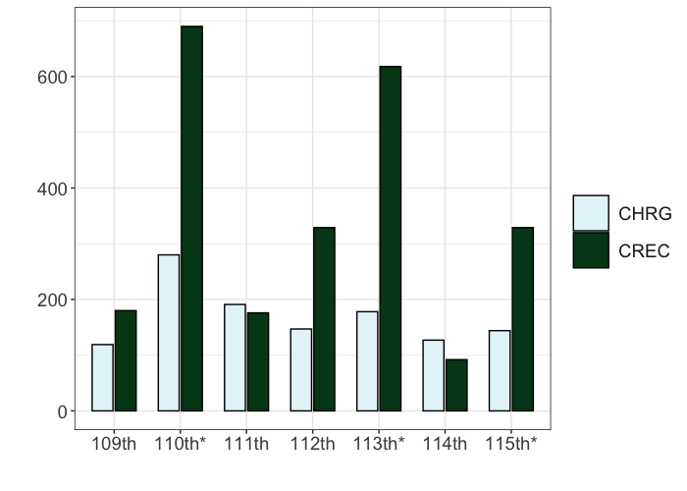
Data
I apply this dictionary-complexity score to to a case study of 3,267 congressional documents discussing the Farm Bill from the 109th – 115th Congress (2007-2018).
Figure 1: Document distribution, 109th – 115th Congress Note: Data collected from GPO. Asterisk indicates year that a Farm Bill was passed by Congress.

Slide 8
Results
Overall, the dictionary-complexity measure generates a lower complexity score compared to existing Dale-Chall and Flesch Reading Scores (FRE), more accurately capturing legislator familiarity.
When dictionary-complexity scores are utilized as a dependent variable:
Witness statements, submitted documents, and floor speeches are considered the most complex.
Oversight hearings are the source of the most complex speech and text among hearings.
There is no substantial difference by party.

Slide 9
Benefits to this approach
Accuracy
Dictionary-complexity has less variation, compared to Dale-Chall reading scores.
Flexibility
Researchers can develop corpora, frequency measure, and dictionaries based on the research question at hand.
Accessibility
This approach bypasses resource-heavy and time-consuming computational text alternatives.

Slide 10
Next steps
Intercoder-reliability checks
Clarification that texts are correctly scored and scaled.
Consider more discussion on “complexity” versus “familiarity” in the scope of methodological studies.
Submission as a research note
Shorter text, fewer descriptive statistics.
Open to suggestions!

Slide 11
Q&A
Thank you!

Slide 12
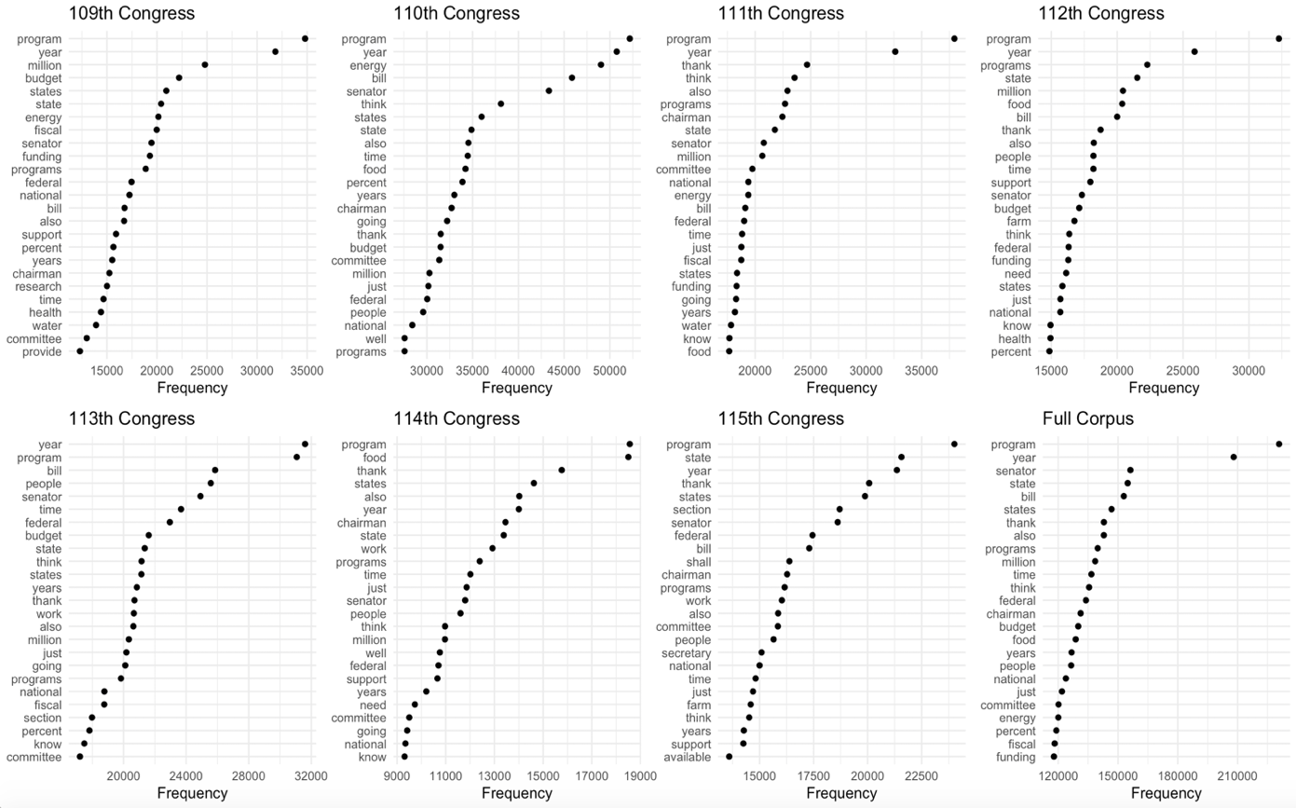
Appendix
Figure 2: Top 25 Words, Per Corpora, 109th – 115th Congress

Slide 13
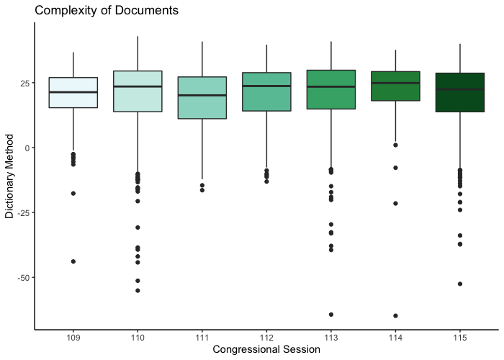
Appendix
Figure 3: Dictionary-Complexity Measure, by Congressional Session Note: The higher the score on the Y axis, the more readable (less complex) the text is.

Slide 14
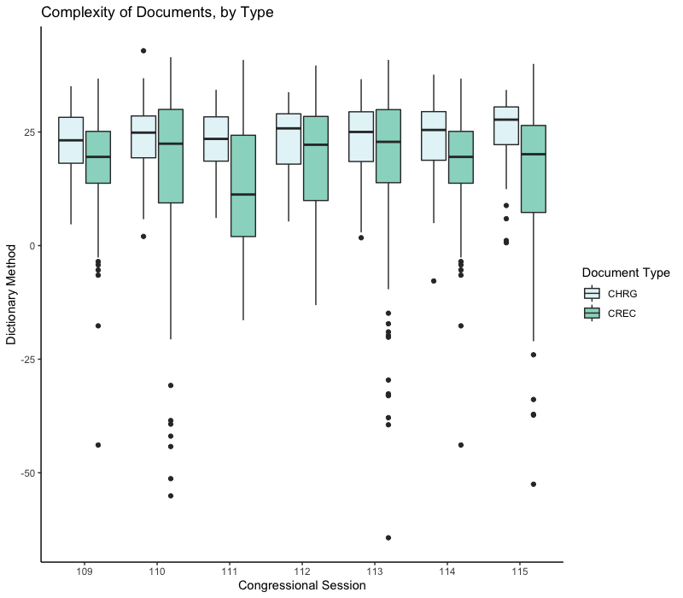
Appendix
Figure 4: Document Complexity, Dictionary-Complexity measure, 109th – 115th Congress Note: CHRG refers to Committee Hearing Documents, and CREC refers to Congressional Record documents.

Slide 15
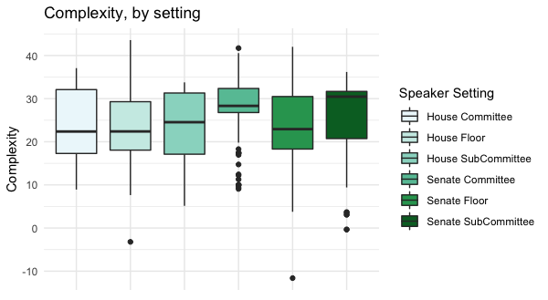
Appendix
Figure 5: Complexity by speaker setting, 109th Congress Note: Complexity is measured by the new dictionary-complexity measure detailed in this paper.

Slide 16
Appendix
Variable | Dictionary estimate | Dale-Chall estimate
Intercept | 29.646*** (2.079) | 27.941*** (2.316)
Opening Statement (hearing) | -1.300 (2.122) | -1.224 (2.364)
Prepared Statement (hearing) | -5.137* (2.220) | -16.596*** (2.473)
Q&A (hearing) | -1.714 (5.325) | -2.176 (2.384)
Submitted Q&A (hearing) | -4.056 (2.312) | -17.873*** (2.575)
Floor Speech | -5.117*** (2.133) | -5.358* (2.376)
Submitted for Record (hearing) | -11.676 (7.779) | -14.145*** (2.947)
Submitted for Record (floor) | -12.541*** (2.645) | -14.145*** (2.947)
N Adjusted R-squared F-statistic | 952 0.337
Table 1: Statement Type, 109th Congress
Note: Standard errors are reported in parenthesis, with confidence levels reported as follows: *p<0.1; **p<0.05; ***p<0.01. The dependent variable is the dictionary-complexity score.

Slide 17
Appendix
Variable | Dictionary estimate | Dale-Chall estimate
Intercept | 27.8169*** (0.284) | 23.256*** (0.324)
Oversight Hearing | -9.095*** (1.742) | -11.556*** (2.576)
Nomination Hearing | -0.952 (1.045) | 1.372 (1.54)
N Adjusted R-squared | 686 0.0632 | 686 0.030
Table 2: Text complexity, by hearing type, 109th Congress
Note: Standard errors are reported in parenthesis, with confidence levels reported as follows: *p<0.1; **p<0.05; ***p<0.01. The dependent variable is the dictionary-complexity score.

Slide 18
Appendix
Variable | Dictionary estimate | Dale-Chall estimate
Intercept | 27.134*** (0.6065 | 19.286*** (0.878)
Committee Chair | 0.809 (0.894) | 2.522* (1.007)
Witness | -0.469 (0.777) | 5.524*** (1.117)
Republican MC | 0.699 (7.074) | 2.978** (1.024)
N Adjusted R-squared | 686 0.0696 | 686 0.0325
Table 3: Impact of Speaker and Setting on Document Complexity
Note: Standard errors are reported in parenthesis, with confidence levels reported as follows: *p<0.1; **p<0.05; ***p<0.01. The dependent variable is the dictionary complexity score.

