Slide 1
NASA
Boiling Detection
By: Alexander Arrieta, Nathan Hill, Soren Paetau
NASA Advisors: Michael Khasin, Matteo Corbetta
Cal Poly Faculty: Hunter Glanz, Jonathan Ventura

Slide 2
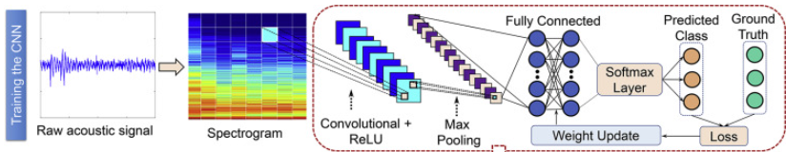

Previous work
“Deep learning the sound of boiling for advance prediction of boiling crisis” w/ Dataset – Sinha et al., Cell Reports Physical Science, 2021
Sinha et al. working with hydrophone data on boiling pots

Slide 3
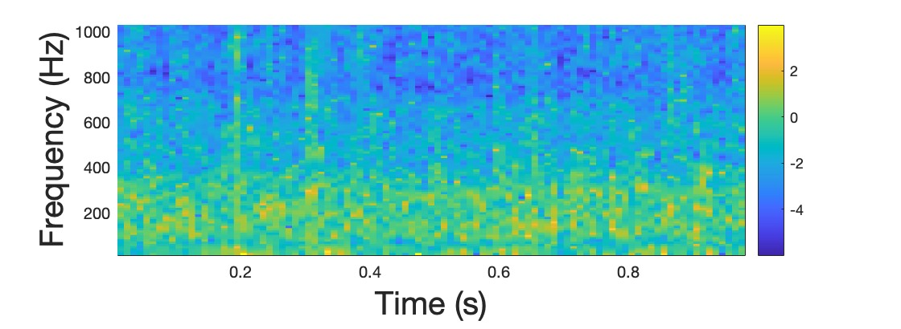
Audio Data
In audio data, 160 - 200 Hz range most important for classifying boiling
Are there similar characteristics from accelerometers?
Nucleate Boiling - Background

Slide 4
Objectives
Determine if accelerometers are viable for real-time boiling detection on a rocket
Can accelerometers detect boiling?
Is the model fast enough to predict in real time?
Is the model generalizable?

Slide 5
Overview of Data
Composed of background noise, stationary boiling, and calm to boiling data
Data Type | Number of Files | Length in Seconds
Background Noise | 5 | 48.7
Stationary Boiling | 3 | 25.9
Calm to Boiling | 4 | 35.4
Total | 12 | 110

Slide 6
Data Cleaning
Crop Data to nearest
0.1 second
Label Ground Truth
Combine all Files

Slide 7
Data Workflow
60%
Accelerometer 1
Training Data
Full Raw Data
20%
Accelerometer 2
Validation Data
20%
Ground Truth Label
Test Data

Slide 8
Transformations and Normalizations
Log Transform
Min-Max Normalization
Fast Fourier Transform
Train/Test/Validation Sets

Slide 9
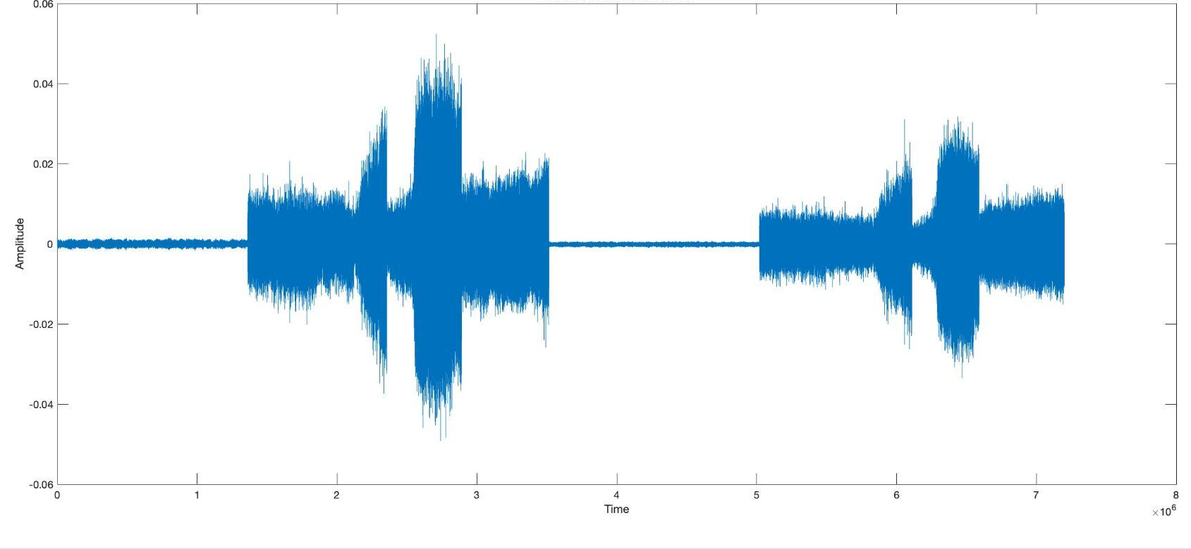
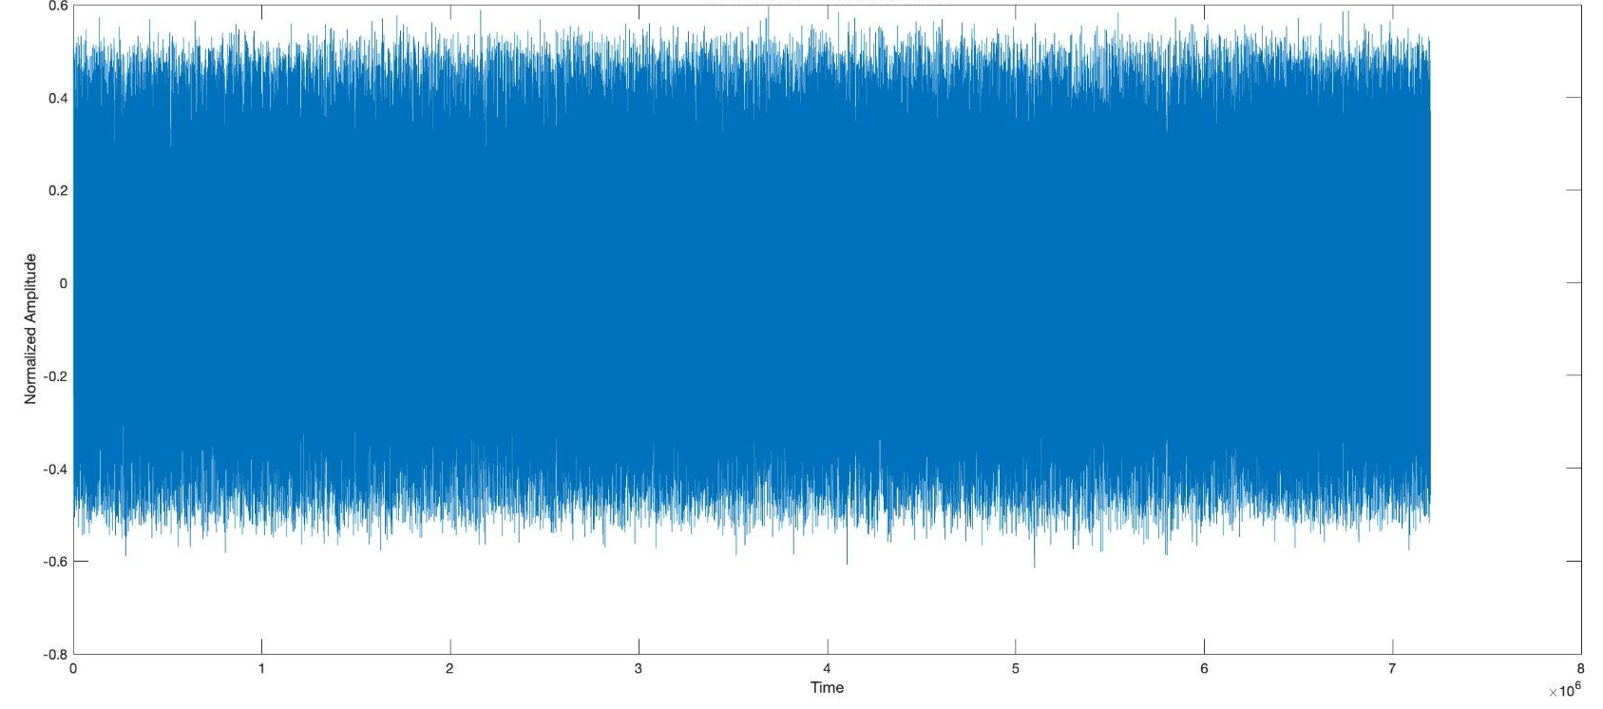
Raw Data Before Normalization
Data After Min-Max Normalization

Slide 10
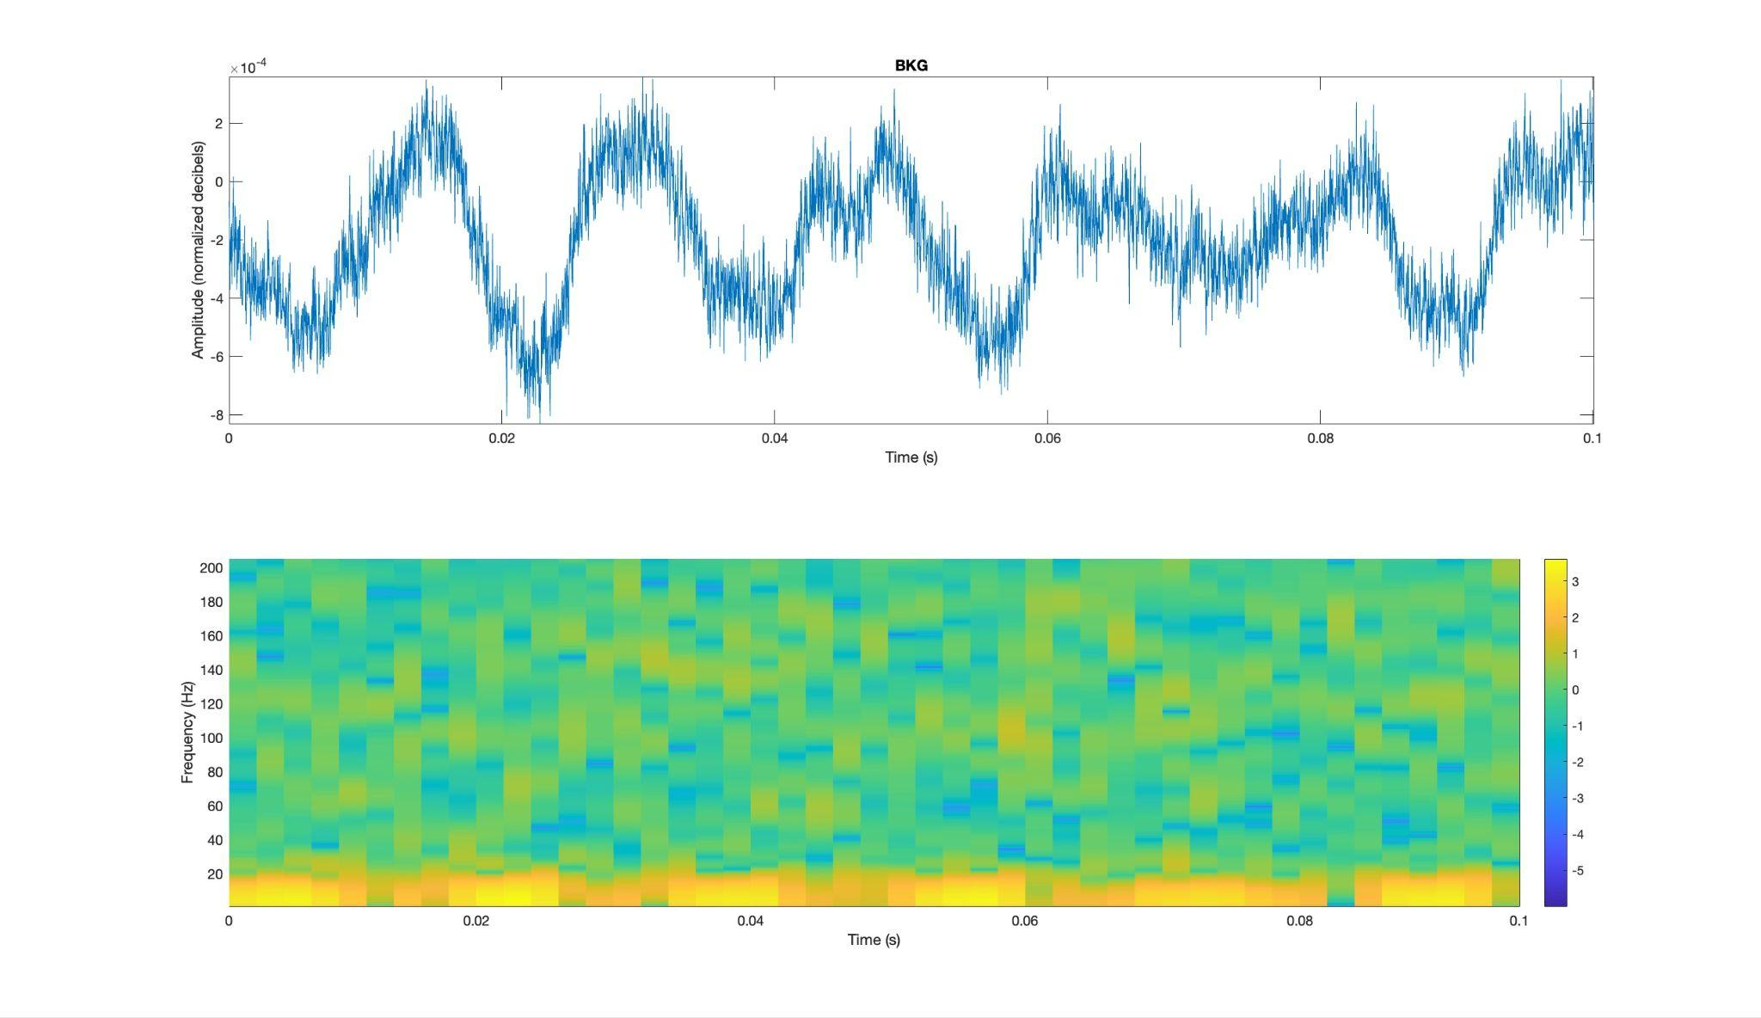
Example 0.1 Second Interval
Background Noise

Slide 11
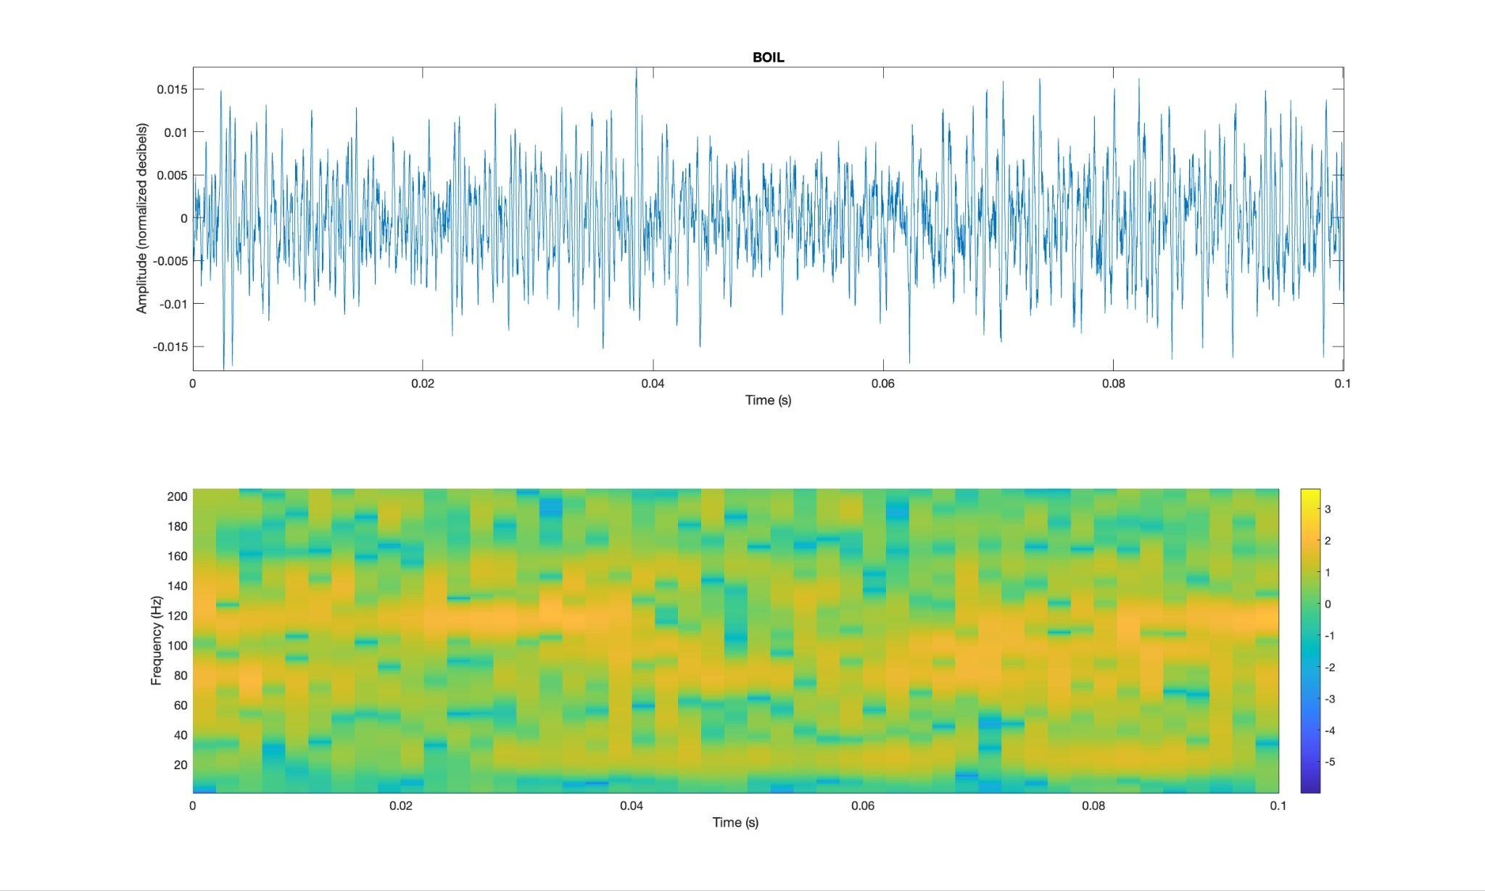
Example 0.1 Second Interval
Boiling

Slide 12
Our Model
Convolutional Neural Network (CNN) for classification
Fast Training
  3 minutes for 25 epochs with 120 iterations each
Fast Classification
High Accuracy
Validation Accuracy:
93.96%
Number of Observations | Time to Classify (seconds)
1 | 0.0020
5 | 0.0038
10 | 0.0094
100 | 0.0315
Notes:
24 layers
Relu, normalization, dropout, fully connected, softmax, cross-entropy loss

Slide 13
Model performance
 |  | Predicted Class
True Class |  | BKG | BOIL
 | BKG | 228 | 28
 | BOIL | 1 | 223

Slide 14
Feature Extraction Evaluation
Similar to previous work, different Hz bands had different impacts
 |  | Predicted Class
True Class |  | BKG | BOIL
 | BKG | 304 | 0
 | BOIL | 207 | 10
Confusion Matrix for altering the 150 to 155 Hz range

Slide 15
Feature Extraction Evaluation
Model worked effectively on several different 10 Hz bands
 |  | Predicted Class
True Class |  | BKG | BOIL
 | BKG | 275 | 41
 | BOIL | 26 | 179
Confusion Matrix for using only the 60 to 70 Hz range
Notes:
190 to 200 Hz was worse, but still 70% accurate

Slide 16
Model Comparison
Initial data collected in late February and early March is very distinct
Raw and normalized data easily classifiable using basic thresholding techniques
Over 90% accuracy using simple splitting

Slide 17
Adding Noise
Simulates potential real life noise in data

Slide 18
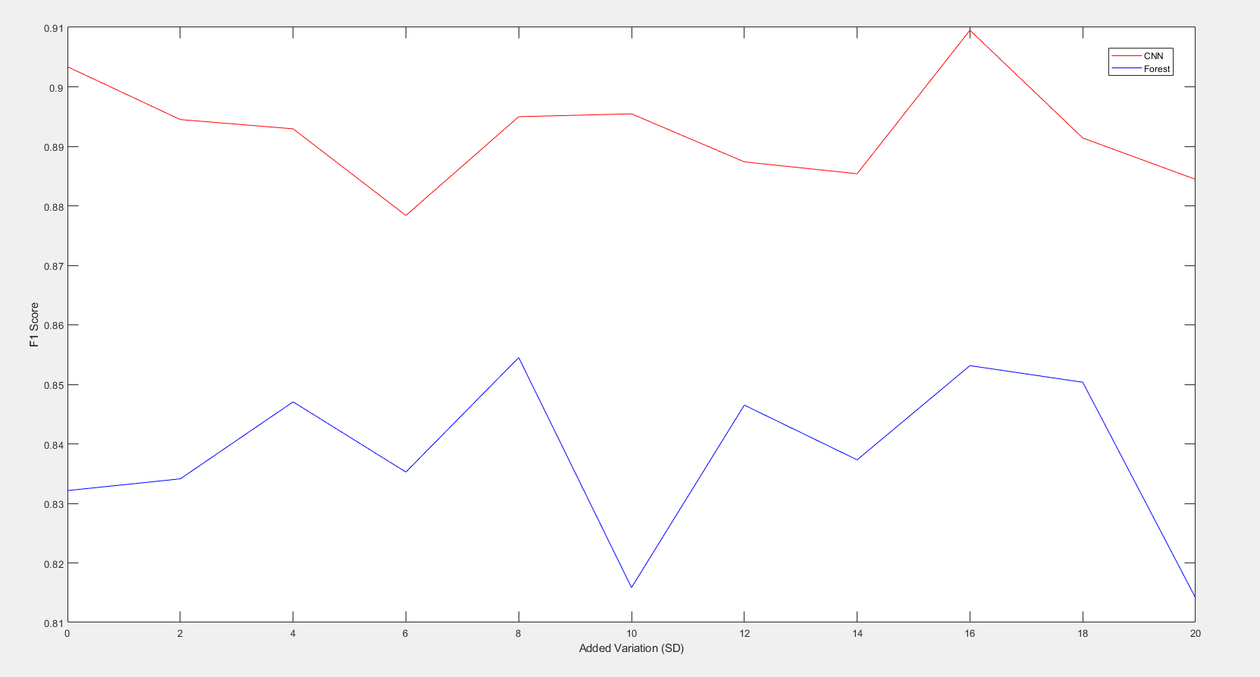

Slide 19
Not Immediately Generalizable to Unfamiliar Setups
Model trained on background, stationary, calm to boiling data
Fit blindly to new sets of data with less clear boiling classifications
% Classified as Boiling | Actual Classification
98.50% | No Boiling
98.80% | Boiling at Hot Spot
% Classified as Boiling | Actual Classification
0.00% | No Boiling
40.00% | Boiling at Hot Spot
36.78% | Boiling at Hot Spot
33.36% | Boiling at Hot Spot

Slide 20
What is Boiling?
Small Bubbles Attached to Wall
Convection
Bubbles Freeing
The first signs of boiling are small bubbles that form on the wall at the hot spot
Movement in the fluid as certain regions become warmer than others
Bubbles detach from the hot spot

Slide 21
Conclusions
CNN architecture proves to be transferable to the new data set with high accuracy
Only marginally more successful than simpler techniques
No conclusive evidence for best methodology or model generalizability
More data for analysis and testing is needed

Slide 22
Future Work
Continue to use established process pipeline to test new data
Collect data from more varied settings to test model generalizability
Continue feature extraction using more methods
Analyze probability output from model to understand where misclassifications are coming from

