Slide 1

Multi-Lingual Theme Prediction of Customer Reviews Using Deep Pre-Trained Embeddings
Team 06
Michael Sorg
08.05.2019

Slide 2

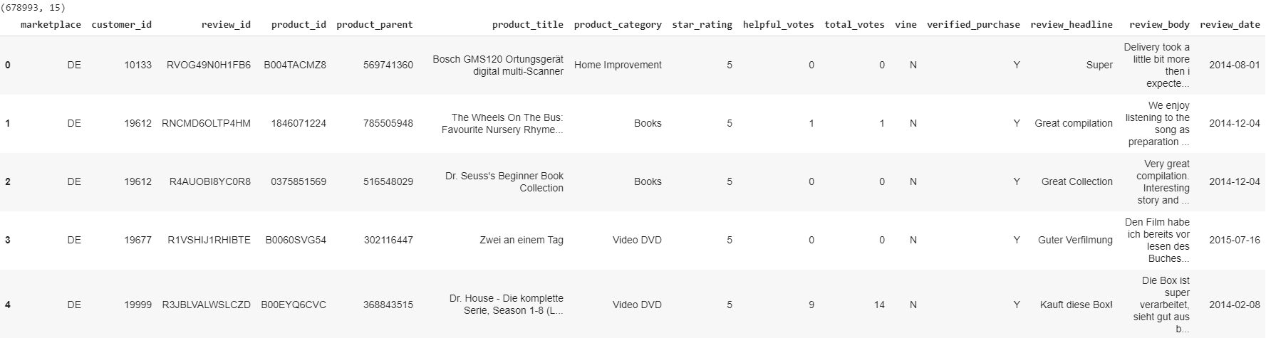
Amazon Multilingual Dataset

Slide 3
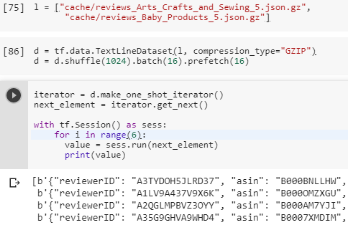
Review
For each dataset create tensorflow dataset loader (using dataset api)
Amazon Reviews dataset does not fit on disk and into ram → change runtime in colab
Todo: look into TFRecord
Notes:
TPU slower!

Slide 4
Review
☑ Full training pipeline with dummy architecture

Slide 5
Roadmap
network architecture search (train/test on amazon multilingual en/de)
w/o training xling embeddings
Additionally use full amazon reviews dataset
Test and fine-tune on organic dataset

Slide 6
Questions
Docker instances → Google account required

Slide 7
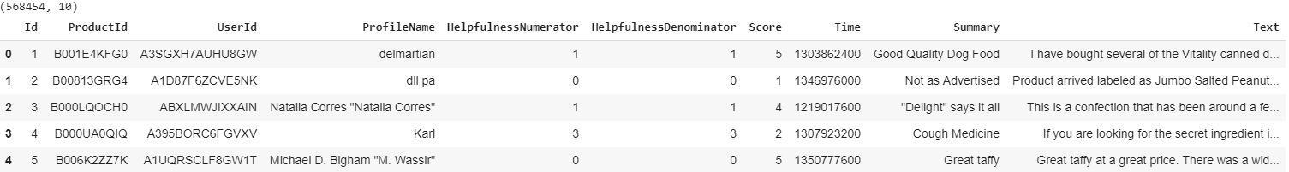
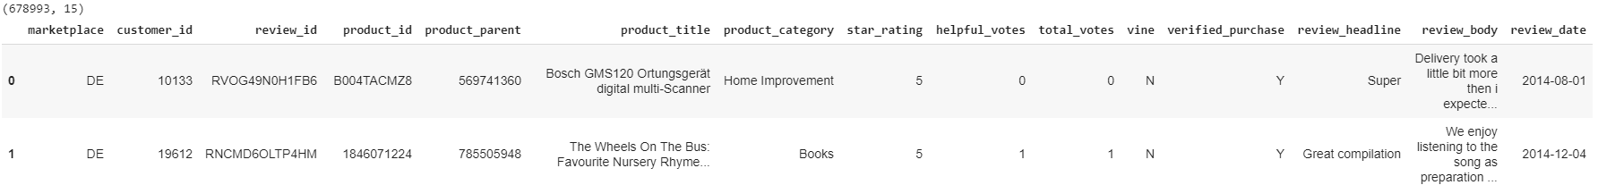
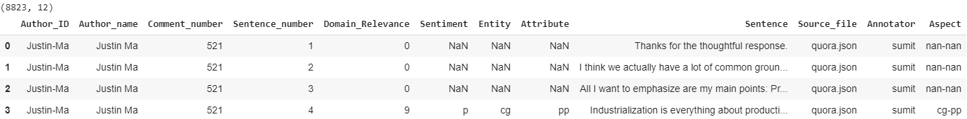
De: 600k, UK: 1,7m, US: 7M

