Slide 1
Sleeejds

Slide 2
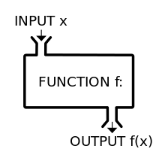
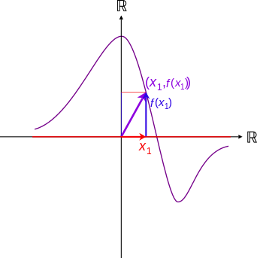
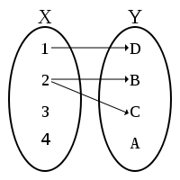
What is a model?
It is a plot…
It is a machine…
It is a mapping…
Output
Input

Slide 3
Visualization of data
Output
Two column data set
… or matrix
SOT | SOD
0 | 4
.2 | 3.8
1 | 7
2 | 12
3 | 13
5 | 7
9 | 2
… | …
Skills on the dance floor (points of awesomeness)
Input
Shots of tequila (2cl, 35%w/V)

Slide 4
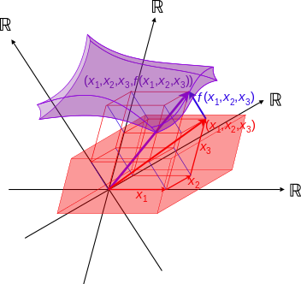
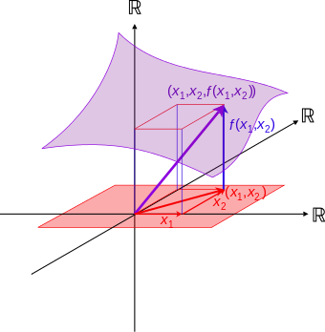
Multivariate functions / statistics
Output
Input 3
Output
Output 1
Input 2
Input 2
Input 1
Input 1
Input 1
SOT | SOD
0 | 4
.2 | 3.8
1 | 7
2 | 12
3 | 13
5 | 7
9 | 2
… | …
SOT | SOD | SDC | BMI
0 | 4 | 5 | 28
.2 | 3.8 | 5 | 18
1 | 7 | 4 | 28
2 | 12 | 3 | 27
3 | 13 | 2 | 35
5 | 7 | 1 | 17
9 | 2 | ½ | 42
… | … | … | …
SOT | SOD | SDC
0 | 4 | 5
.2 | 3.8 | 5
1 | 7 | 4
2 | 12 | 3
3 | 13 | 2
5 | 7 | 1
9 | 2 | ½
… | … | …
2D
3D
4D

Slide 5
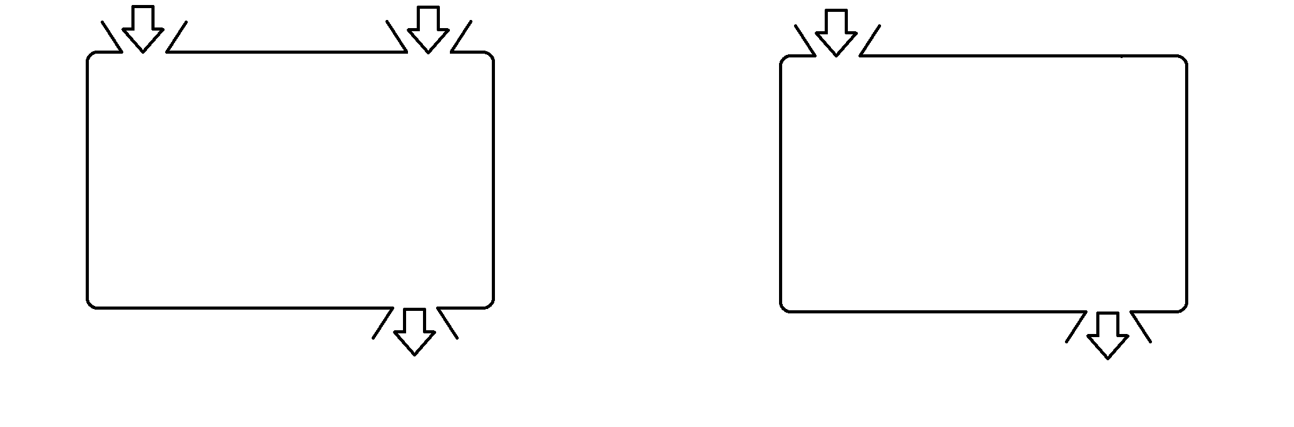

Slide 6
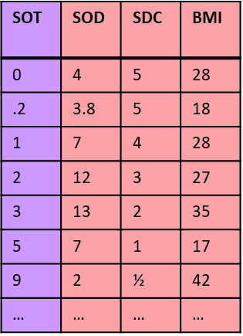


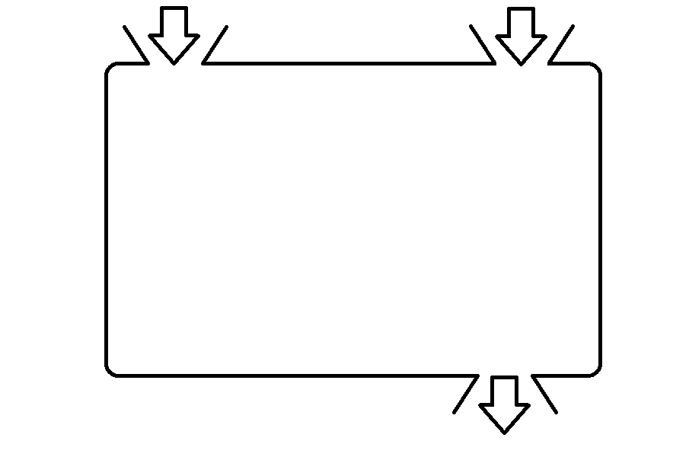
What is a learner?
Useful model:
dataset
tweak parameters
Learning
algorithm
model

Slide 7
What is a learner?

Slide 8
Why do parameters matter ?
Skills on the dance floor (points of awesomeness)
Shots tequila (2cl, 35%w/V)

Slide 9
Skills on the dance floor (points of awesomeness)
Shots tequila (2cl, 35%w/V)

Slide 11
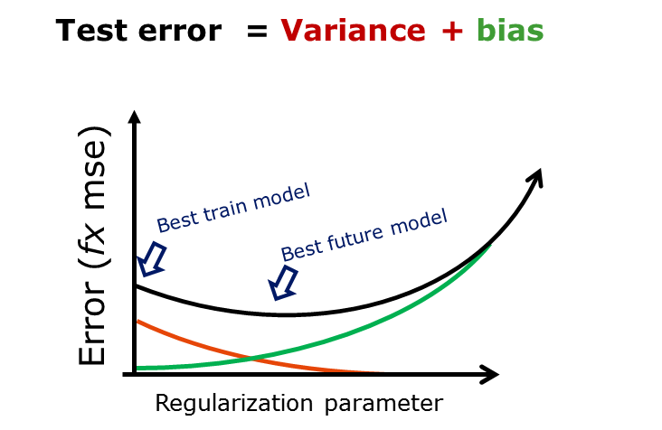
Test error = Variance + bias
Best train model
Error (fx mse)
Best future model
Regularization parameter

Slide 12
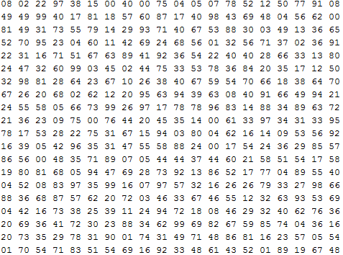


Model-fit
Supervised-learning:
GLM
PLS
Ridge
Model
kNN
Xy-train
RF
Deep
neural
nets
Training parameters
Hyper parameters
P(‘Søren’)=93%

Slide 13
