Slide 1

Website Design
This is my Blog website that made me unleash my creativity .
Hailie Jade U. Canlas

Slide 2
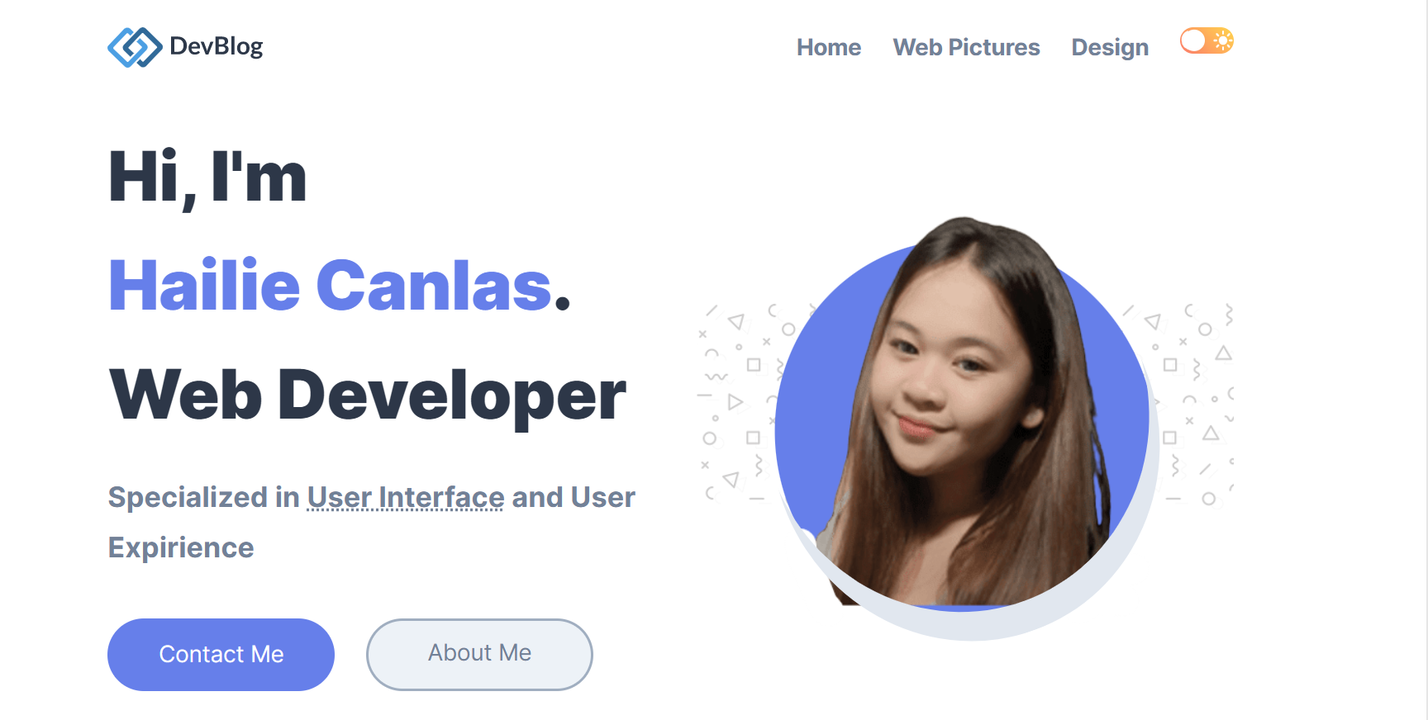

Slide 3
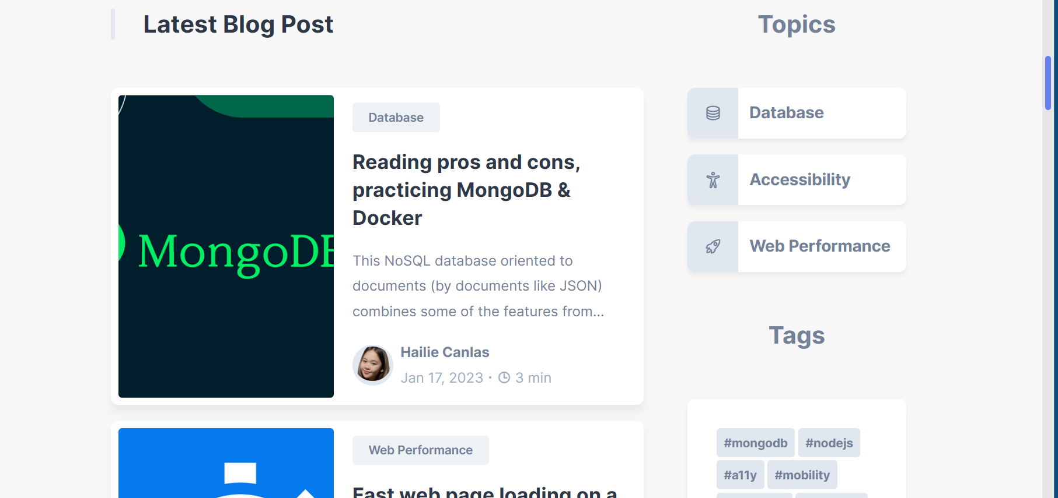

Slide 4
THANK YOU

Slide 5
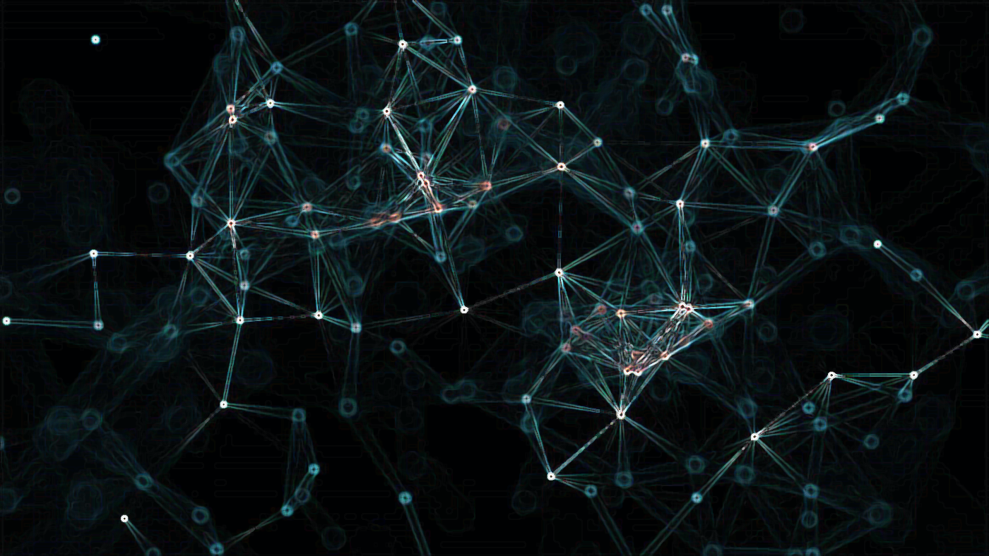
THANK YOU
This Photo by Unknown Author is licensed under CC BY

