Slide 1
AutoDraw
Fast Drawing for Everyone

Slide 2
What is it?
AutoDraw is a web-based drawing tool that combines machine learning (ML) with artwork generated by artists to assist you in sketching.
It is derived from another Google tool, QuickDraw, a little game in which you are given a one-word prompt, 20 seconds to draw it, and the neural network AI is asked to identify your artwork properly.

Slide 3
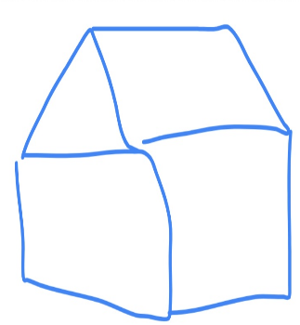


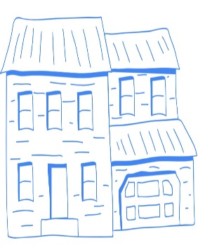
How does it work?
You just begin drawing your best depiction of a plane, home, animal, or birthday cake, and the algorithms attempt to figure out what you’re attempting to create. It then attempts to match your squiggles with drawings in its database, and if any plausible matches are found, they are shown in a list at the top of your virtual canvas.
If you prefer one of those possibilities, simply click on it, and AutoDraw will replace your unprofessional design with something a little more professional.
Drawing 3 types of houses in less than 30 seconds using the suggestion tool.

Slide 4
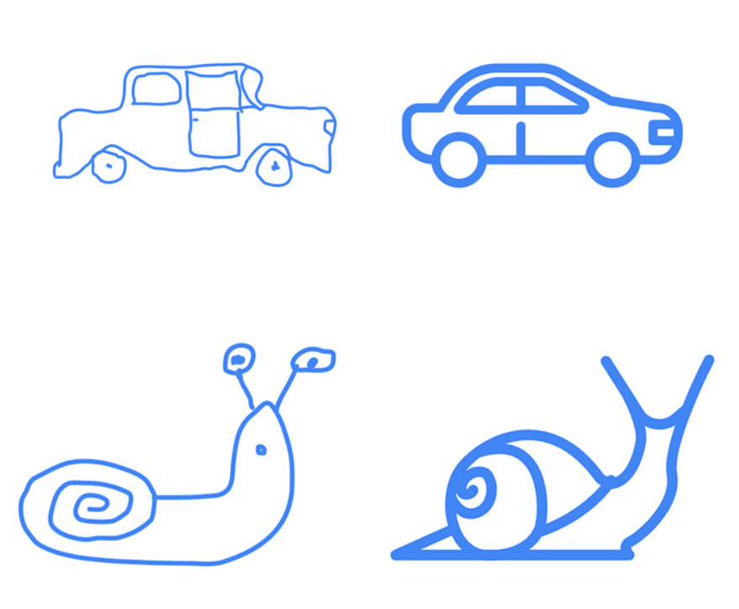
”There’s nothing to download. Nothing to pay for. And it works anywhere: smartphone, tablet, laptop, desktop, etc,. It was created because drawing on your phone or computer can be slow and difficult.” says Google about AutoDraw.
The idea is that you would be able to rapidly obtain clean and simple graphics from experienced artists, allowing you to effortlessly produce fliers, invites, infographics, story illustration and other things that would otherwise need graphic-design knowledge.

Slide 5
AutoDraw is packed with useful tools that make it super easy for us to use. By far the most valuable tool AutoDraw has to offer is the suggestion tool. This tool predicts what the user is drawing and offers a variety of suggestions. Other notable features users should make the most of include:
How-to guides
Sharing features
Artist catalog
Color selection tools
Pencil selection tools
Shape selection tools
Integrates with the Remove.bg tool, which allows you to easily remove the background
Provides several shortcuts and tips to make your icon creation process more efficient.

Slide 6
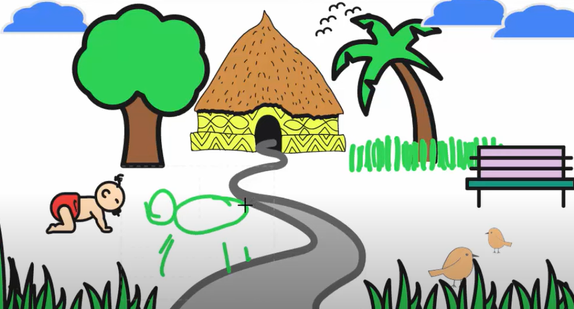
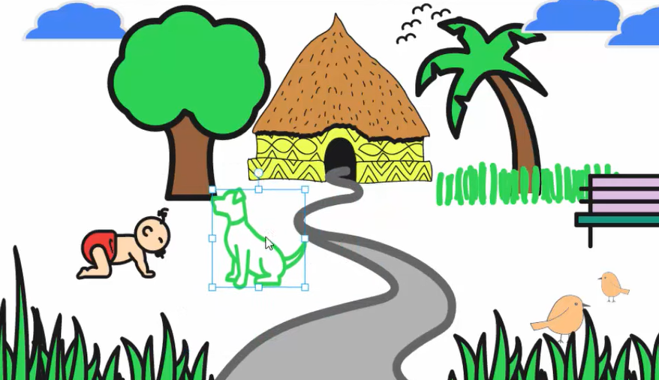
AutoDraw is a basic drawing tool designed to help users quickly draw high-quality images and it does that perfectly. It wasn’t designed to create art masterpieces that could be put up in a gallery.

Slide 7
AutoDraw AI use cases
Educational purposes:
Thanks to its simplicity, AutoDraw is an excellent tool educators can use to teach their students about the potential of machine learning.Particularly valuable for the world of art, students can use AutoDraw to investigate how AI tech can change art and how we can use it to our advantage.
Non-artists seeking inspiration and support
AutoDraw is also a valuable tool for non-artists that need help with their drawings. This can help non-artists produce high-quality, professional-like drawings with little effort and knowledge.
Design and marketing
Graphic designers, marketers, and even business individuals that present daily can use AutoDraw to create high-quality drawings. There’s technically nothing stopping businesses from making logos using AutoDraw

Slide 8
Good:
Bad:
Free-to-use
Easy-to-use
Beginner-friendly
Powerful suggestion tool
Feature-rich
Accessible on most devices
Not as high-quality as other tools
No realistic drawing options
No advanced features

Slide 9
Source:
https://topapps.ai/auto-draw/#:~:text=Essentially%2C%20the%20AutoDraw%20model%20uses,tool%20draw%20images%20for%20you.

