Slide 1
Expected goals:
What are they and what do they tell us?
Sorin Tuinea
November 2023

Slide 2

THE…..DATA Before bothering Data with all the questions,let’s get to know it better, shall we?
23 competitions
8 seasons
569 teams
Over 30.000 matches
Important variables: team’s value index, xG, goals, projected score, result probability

Slide 3

Hello! My name is xG and I want to be friends. So let me tell you some things about me.
Often used as a descriptive metric rather than a predictive one.
Designed to measure the probability of a shot resulting in a goal.
xG min
Values between 0(no chance of scoring) and 1( you should score that, mate!).

Slide 4
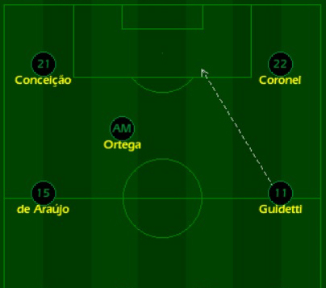
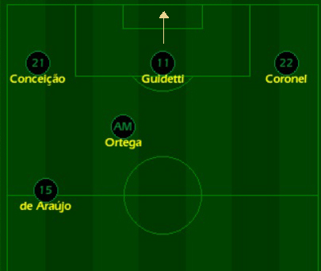
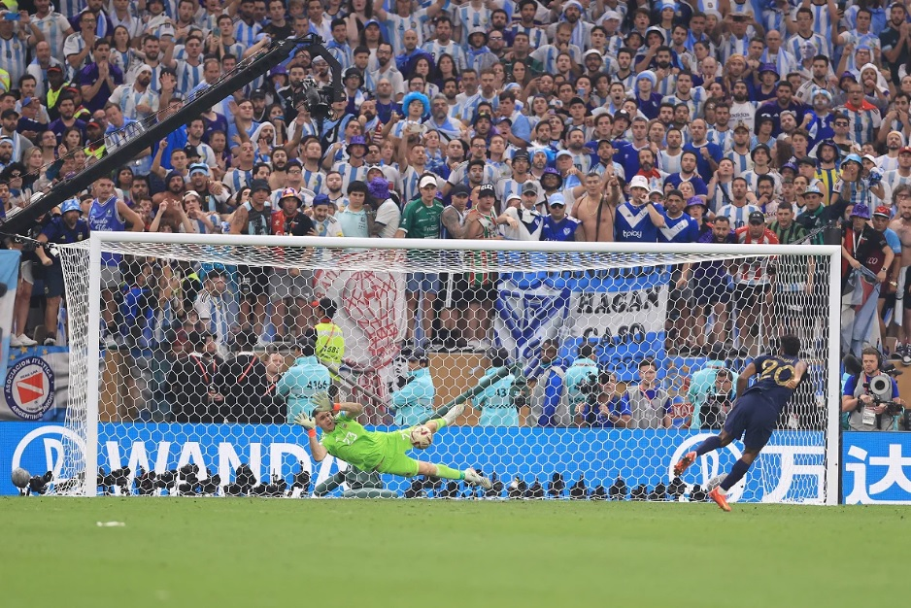
Long distance or tight angle=
Lower xG
Short distance, good angle=
Higher xG
And here is Kingsley Coman, missing the decisive penalty in 2022 World Cup final.
The Xg for a penalty, no defense in front of you, just the goalkeeper? 0.79 (almost 80% of penalties are scored)

Slide 5
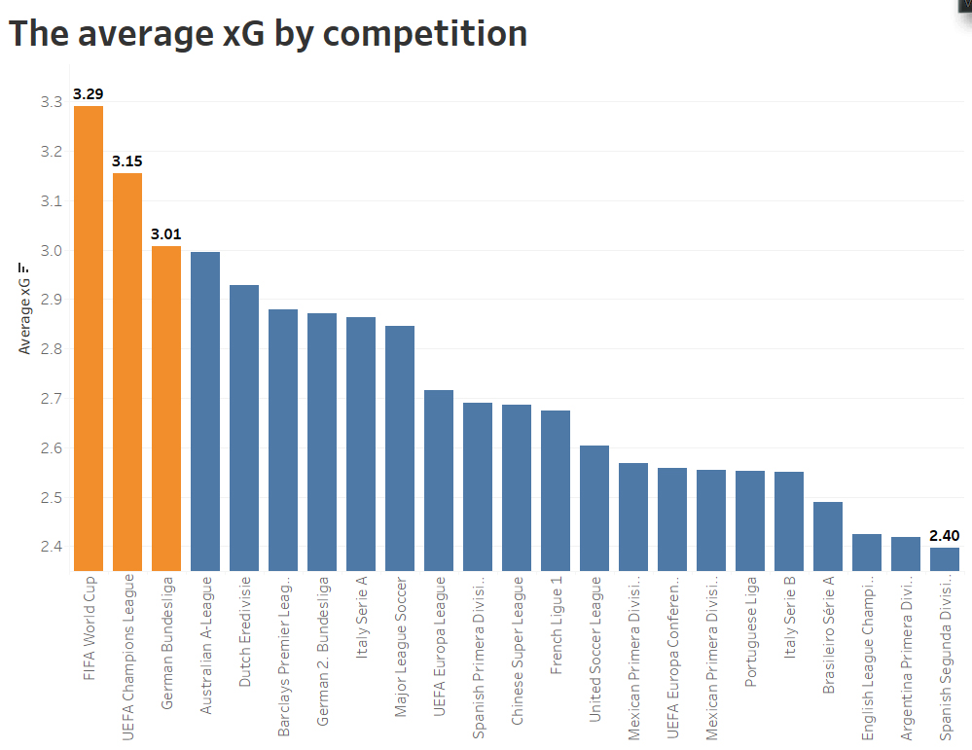

Slide 6
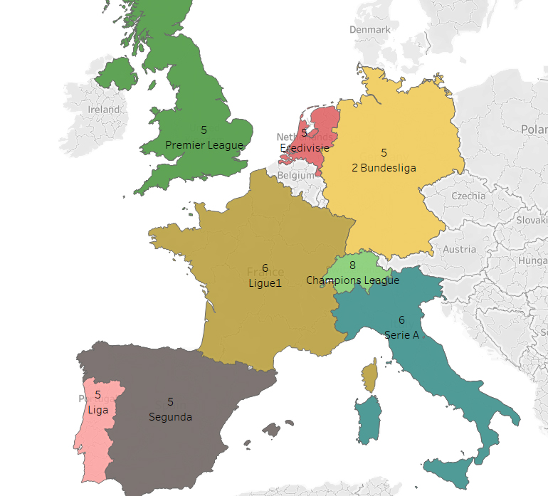
It’s the best time of the year!
The month when the average xG is at its best for each competition

Slide 7
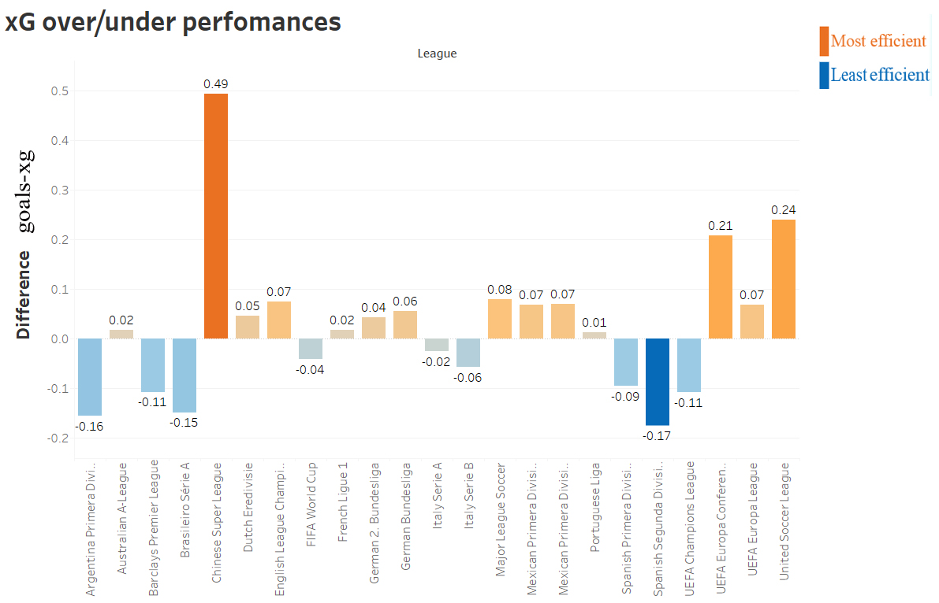

Slide 8
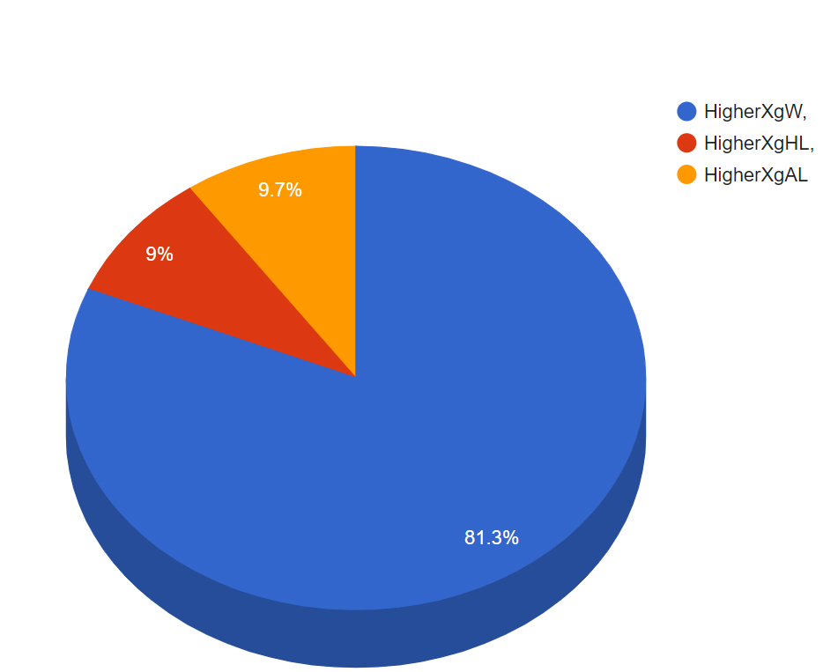
XG and the final result

Slide 9
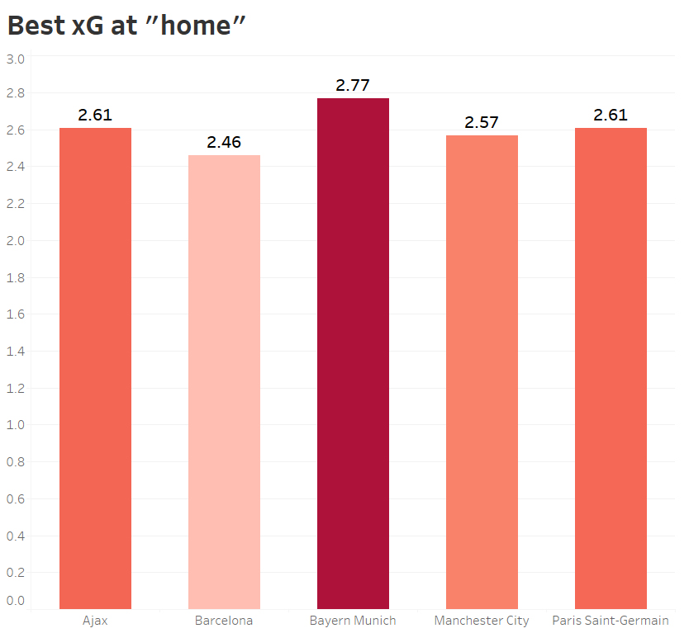
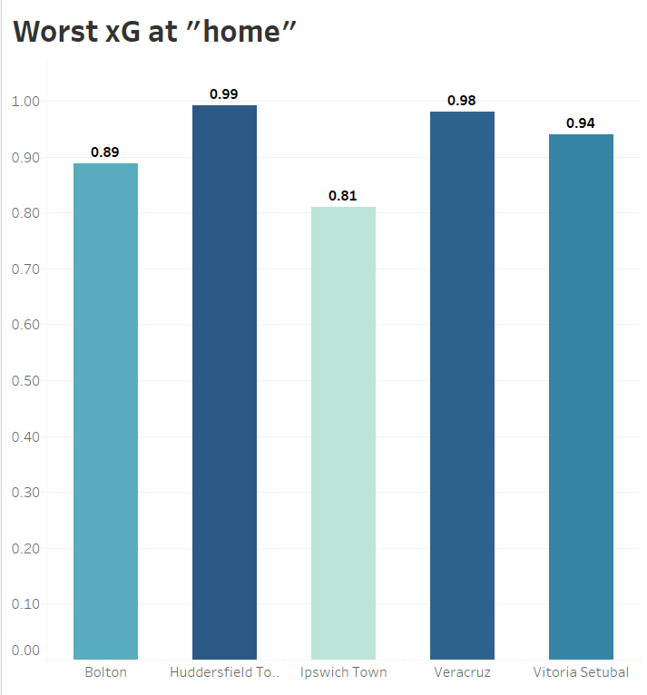

Slide 10
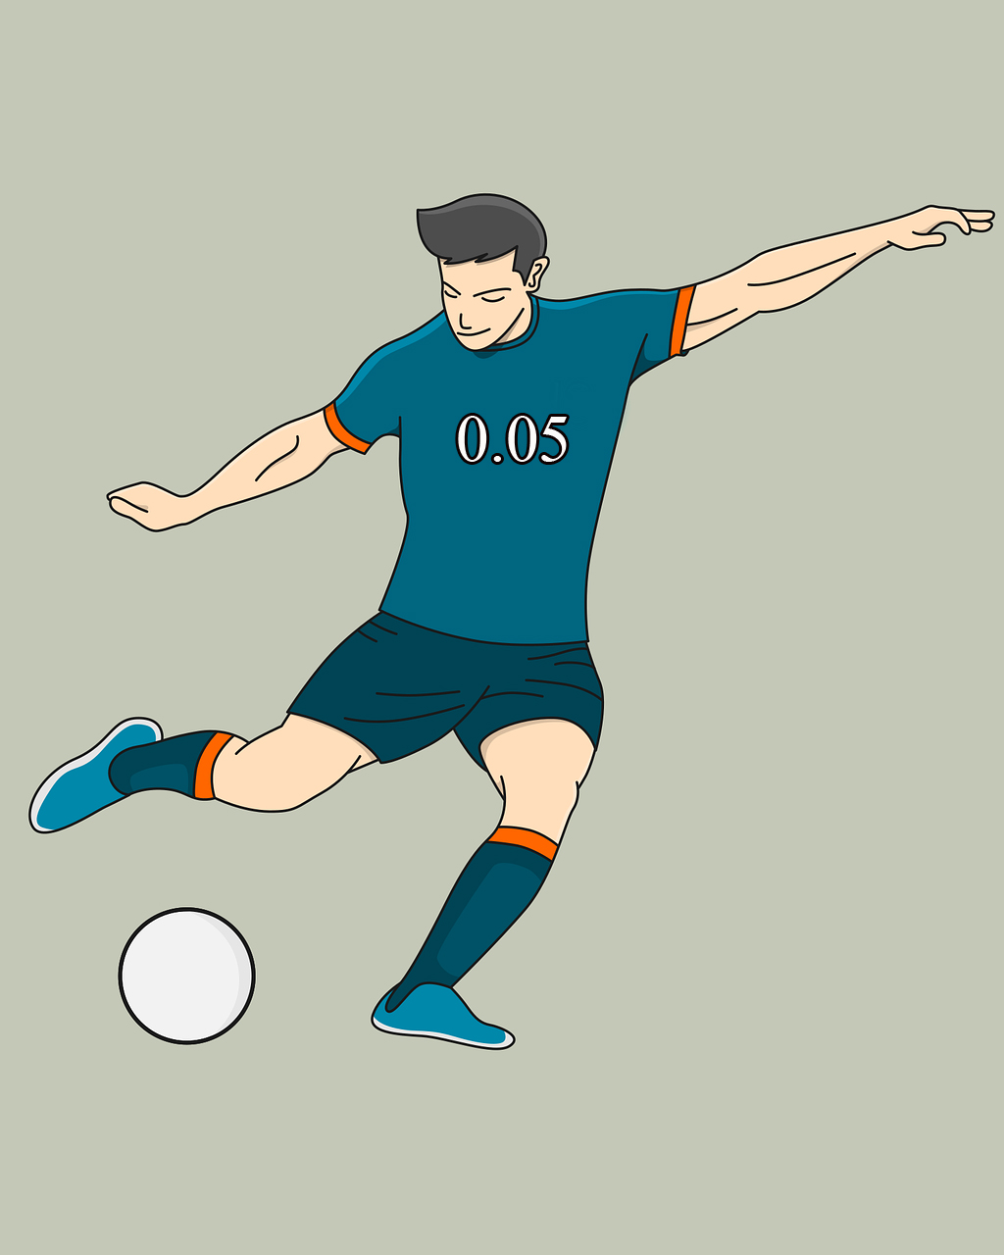


Hypothesis test Is the average xG equal to the average of goals scored?
#H0: mean xG value = 2.69
#H1: mean xG value <> 2.69
P value is 0.07, we can not reject H0

Slide 11
Thank you
for your attention!

