Slide 1

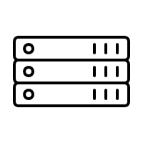

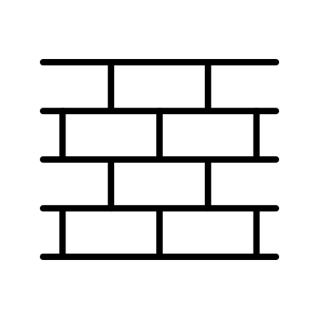
On Prem data center
Load Balancer
Origin Pool
Arcadia Server1
Arcadia Public IP
Firewall
ADC
F5XC GLOBAL NETWORK
Arcadia Server2

Slide 2
On Prem data center
Load Balancer ------------------- WAF API Security Bot Protection
Origin Pool
Arcadia Server1
Arcadia Public IP
Firewall
ADC
F5XC GLOBAL NETWORK
Arcadia Server2

Slide 3


On Prem data center
Health Check Origin Pool
Load Balancer ------------------- WAF API Security Bot Protection
IPSEC Tunnel
Arcadia Server1
F5XC RE
F5XC CE
F5XC GLOBAL NETWORK
Arcadia Server2
Firewall
ADC

Slide 4
On Prem data center
Health Check Origin Pool
Load Balancer ------------------- WAF API Security Bot Protection
IPSEC Tunnel
Arcadia Server1
Load Balancer ------------------- WAF API Security Bot Protection
F5XC CE
F5XC RE
F5XC GLOBAL NETWORK
Arcadia Server2
Firewall
ADC

Slide 5

AWS VPC Site
AWS Origin Pool
F5XC CE
Stocks Stocks Transaction
Frontend
Default pool
IPSEC Tunnel
Load Balancer ------------------- WAF API Security Bot Protection
IPSEC Tunnel
F5XC RE
On Prem data center
F5XC GLOBAL NETWORK
IPSEC Tunnel
/v1/users
/v1/login
Users Login
F5XC CE
Users
Login
Firewall
ADC

Slide 6
AWS VPC Site
Internal Load Balancer
F5XC CE
Stocks Stocks Transaction
Frontend
Default pool
IPSEC Tunnel
Load Balancer ------------------- WAF API Security Bot Protection
IPSEC Tunnel
F5XC RE
On Prem data center
F5XC GLOBAL NETWORK
IPSEC Tunnel
/v1/users
/v1/login
Users Login
F5XC CE
Users
Login
Firewall
ADC

Slide 7
AWS VPC Site
Internal Load Balancer
Stocks Transaction
Frontend
F5XC CE
Default pool
IPSEC Tunnel
Stocks
Load Balancer ------------------- WAF API Security Bot Protection
IPSEC Tunnel
F5XC RE
On Prem data center
F5XC GLOBAL NETWORK
IPSEC Tunnel
/v1/users
/v1/login
Users Login
F5XC CE
Users
Login
Firewall
ADC

