Slide 1

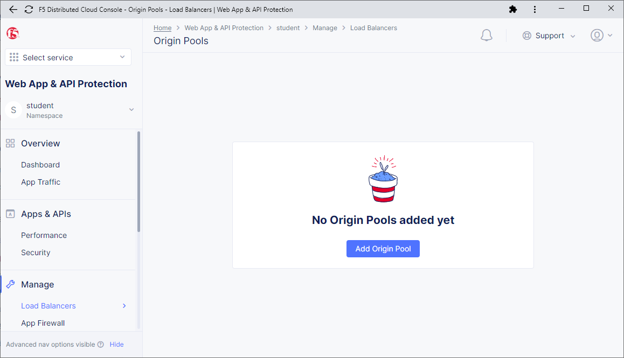
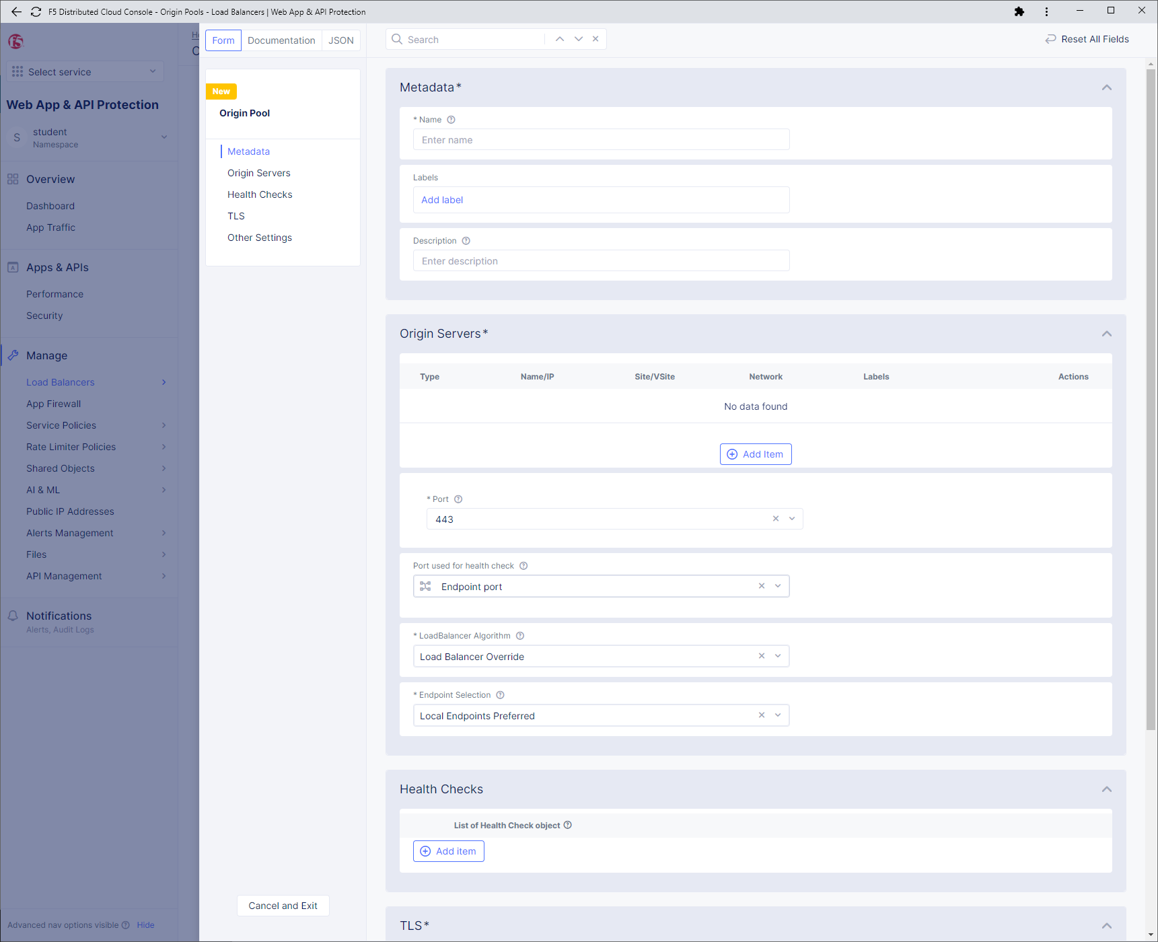
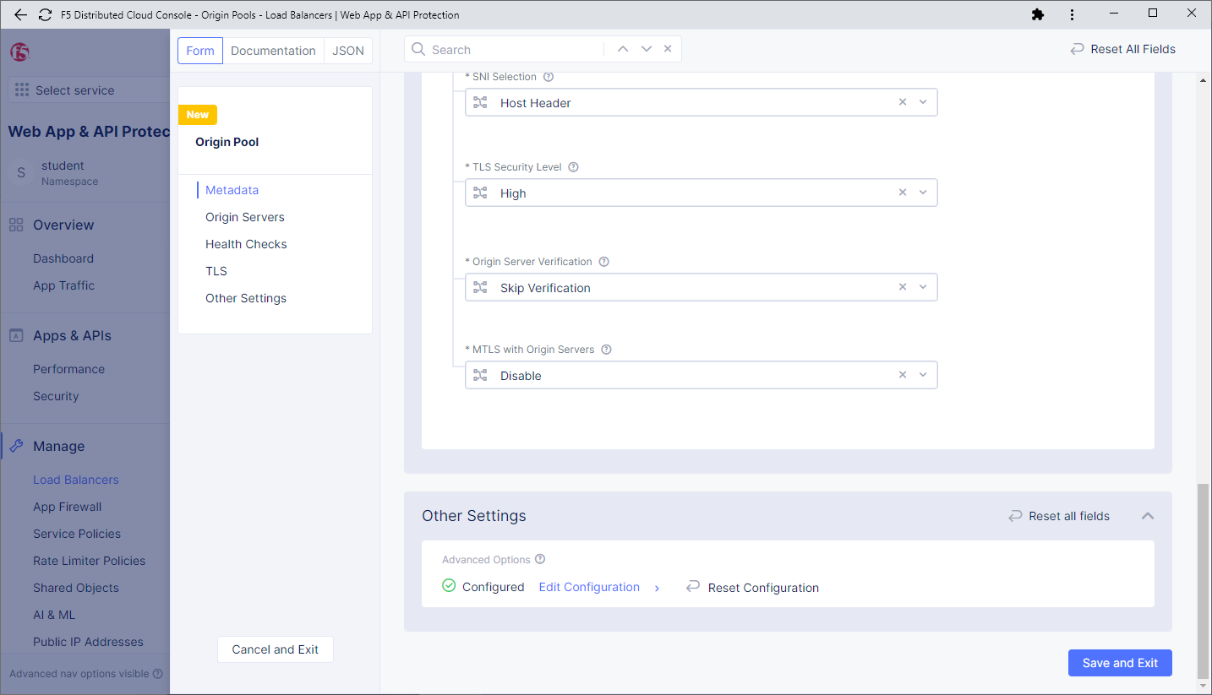
2
4
Copy the configuration from the guide and paste it
1
3
5
6

Slide 2
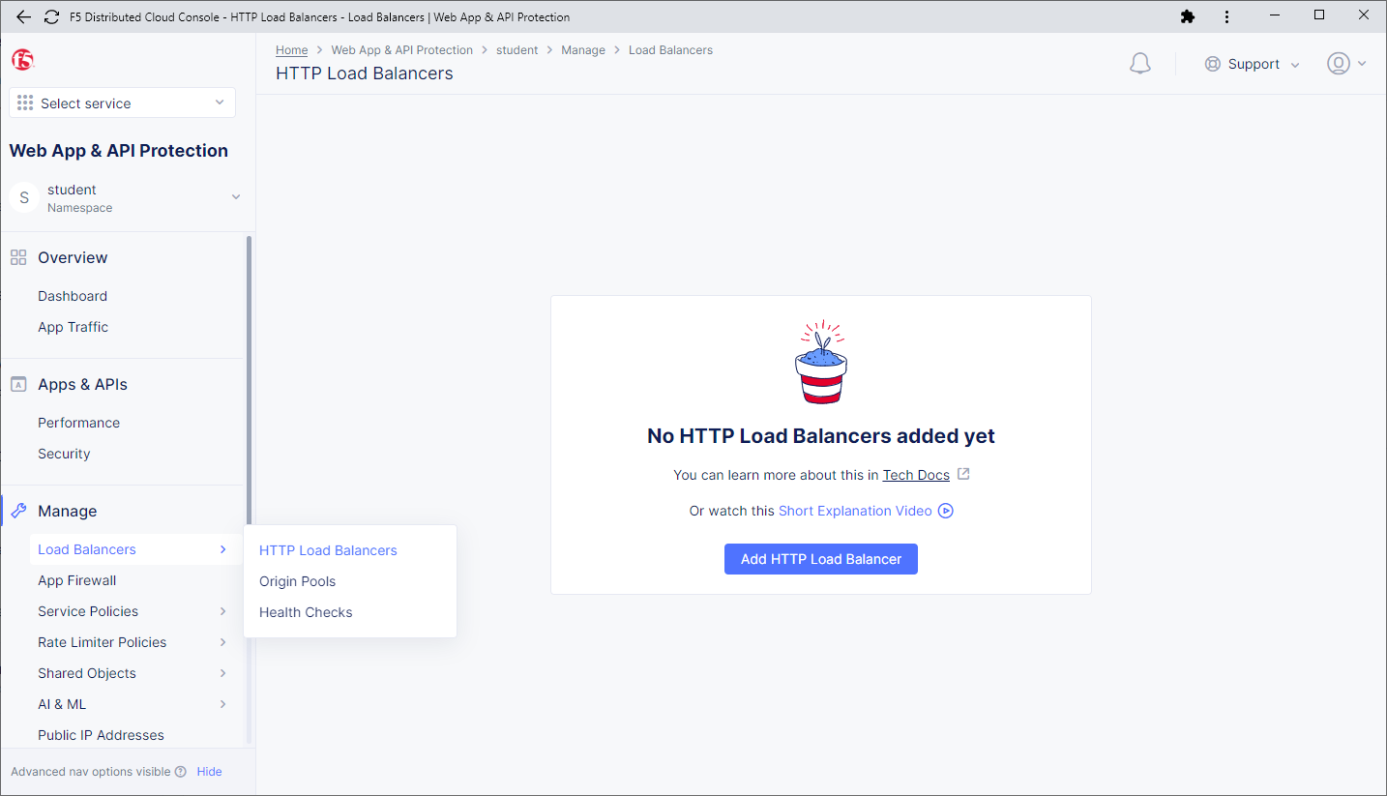
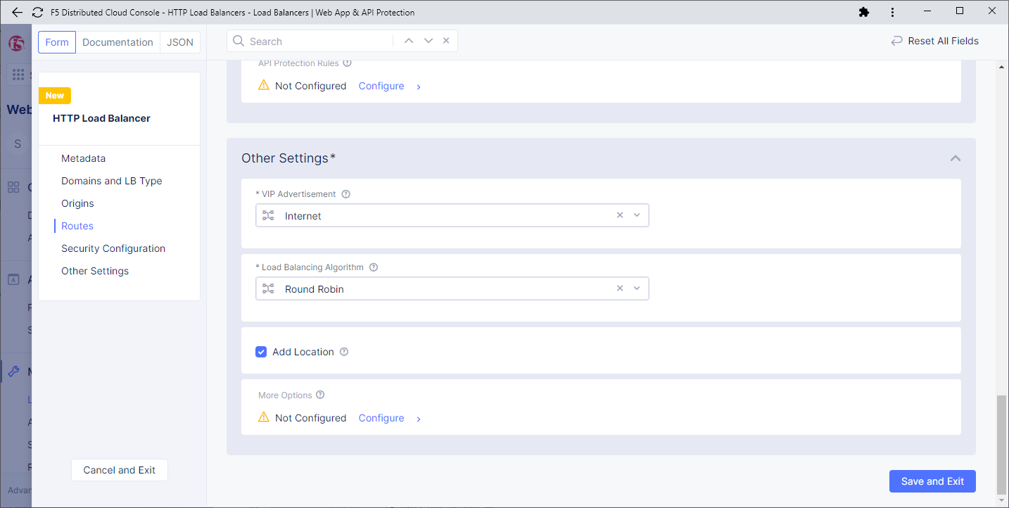
4
Copy the configuration from the guide and paste it in the “JSON” textbox
1
2
3
5

