Slide 1
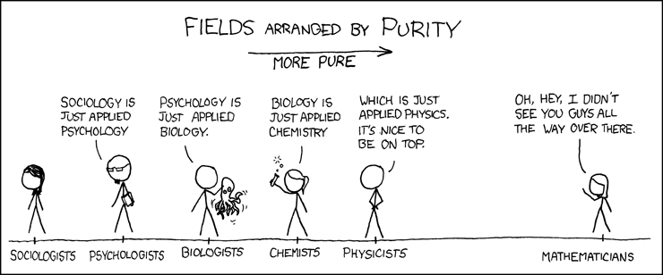

Slide 2
Creativity in the Arts and Sciences:
Contrasts in Disposition, Development, and Achievement

Slide 3
Three Arguments
First, creativity is a
  heterogeneous rather than homogeneous phenomenon: no “one-size fits all”
  but a substantial proportion of this heterogeneity can be captured by a single dimension that extends from the sciences to the arts

Slide 4
Three Arguments
Second, this single dimension is correlated with psychological traits and experiences of creators who practice in a given domain
that is, these variables are
  dispositional (e.g., personality), and
  developmental (e.g., education)

Slide 5
Three Arguments
Third, an individual’s magnitude of creativity in a chosen domain corresponds at least in part with the fit between his/her
  dispositional traits and
  developmental experiences
and those that are typical of that domain or some other domain along the same dimension

Slide 6
First Argument:
Hierarchy of the Sciences
Classic concept: Auguste Comte
  astronomy
  physics
  chemistry
  biology
  sociology

Slide 7
First Argument:
Hierarchy of the Sciences
Contemporary concepts:
  physical, biological, and social sciences
  exact versus non-exact sciences
  hard versus soft sciences
  paradigmatic versus pre-paradigmatic sciences
  natural versus human sciences
  sciences, humanities, and the arts

Slide 8
First Argument:
Hierarchy of the Sciences
Empirical research:
  Major scientific disciplines can be ordered along a single dimension using a large number of positive and negative indicators of “hardness”

Slide 9
Positive indicators
Peer evaluation consensus
Citation concentration
Early impact rate
Citation immediacy
Anticipation frequency
Obsolescence rate
Graph prominence
Rated disciplinary hardness

Slide 10
Negative indicators
Consultation rate
Theories-to-laws ratio
Age at receipt of Nobel prize
Lecture disfluency

Slide 11
Yielding …

Slide 12
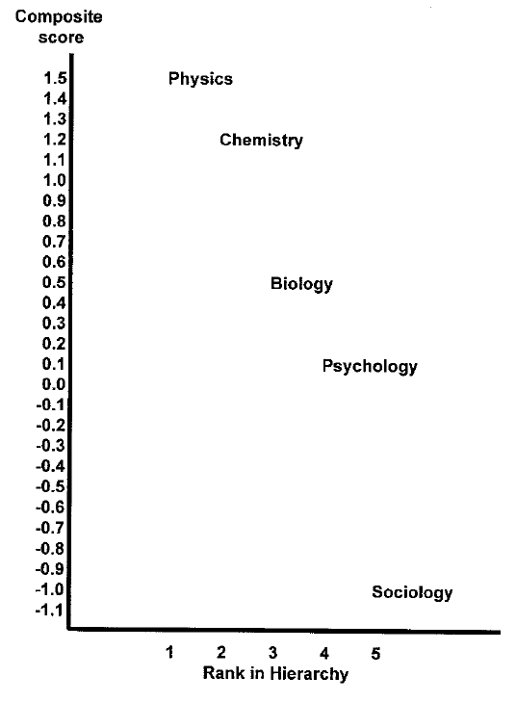

Slide 13
Two Elaborations
Extrapolation beyond Scientific Domains
Interpolation within Creative Domains

Slide 14
Two Elaborations
One - This hierarchy can be extrapolated beyond scientific domains:
  Scientific versus artistic creativity, where
  creativity in the humanities falls somewhere between that in the sciences and the arts

Slide 15
Two Elaborations
Illustrations using criteria previously applied in constructing scientific hierarchy:
  Obsolescence rate:
    psychology/sociology > history > English
  Lecture disfluency:
    psychology/sociology < political science < art history < English (cf. philosophy)

Slide 16
Two Elaborations
Two - This hierarchy can be interpolated within creative domains:
  Paradigmatic sciences in “normal” versus “crisis” stages (e.g., classical physics in middle 19th versus early 20th century)
  Formal versus expressive arts (Apollonian versus Dionysian; Classical versus Romantic; linear versus painterly; etc.)
  Non-paradigmatic sciences with contrasting theoretical/methodological orientations (e.g., the two psychologies)

Slide 17
Illustration:
54 Eminent Psychologists
Objectivistic versus Subjectivistic
Quantitative versus Qualitative
Elementaristic versus Holistic
Impersonal versus Personal
Static versus Dynamic
Exogenist versus Endogenist

Slide 18
54 Eminent Psychologists
The six bipolar dimensions can be consolidated into a single bipolar dimension
  “Hard,” “tough-minded,” “natural-science” psychology versus
  “Soft,” “tender-minded,” “human-science” psychology
Moreover, evidence that these two psychologies are distinct

Slide 19
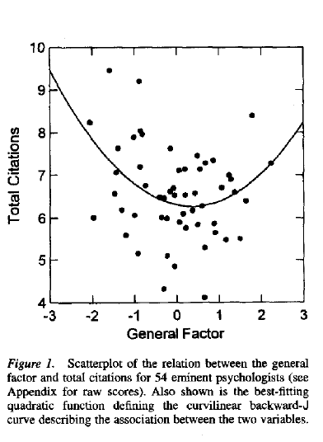
“Soft”
“Hard”

Slide 20
Second Argument
Creators working in different disciplines should display dispositional traits and developmental experiences that correspond to the chosen domain’s placement along the single dimension
That is, at least to some extent the dimension should have a psychological basis because there should be a partial match between discipline and disposition/development

Slide 21
What Dispositional and Developmental Factors Determine Preferences Regarding
Consensus versus Dissent?
Collectivism versus Individualism?
Constraint versus Freedom?
Objectivity versus Subjectivity?
Logic versus Intuition?
Exactness versus Ambiguity?
Formality versus Informality?
Rationality versus Emotion?
Algorithms versus Heuristics?

Slide 22
Or, in terms of the BVSR theory of creativity
Low dependence on BVSR
versus
High dependence on BVSR?
where BVSR =
Blind variation and selective retention
that is, the variant probabilities are decoupled from their likelihoods of proving successful

Slide 23
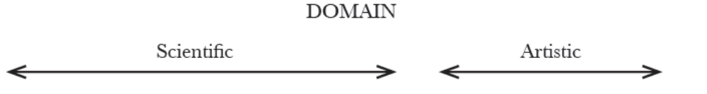


Slide 24
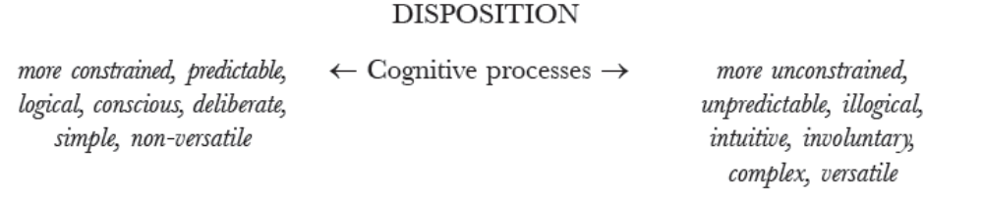

Slide 25
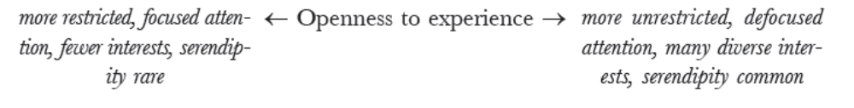

Slide 27
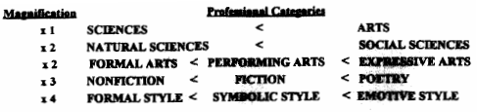
Illustrations

Slide 28
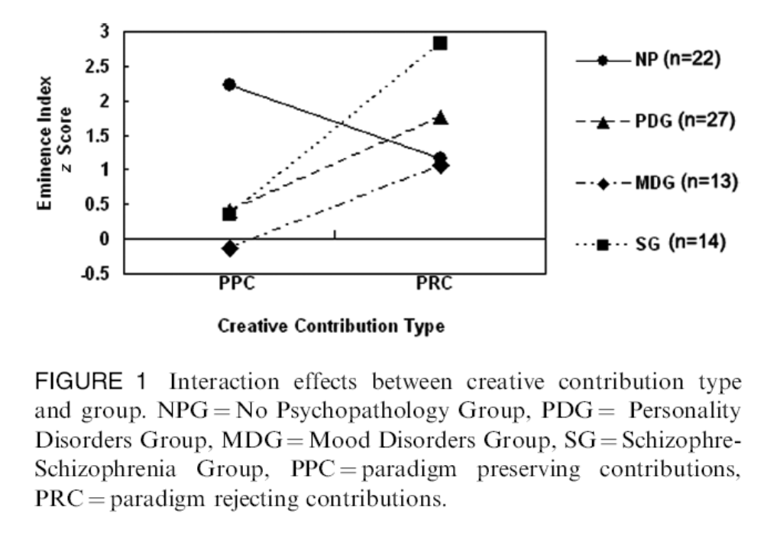

Slide 29
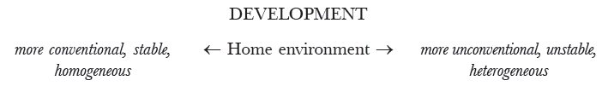

Slide 30
Illustration
Family background of Nobel laureates (omitting physiology or medicine):
  Father academic professional: physics 28%, chemistry 17%, literature 6%
  Father lost by age 16: physics 2%, chemistry 11%, literature 17%
  30% of latter “lost at least one parent through death or desertion or experienced the father’s bankruptcy or impoverishment” whereas “the physicists, in particular, seem to have remarkably uneventful lives”

Slide 32
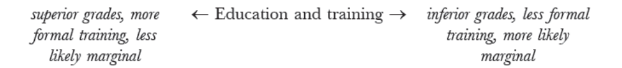

Slide 35
Third Argument:
Differential Impact Within a Domain
Some traits/experiences that determine an individual’s disciplinary preference may also determine his or her disciplinary impact
There are three main possibilities:

Slide 36
Third Argument:
Differential Impact Within a Domain
First, the most successful creators may be those whose dispositional traits and developmental experiences put them closest to the disciplinary centroid
  i.e., “domain-typical” creator
  e.g., stasis or equilibrium due to optimization of domain-disposition/development relationship
The lower-impact creator will be peripheral relative to this centroid, either above or below

Slide 37
Third Argument:
Differential Impact Within a Domain
Second, the most successful creators may be those whose dispositional traits and developmental experiences put them closer to the centroid for disciplines more advanced in the hierarchy
  i.e., “domain-progressive” creators
  e.g., behavior geneticists, cognitive neuroscientists, and evolutionary psychologists within psychology
  viz. the “reductionists”

Slide 38
Third Argument:
Differential Impact Within a Domain
Third, the most successful creators are those whose dispositional traits and developmental experiences put them closer to the centroid for a discipline lower down in the hierarchy
  i.e., “domain-regressive” creators
  e.g., scientific creativity as contingent on “regression” toward artistic creativity
  cf. old psychoanalytic theory of creativity as “regression in service of the ego”

Slide 39
Third Argument:
Differential Impact Within a Domain
Empirical data indicate that the third option may apply to the most dispositional and developmental predictors
That is, the most eminently creative figures in a given domain are more similar to more average creators lower down in the disciplinary hierarchy

Slide 40
Illustration
Avocational interests and hobbies:
  Scientific creativity positively associated with involvement in the arts:
    Nobel laureates >
    RS & NAS >
    Sigma Xi & US public

Slide 41
Quotations
Albert Einstein: “to these elementary laws there leads no logical path, but only intuition, supported by being sympathetically in touch with experience.”
Max Planck: creative scientists “must have a vivid intuitive imagination, for new ideas are not generated by deduction, but by an artistically creative imagination.”

Slide 42
Conclusion
Thus the need to invert and redefine the hierarchy?

Slide 43
FIELDS ARRANGED BY CREATIVITY
← MORE CREATIVITY

Slide 44
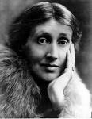


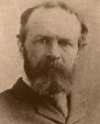



FIELDS ARRANGED BY CREATIVITY
← MORE CREATIVITY

