Slide 2
CMS 135 using Latest QDM
Simplify logic through use of new temporal logic statements and use of variables
AND: "Occurrence A of Encounter, Performed: Care Services in Long-Term Residential Facility" during "Measurement Period"
AND: "Occurrence A of Diagnosis, Active: Heart Failure" starts before or during "Occurrence A of Encounter, Performed: Care Services in Long-Term Residential Facility"
AND NOT: "Occurrence A of Diagnosis, Active: Heart Failure" ends before start of "Occurrence A of Encounter, Performed: Care Services in Long-Term Residential Facility
becomes
$LTRFEnc =
"Encounter, Performed: Care Services in Long-Term Residential Facility" satisfies all
during "Measurement Period"
overlaps "Diagnosis, Active: Heart Failure"

Slide 3
CMS 135 using Latest QDM (cont.)
Simplify logic by defining a single variable made up of several variables
This block of code is repeated 7 times with 7 different encounter types
AND: "Occurrence A of Encounter, Performed: Care Services in Long-Term Residential Facility" during "Measurement Period"
AND: "Occurrence A of Diagnosis, Active: Heart Failure" starts before or during "Occurrence A of Encounter, Performed: Care Services in Long-Term Residential Facility"
AND NOT: "Occurrence A of Diagnosis, Active: Heart Failure" ends before start of "Occurrence A of Encounter, Performed: Care Services in Long-Term Residential Facility
By defining each block as a separate variable, we can combine into a single variable and replaced 29 lines of code with
AND: Occurrence A of $UnionEnc
where
$UnionEnc = Union of
$LTRFEnc + 6 other variables

Slide 4
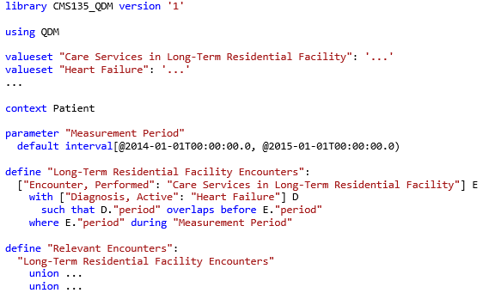
CMS 135 using CQL/QDM
Valueset definitions allow local names to be used within the artifact
Identifiers can include spaces and punctuation to make logic more readable
Filtering is explicit in criteria, rather than implicit in the model
Each define is a set, rather than a criteria definition, so “occurrencing” is not required

