Slide 1
Clinical Quality Language Update
Clinical Quality Framework S&I Initiative
HL7 Clinical Decision Support
HL7 Clinical Quality Information
HL7 Implementable Technology Specifications

Slide 2
Decisions Made
Library Definitions
QUICK Statement Structure
Retrieve Expressions
Core Query Construct
Interval Operations

Slide 3
Library Definitions
Each CQL file is a library
Versioning is managed by the repository
Definitions within each library must be unique
References are named when they are included
Avoids naming clashes

Slide 4
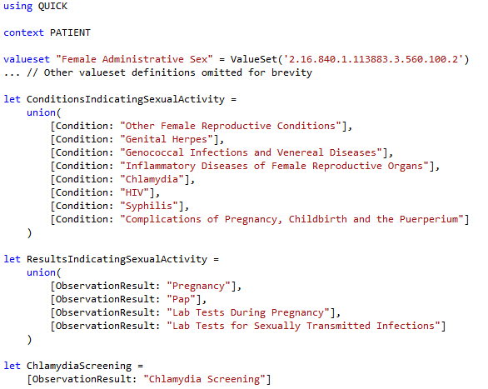
Library Definitions (example)

Slide 5
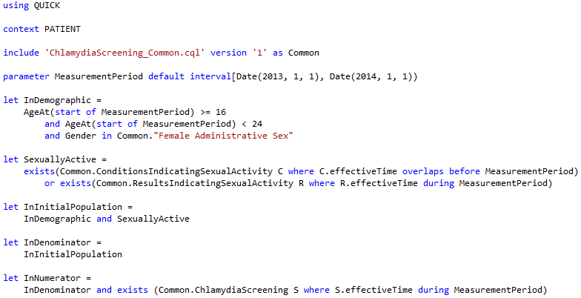
Library Definitions (example, cont)

Slide 6
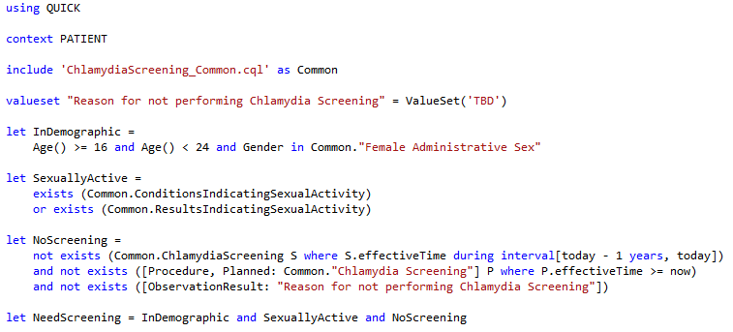
Library Definitions (example, cont)

Slide 7
QUICK Statement Structure
Every clinical statement has
Occurrence (Occurrence, NonOccurrence, UnknownOccurrence)
a Topic, either an Observable, or an Act
Observables:
Condition, Prognosis, ObservationResult, etc.
Acts:
Procedure, Medication Administration, etc.
In addition, Acts have Modality:
Proposal, Order, Performance, etc.

Slide 8
Retrieve
Retrieves information from the data layer
Respects current context (PATIENT, ENCOUNTER)
Specified in terms of Data Model
('no' | 'unknown')? '[' topicType (',' activityType)? ']';
[Encounter, Performed]
no [Procedure, Proposal]
unknown [DeviceUse]
Optionally filter by Code
[Encounter, Performed: "Inpatient"]
Optionally filter by Date Range
[Encounter, Performed, during MeasurementPeriod]

Slide 9
Queries
The “query” construct is used to perform various operations, including filtering, shaping, sorting, and relating results.
Query has clauses
Primary source
Any number of “with” clauses defining filtering relationships to other sources
Optional “where” clause, filtering the results
Optional “return” clause, shaping the results
Optional “sort” clause, sorting the results

Slide 10

Queries (example)
Retrieve “Inpatient” encounters performed that have a condition of “Acute Pharyngitis” that began during the encounter and continues after it. Only include encounters with a duration of 120 days or more. For each encounter, return a tuple with the id and the length of stay. Order the results by the length of stay descending.

Slide 11
Interval Operators
Operator/Inverse | Diagram | Interpretation
X concurrent with Y Y concurrent with X |  | start of X = start of Y and end of X = end of Y
X before Y Y after X |  | end of X < start of Y
X meets before Y Y meets after X X meets Y |  | successor of end of X = start of Y
X overlaps before Y Y overlaps after X X overlaps Y |  | start of X <= start of Y and start of Y <= end of X
X begins Y Y begun by X |  | start of X = start of Y and end of X <= end of Y
X included in (during) Y Y includes X |  | start of X >= start of Y and end of X <= end of Y
X ends Y Y ended by X |  | start of X >= start of Y and end of X = end of Y
X
Y
X
Y
X
Y
X
Y
X
Y
X
Y
X
Y

Slide 12
Next Steps
Nearing completion on the draft syntax
Working on PSS & NIB
Mapping QUICK to FHIR
Performance/Implementation implications
Representation in XML artifacts
Clinical Quality Language Specification (ballot materials)
Sub-team meets weekly, Wed 11:00 Eastern
https://global.gotomeeting.com/meeting/join/554237525
Dial +1 770-657-9270, Participant Code: 6870541
Using a common cqframework repository
https://github.com/cqframework/OneModel

