Slide 1
Clinical Quality Language (CQL)
Bryn Rhodes
Chris Moesel
Mark Kramer

Slide 2
CQL Background
Part of CQM-CDS harmonization project
Objective is to define an author-friendly and human-readable language to define quality measures and decision support rules (QDM heritage)
Must be computable and implementable (HeD heritage)
Functional requirements defined in “Harmonization of Health Quality Artifact Reasoning and Expression Logic”

Slide 3
Overview of CQL Conceptual Architecture
Initial Population Definition
Chlamydia Test Recommended
Defined by Rule/Measure authors using CQL
Probably Sexually Active
Intermediate inference
Concepts defined in Quality Logical Model (QUICK)
Condition, Occurrence
Patient
Medication Treatment, Ordered
Mappings from quality logical model to underlying data models
FHIR Logic
…
Custom EHR Logic
…
CCDA Logic
REST API
e.g. SQL
Integration with back-end data stores
FHIR API
EHR
CCDA Generator
EHR
EHR

Slide 4
CQL File Structure
Each library is a readable, plain text file
May include other libraries by reference
Logic in each file is potentially reusable by other libraries
Inputs
(parameters)
Declarations
Data Retrieval
May be comingled
Computation
Outputs

Slide 5
CQL Declarations
library declaration
Defines the name and optional version of the library
using declaration
Define the data model(s) in use in file
include declaration
Define other libraries (CQL files) referenced
context declaration
Define the context for subsequent statements(e.g. Patient or Population)
Anchors references in the file
parameter declaration
Define available “inputs”
valueset declaration
Define user-friendly labels for value sets within the library

Slide 6
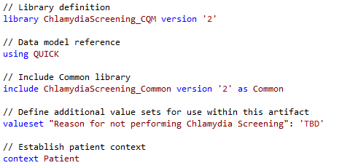
Declaration Examples

Slide 7
Retrieve
Retrieves information from the data layer
Respects current context (Patient, Population)
Specified in terms of Data Model
'[' namedTypeSpecifier ']'
[Encounter]
[ProcedureRequest]
[DeviceUse]
Optionally filter by “primary” Code
[Encounter: "Inpatient"]
Optionally filter by specific Code
[Encounter: severity in "Severities"]

Slide 8
Data Types
Simple Types
Boolean, String, Number, Date/Time
true, 16, 'female', @2015-05-01
Clinical Types
Quantities, Value Sets
3 months, 6 'gm/cm3'
"Female Administrative Sex"
Structured Types
Model Classes, Tuples
[Encounter]
Tuple { Name: 'Patrick', DOB: Date(2014, 1, 1) }
List Types
{ 1, 2, 3, 4, 5 }
Interval Types
Interval(today - 1 years, today]

Slide 9
Simple Expressions
Logic
A and B
A and not (B or C)
Comparison
A >= B
A <> B
Arithmetic
A + B
A + B * C

Slide 10
Timing/Interval Operations
Full set from QDM
starts before start, starts same day as
Timing Phrases
starts 3 days before start
starts 3 days or less before start
starts within 3 days of start
Interval operators
meets, overlaps, during
Boundary access
start of MeasurementPeriod
Membership
X in interval[4, 6]

Slide 11
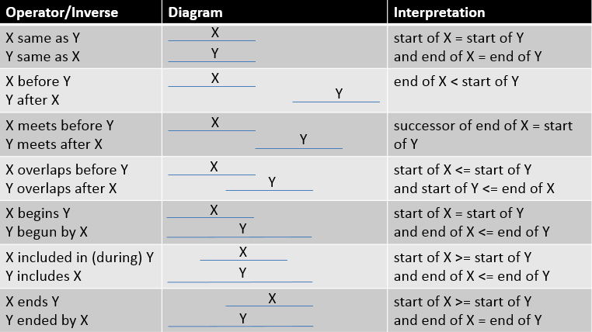
Interval Operators

Slide 12
Date/Time Manipulation
Date Construction
@2014-01-01T12:00:00-06:00
Date(2014, 1, 1, 12, 0, 0, -6)
convert '2014-01-01T12:00:00-06:00' to DateTime
Date Arithmetic
today + 3 months - 2 days
months between start of X and end of X
difference in days between X and Y
duration in months of X
Date/Time extraction
date of D // returns the date without the time
time of D // returns the time without the date
Component extraction
month of D // returns the number of whole units

Slide 13
List Operations
Selector – builds a list
{ 1, 2, 3, 4, 5 }
Membership – determine if an element is in a list
X in { 1, 2, 3, 4, 5 }
{ 1, 2, 3, 4, 5 } contains X
Comparison
L = { 4, 5, 6 } // true if L has the same elements
L includes { 4, 5, 6 } // true if L includes each element
{ 4, 5, 6 } included in L // inverse of includes
Indexer/Position
{ 4, 5, 6 }[1] // 1-based, evaluates to 4
Count
Count({ 4, 5, 6 }) // evaluates to 3
First/Last
First({ 4, 5, 6 }) // evaluates to 4

Slide 14
Queries
The “query” construct is used to perform various operations, including filtering, shaping, sorting, and relating results.
Simplest query involves only a single source:
The alias “E” allows the source to be referenced anywhere within the query.

Slide 15

Filtering
A “where” clause returns only those elements that satisfy the condition:

Slide 16
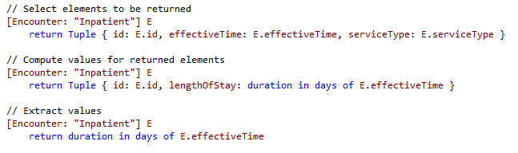
Shaping
The “return” clause allows the shape of the result to be described:

Slide 17
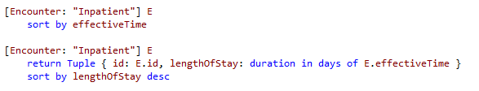
Sorting
“sort by” allows the results of a query to be ordered.
Sorting is evaluated after any “return”

Slide 18

Filtering by Relationships
Use the “with” keyword to introduce a filtering relationship:
NOTE: This operation is known as a semi-join in database languages.

Slide 19
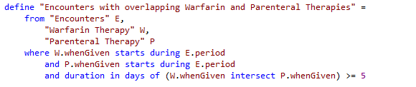
Multi-Source Queries
Queries can specify multiple sources to be combined:

Slide 20
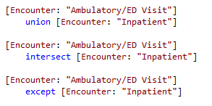
Set Operations
CQL supports standard set operations:
union, intersection, and difference (except)

Slide 21
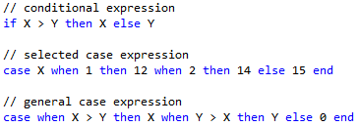
Conditional Expressions
CQL supports an “if” expression, as well as a SQL-style “case” expression:

Slide 22
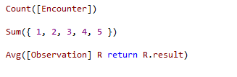
Aggregate Expressions
CQL supports a full complement of aggregate expressions including:
Count, Sum, Min, Max, Avg
Std Dev, Variance, Median, Mode

Slide 23
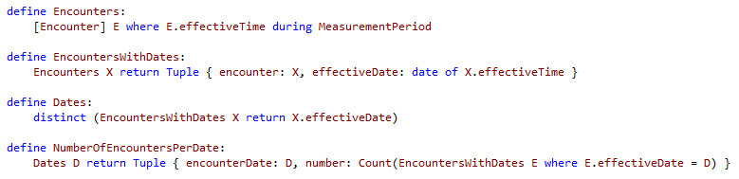
Define Statements
“define” statements can be used to break expressions into smaller chunks:

Slide 24
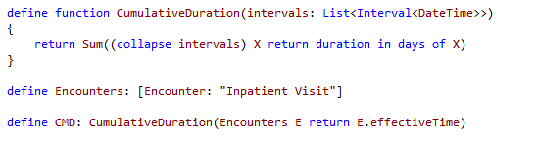
Defining Functions
CQL allows functions to be defined:

Slide 25
Using Libraries
Each library defines a name and optional version
Elements referenced from a library must be qualified
Element names within a library must be unique
Library names must be unique within a repository
Version number is optional for library definition
If none given, references cannot use a version
Version is optional for include definition
If specified, that version must be used
If none given, the “most recent” version is used

Slide 26
Next Steps
CQL Specification
Author’s Guide provides a more detailed introduction
Developer’s Guide provides more technical detail
CQL Reference provides detailed descriptions of all available operators
CQL Office hours weekly, Wed 11:00 Eastern
https://global.gotomeeting.com/meeting/join/554237525
Dial +1 770-657-9270, Participant Code: 6870541
CQL Github Repository
https://github.com/cqframework/clinical_quality_language

