Slide 1
K-Approximate String matching
Lu chen, Nika Mansouri ghiasi, Andrea Soro

Slide 2
Outline
Problem Statement Recap
Related Work
Sequential ASM Algorithms
Development
K-ASM and GPU’s
Chosen Algorithms
What we’ve done
Sequential Algorithms Implementation
Test Input
Performance assessment of sequential algorithms
Preliminary version of parallel of 1. and 2. with multi-threads (and graphs if available)
Memory Model: Shared Memory (LU)
Parallelizable Operations (Andrea)
Future Milestone
Notes:
Here brief overview of what we are gonna address

Slide 3

1. Problem Statement Recap
K Approximate String Matching
Input Parameters (x,y,k) :
x: text of length n
y: Pattern of length m
k: maximum number of edits (substitution, deletion, insertion)
Output: indexes in text at which matches with edits<=k are found
Notes:
Let's start off with a brief overview of our topic which is k-approximate string matching.
The algorithm takes three parameters
And outputs indexes at which a match with at most k differences is foundß

Slide 4
2.1 Related Work : sequential ASM algorithms
1. DYNAMIC PROGRAMMING ALGORITHMS
2. ALGORITHMS BASED ON AUTOMATA
3. BIT-PARALLELISM
4. FILTERING ALGORITHMS
Notes:
In summary, there are 4 types of sequential algorithms:
1. DYNAMIC PROGRAMMING ALGORITHMS 2. ALGORITHMS BASED ON AUTOMATA 3. BIT-PARALLELISM 4. FILTERING ALGORITHMS
Here, we focus on the classical dynamic programming algorithms and give a figure indicating the evolution of this type of algorithms.
dynamic programming (also known as dynamic optimization) is a method for solving a complex problem by breaking it down into a collection of simpler subproblem
And for sequential version, we have implemented two algorithms of O(mn) and one algorithm of O(kn).

Slide 5
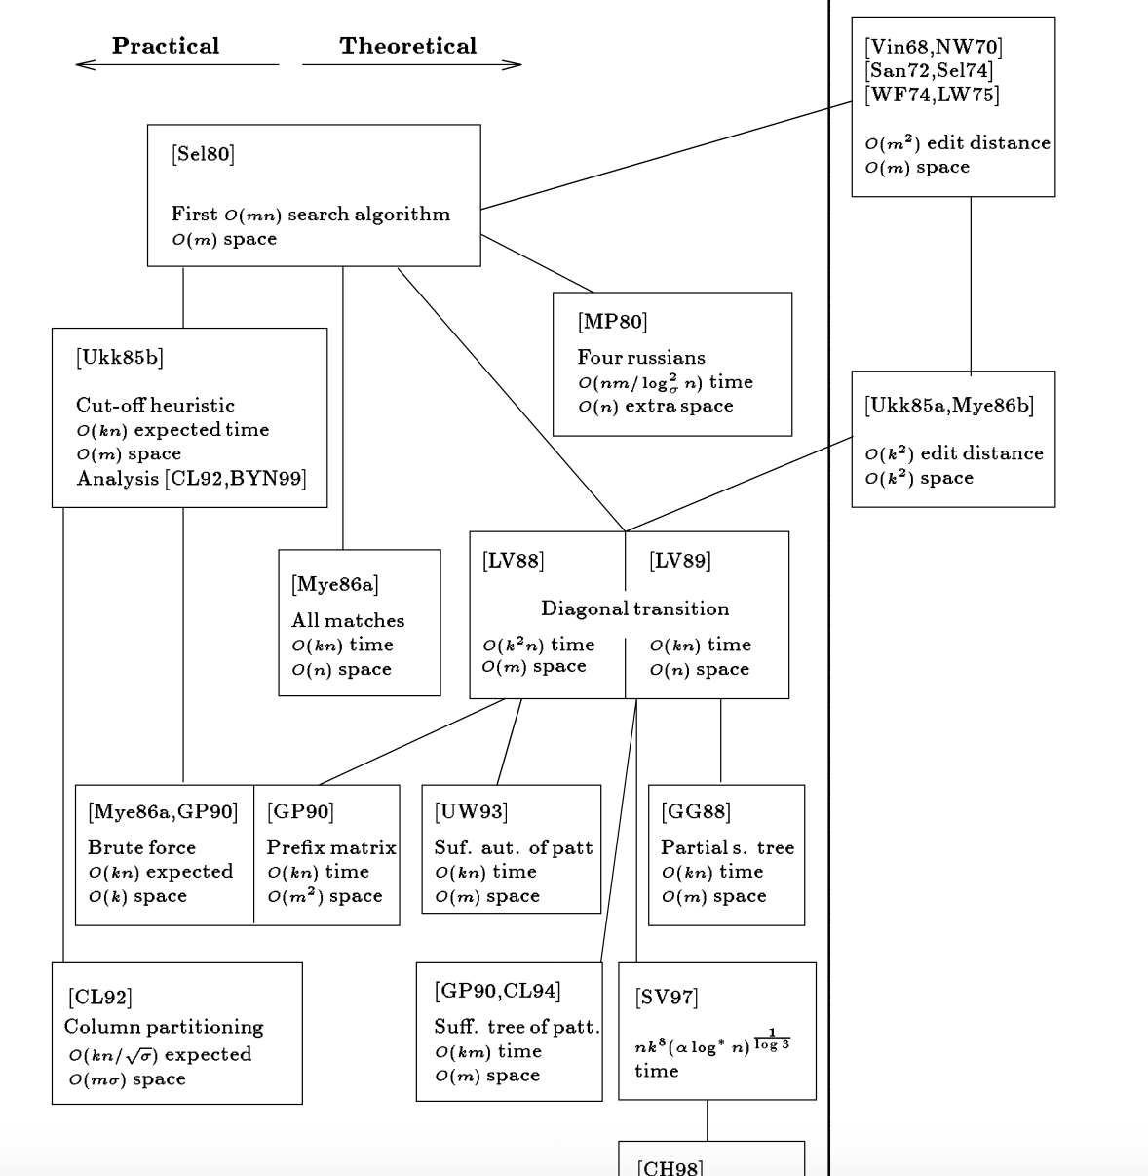
2.2 Related Work: development of ASM Algorithms
[5]
Notes:
In summary, there are 4 types of sequential algorithms:
1. DYNAMIC PROGRAMMING ALGORITHMS 2. ALGORITHMS BASED ON AUTOMATA 3. BIT-PARALLELISM 4. FILTERING ALGORITHMS
Here, we focus on the classical dynamic programming algorithms and give a figure indicating the evolution of this type of algorithms.
And for sequential version, we have implemented two algorithms of O(mn) and one algorithm of O(kn).
(from paper "A Guided Tour to Approximate String Matching”)

Slide 6
2.3 K-ASM and GPU
Since most ASM algorithms deal with great amounts of basic operations and with big matrices most of the latest papers about the topic deal with GPU implementations rather than CPU .
The high number of cores present on GPU makes GPU implementations of this kind of problem more efficient
As a consequence most papers published are GPU implementations

Slide 7
2.4 Chosen Algorithms
O(mn) Algorithm: [1]
Memory: (m x n) D Matrix
Easily parallelizable
Memory efficient O(mn) Algorithm: [2]
Paper based on GPU but can be applied to CPU
Memory: (3 x m) Matrix
Easily parallelizable
C-based O(mn) Algorithm:[3],[4]
Computes (n-m+2k+3)x(k+2) C matrix
O(kn) Algorithm[4]:
Improves time complexity of (III)
Hard to parallelize (lots of data dependencies)

Slide 8
3. What we’ve done so far
Sequential Algorithms Implementation - For all the above-mentioned algorithms we have the working sequential version (https://github.com/soroa/Parallel-ASM/tree/master/src/sequential)
Performance assessment of sequential algorithms
Preliminary version of parallel of (I) and (III) with multi-threads

Slide 9
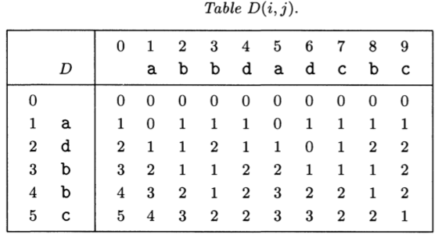

(i) O(MN) Algorithm: D matrix
Calculates edit-distances between substring of Y and X
$D\left(i,j\right) , 0<i≤m and 0<j≤n$: minimum number of differences between $y_{1} …y_{i}$ and any substring of $x$ ending at $x_{j}$
Two possible ways to iterate:
Row-wise
Diagonal-wise
INITIALIZATION
COMPUTATION
DEPENDENCIES

Slide 10

(i) O(MN) Algorithm: D matrix
$∀j:0≤j≤n, if(D\left(m, j\right)≤k$the text contains a k-match with the pattern.
K = 2

Slide 11
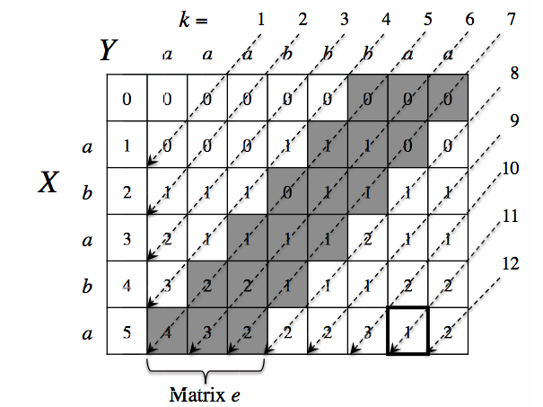

(II) Memory efficient O(mn)
D matrix computed diagonal-wise
Only last 3-diagonals are kept in memory
Memory complexity drops from $O\left(mn\right)$ to $O(m)$
Speed stays the same

Slide 12
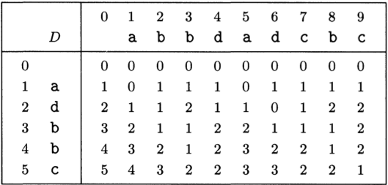
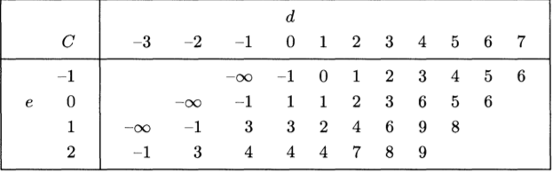

(III) O(mn) algorithm with C-matrix
C Matrix
Given a diagonal d and a difference $e≤k$, $C(e,d)$ is the largest column j such that $D\left(j−d,j\right)$
If $C\left(e,d\right)=m+d for e≤k$ there was a k-match between pattern and text

Slide 13
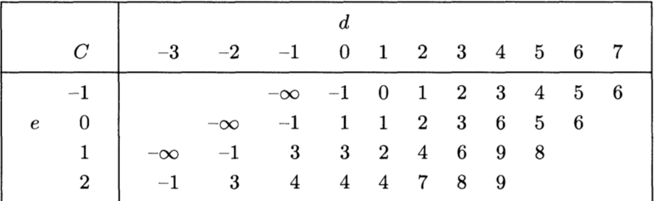
(iII) C Matrix Initialization
Initialization
First two diagonals and first row are initialized to default values
No data dependence -> can be done completely parallel
No communication involved

Slide 14
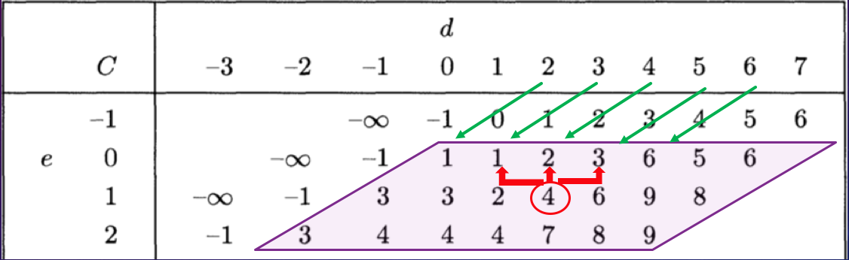
(iII) C matrix computation
Matrix computation occurs diagonal-wise or row-wise
Cell is computed from the three cells above
We can assign a process to each diagonal or to each row
Data Dependency: every element depends on the results of the previous step in two adjacent diagonals
Must be solved with synchronization: every process updates a global variable with the last round performed
Worst case scenario: first p is slow and p₂… p_{n} have to wait for it.

Slide 15

(IV) Efficient O(kn) with C-matrix
Base line for sequential k-ASM
Speeds up C-Matrix computation by doing prefix analysis of the pattern
Lots of dependencies
Really complex code
Considerable Pre-processing: O(m²):
Initialization of C Matrix: O(n) entries
Initialization of Prefix matrix: $O(m^{2})$ entries
Initialization of Triplets Matrix: $O(m^{2})$ entries
Current-stand:
Sequential implementation completed
Still looking into how to parallelize it

Slide 16
3.2 Test Input
We are using our approximate string matching codes for detecting special genes in long strings of chromosomes.
Results are collected by measuring the time of our codes for detecting the gene that represents the size of the head of humans in their first Chromosomes!

Slide 17
Test strategy
We tested three different sequential algorithms.
Each for 10 different text sizes, from 7 Kilo to 70 Kilo string lengths.
We test each case with different numbers of mismatches allowed to check the effect on the performance of the algorithms.

Slide 18
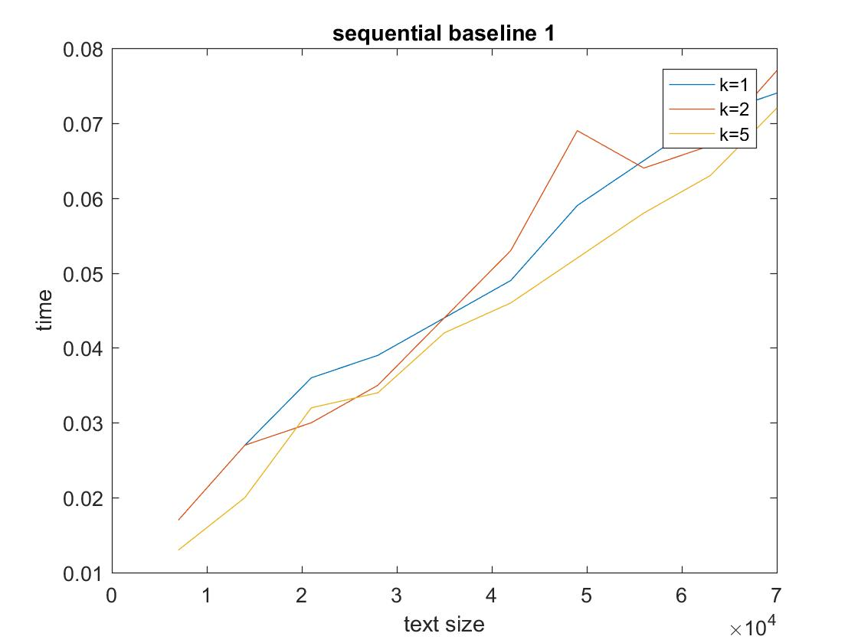
3.3 Performance of sequential Algorithms
(I) O(mn) with D Matrix

Slide 19
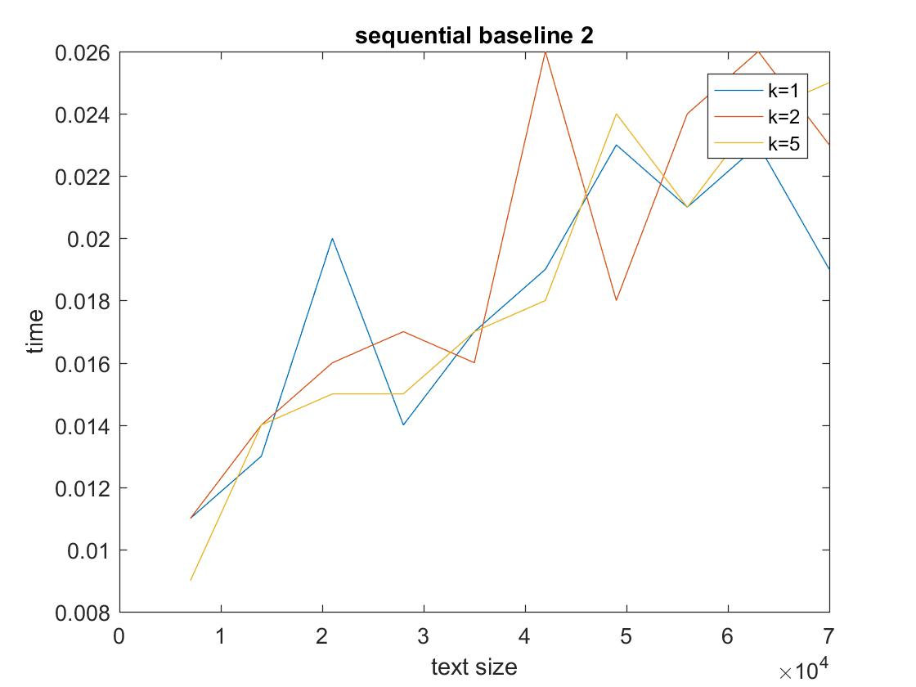
3.3 Performance of sequential Algorithms
(III) O(mn) with C Matrix

Slide 20
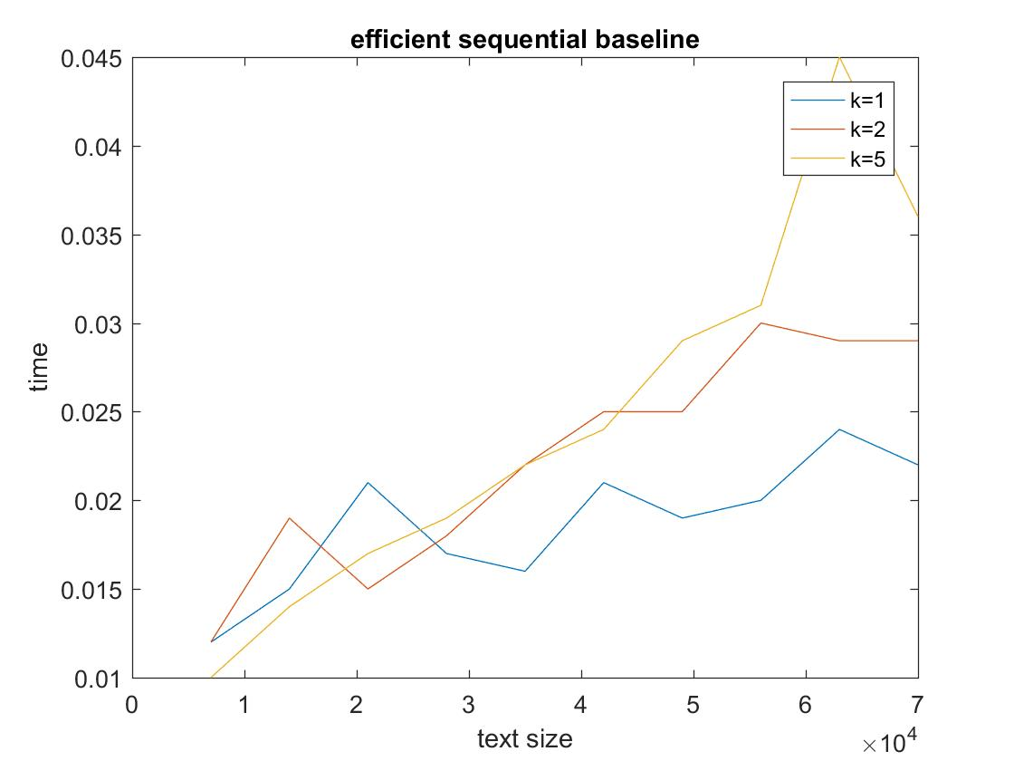
3.3 Performance of sequential Algorithms
(IV) O(kn)

Slide 21
Comparison of Sequential Algorithms
Given n=text length m=pattern length k= number of mismatches
Baseline 1 (Alg. I) is the slowest.
Baseline 1 (Alg. I) and baseline 2 (Alg. III) do not show special patterns of execution time when we increase k.
Their complexity: O(mn)
The performance plot of the most efficient algorithm (IV) shows that with different k, we have significantly different execution time.
Complexity: O(nk)

Slide 22
3.4 Preliminary parallel versions
We implemented preliminary parallel versions of
(I) O(mn) using D Matrix
(III) O(mn) using C Matrix
https://github.com/soroa/Parallel-ASM/tree/master/src/parallel
Performance still to be tested
Implementations using multi-threading (<pthread.h>)

Slide 23
3.4.1 Parallel Programming model
Parallel Programming Model
use Shared Memory Model
All threads can access all memory as global address space
Implementations: POSIX Threads & OpenMP
Parallel Strategy
loop parallelism & synchronization
Our Current Implementation: POSIX Threads
Notes:
We use Shared Memory Model as our Parallel Programming Model. As shown in the figure, all threads can access all memory as global address space in shared memory model.
There are two standardized implementation method: multi threads and open-mp. Our current parallel algorithm is implemented using multi threads, and use synchronization constructs to ensure correct order of access to global memory.

Slide 24
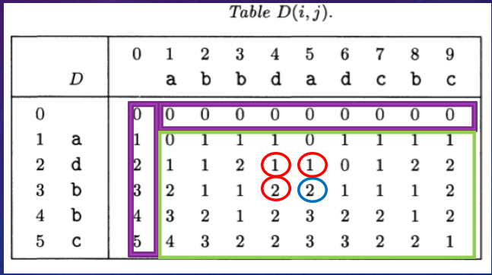

3.4.2 Parallelizable Operations
Algorithm (I): O(mn) with D Matrix
Parallelized row wise
Thread $t_{i}$ gets row i
Every thread process $t_{i} at column j$ initially has to wait O(1) time until $t_{i−1}$ has processed column j

Slide 25

3.4.2 Parallelizable Operations
Algorithm (III): O(mn) with D Matrix
Parallelized row wise
Thread $t_{i}$ gets row i
Needs k+1 threads to be optimal
Every thread process $t_{i} at column j$ initially has to wait O(1) time until $t_{i−1}$ has processed column j

Slide 26
4. Future milestones
Further improve parallel versions
Parallelize Initialization of Matrix D and C
Parallelize diagonal-wise and compare to row-wise
Implement parallel versions using openMP and compare with current version
Try to parallelize O(kn) algorithm

Slide 27
References
[1] R. A. WAGNER AND M. J. FISCHER, The string-to-string correction problem, J. Assoc. Comput. Mach., 21 (1974), pp. 168-173.
[2] D. Man, K. Nakano, and Y. Ito, The Approximate String Matching on the Hierarchical Memory Machine, with Performance Evaluation, 2013
[3] E. UKKONEN, Algorithms for approximate string matching, Inform. and Control, 64 (1985), pp. 100-118.
[4] Z. GALIL, K. PARK, AN IMPROVED ALGORITHM FOR APPROXIMATE STRING MATCHING, SIAM J COMPUT. Vol. 19, No. 6, pp. 989-999, December 1990
[5] G. NAVARRO, A Guided Tour to Approximate String Matching, ACM Computing Surveys (CSUR), Volume 33 Issue 1, March 2001
.

