Slide 1
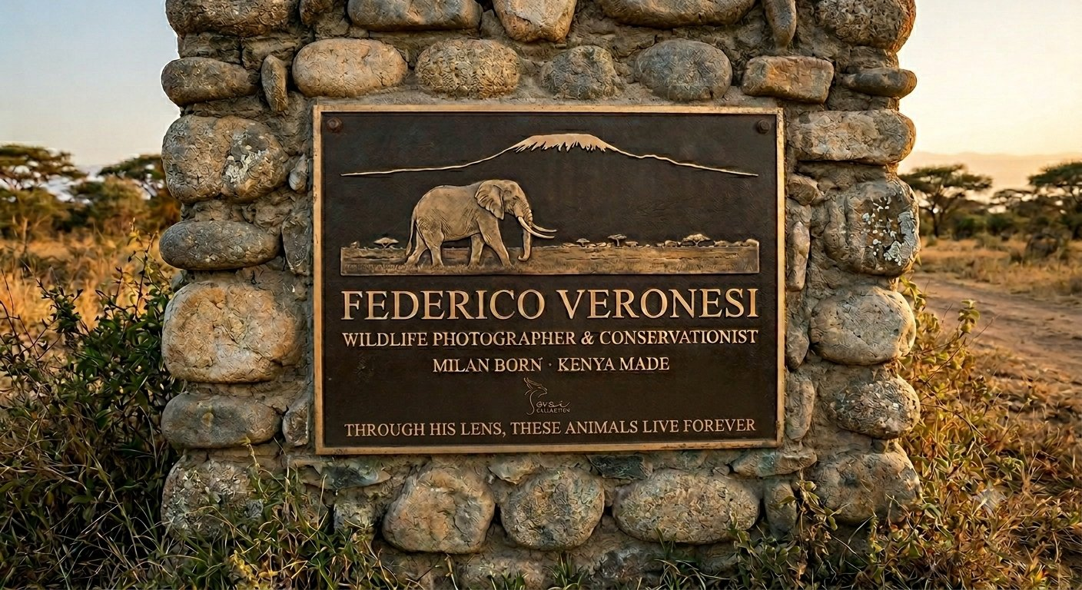
SOROI COLLECTION
Federico
Veronesi
COMMEMORATIVE PLAQUE
Concept, Artwork & Manufacturing Brief
Soroi Amboseli · 2026

Slide 2
01 / CONCEPT
The Story Behind the Plaque
◎
◈
◇
Why a Plaque
Why Amboseli
Why This Format
Federico Veronesi's fine-art prints hang throughout every Soroi property. His images define how guests see and feel the wildlife around them. The plaque is a formal recognition of that contribution — permanent, physical, and placed in the landscape he has spent a lifetime photographing.
Amboseli is where Federico made one of the defining encounters of his career — with Tim, one of Africa's last great tuskers. The connection between this photographer and this landscape is not incidental. It is the subject matter of his life's work. Placing the plaque here is the only right choice.
The Archers Post Ranger Station plaque — funded by the African Wildlife Foundation — was the reference. Cast bronze on stone. A format with heritage, weight, and permanence. The language of conservation rather than hospitality. Federico's work sits squarely in that tradition.

Slide 3
02 / COPY
The Inscription
FEDERICO VERONESI
FEDERICO VERONESI
Full name leads, set largest. His name is already recognised in wildlife photography circles globally. No title precedes it.
WILDLIFE PHOTOGRAPHER & CONSERVATIONIST
WILDLIFE PHOTOGRAPHER & CONSERVATIONIST
MILAN BORN · KENYA MADE
RESIDENT ARTIST, THE SOROI COLLECTION
Double descriptor. Photography is the craft; conservation is the purpose. Both are true and both matter here.
THROUGH HIS LENS,
MILAN BORN · KENYA MADE
THESE ANIMALS LIVE FOREVER
The biographical anchor. Captures the journey — the Italian who chose Africa — in five words. The dot is a traditional separator used on heritage plaques.
RESIDENT ARTIST, THE SOROI COLLECTION
Formalises the relationship. Gives the plaque institutional weight and connects it directly to the property.
THROUGH HIS LENS, THESE ANIMALS LIVE FOREVER
The closing epitaph. Present tense. Speaks to the permanence of his imagery and its conservation value.

Slide 4
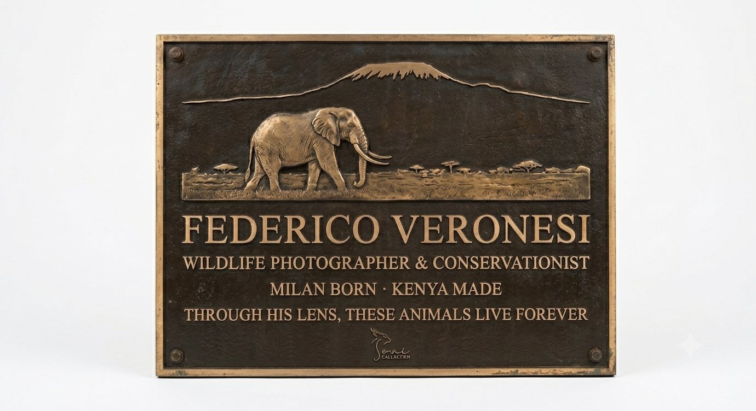
03 / ARTWORK
The Relief Artwork
01
Subject: Tim the Tusker
A lone bull elephant with long curved tusks, walking in profile left to right. Directly references Federico's most famous Amboseli subject. Immediately recognisable to anyone familiar with the landscape.
02
Backdrop: Kilimanjaro
The unmistakable flat-topped silhouette of Kilimanjaro rises behind the elephant. Africa's highest peak is both Federico's backdrop and the defining visual of Soroi Amboseli.
03
Setting: Amboseli Plains
A minimal ground line with acacia trees in the mid-distance. Just enough geography to anchor the scene without overcomplicating the relief. Classic Amboseli iconography.
04
Style: High-Relief Silhouette
Graphic and bold. Reads cleanly at any size and reproduces faithfully in cast bronze. Consistent with the Archers Post reference — heritage plaque aesthetic, not decorative illustration.

Slide 5
04 / VISUALISATION
In Situ — Soroi Amboseli
AI visualisation. Final plaque subject to fabricator confirmation.

Slide 6
05 / MATERIALS
Materials Specification
Silicon Bronze Alloy (C87200)
316 Marine-Grade Stainless Steel
PLAQUE BODY
FIXING HARDWARE
The industry standard for architectural and heritage plaques. Minimum 90% copper content. Excellent castability, corrosion resistance in outdoor environments, and the warm deep-brown patina that develops over time with exposure. Superior to brass in coastal or humid climates — well suited to Amboseli's dust and seasonal rains.
Four countersunk M8 bolts, one at each corner. Marine-grade stainless is specified for long-term resistance to corrosion in outdoor conditions. Bolt heads sit flush with the plaque face.
Dark Patina with Raised Polished Bronze
Natural River Stone Masonry
FINISH
BACKING WALL
Background chemically patinated to a deep brown-black using liver of sulphur solution. Raised lettering and relief artwork polished back to bright bronze. This two-tone contrast is the defining visual characteristic of heritage cast plaques. A clear lacquer sealant is applied over the polished surfaces to protect against oxidation.
Consistent with the Archers Post reference plaque and with the material language of East African conservation infrastructure. Locally sourced rounded river stones set in a rough mortar. The plaque is recessed slightly into the face of the wall for a flush, integrated finish.
MOUNTING FRAME
Brass Border Frame, 10mm
A narrow raised brass border frames the perimeter of the plaque. Provides structural edge protection and visual definition against the stone backing. Corner-drilled for stainless steel countersunk fixing bolts.

Slide 7
06 / MANUFACTURING
How It Is Made
01
Artwork Preparation
02
Pattern Making
Final artwork produced as a high-resolution vector file (SVG/AI). The elephant and Kilimanjaro silhouette is drawn with clean, castable edges — no hairlines or detail that would be lost at relief depth. Typography set in the final approved font and converted to outlines. File supplied to foundry at 1:1 scale.
The foundry produces a master pattern from the artwork — either CNC-milled from tooling board or 3D-printed in resin. Relief depth is specified at 4–6mm for the artwork and 3mm for the lettering. The pattern is finished and inspected before moulding begins.
03
Sand Casting
04
Finishing & Chasing
The pattern is pressed into specially compacted foundry sand to create a negative mould. Molten silicon bronze (approximately 950°C) is poured into the mould cavity. Once cooled and solidified, the casting is broken from the sand mould and the rough casting is extracted.
The raw casting is shot-blasted to remove surface scale. A skilled chaser refines the relief surfaces with hand tools — sharpening the edges of the elephant, the mountain profile, and the letterforms. Any casting imperfections are repaired at this stage.
05
Patination
06
Sealing & Installation
The background is treated with liver of sulphur (ammonium polysulphide) solution, applied by brush or dip, to develop the dark brown-black patina. The raised surfaces are then carefully hand-polished back to bright bronze using progressively finer abrasive papers.
A clear lacquer (Renaissance Wax or equivalent) is applied to the polished surfaces to retard future oxidation. The plaque is drilled, the brass frame attached, and the completed piece shipped flat in protective foam. Installation by a qualified stonemason into the prepared stone wall.

Slide 8
07 / DIMENSIONS & PLACEMENT
Size, Placement & Timeline
RECOMMENDED DIMENSIONS
PLACEMENT
Plaque width
600mm (approx. 24")
Mounted on a free-standing or attached stone pillar at the camp entrance or near the main public area. Eye-level centre at approximately 1500mm from ground. Stone wall construction by a local Amboseli stonemason consistent with the camp's existing material language.
Plaque height
450mm (approx. 18")
Relief depth — artwork
4–6mm
Relief depth — lettering
3mm
Frame border width
10mm
INDICATIVE TIMELINE
Overall thickness incl. backing
12–15mm
Artwork sign-off
Week 1
Pattern making
Weeks 2–3
Approx. weight
8–10 kg
Casting & finishing
Weeks 4–6
Fixing bolt centres
560 × 410mm

Slide 9
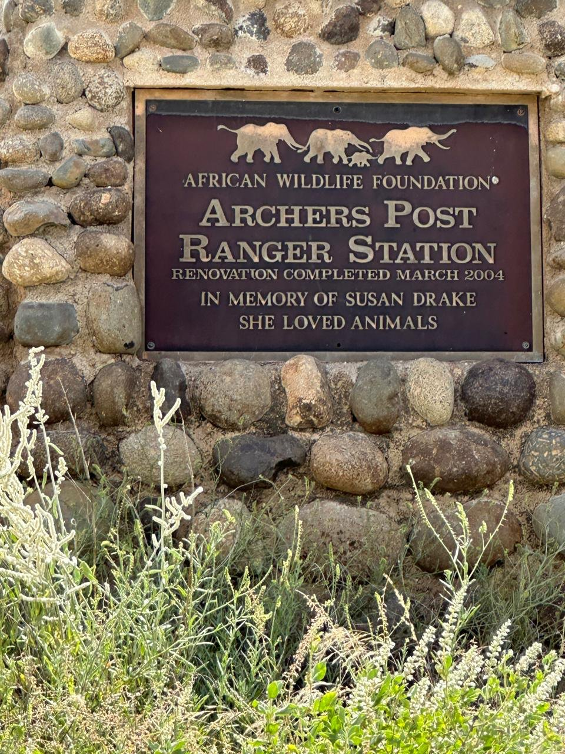
08 / REFERENCE
Design Reference — Archers Post
What We Are Matching
Cast bronze on rough-hewn natural stone. Dark patinated background with raised polished lettering. Silhouette relief artwork at the top of the plaque. A formal heritage hierarchy: organisation → name → role → tribute line.
What We Are Adapting
The Archers Post plaque is a memorial. The Veronesi plaque is celebratory — honouring a living artist. The closing line ('Through his lens, these animals live forever') is present-tense and forward-looking rather than elegiac.
Tonal Difference
Archers Post is institutional — African Wildlife Foundation commissioning a ranger station renovation. The Soroi plaque carries the same formal register but adds 'Resident Artist, The Soroi Collection' to root it firmly within the property and the brand.
Artwork Shift
Archers Post uses a simple elephant procession silhouette. The Veronesi plaque elevates this to a full landscape composition — lone tusker, Kilimanjaro, acacia plains — because the landscape IS Federico's subject matter.

Slide 10
THROUGH HIS LENS,
THESE ANIMALS LIVE FOREVER
Federico Veronesi · Soroi Amboseli · 2026

