Slide 1
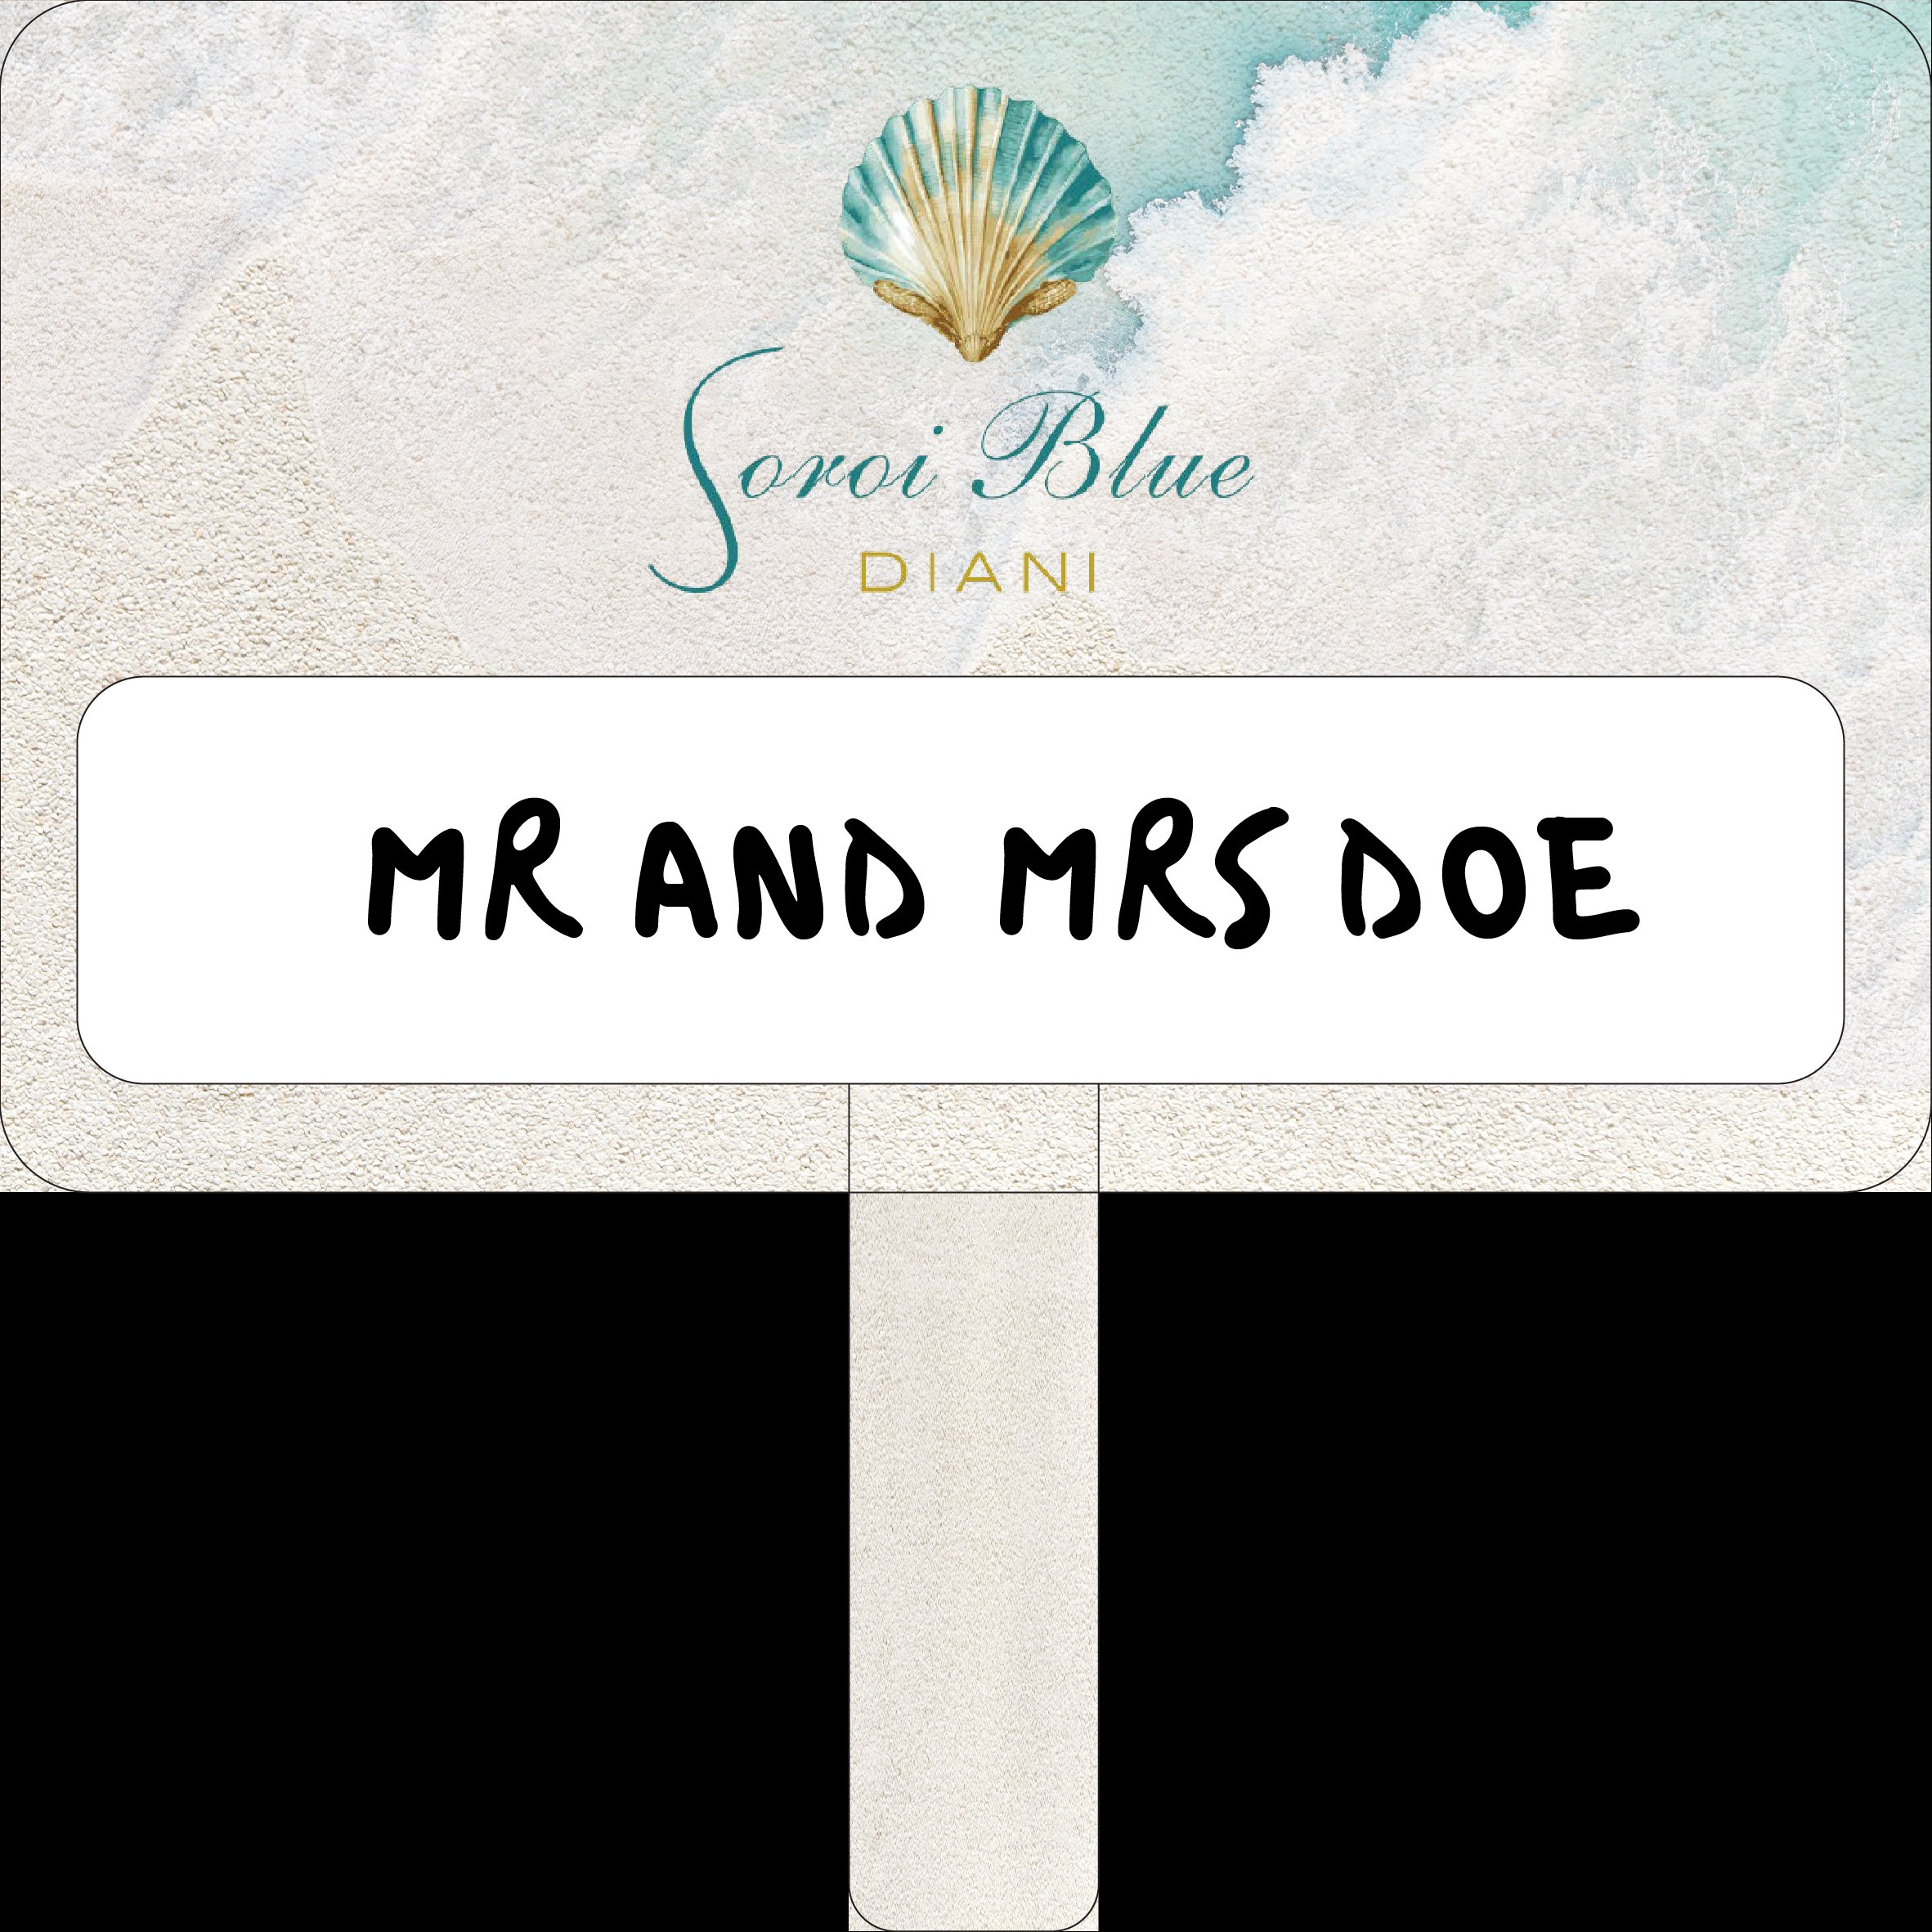
PRINT BRIEF
Arrival Plaque Card
Soroi Blue Diani
reservations@soroi.com · +254 754 351 908 · www.soroi.com

Slide 2
ARTWORK REFERENCE · KEY SPECIFICATIONS
Soroi Blue Diani — Arrival Plaque Card
Key Specifications
Item
Airport arrival plaque card
Quantity
TBC — confirm before order
Substrate
Alucoboard (aluminium composite) — 3mm
Board width
40 cm
Board height
24 cm
Handle height
10 cm (extends below board)
Handle width
Approx. 7 cm — centred
Corner radius
Match artwork — generous rounded corners
Print method
UV flatbed — direct to alucoboard
Finish
Matte laminate — full board face
Erase panel
Dry-erase white vinyl — self-adhesive
Erase panel size
38 cm (W) × 10 cm (H)
Erase position
Centred in lower zone — see artwork
Marker type
Posca PC-5M / whiteboard markers
Supplied artwork file: WELCOME_PLAQUE_CARD-01.png

Slide 3
TECHNICAL PRINT BRIEF
Soroi Blue Diani — Arrival Plaque Card
CLIENT DETAILS
PRINT SPECIFICATION
Client
Soroi Collection
Print method
UV flatbed — direct to alucoboard
Property
Soroi Blue Diani
Colour mode
CMYK + spot varnish if available
Contact
reservations@soroi.com
Resolution
Minimum 150 dpi at final output size
Phone
+254 754 351 908
Artwork file
WELCOME_PLAQUE_CARD-01.png (supplied)
Job ref.
DIANI-PLAQUE-001
Bleed
3mm on all edges
Safe zone
5mm inside cut line — keep text clear
SUBSTRATE & MATERIAL
Finish
Matte laminate over entire board face
Material
Alucoboard — aluminium composite panel
Back face
Plain alucoboard — no print required
Thickness
3mm
Weight target
Approx. 250–320 g per unit
DRY-ERASE VINYL PANEL
Surface
White polyester-coated — standard print grade
Material
Dry-erase white vinyl — self-adhesive
Reason
Lightweight, rigid, weatherproof, printable
Panel W × H
38 cm × 10 cm
Do NOT use
Wood, acrylic, foam board, or PVC
Position
Centred horizontally in lower board zone
Corner style
Rounded — approx. 1 cm radius
SHAPE & CUTTING
Surface finish
Gloss white — writeable and wipeable
Cut method
CNC router — clean burr-free edges
Application
Applied after laminate — flush, no bubbles
Board shape
Rounded rectangle — match artwork exactly
Marker compat.
Posca PC-5M / standard whiteboard markers
Board W × H
40 cm × 24 cm
Wipe clean
Must wipe clean with dry cloth or tissue
Corner radius
Approx. 3–4 cm — match artwork
Handle W × H
Approx. 7 cm × 10 cm
HANDLE & GRIP
Handle position
Centred on bottom edge
Handle material
Same alucoboard sheet — cut as one piece
Edge finish
All edges smooth — sand or de-burr
Grip wrap
Matte black rubber grip tape
Grip coverage
Full handle height — comfortable hold
Carry hole
Optional 8mm hole at handle top

Slide 4
DIMENSIONS DIAGRAM · CRITICAL NOTES
Soroi Blue Diani — Arrival Plaque Card
Critical Notes for Printer
BRAND ZONE
(UV print — full colour)
🔴 MATERIAL: Alucoboard (3mm aluminium composite) only. Wood, acrylic, foam board or PVC will be rejected.
24 cm
🔴 DRY-ERASE PANEL: Genuine dry-erase white vinyl, self-adhesive, 38 cm × 10 cm. Wipe-clean performance must be confirmed before delivery.
DRY-ERASE PANEL
38 cm (W) × 10 cm (H)
🔴 FINISH: Matte laminate over entire board face before applying dry-erase panel. Gloss finish will not be accepted.
← 38 cm (dry-erase panel) →
⚠️ ARTWORK: Print from WELCOME_PLAQUE_CARD-01.png only. Do not alter any element — no recolouring, cropping, or repositioning.
HANDLE
10 cm
10 cm
⚠️ CUTTING: CNC router required. All edges smooth and de-burred. Corner radius must match the artwork reference.
✅ PROOF: Supply physical or digital pre-production proof before full run. No production without client sign-off.
← 40 cm (board width) →
✅ DELIVERY: Wrap each unit individually to protect the dry-erase surface in transit.

Slide 5
BRAND COLOURS · SIGN-OFF SHEET
Soroi Blue Diani — Arrival Plaque Card
Soroi Blue Diani — Reference palette (print from supplied artwork file — do not colour-match manually)
Alice Blue
Jordy Blue
Tufts Blue
Cobalt Blue
Bronze Gold
Parchment
#E9F5FF
#93BFEF
#468BE6
#1A5799
#C4A265
#F0EBE3
Job Sign-Off
Job title
Soroi Blue Diani — Airport Arrival Plaque Card
Artwork file
WELCOME_PLAQUE_CARD-01.png
Substrate
3mm Alucoboard — aluminium composite
Board size
40 cm (W) × 24 cm (H)
Handle
Approx. 7 cm (W) × 10 cm (H) — centred — rubber grip
Erase panel
38 cm (W) × 10 cm (H) — dry-erase white vinyl
Finish
Matte laminate — full board face
Quantity
________ units (to be confirmed by client)
Proof approved by
________________________________
Approval date
________________________________
Printer ref.
________________________________
Soroi Collection · reservations@soroi.com · +254 754 351 908 · www.soroi.com

