Slide 1
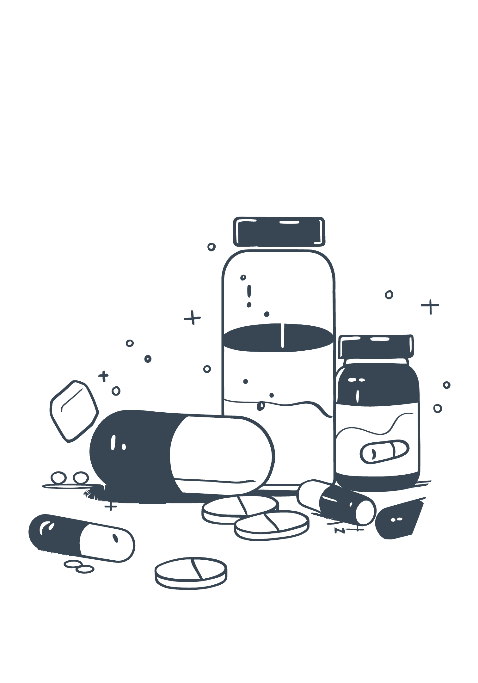
Capsule Counterfeit Detection Using Deep Learning
Safeguarding health through intelligent vision.
Addressing a Critical Need
Counterfeit medicines are a severe global threat, endangering public health and eroding trust in healthcare systems.
Innovative Detection Solution
Our project delivers an automated, scalable, and real-time deep learning solution for accurate counterfeit capsule detection.

Slide 2

Motivation
The Problem
High Prevalence of Counterfeit Drugs: A significant percentage (10%) of pharmaceuticals in regions like Bangladesh are suspected to be counterfeit or substandard. In recent estimates numbers raised to 20%.
Lack of Automation in Quality Control: Current inspection techniques rely heavily on human expertise and visual cues, which are time-consuming and prone to error.
Low Accessibility of Detection Tools: There is no low-cost, scalable system available to verify capsule authenticity at the consumer, pharmacy, or field level.

Slide 3

Objectives
Detection & Classification
Authenticity Verification
Identify and categorize capsules as authentic or counterfeit.
Confirm legitimacy using visual similarity analysis.

Slide 4
Literature Review
Study | Model / Architecture | Task | Dataset / Tools
Zhou et al. (2020) [1] | RACNN (Custom CNN with dropout, L2 reg, Adam) | Multi-class defect classification | Capsule production-line images (PyTorch)
Burgin (2019) [2] | CNN + Superpixel Graph Labeling | Defect localization on tablets | Tablet coating images + graph-based labeling
Yan (2015) [3] | Random Forest on region-specific features | Region-wise tablet defect analysis | Segmented tablet regions; traditional ML
Motwani (2022) [4] | Fine-tuned VGG16, ResNet50 (Keras/TensorFlow) | Real vs. counterfeit classification | Smartphone images of capsules
Zhao (2024) [5] | YOLOv5 + MobileNetV3 + SE + CH-SPP | Real-time transparent capsule detection | Custom capsule dataset; PyTorch

Slide 5



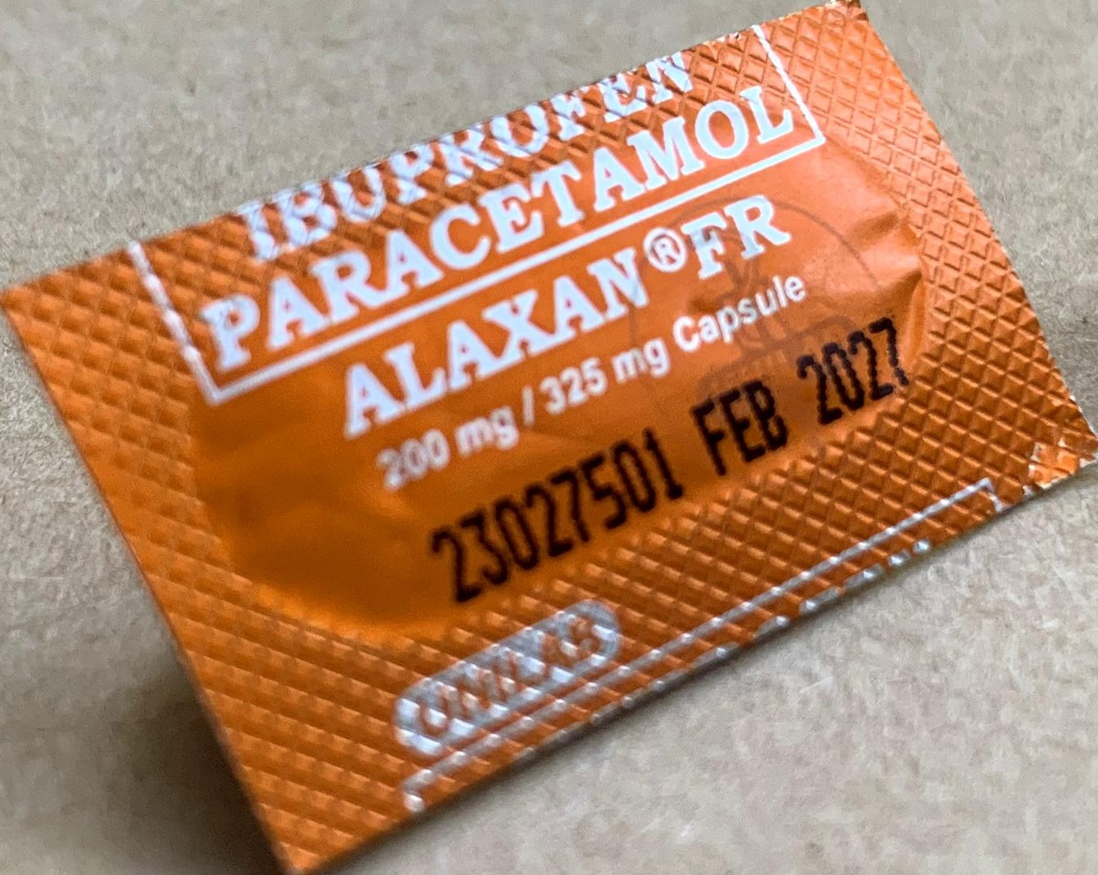
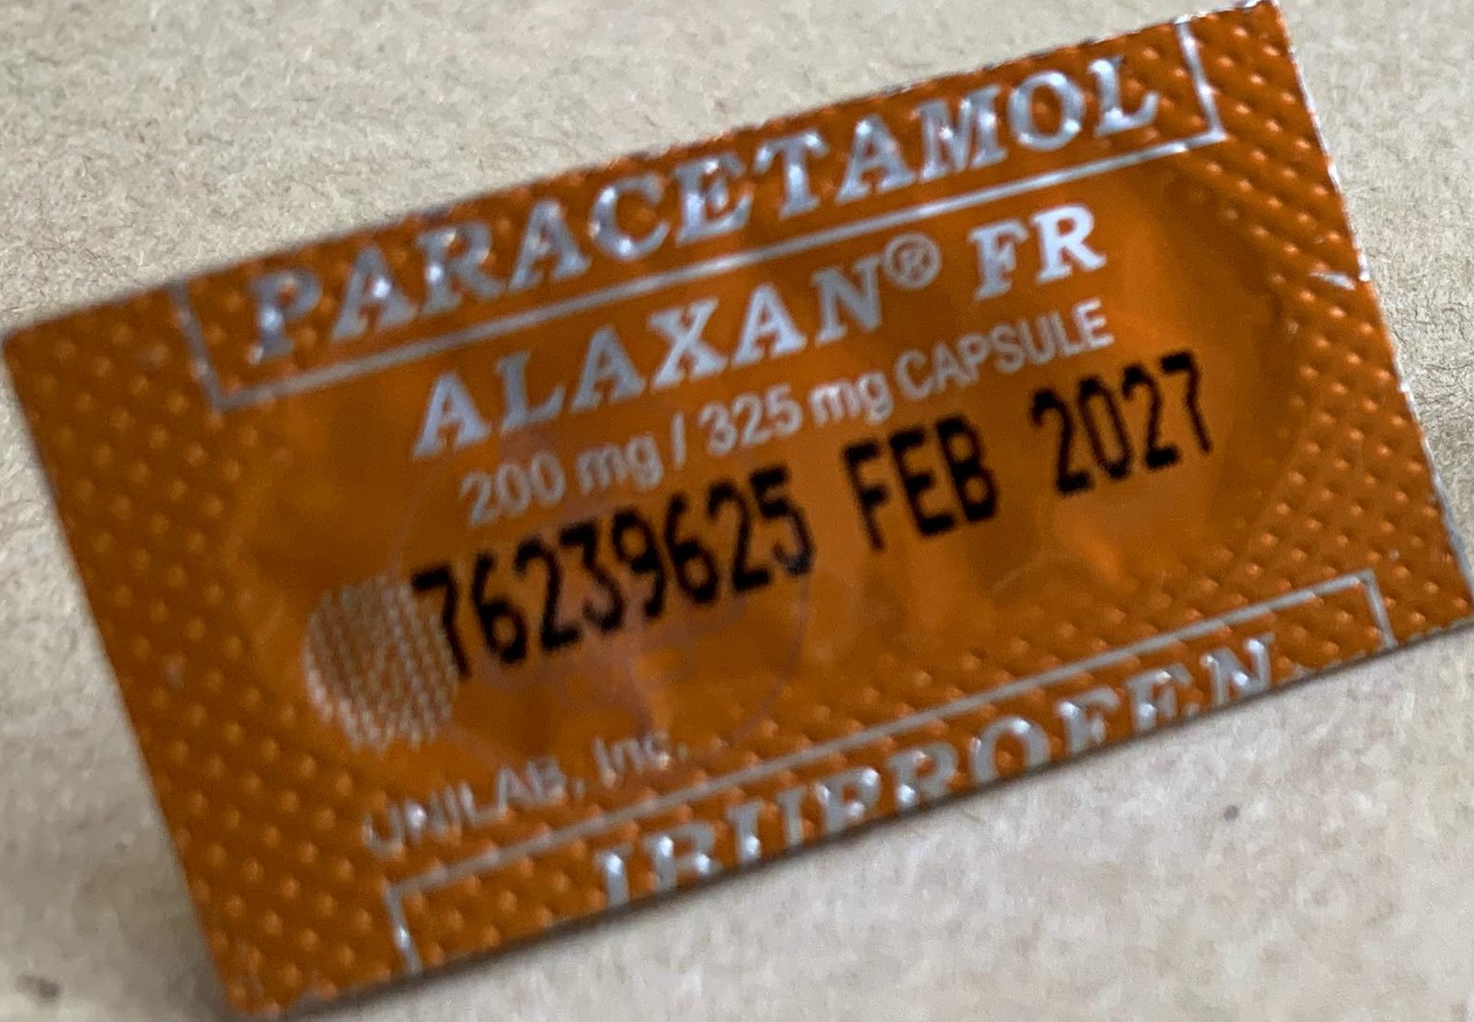
Dataset
Our comprehensive dataset was meticulously sourced from Roboflow, a platform known for its diverse image collections.
Below are illustrative examples from our dataset, showcasing the subtle visual differences between authentic and counterfeit capsules, which our model is trained to identify:
It is specifically curated for capsule detection, featuring 8 distinct classes: 4 representing authentic capsule types and 4 representing their corresponding counterfeit versions.
This rich collection comprises over 4,800 annotated images.
The raw data was initially in Pascal VOC format and was meticulously converted to YOLO format, a more efficient and widely adopted standard for real-time object detection models, to streamline our model training and inference processes.
Authentic
Counterfeit
Authentic
Counterfeit

Slide 6

Dataset Preprocessing
Folder Organization
Capsule Cropping
Images saved into 8 distinct folders: 4 authentic, 4 counterfeit.
Capsules were precisely cropped using YOLO bounding boxes.
Resizing
Image Pair Creation
All images resized to 320x320 before training.
Created 10,000 image pairs (5,000 positive, 5,000 negative).

Slide 7

Architecture Overview
Siamese Verification Model
Backbone: ResNet-18
Input: 320x320 image pairs
Output Embedding: 256-dimensional feature vector
Output: 2-layer similarity head (Sigmoid)
Head Network
Loss: BCE loss
Training
10,000 image pairs
30 epochs, batch size 16

Slide 8





Evaluation & Performance Metrics
Key Metrics
Precision, Recall, Accuracy, F1 Score.
Distribution Analysis
Embedding distance distribution.
Verification Accuracy
Overall system verification performance.
ROC & AUC
Receiver Operating Characteristic Curve and Area Under Curve.

Slide 9
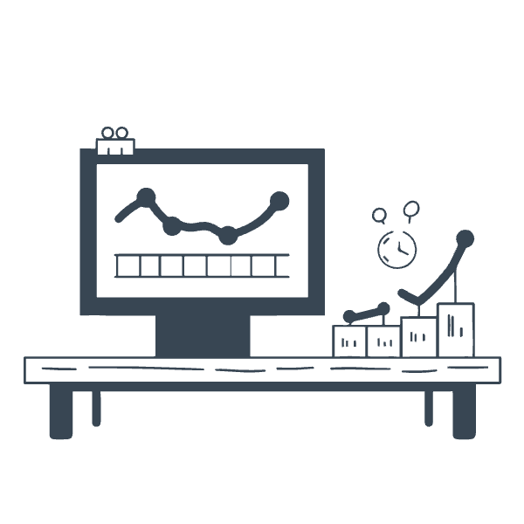
Results
Our model demonstrated exceptional performance in capsule counterfeit detection, achieving outstanding results across all key metrics:
Accuracy: 0.8965 - Indicating a very high proportion of correct predictions across all classifications.
Precision: 0.8662 - Highlighting the reliability of our positive identifications for counterfeit capsules.
Recall: 0.9314 - Demonstrating the model's effectiveness in correctly identifying nearly all actual counterfeit cases.
F1 Score: 0.8962 - Representing an excellent balance between precision and recall, underscoring the model's overall robustness.

Slide 10
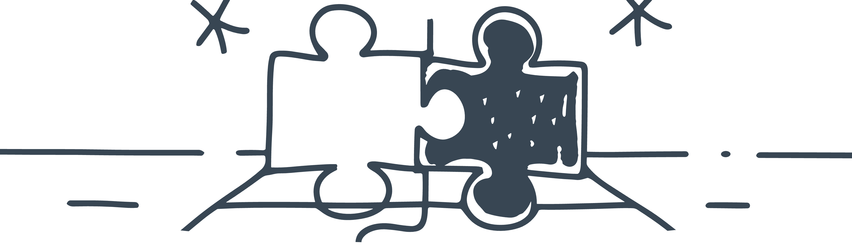
Challenges
Class Confusion
Environmental Factors
Dataset Limitations
Visually identical capsules pose classification difficulties.
Lighting, blur, and camera quality impact detection accuracy.
Limited diversity in the current dataset.

Slide 11
Future Work & Conclusion
Future Work
Conclusion
Expand dataset with more brands and variations.
The Imperative: Protecting global health from counterfeit drugs.
Explore Triplet Networks or transformer-based models.
Deploy on mobile (Android) using ONNX or TensorFlow Lite.
Investment in Innovation: Key to a safer, more secure pharmaceutical supply chain.

Slide 12


Thank You!
We appreciate your attention and welcome any questions you may have.
Sadik Mahmud 011221113
Yeamine Alam Sorol 011221108

