Slide 1

Dept. Of Computer Science & Engineering
Assignment-01
Of Team Bratva
Course Code: CSE-3523 Course Title: Microprocessor, Microcontrollers & Embedded System
Submitted to-
Md. Safayat Hossen
Assistant Lecturer, Dept. of CSE, IIUC
Cell: 01736161688, safayathossen@iut-dhaka.edu

Slide 2
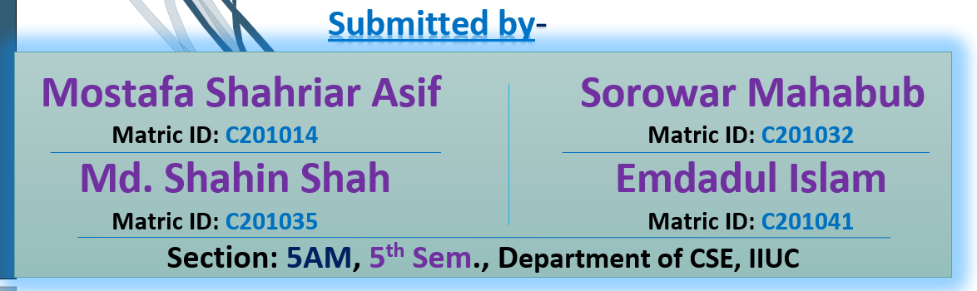
Assignment’s Topics are:
An overview of
a. Intel 80186, b. Intel 80286, c. Intel 80386,
d. Intel 80486, and e. Pentium microprocessor; f. Advanced microprocessor:
i. Embedded microprocessor, ii. Bit slice microprocessor,
iii. Arithmetic processor, iv. Multitasking,
v. Itanium, and Merced Microprocessor
Page- 02

Slide 3
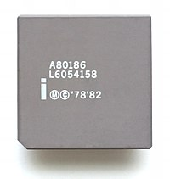
An overview of Intel 80186
The Intel 80186 is an improved version of the 8086 microprocessor.
80186 is a 16-bit microprocessor with a 16-bit data bus and
a 20-bit address bus. It has a programmable peripheral device
integrated into the same package. The instruction set of the 80186 is a superset of the instruction set of the 8086. The term super-set means that all of the 8086 instructions will execute properly on an 80186, but the 80186 has a few additional instructions. The CPU is divided into seven independent functional parts are-
The Bus Interface Unit (BIU)
Execution Unit (EU)
Clock Generator
Programmable interrupt controller
Programmable Chip Select Unit (CSU)
Programmable DMA Unit
Programmable counter/timers
Click Here to Read More
Page- 03

Slide 4
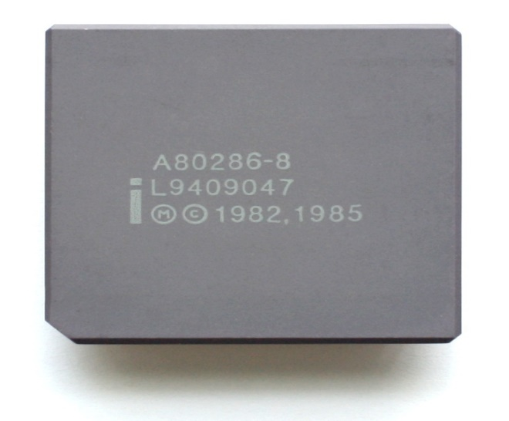
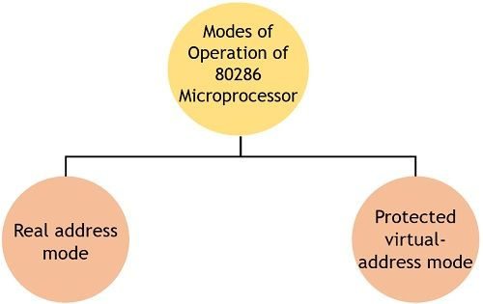
An overview of Intel 80286 (Part-01)
The second generation of x86 16-bit processors, Intel 80286,
was released in 1982. The major new feature of the 80286 mic-
roprocessor was protected mode. When switched to this mode,
the CPU could address up to 16 MB of operating memory (previous generation of 8086/8088 microprocessors was limited to 1 MB). In the protected mode it was
possible to protect memory and
other system resources from user
programs - this feature was neces-
sary for real program multitasking.
Page- 04

Slide 5

An overview of Intel 80286 (Part-02)
Now the question arises what are the factors that make 80286 more advantageous than 8086 microprocessor?
It has non-multiplexed address and data bus that reduces operational speed.
The addressable memory in case of 80286 is 16 MB.
It offers an additional adder for address calculation.
80286 has faster multipliers that lead to quick operation.
The performance per clock cycle of 80286 is almost twice when compared with 8086 or 8088.
Click Here to Read More
Page- 05

Slide 6
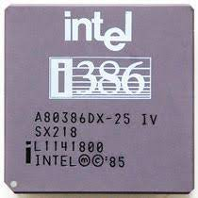
An overview of Intel 80386
The 80386 was a family of 32-bit 3rd-generation x86 microprocessors
introduced by Intel in 1985 as a successor to 80286. These processors
provided were fully backwards compatible with previous generations
of x86 processors but introduced a number of major new features including enhancements to protected mode and virtual 8086 mode.
Features of 80386
As it is a 32-bit microprocessor. Thus has a 32-bit ALU.
80386 has a data bus of 32-bit.
It holds an address bus of 32 bit.
It supports physical memory addressability of 4 GB and virtual memory addressability of 64 TB.
80386 supports a variety of operating clock frequencies, which are 16 MHz, 20 MHz, 25 MHz, and 33 MHz
It offers 3 stage pipeline: fetch, decode and execute. As it supports simultaneous fetching, decoding, and execution inside the system.
Click Here to Read More
Page- 06

Slide 7
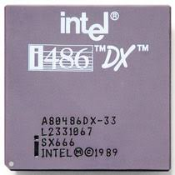
An overview of Intel 80486
A computer processor developed by Intel as an upgrade to the 386
processor series and commonly referred to as the 486 or i486. The
80486 has k of memory cache built into the processor with 32-bit
data bus architecture and was available in clock rates ranging from 20 MHz to 33 MHz. The picture is an example of the Intel i486 SX processor with the Overdrive socket.
Features of 80486
It has complete 32-bit architecture which can support 8-bit, 16-bit and 32-bit data types.
Intel 80486 operates at much faster bus transfers.
This processor retains all complex instruction sets of 80386, and more pipelining has been intro­duced to improve performance in speed.
Power management and System Management Mode (SMM) of 80486 became a standard feature of the processor.
Click Here to Read More
Page- 07

Slide 8
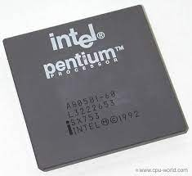
An overview of Pentium Microprocessor
Pentium Microprocessor is one of the powerful family members of Intel’s
Χ86 microprocessor. It is an advanced superscalar 32-bit microprocessor,
introduced in the year 1993 that contains around 3.1 million transistors.
It has a 64-bit data bus and a 32-bit address bus that offers 4 Gb of physical memory space. While the maximum clock rating offered is around 60 to 233 MHz.
Features of Pentium Microprocessor
Superscalar architecture
Separate data and instruction caches
Bus cycle pipelining
Execution tracing
64-bit data bus
Internal parity checking
Dynamic branch prediction
Dual processing support
Performance monitoring
Super fast
Click Here to Read More
Page- 08

Slide 9
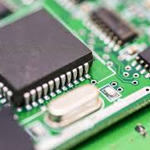
An overview of Embedded Microprocessor (P-01)
An embedded microprocessor is a computer chip used inside several
devices and equipment's to provide added functionality. A microprocessor
is a digital-electronic component with transistors integrated on a single
semiconductor IC that is small and consumes less power. Due to flexibility, cost, programmability and adaptability microcontrollers are popular to implement various types of controllers that we know from the electronics history. The functions of the microprocessor include fetching, decoding and processing the data.
Its importance includes:
Handling many functions like calculations and word processing at higher speeds
Performing operations for the repetitive, continuous, progressive and sequential functions without human labor
Communicating with the internet, telephones and other interfacing devices
Page- 09

Slide 10
An overview of Embedded Microprocessor (P-02)
Types of Microprocessors:
A microprocessor chip is built by using semiconductor devices wherein thousands of transistors are integrated into a single chip for better performance. The major microprocessor’s parts include:
ALU (Arithmetic Logic Unit)
Memory unit
Control Unit
Registers
System Bus
The classification of embedded-microprocessor depends on several factors like computing performance, availability of memory, type of application, etc., and some of these microprocessors include:
Complex instruction set microprocessors
Reduced instruction set microprocessors
Superscalar microprocessors
Application specific integrated circuit (ASIC)
Digital signal microprocessors (DSPs)
Click Here to Read More
Page- 10

Slide 11
An overview of BSM Microprocessor
A bit-slice microprocessor (BSM) is a microprocessor designed as a module with the primary purpose of being able to assemble multiple identical such microprocessors to form a larger processor of some desired word size. Bit-slice microprocessors can be cascaded to produce any conventional (e.g. 4-bit, 8-bit, 16-bit) as well as unconventional word sizes (e.g. 10-bit, 12-bit, 18-bit). A notable advantage of a BSM over discrete logic components is the fact that most connections are internal to the chip with only few connections being external.
Bit-slice microprocessors are the answer to the prayer of the engineer who needs to build a computer with greater power than that offered by today's microprocessors at a cost comparable with microprocessor systems
Page- 11

Slide 12
An overview of Arithmetic Processor
A processor if devoted exclusively to arithmetic functions can be used to implement a full variety of arithmetic functions in hardware at a relatively low cost. This can be done in a single Integrated Circuit. So a special purpose arithmetic processor for performing only arithmetic operations can be constructed. This processor physically may be separate however can be utilized by CPU to execute complex arithmetic instructions. Please note in the absence of arithmetic processors these instructions can be executed using slower software routines by the CPU itself. So this auxiliary processor improves the speed of execution of programs having several complex arithmetic computations.
An arithmetic processor also assists in reducing program complexity as it provides a richer instruction set for a machine.
Page- 12

Slide 13
An overview of Multitasking Processor (P-01)
In computing, multitasking is a method by which multiple tasks, also known as processes, share common processing resources such as a CPU. With a multitasking OS, such as Windows XP, you can simultaneously run multiple applications. Multitasking refers to the ability of the OS to quickly switch between each computing task to give the impression the different applications are executing multiple actions simultaneously.
As CPU clock speeds have increased steadily over time, not only do applications run faster, but OSs can switch between applications more quickly. This provides better overall performance. Many actions can happen at once on a computer, and individual applications can run faster.
Page- 13

Slide 14
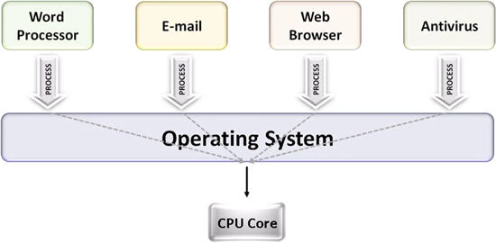
An overview of Multitasking Processor (P-02)
In the case of a computer with a single CPU core, only one task runs at any point in time, meaning that the CPU is actively executing instructions for that task. Multitasking solves this problem by scheduling which task may run at any given time and when another waiting task gets a turn.
Single Core
Page- 14

Slide 15
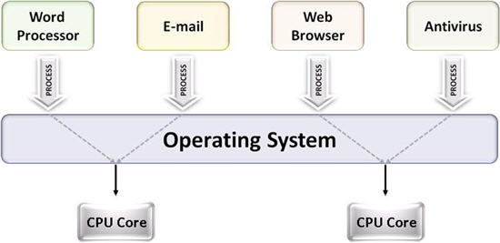
An overview of Multitasking Processor (P-03)
When running on a multicore system, multitasking OSs can truly execute multiple tasks concurrently. The multiple computing engines work independently on different tasks.
For example, on a dual-core system, four applications - such as word processing, e-mail, Web browsing, and antivirus software - can each access a separate processor core at the same time. You can multitask by checking e-mail and typing a letter simultaneously, thus improving overall performance for applications.
Multi Core
Page- 15

Slide 16
An overview of Itanium & Merced Microprocessor
Itanium (the brand name for Merced, which was the original code name) is a 64-bit microprocessor jointly developed by Intel and Hewlett-Packard. Itanium is manufactured with a 0.18-micron process and contains tens of millions of transistors. While Itanium is able to run software written for the x86 processor architecture, it uses a new architecture, officially known as Intel Architecture-64 (IA-64). The name IA-64 refers to the fact that 64 bits of data can be processed during one clock cycle. Other Intel chips are based around a 32-bit architecture. Itanium is a complete 64-bit processor.
Itanium is the first in a series of processors based on the new architecture. Itanium and its successors are being designed to perform comparably to and compete directly with chips such as Sun's UltraSPARC and Compaq's Alpha.
Page- 16

Slide 17
Ending Slide of Assignment
If any mistake found or any update is needed, you’re requested to know us, We’ll update it according to the requirements, In Shaa Allah.
- Sorowar Mahabub, Team Leader, Team bratva
Done & submitted by-
This is The End.
Assalamualaikum Waa Rahmatullah to All, Thank You!
Page- 17

