Slide 1

Dept. Of Computer Science & Engineering
Assignment-01
Of Team Bratva
Course Code: CSE-3523 Course Title: Microprocessor, Microcontrollers & Embedded System
Submitted to-
Md. Safayat Hossen
Assistant Lecturer, Dept. of CSE, IIUC
Cell: 01736161688, safayathossen@iut-dhaka.edu

Slide 2
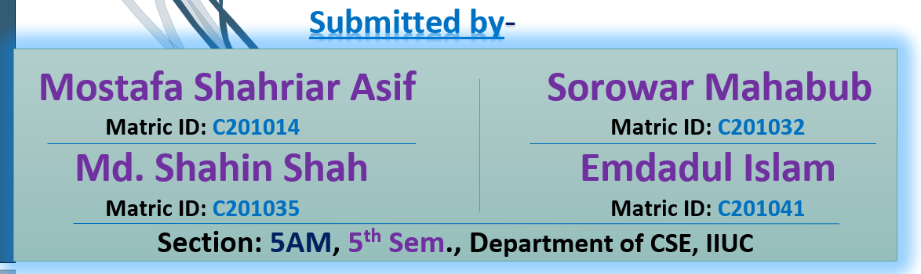
Assignment’s Topics are:
An overview of
a. Intel 80186, b. Intel 80286, c. Intel 80386,
d. Intel 80486, and e. Pentium microprocessor; f. Advanced microprocessor:
i. Embedded microprocessor, ii. Bit slice microprocessor,
iii. Arithmetic processor, iv. Multitasking,
v. Itanium, and Merced Microprocessor
Page- 02

Slide 3
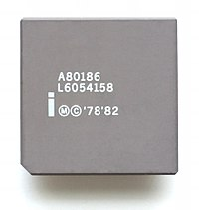
An overview of Intel 80186
The Intel 80186 is an improved version of the 8086 microprocessor.
80186 is a 16-bit microprocessor with a 16-bit data bus and
a 20-bit address bus. It has a programmable peripheral device
integrated into the same package. The instruction set of the 80186 is a superset of the instruction set of the 8086. The term super-set means that all of the 8086 instructions will execute properly on an 80186, but the 80186 has a few additional instructions. The CPU is divided into seven independent functional parts are-
The Bus Interface Unit (BIU)
Execution Unit (EU)
Clock Generator
Programmable interrupt controller
Programmable Chip Select Unit (CSU)
Programmable DMA Unit
Programmable counter/timers
Click Here to Read More
Page- 03

Slide 4
An overview of Intel 80286
The Intel 80186 is an improved version of the 8086 microprocessor.
80186 is a 16-bit microprocessor with a 16-bit data bus and
a 20-bit address bus. It has a programmable peripheral device
integrated into the same package. The instruction set of the 80186 is a superset of the instruction set of the 8086. The term super-set means that all of the 8086 instructions will execute properly on an 80186, but the 80186 has a few additional instructions. The CPU is divided into seven independent functional parts are-
The Bus Interface Unit (BIU)
Execution Unit (EU)
Clock Generator
Programmable interrupt controller
Programmable Chip Select Unit (CSU)
Programmable DMA Unit
Programmable counter/timers
Click Here to Read More
Page- 03

Slide 5
Speed Test of a Moving Object
Features:
Helps in capturing speed of moving object.
Can display the speed of a moving object.
No need of human involvement.
This project can also be used as traffic logger, traffic counter and few other traffic related applications.
Page- 04

Slide 6
Speed Test of a Moving Object
Limitations:
It can’t capture speed of all kinds of moving object, like fan.
It has not any sound system, that tells you the speed.
Future Scope:
In Future, we can add sound system in this project. By adding sound system, it can tell you the speed of a moving object besides showing the speed in display.
Page- 05

Slide 7
Speed Test of a Moving Object
Social Impact:
Have Look at the example:
There are definite rules laid out by authorities about driving cars on roads. The most common rule in any country is speed limit in certain roads i.e., you will be in violation of the law if your car speed exceeds this limit. In that case, one can place the system in one place and view the results (speed) instantly without any human intervention.
Page- 06

Slide 8
Speed Test of a Moving Object
Sensors and Equipment’s:
Arduino Nano R3 x 1
Adafruit Standard LCD - 16x2 White on Blue x 1
Ultrasonic Sensor - HC-SR04 (Generic) x 1
LED (generic) x 1
Resistor 330-ohm x 1
Single Turn Potentiometer- 10k ohms x 1
Some Connecting Wire
Page- 07

Slide 9
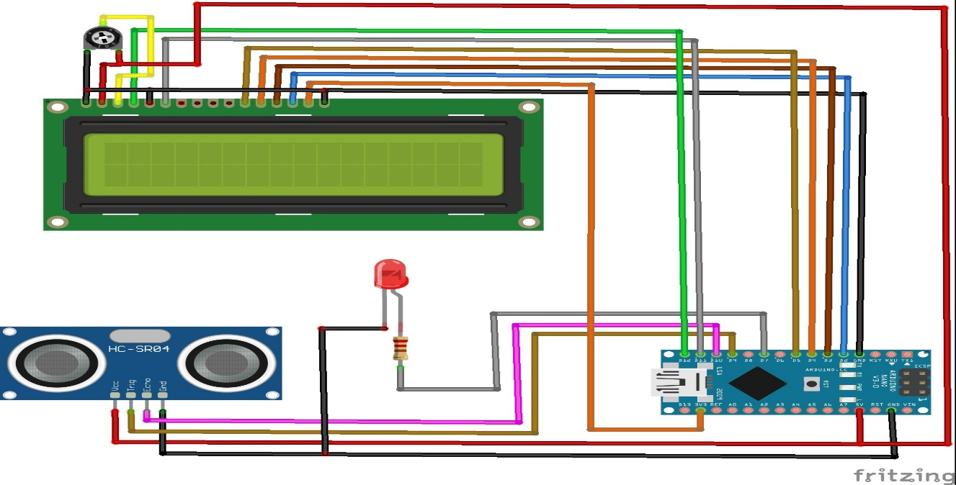
Speed Test of a Moving Object
Circuit Diagram:
Page- 08

Slide 10
Speed Test of a Moving Object
Cost Analysis:
Arduino Nano R3 x 1 -650 TK
Adafruit Standard LCD - 16x2 White on Blue x 1 -250 TK
Ultrasonic Sensor - HC-SR04 (Generic) x 1 - 95 TK
LED (generic) x 1 - 10 TK
Resistor 330-ohm x 1 - 5 TK
Single Turn Potentiometer- 10k ohms x 1 - 30 TK
Here, Our Total Estimated Cost Is 1000 TK To 1200 TK.
Page- 09

Slide 11
Speed Test of a Moving Object
Application:
The goal of measuring speed may vary based on the application-
Including the safer operation of vehicles;
Calculation of power as a product of speed and force;
Evaluation of driver travel routes based on fuel efficiency and travel time;
Fuel level tracking to prevent fuel theft, etc.
This is The End.
Assalamualaikum Waa Rahmatullah to All, Thank You!
Page- 10

