Slide 1
Bangkok Cooling Shelter Dashboard
เขตคลองสามวา
58 locations
Top hotspot district in the current file
Dataset: สรุปจำนวนห้องหลบร้อนจุดหลบร้อน ณ วันที่ 31 มีค 69
Locations 599
Mapped points 592
Coverage 98.83%

Slide 2
Executive summary
Metric | Value
Total locations | 599
Mapped points | 592
Coverage | 98.83%
1. Coverage is high, with only 7 records missing coordinates.
2. เขตคลองสามวา is the largest cluster.
3. District-level analysis is more reliable than subdistrict-level analysis because many rows still omit subdistrict names.

Slide 3
Top districts by location count
เขตคลองสามวา
58 locations
The eastern and outer districts dominate the current inventory.

Slide 4
Subdistrict names and data quality
Metric | Value
Known subdistricts | 183
Missing coordinates | 7
Subdistrict coverage is usable but incomplete. District-level comparisons remain the most stable cut of the dataset for executive reporting.

Slide 5
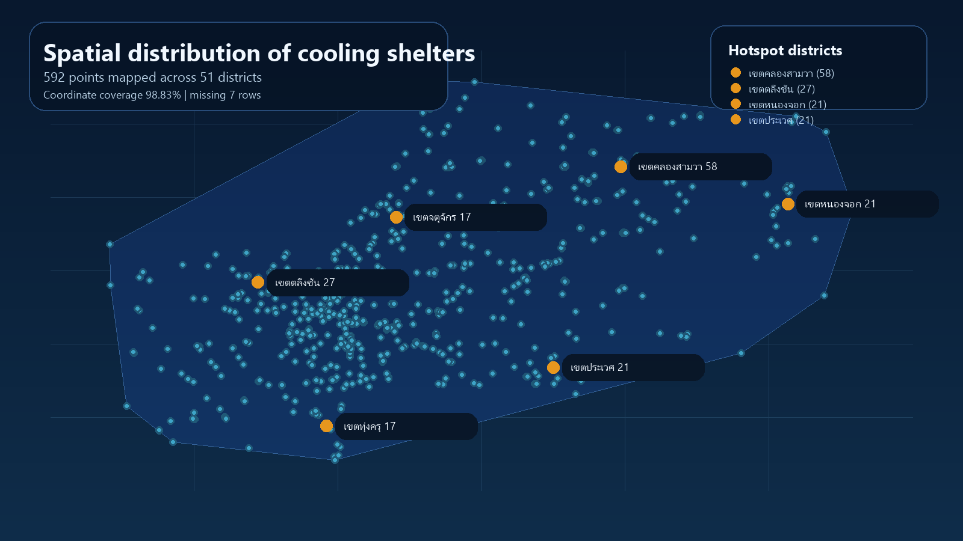
GeoJSON point map
Mapped points 592
Districts 51
GeoJSON markers show broad citywide coverage with stronger clusters in outer districts.
Source: points.geojson rendered from the cleaned spatial dataset.

