Slide 1
piLED
Brandon Wood & Jackson Sorrells

Slide 2
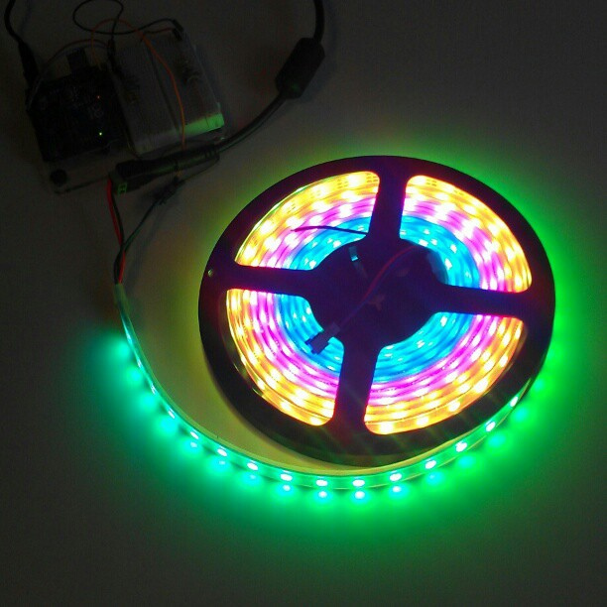
Project Details
Control an LED strip using a raspberry pi
Combination of hardware and software
Build a control interface in the form of an app, script, or website
Multiple lighting modes

Slide 3
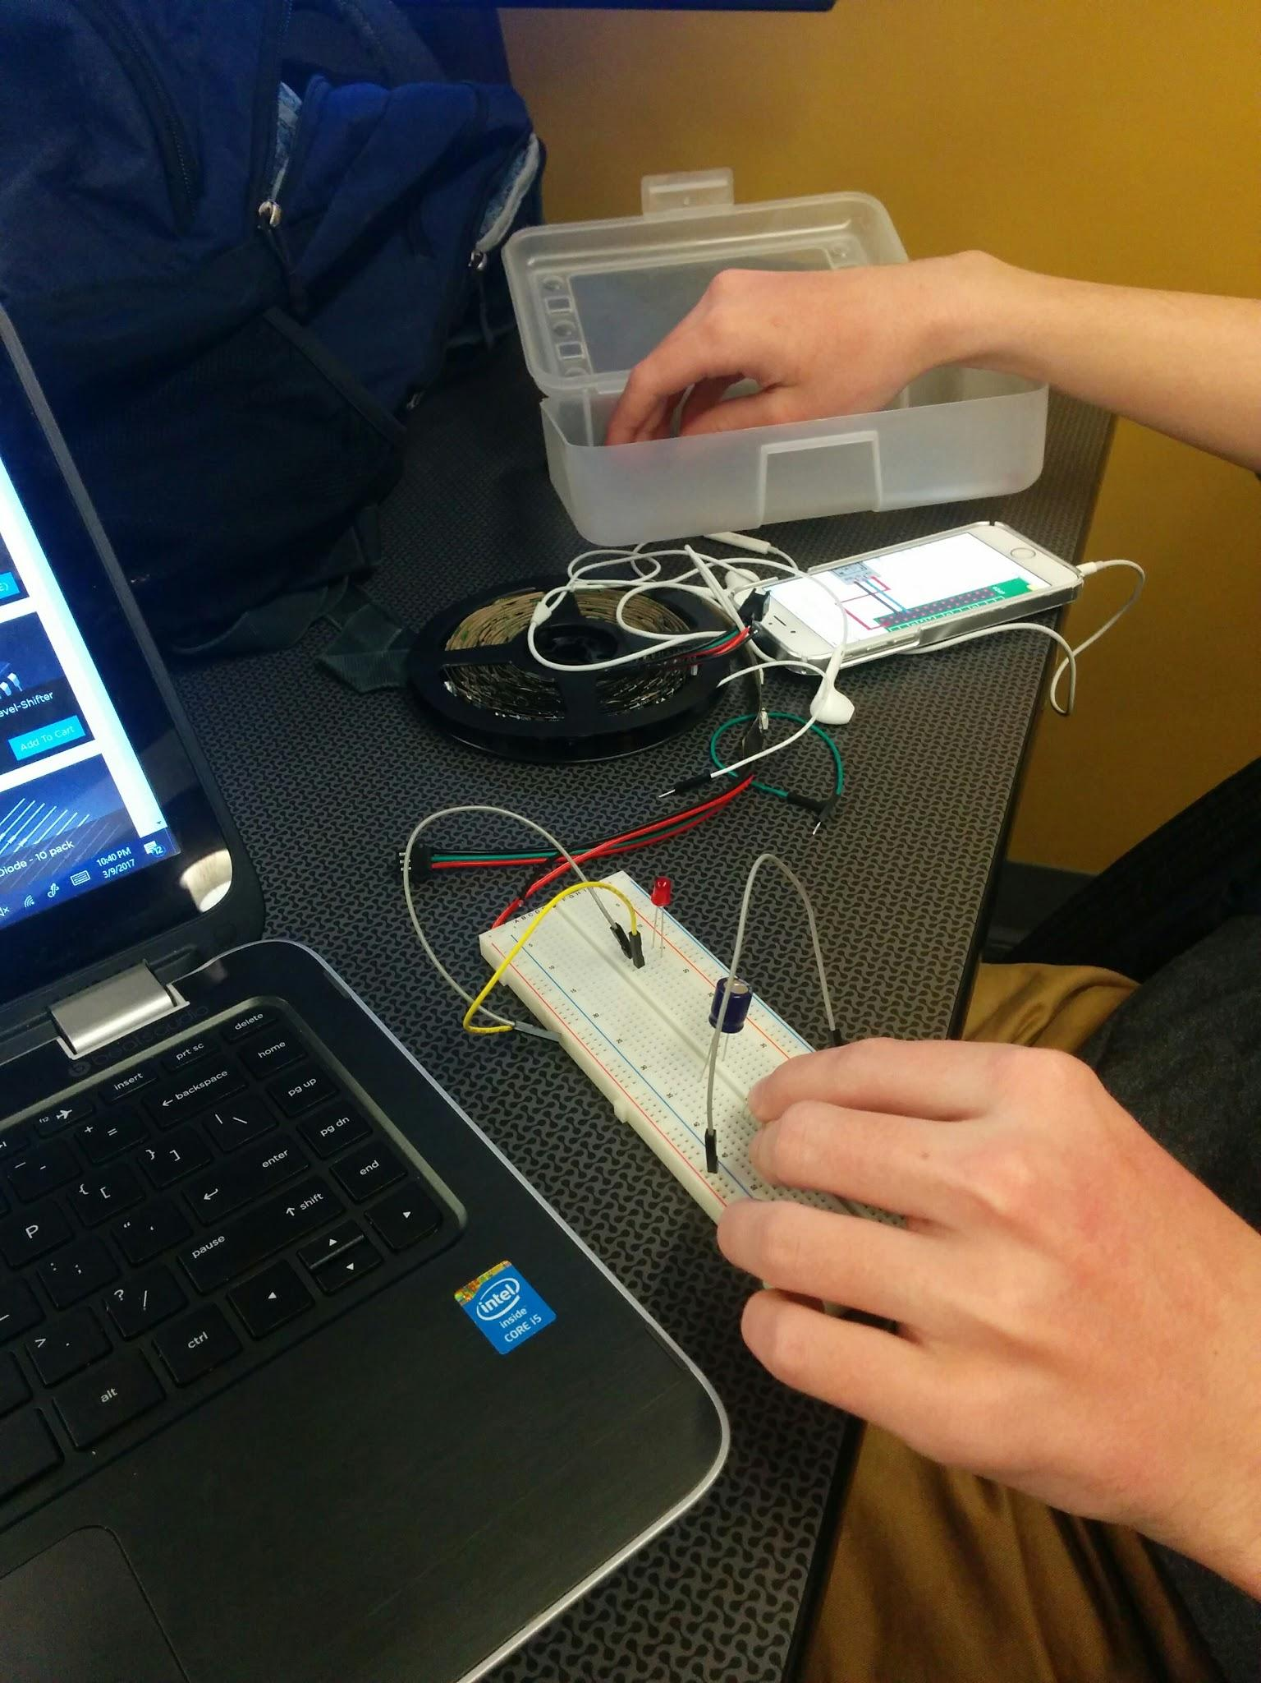
Timeline
Week 1 : Learn basic python
Week 2 : Learn and assemble breadboard control system
Week 3 : Write first control scripts
Week 4 : Write advanced scripts
Week 5 : Finalize scripts and present

Slide 4
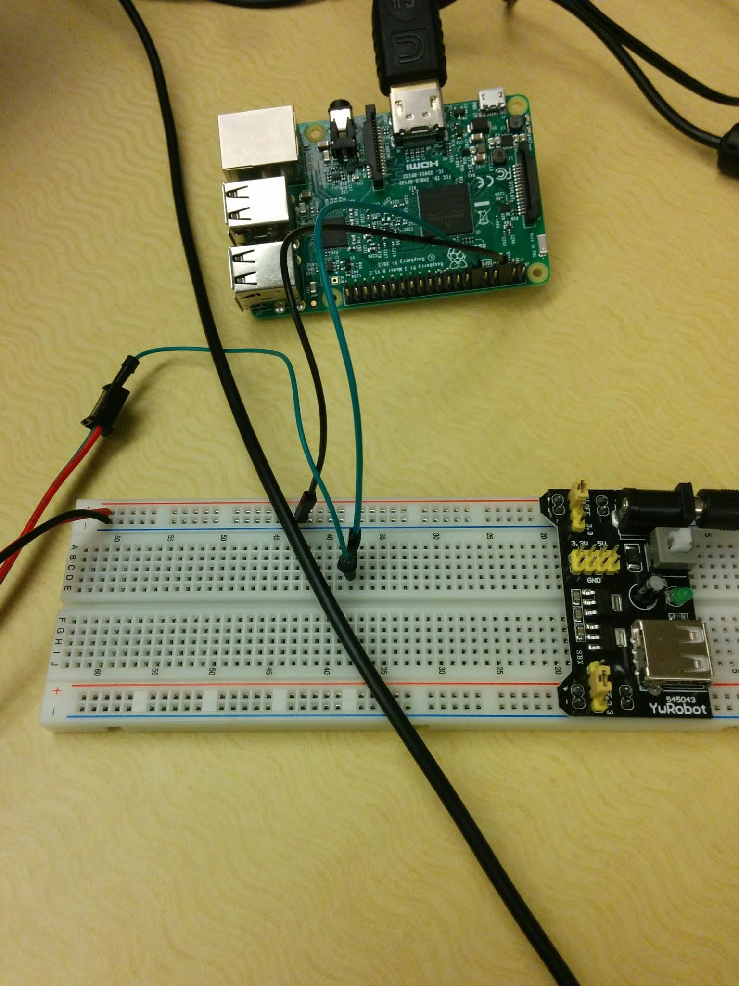
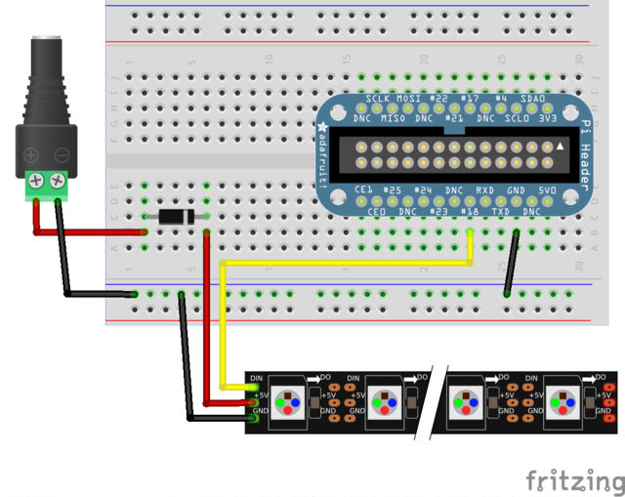
Hardware
Raspberry pi 3
ywRobot 3.5/5v power supply
+ out
- out
DIN (data in)

Slide 5
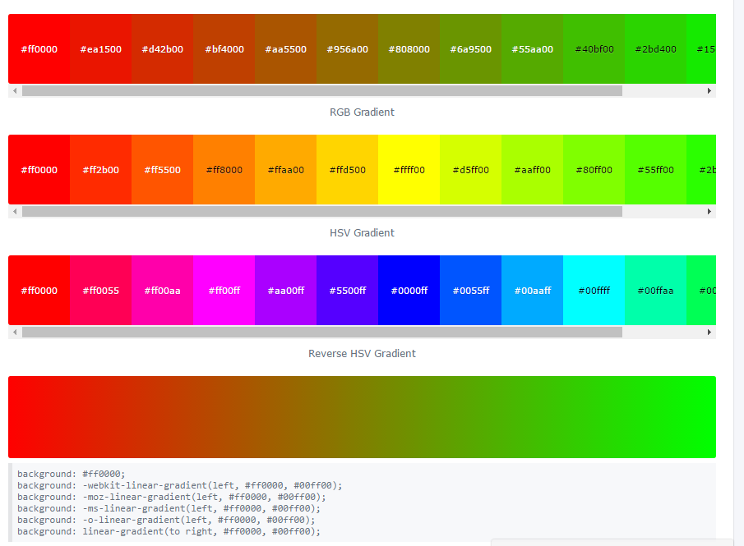
Software/Colors and weather
We used a gradient generator to create RGB color codes
We then assigned color codes to temperatures and weather conditions
Half of LEDS display temp, half display conditions
Constantly running script on pi uses weather api to get information

Slide 6
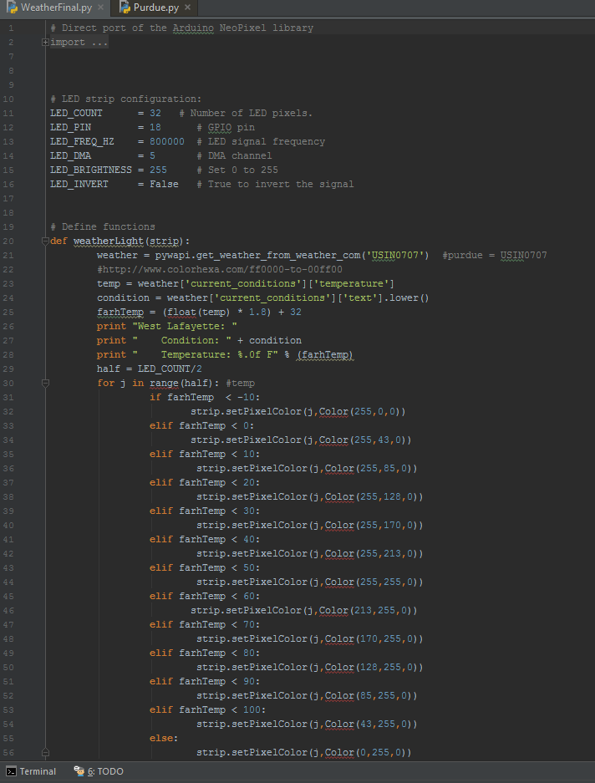
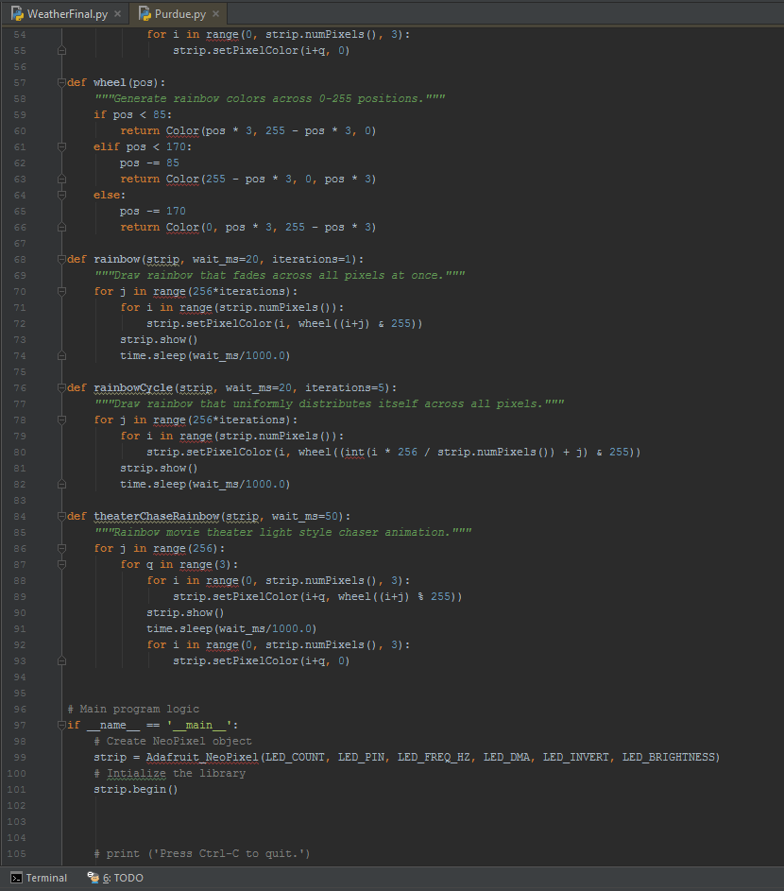

Slide 7
Backup Video

