Slide 1
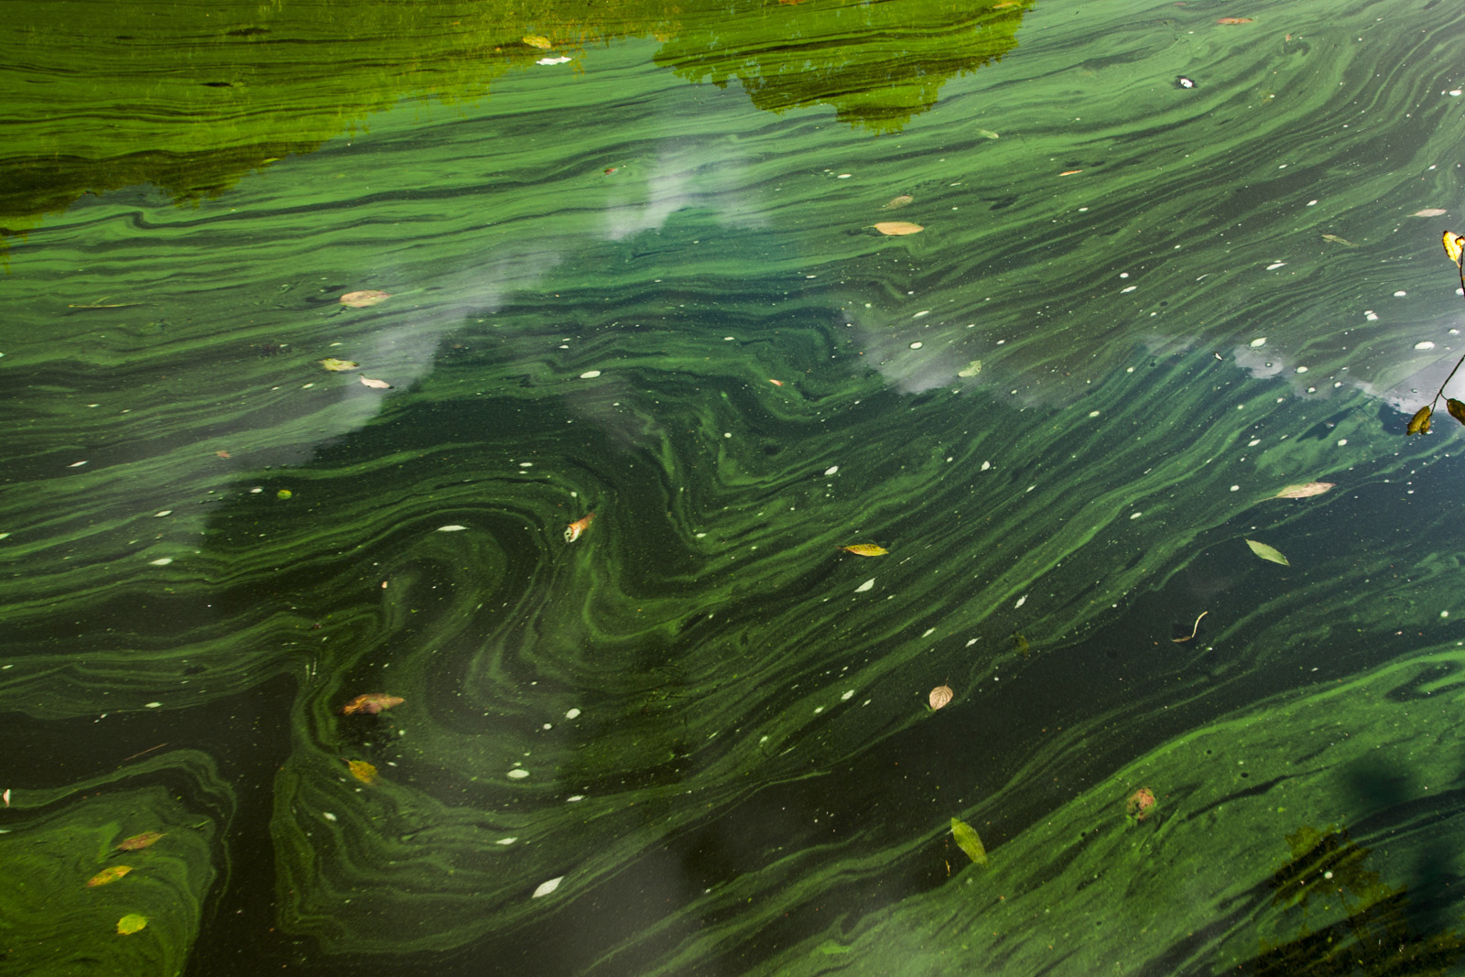

Climate and chlorophyll
A practical bioinformatics project by:
Lina Luettgert
Sorsha Passmore

Slide 2
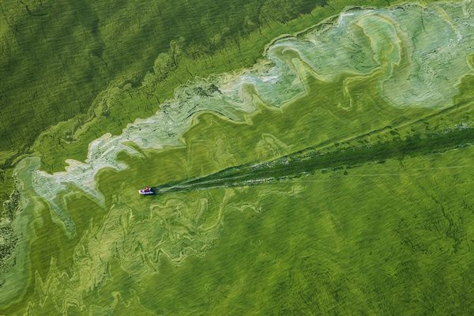
Introduction
Climate and chlorophyll - popular research topic
NOAA databases widely used
Difficult to read, interpret or analyse
Our goals:
Produce easy to follow scripts, codes and functions
Reformat data so it is easy to understand and work with
Create graphs and maps to visualize results
Notes:
We choose climate and chlorophyll as a topic because of how important this subject is and how widely studied it has become especially over recent years.
The most data on the matter is foudn on the NOAA website however we found some of these databases difficult to make sense of
Therefore, in this project, our aim was to create scripts, codes and functions in order to reformat data to understand and work with and then as an extra to create graphs and maps to visualise our results that we wanted to see. Not much data on chlorophyll, mostly satellite data. Which is why we chose gulf of mexico

Slide 3




Approach plan
1. Download and extract database
2.Python for reformatting data
3.R studio for plotting sample points and maps
4. Create GIFs to show results
Notes:
Our approach plan was as follows:
Firstly we were to find the desired database, then downloadit and extract it to jEdit. Once in jEdit, we used it to write up our script but ran it in python to reformat the data.
Thirdly, R studio functions were used to plot sample points using coordinates of longtitude and latitude. These coordinates were also used to create maps in R studio.

Slide 4
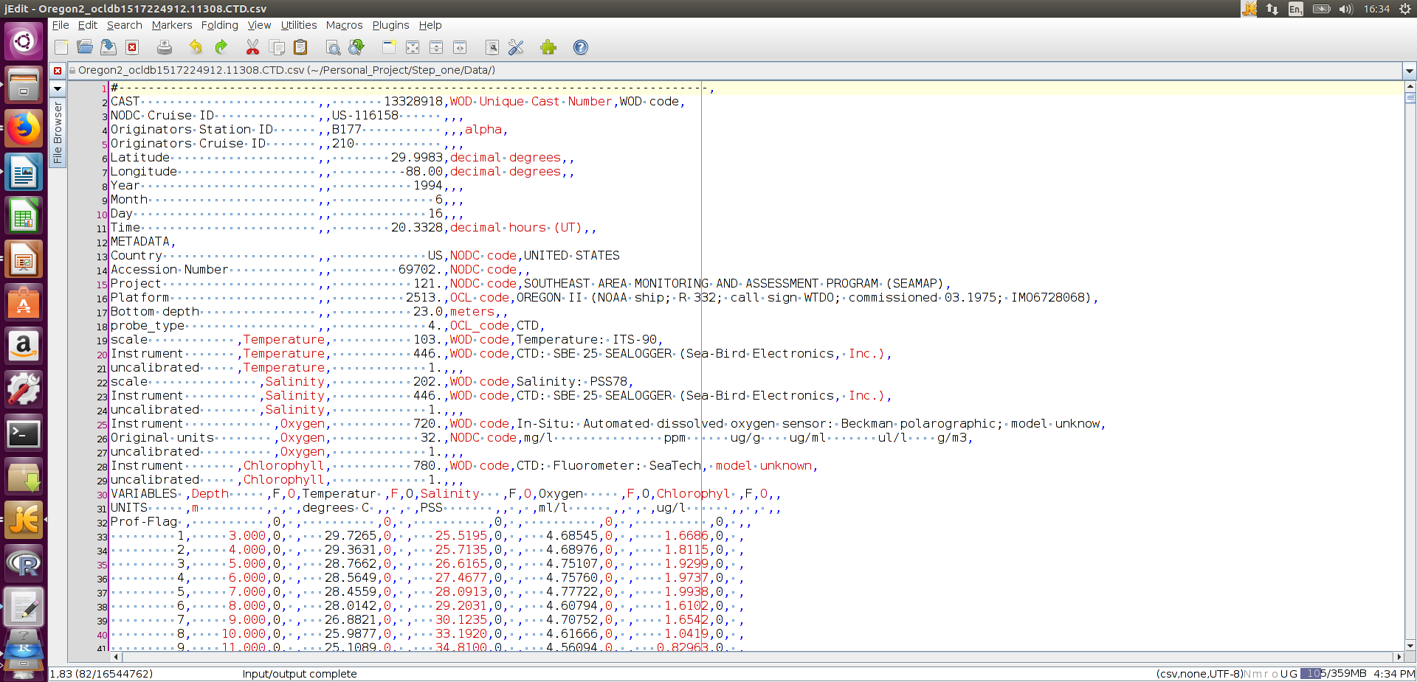
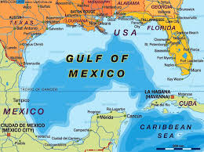
1. Downloading & extracting the database
1994-2008
2943 data points
16.5MB
Notes:
So now we will take you through our presentation step by step
We decided to use the gulf of mexico, well known for its "dead zone" and also because we thought it would be good to practise with a slightly smaller dataset.
Our first step was to download and extract the database
We used the years 1994-2008, which almost added up to 15 years of data
Almost 3000 data points all together
16.5MB.

Slide 5
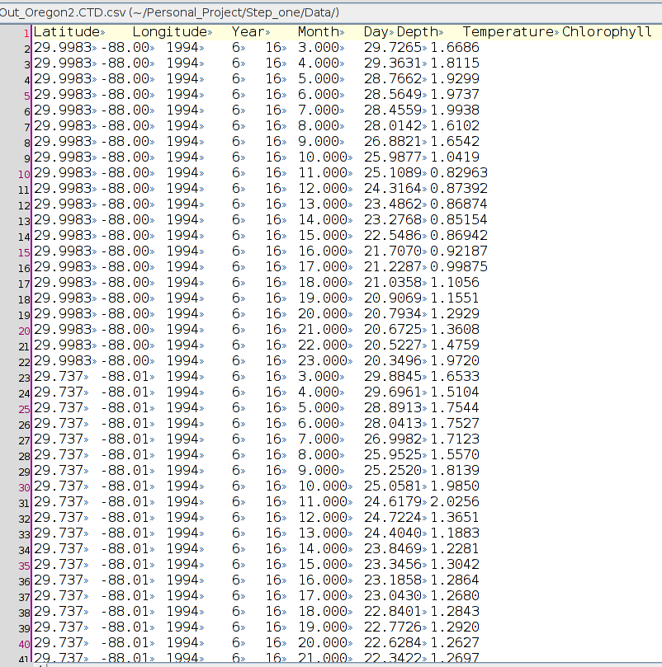
2. Reformatting data
Notes:
Step number two: on the left is an screen shot of the datafile before we reformatted it using python, on the right is an image in the format we much prefer! We thought this way was much easier to make sense of, read, interpret and also analyze statistically.

Slide 6



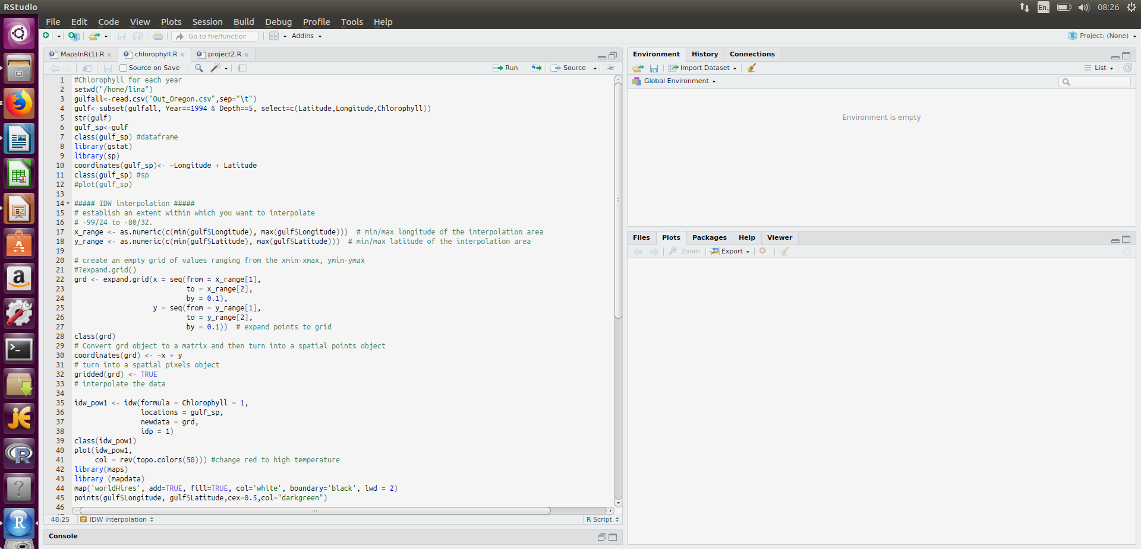
3. Plotting sample points
R studio
Temperature and chlorophyll
Script Coordinates and interpolation on matrix
Maps
Mapsdata
Fields
Png
Notes:
Thirdly, in order to plot sample points we needed to use R studio. We did seperate files for the different variables - temperature and chlorophyll. This is when we encounted our first real problem - installing marmap. We spent a while trying to figure out how to install it because originally we thought we needed to use it. We created our own NETcdf files etc in order to use MARMAP but it did not work until we (with the help of Michael) went throught terminal to install it on R. In the end, we didn't really even use marmap specifically but we did need the package to be installed in order for us to plot our sample points and to create our maps. On the bottom of this slide you can see a section of the script we used to enter the coortdinates and th einterpolation functions for within the matrix.

Slide 7
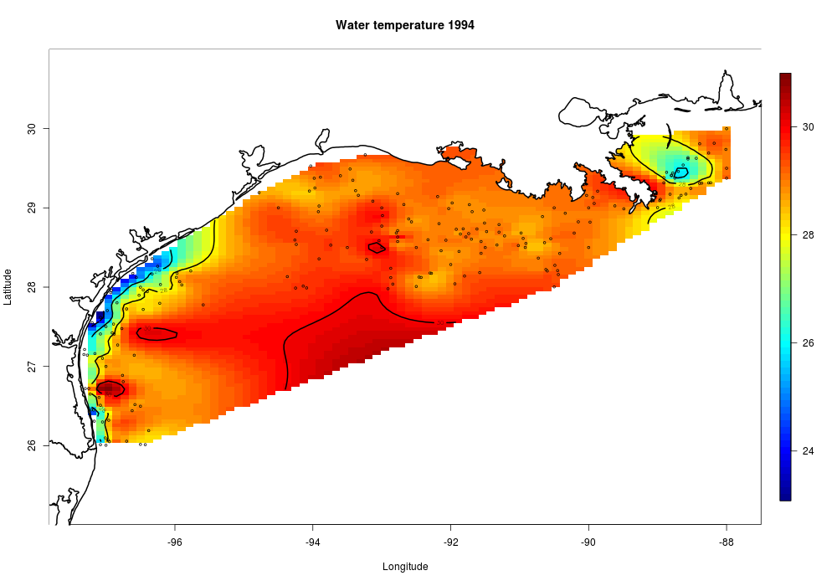
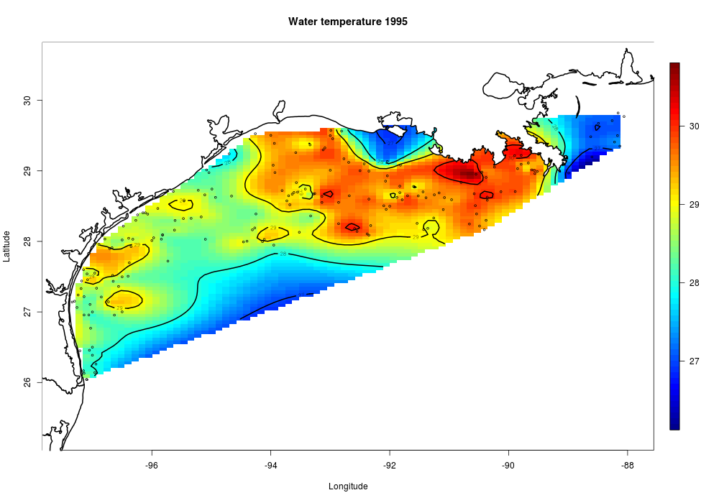
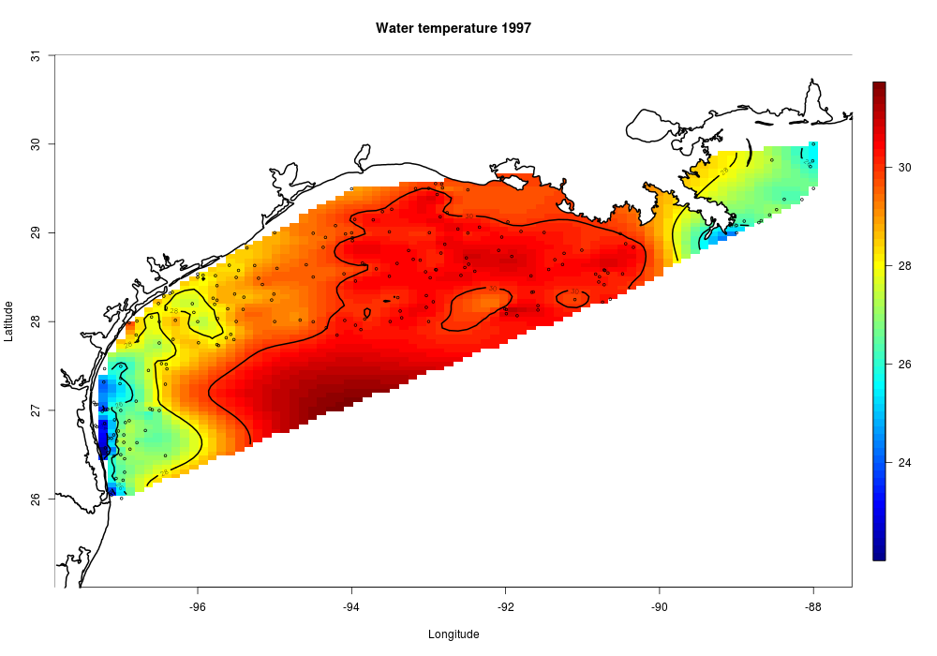
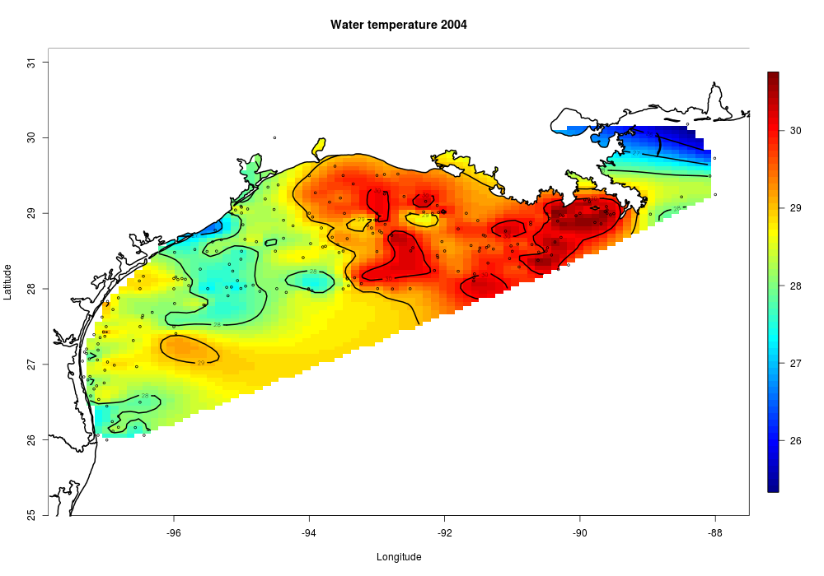
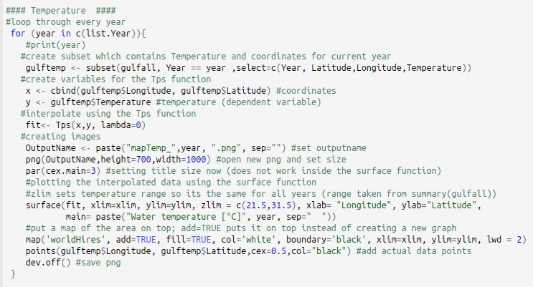
3. Creating maps
Installed necessary packages
Only chose depth '5'
Created 1 map per year
Notes:
Lastly, to create our maps we had to install several more packages on R studio including ggmap, marmap, map, mapdata and so on and so forth. We had to use the 'worldHires' database to get a template of the map we wanted and specified the location by adding longitude and latitude.
Then, as an extra, we wanted to create a GIF to show the differences of temperature and chlorophyll over each independent year - time scale.Many packages, which one?
Only chose

Slide 8
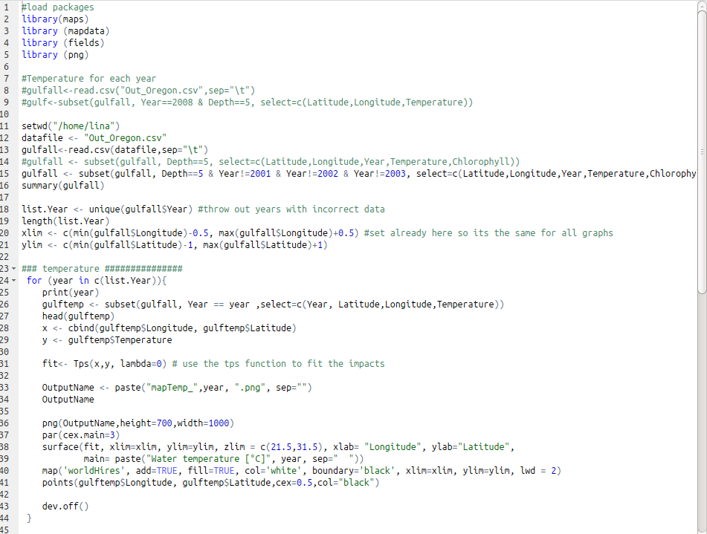
4. Creating GIFs
Issues
Data was entered wrong: '-1000' coordinate
Difficult to create a map for certain years
Skipped the years 2001-2003
Shows how human error can affect databases
Once the problematic years were removed...

Slide 9
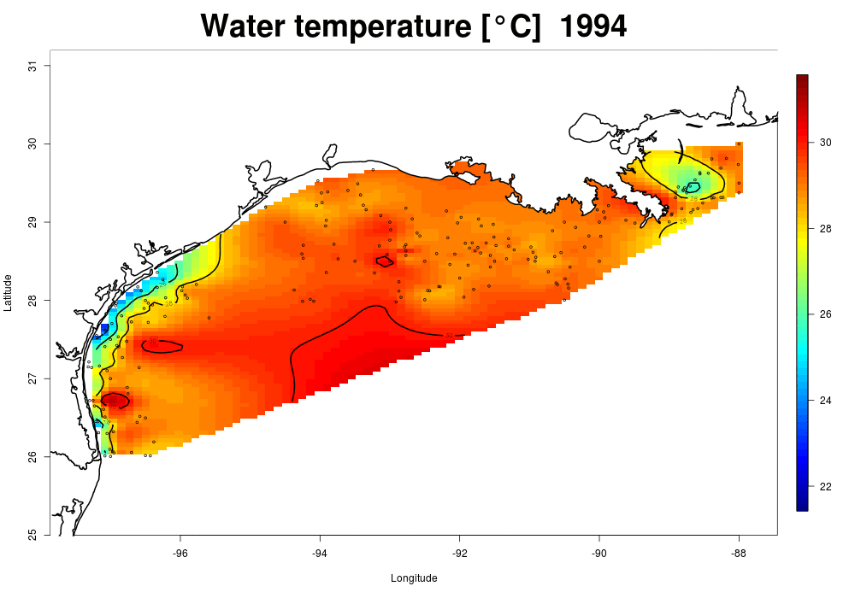
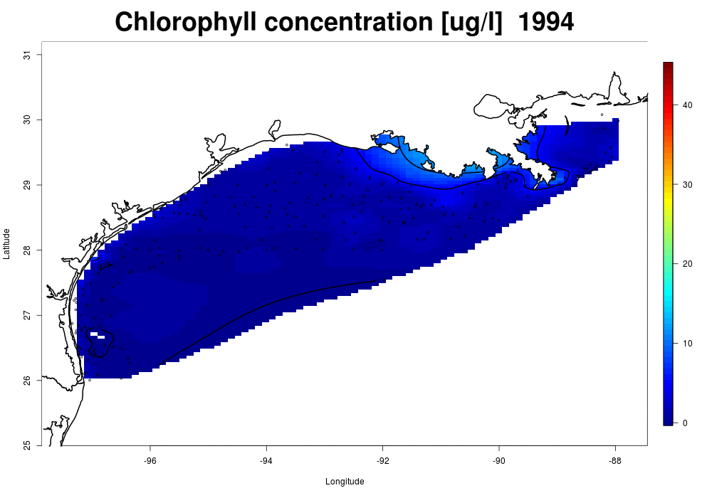
Results

Slide 10
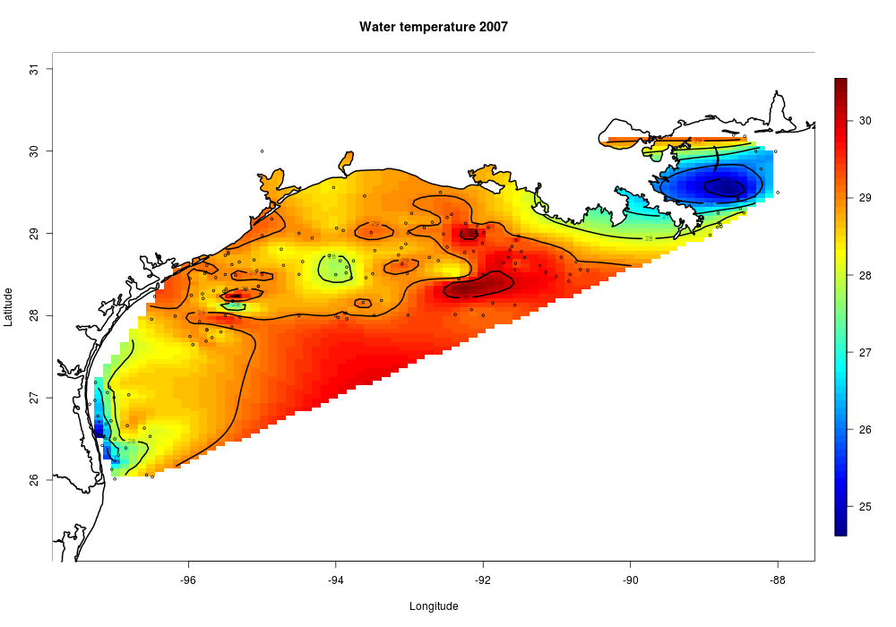
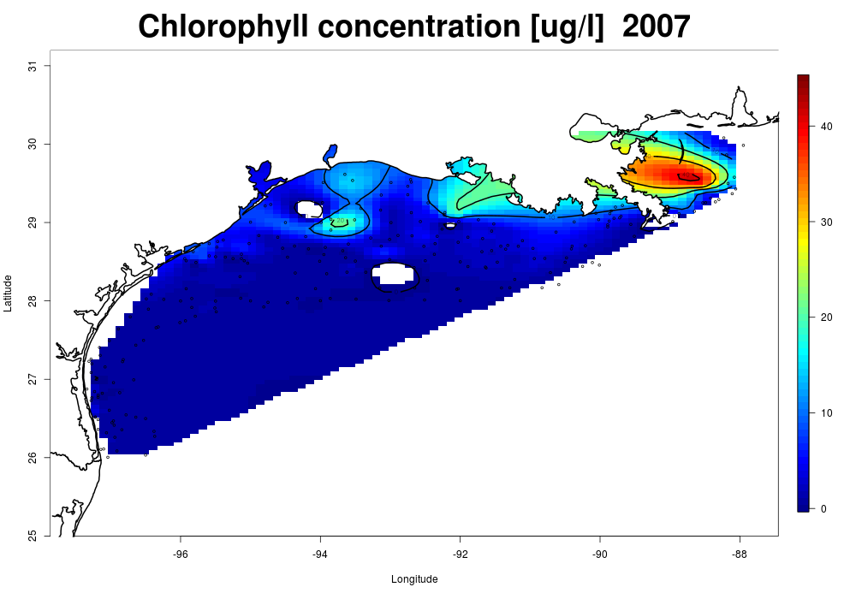
Results and Discussion
Data only over 15 years so difficult to see trend
Towards the end of GIF, chlorophyll and temperature decreased
Zheng and Tang (2007) hypothesised that typhoons may be responsible
Notes:
As it stands, there are a lot of assumptions to be made: so therefore we also included a further research slide

Slide 11

Further Research
We were time limited so if we were to repeat this exercise, we would do:
Statistical analysis
GIFs throughout different seasons
Longer study period
Larger area

Slide 12
Conclusions
Recap of our goals:
We have created a program which is:
Replicable, functional, efficient, easy to manipulate and colourful
Reformat data so it is easy to understand and work with
Produce easy to follow scripts, codes and functions
Create graphs and maps to visualize results

Slide 13
Thanks for listening!
Github link: https://github.com/sorshapassmore/PBfB_Personal_Project.git

