Slide 1


J D COLLEGE OF ENGINEERING & MANAGEMENT, NAGPUR
Secure File Sharing System Using Visual Cryptography and Blockchain
Name: Chintu M. Sorte
Enrolment No.: MC240105CA
Project Guide: Prof. Rohan B. Kokate
Date of Presentation : 05/05/26 Department Name: MCA

Slide 2
J D COLLEGE OF ENGINEERING & MANAGEMENT, NAGPUR
INTRODUCTIONc
Problem Statement
Traditional file sharing systems are vulnerable to data breaches and unauthorized access.
Single-point encryption can be compromised, risking sensitive data.
Objective
To develop a secure file sharing system using Visual Cryptography.
To ensure data privacy by splitting files into multiple shares.
To use Blockchain for integrity and access control.
To provide a reliable and decentralized solution.
Project Idea
The system splits a file into encrypted shares using VC.
Shares are stored securely (IPFS).
Blockchain stores hashes and manages access permissions.
The original file is reconstructed only when valid shares are combined.

Slide 3
J D COLLEGE OF ENGINEERING & MANAGEMENT, NAGPUR
LITERATURE REVIEW
Work | What They Did | What’s Good | What’s Missing (Gap)
Moni Naor & Adi Shamir (1994) | Introduced Visual Cryptography to split images into shares | No decryption needed, very secure | Only works well for images, not full files
Adi Shamir (1979) | Proposed Secret Sharing (SSS) for splitting data mathematically | Strong security model | Needs computation to reconstruct
IPFS | Decentralized file storage using distributed nodes | No single point of failure | Data availability depends on nodes
Ethereum | Smart contracts for secure access control | Tamper-proof and transparent | Cost and scalability issues
Recent Systems | Combine VC + Blockchain + Storage | Better security + decentralization | Complex integration, not optimized

Slide 4
J D COLLEGE OF ENGINEERING & MANAGEMENT, NAGPUR
PROPOSED SYSTEM
The system provides secure file sharing using Visual Cryptography and Shamir’s Secret Sharing.
A file is divided into multiple encrypted shares using a Python-based VC service.
These shares are stored securely and cannot reveal any information individually.
A Node.js backend manages file operations, share handling, and API communication.
PostgreSQL is used as the database to store metadata, user data, and file references.
Authentication is handled using HTTP-only cookies, ensuring secure session management.
Blockchain (smart contracts) is used to store hashes and enforce access control.
The original file is reconstructed only when authorized shares are combined.

Slide 5
J D COLLEGE OF ENGINEERING & MANAGEMENT, NAGPUR
TECHNOLOGIES USED
Frontend: React + TypeScript (Vite + Tailwind CSS)
Backend: Node.js (Express)
VC Service: Python (for share splitting & reconstruction)
Database: PostgreSQL
Authentication: HTTP-only Cookies (session-based auth)
Blockchain: Smart Contracts (Polygon / Ethereum)
Storage (optional based on design): IPFS / Local storage

Slide 6
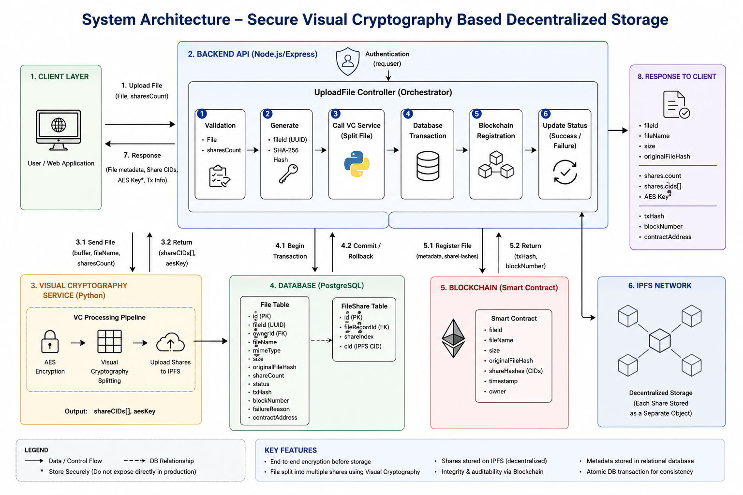
J D COLLEGE OF ENGINEERING & MANAGEMENT, NAGPUR
SYSTEM ARCHITECTURE

Slide 7
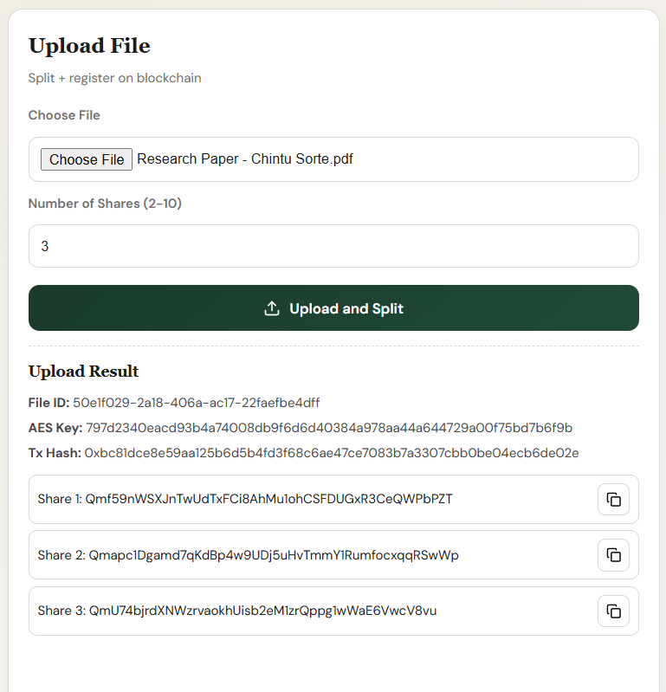
J D COLLEGE OF ENGINEERING & MANAGEMENT, NAGPUR
RESULTS & ANALYSIS
User uploads a file through the frontend interface.
The backend sends the file to the Python VC service.
The file is split into multiple encrypted shares.
Shares are stored securely and metadata is saved in PostgreSQL.
Blockchain stores hash for integrity verification.
Result: File is securely stored in distributed form (not readable individually).

Slide 8
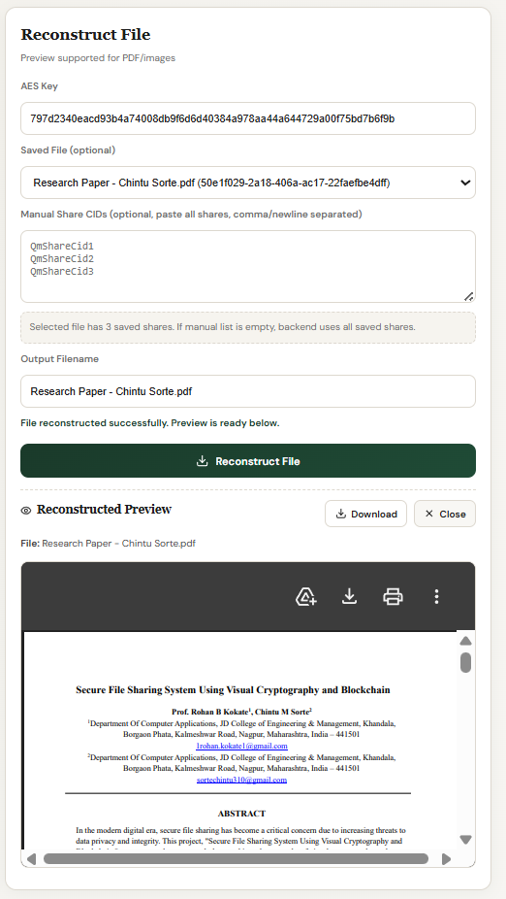
J D COLLEGE OF ENGINEERING & MANAGEMENT, NAGPUR
Authorized user requests the file.
Backend fetches required shares from storage.
Shares are sent to the Python VC service.
The original file is reconstructed using valid shares.
Integrity is verified using blockchain hash.
Result: File is restored accurately only for authorized users.

Slide 9
J D COLLEGE OF ENGINEERING & MANAGEMENT, NAGPUR
PROJECT TIMELINE
Phase | Work Done | Status
Problem Identification | Defined secure file sharing problem and objectives | Completed
Literature Review | Studied Visual Cryptography, Secret Sharing, Blockchain | Completed
System Design | Designed full architecture (Frontend, Backend, VC Service, Blockchain) | Completed
Backend Development | Developed APIs, authentication (HTTP-only cookies) | Completed
VC Service (Python) | Implemented share splitting and reconstruction logic | Completed
Database Setup | Designed schema using PostgreSQL | Completed
Frontend Development | Built user interface using React and TypeScript | Completed
Integration | Connected all components (Frontend, Backend, VC, Blockchain) | Completed
Testing | Performed functional and security testing | Completed
Deployment | Deployed system and finalized documentation | Completed

Slide 10
J D COLLEGE OF ENGINEERING & MANAGEMENT, NAGPUR
REFERENCES
Naor, M., & Shamir, A. (1994). Visual Cryptography. Advances in Cryptology — EUROCRYPT ’94. Springer.
Ateniese, G., Blundo, C., De Santis, A., & Stinson, D. R. (1996). Extended capabilities for visual cryptography. Theoretical Computer Science.
Shamir, A. (1979). How to share a secret. Communications of the ACM.
Blakley, G. R. (1979). Safeguarding cryptographic keys. Proceedings of AFIPS.
Nakamoto, S. (2008). Bitcoin: A Peer-to-Peer Electronic Cash System.
Wood, G. (2014). Ethereum: A Secure Decentralised Generalised Transaction Ledger.
Buterin, V. (2014). A Next-Generation Smart Contract and Decentralized Application Platform.
Benet, J. (2014). IPFS - Content Addressed, Versioned, P2P File System.
Protocol Labs. (2023). IPFS Documentation. Retrieved from https://docs.ipfs.tech

Slide 11
J D COLLEGE OF ENGINEERING & MANAGEMENT, NAGPUR
THANKYOU

