Slide 1
YourForecast StoryBoard
Sonia Ortiz

Slide 2
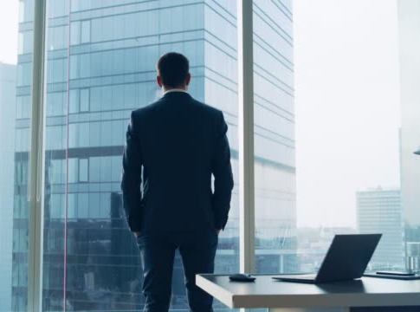
Background
Max is a successful businessman with two kids. He is getting ready to leave for a trip to the new Seattle office and is curious about the weather

Slide 3
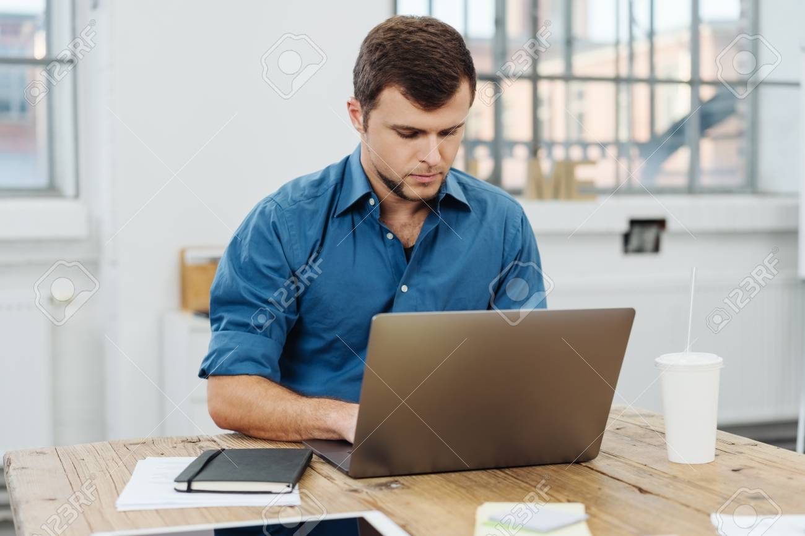
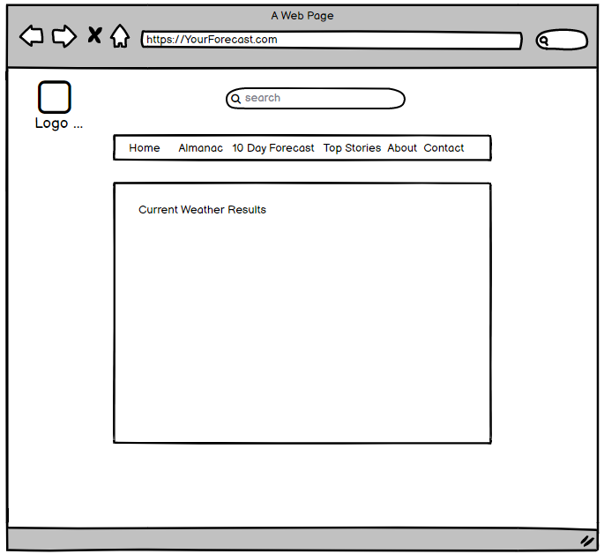
Max sits at his computer and decides he should look at the weather for Seattle to see if he needs to pack a raincoat or umbrella as well as any sweaters
Max navigates to the home screen but notices it doesn’t show what he is looking for
Notes:
Shows MVP

Slide 4
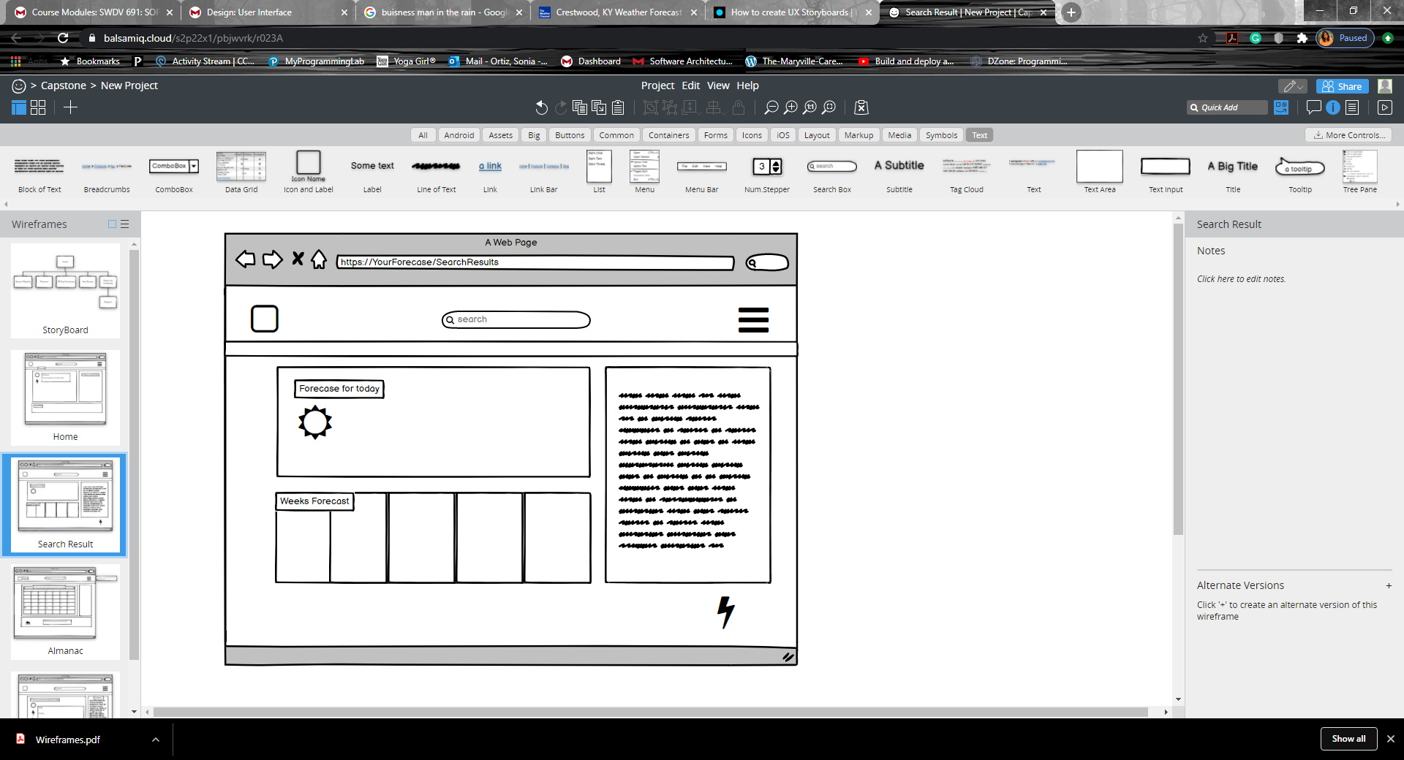
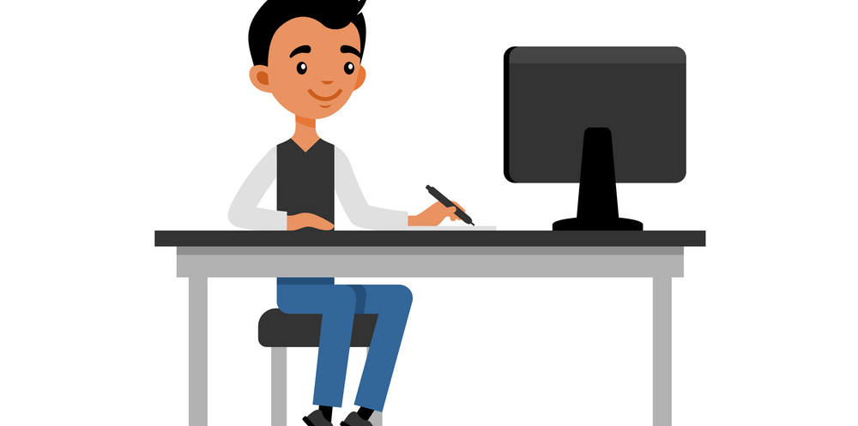
Max decides to search Seattle Washington in the search bar
Max is met with the information about Seattle but needs to look further in the future for when he arrives
Max then navigates to the almanac
*Stretch Feature
Notes:
Stretch features for additional pages

Slide 5
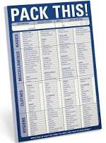
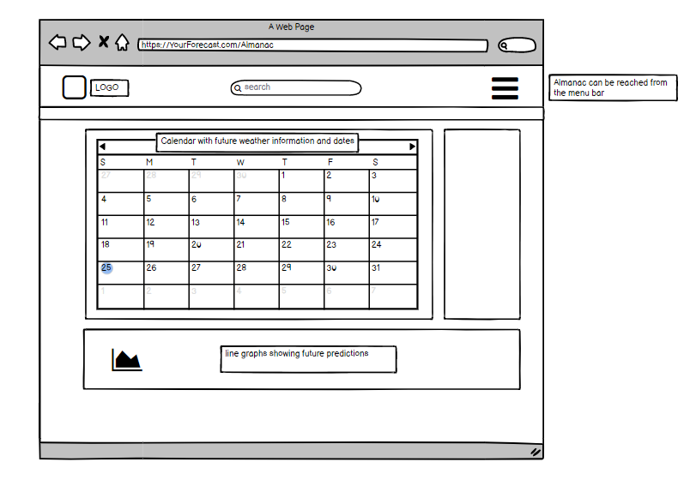
Almanac
The current page will show Max the next month worth of predictive weather. He will also be able to navigate further into the future if he needs to
Max has decided he does in fact need to pack some clothes to stay warm
*Stretch Feature
Notes:
Also stretch feature

