Slide 1
CNL Final project
B05902100 - 馮永輝 B05902101 - 黃千儀 B05902035 - 許國讚 B04902128 - 裵娜娜 B04902127 - 莎蘿柏
Group #11

Slide 2
A survey on the efficiency of SDN-based defense mechanisms against different types of DDoS attacks

Slide 3

Motivation
SDN-based DDoS attack detection techniques have different pros and cons, we want to test their efficiency in a controlled set-up (of 4 different attacks and detection techniques) to get some insights on their overall efficiency.

Slide 4


System Structure
Baseline
Smurf Attack
Entropy
UDP Fragmentation
Mitigation: Drop Packets
Analysis
Connection Rate
TCP SYN Flood
Credit
DNS Amplification

Slide 5



Functions of the project
Set up environment (Mininet, Controller(Pox & Ryu) and OpenFlow Switches)
Cast DDoS Attacks (4 attacks)
Type 1 [Reflection-based flooding]: Smurf Attack
Type 2 [Protocol exploitation flooding]: UDP fragmentation Attack
Type 2 [Protocol exploitation flooding]: TCP SYN Flood Attack
Type 3 [Reflection and amplification-based flooding]: DNS Amplification Attack
Run SDN-Based DDoS attack detection techniques (Minimum 3)
Baseline
Entropy
Credit
Connection Rate
Collect performance data (Wireshark)
Evaluation of data

Slide 6

Introduction of Attacks & Detection Techniques

Slide 7

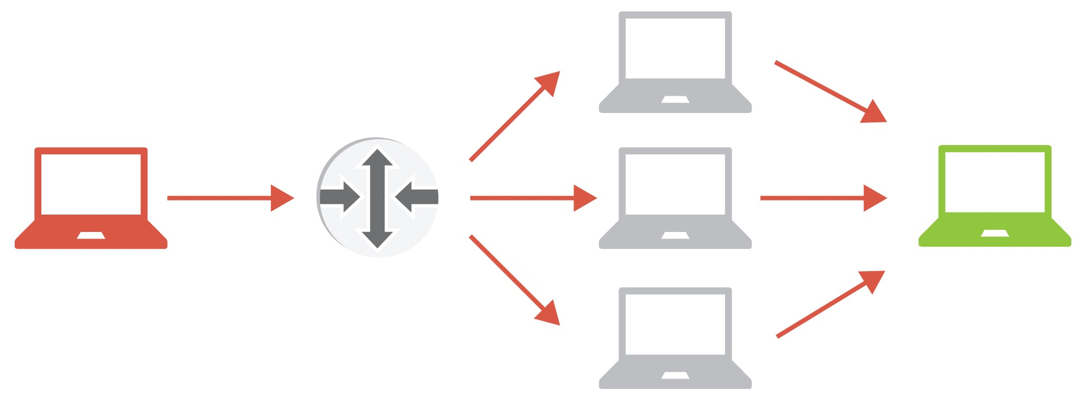
T1 Reflection Based flooding: Smurf Attack
Generate a fake ICMP Echo request with a spoofed source IP.
Each host sends an ICMP response back to the spoofed source address.
By having enough ICMP responses forwarded, host is brought down.

Slide 8


T2 Protocol exploitation flooding: UDP Fragmentation Attack
Transmission of large UDP packets are usually fragmented into many parts and later re-assembled on arrival.
This attack modifies the offset of the fragmented packet, causing the destination host difficulty in re-assembling the packets. Enough fragments will cause the victim host to lose its ability to provide service.

Slide 9
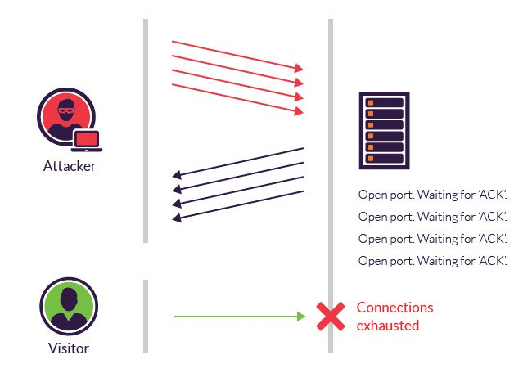
T2 Protocol exploitation flooding: TCP SYN Flood Attack
This attack abuses the three-way handshake by sending TCP connection requests (SYN packets) to every port on a target machine faster than it can process the requests. The server attempts to process the attacker’s fake SYN requests and eventually becomes unresponsive.

Slide 10
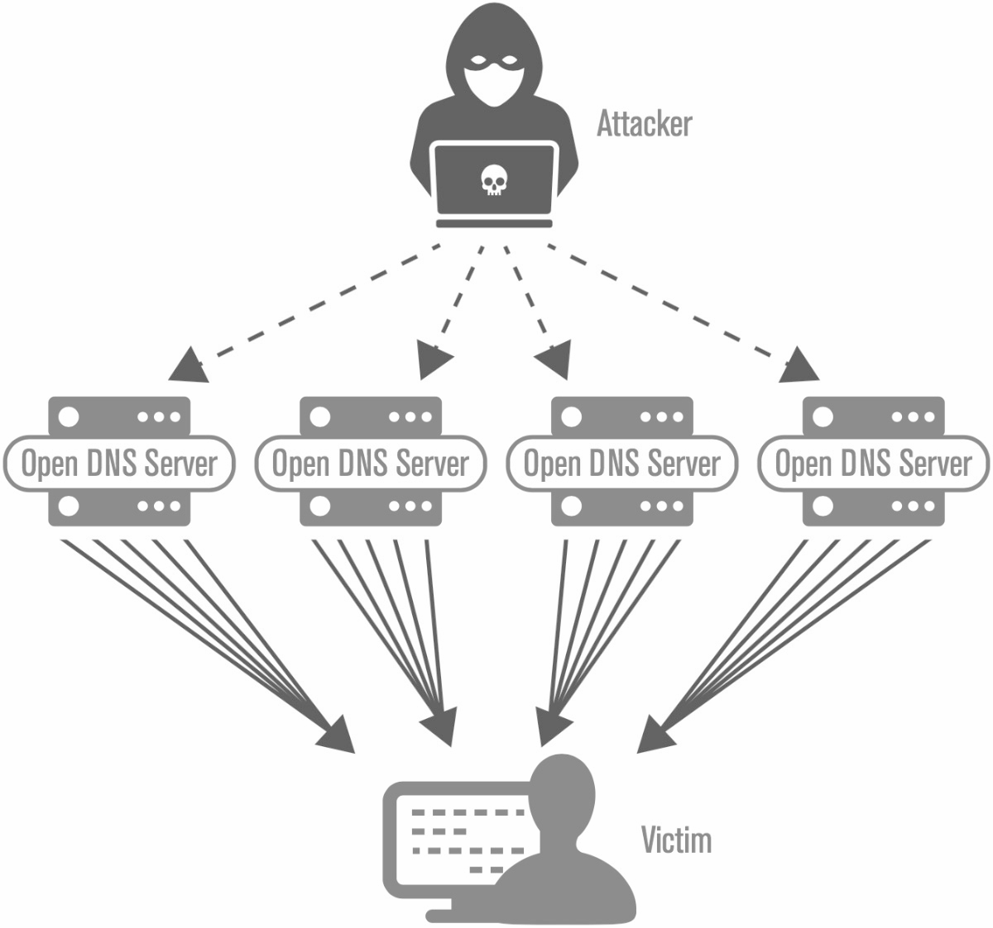
T3 Reflection & Amplification based flooding: DNS Amplification Attack
DNS amplification is an asymmetrical DDoS attack where the attacker sends out a small look-up query with spoofed target IP, making the spoofed target the recipient of much larger DNS responses. With these attacks, the attacker’s goal is to saturate the network by continuously exhausting bandwidth capacity.

Slide 11


Detection Technique: Baseline
Set up a threshold T for the amount of bytes any link can tolerate.
If the incoming flow of bytes surpasses that threshold, block all hosts sending data above this threshold.

Slide 12

Detection Technique: Entropy
Entropy measures randomness in the network.
The higher the randomness the higher the entropy.
Quantify level of randomness by calculating the entropy based on a window size (incoming new packets).
Max entropy → each packet is destined to exactly one host
Min entropy → all the packets in a window are destined for a single host
DDoS Detection: Entropy’s value drops when a large number of packets are attacking one host or a subnet of hosts.

Slide 13


Detection Technique: Connection Rate
When a host wants to connect to another host, it sends a message and waits for a confirmation. While it waits for it, it adds the host to a list of pending connections.
If the size of the list exceeds a certain threshold T, then the host is blocked.
Pending connections

Slide 14

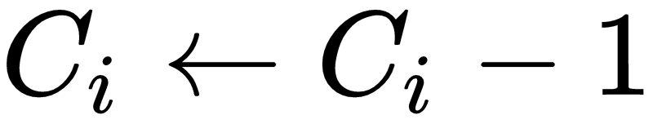
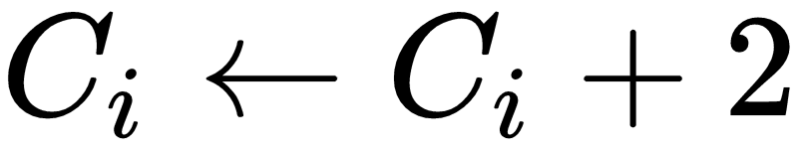

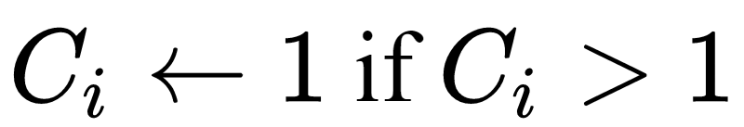
Detection Technique: Credit (TCP specific)
Connection attempts issued by benign hosts are mostly successful, as malicious hosts don’t know what port of what server is available in advance.
Assign credit to hosts and grant flows to hosts with sufficiently high credit.
Initialize credit:
Connection issued:
Connection succeeded:
Every second:
Every 4 seconds:

Slide 15
Detection Technique: DNS Amp Specifics
Emergency: Blackhole all traffic to target.
All the time: Allow few specific DNS known to be safe and change the list from time to time.
Cooperation between networks: Block packets with source ip that doesn’t belong to the network from leaving.
Maybe: Use anycast.

Slide 16
Survey: Flow Behaviour Recognition
Feature Extraction: smaller values indicate attack
Average of Packets per Flow
Average of Bytes per Flow
Average Duration per Flow
Percentage of Paired-Flows
Growth of Single Flows
Growth of Different Ports
Classification: Self Organizing Maps
Random initialization
Competition according to an input
Update neighbors
Repeat till stabalization

Slide 17

Implementation
Run Mininet with simple topology & controller
Run xterm + attack from multiple hosts to a victim host
Run wireshark to verify attack traffic
Demo video: UDPF + Entropy

Slide 18


Results, analysis
& discussion

Slide 19

Results
We present our results with three different criteria in mind:
Success in blocking attacks
RTT relative to pre-Attack and Attack traffics
Overhead of each detection technique

Slide 20

Criteria # 1 - Success in blocking attacks
Attack | Defense | Basic | Entropy | Connection Rate | Credit
Smurf
UDP Fragmentation
TCP flooding
DNS amplification

Slide 21

Criteria # 2 - RTT before/during Attacks
Defense Method | RTT without defense method | RTT before Attack | RTT during Smurf Attack | RTT during UDPF Attack | RTT during TCP Flooding Attack | RTT during DNS amplification
Baseline | 0.0475 | 0.055185 | 0.0331076 | 0.10554 | 0.04426 | 0.03955
Entropy |  | 0.050150 | 0.09384 | 0.073875 | 0.455111 | 0.0856767
Connection Rate |  | 18.694 | 19.7686 | 1146.66921 | 20.624 | 504.51052
Credit |  | 0.05038 | 0.09136 | 0.25310 | 0.090023 | 0.23191
*units: ms

Slide 22
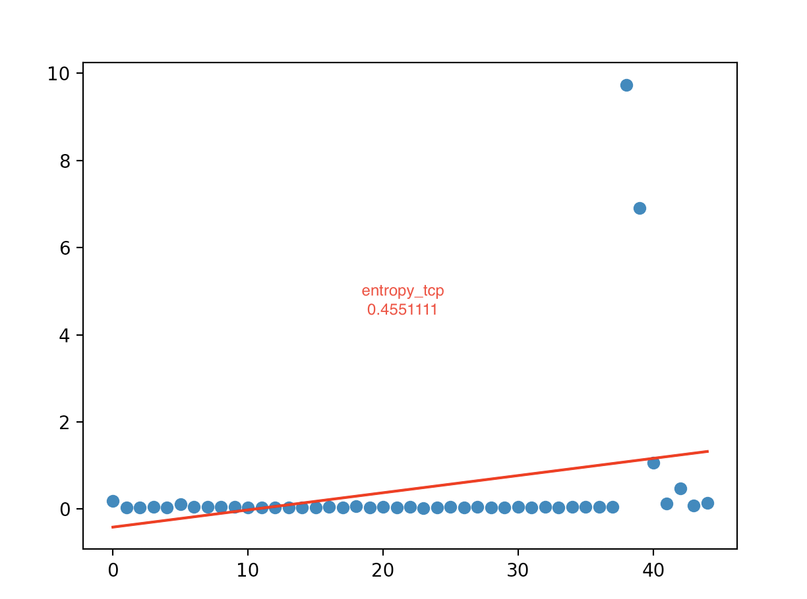
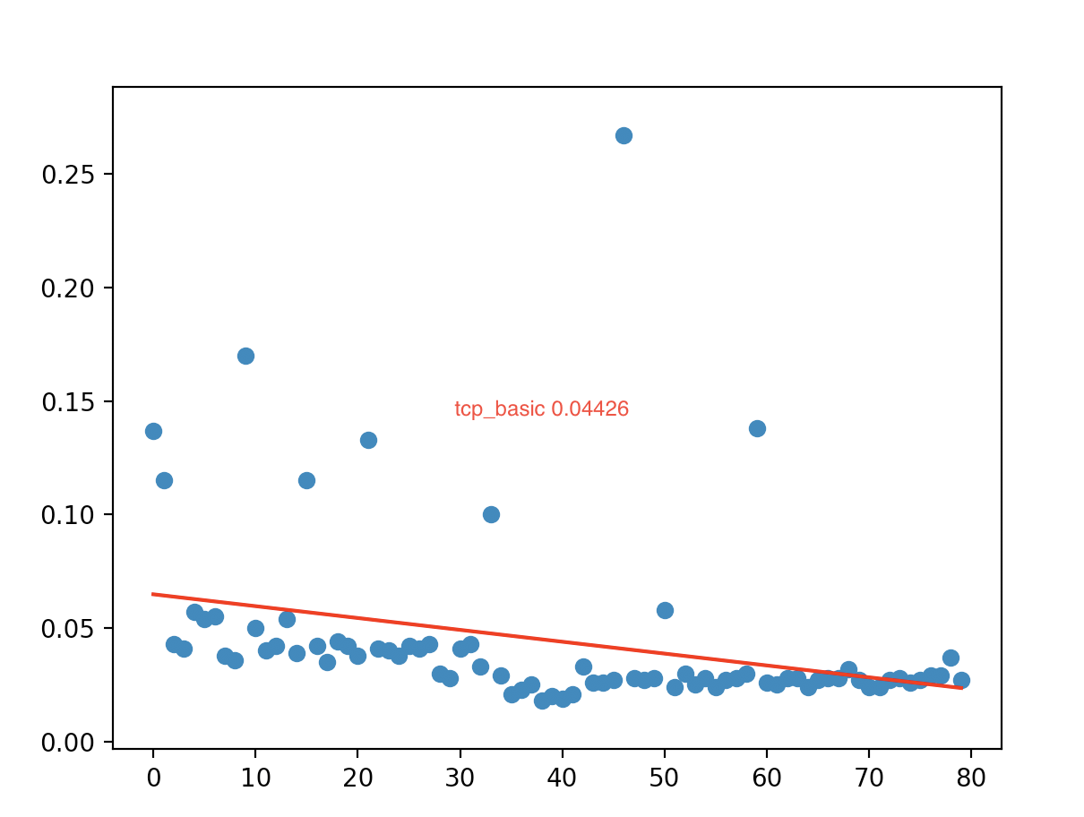
Criteria # 2 - RTT before/during Attacks
*units: ms/ping

Slide 23

Criteria # 3 - Overhead of defenses
Defense Method | Base performance | With defense | Overhead
Baseline | 0.0475 | 0.055185 | 0.007685
Entropy |  | 0.050150 | 0.010150
Connection Rate |  | 18.694 | 18.6465
Credit |  | 0.09 | 0.0425
*units: ms

Slide 24

Analysis
RTT has some variance (±0.02) so minimal differences between RTT measurements should be considered negligible.
Why do so many defenses don’t work for UDP fragmentation? Possible explanation: Fragmented packets are not considered as “real” packets so they don’t trigger a response by the controller.

Slide 25
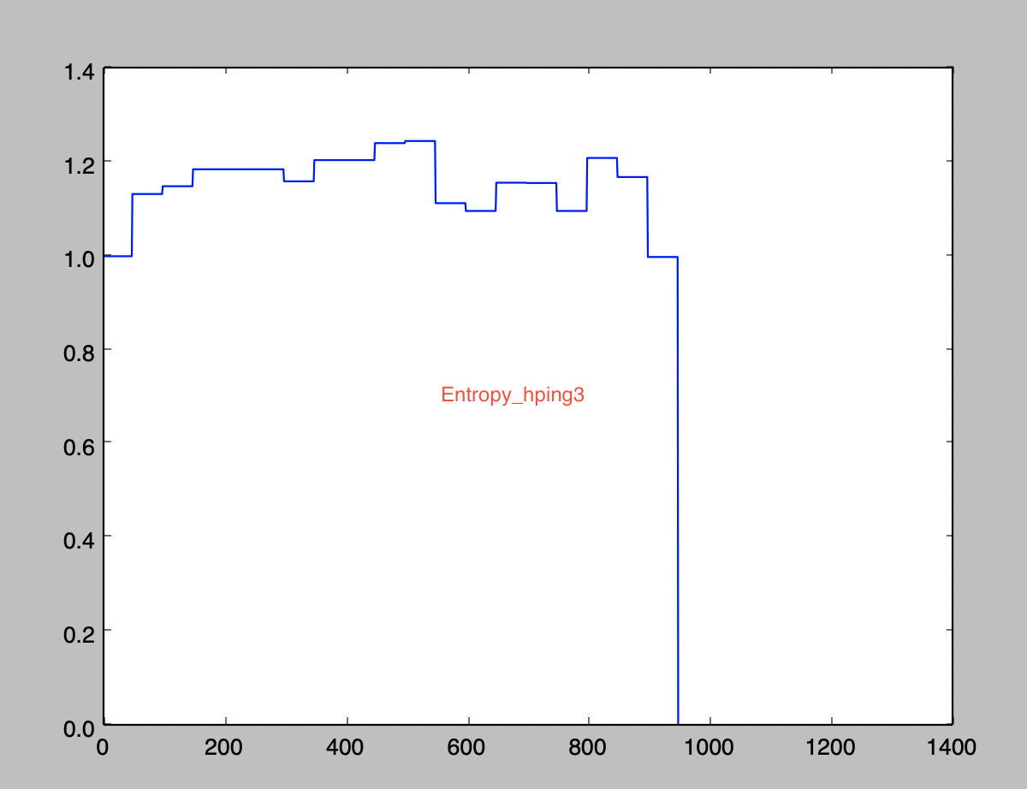
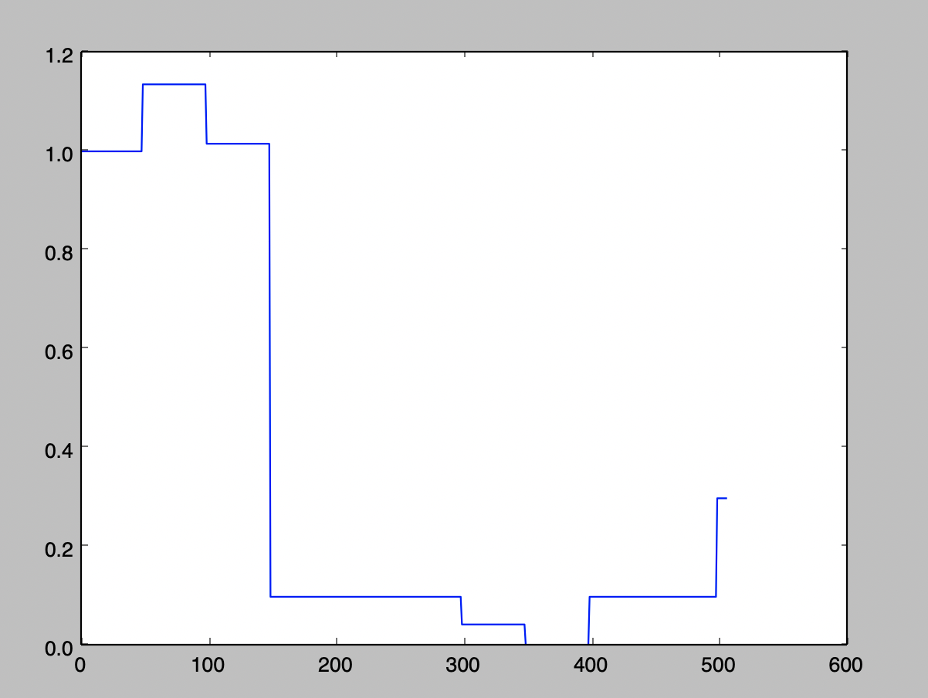

Detection Technique - Entropy
[ TCP SYN Flood ]
[ Smurf Attack]
Normal Traffic
Entropy falling = DDoS
*units: entropy/window

Slide 26
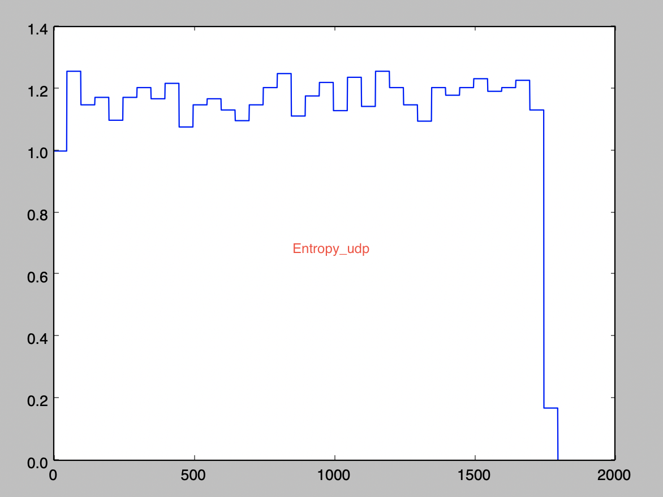
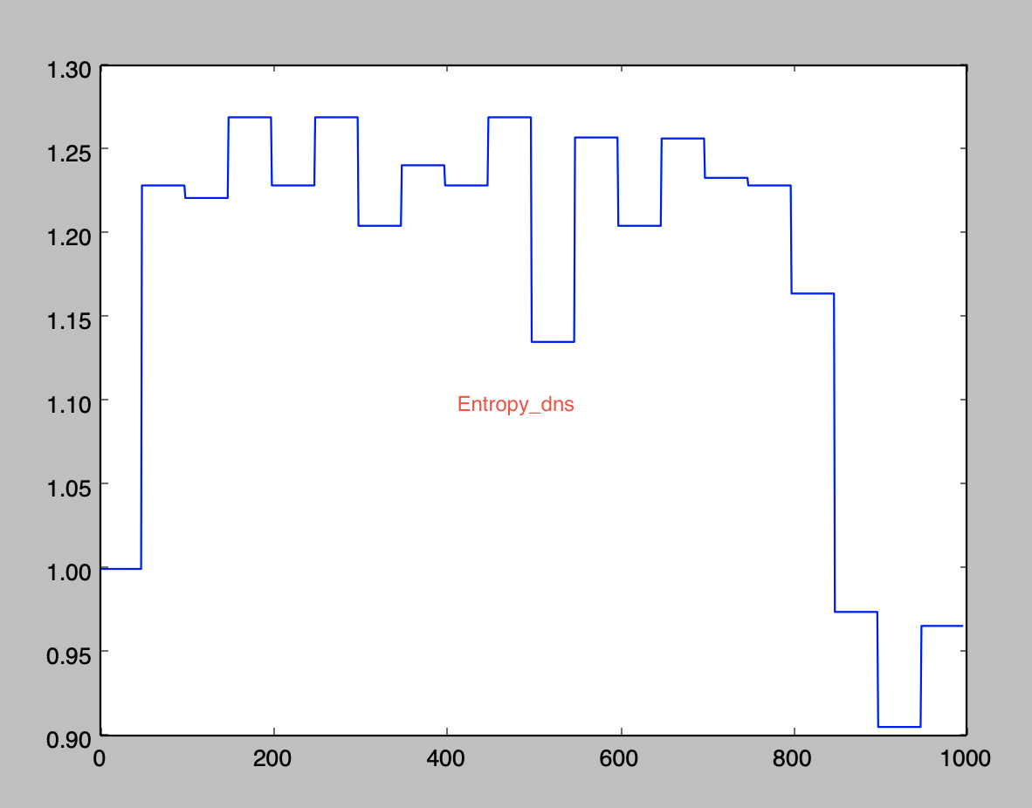
Detection Technique - Entropy
[ UDP Fragmentation ]
[ DNS Amplification ]
Normal Traffic
Entropy falling
DDoS Detected
*units: entropy/window

Slide 27
Summary
Entropy provides a robust and low-overhead solution for detecting DDOS attacks.
Overly simplistic strategies (such as connection rate) are easily circumvented.

Slide 28

Demo video

Slide 29


Slide 30

Q&A
B05902100 - 馮永輝 B05902101 - 黃千儀 B05902035 - 許國讚 B04902128 - 裵娜娜 B04902127 - 莎蘿柏

Slide 31
References
All attacks and detection methods are referenced here:
Bawany, Narmeen & Shamsi, Jawwad & Salah, Khaled. (2017). DDoS Attack Detection and Mitigation Using SDN: Methods, Practices, and Solutions. Arabian Journal for Science and Engineering. 42. 10.1007/s13369-017-2414-5.
Related work Database for this project available at:
https://hackmd.io/MJ8dWHXcSNGUIqHiDZaRjA
Data plots are done using matplotlib:
https://matplotlib.org

