Slide 1
Course code: Information System Analysis and Design Course code: CSE-3621

Slide 2
Book reference:
System Analysis and Design
by Elias M. Awad
2nd edition

Slide 3
Chapter 4 and some parts of chapter 3
System Planning and the Initial Investigation

Slide 4
What is System?
Two definitions:
1. System is a set of detailed methods, procedures and routines created to carry out a specific activity, perform a duty, or solve a problem.
2. System is an organized, purposeful structure that consists of interrelated and interdependent elements (components, entities, factors, members, parts etc.).
These elements continually influence one another (directly or indirectly) to maintain their activity and the existence of the system, in order to achieve the goal of the system.

Slide 5
System
All systems have
(a) inputs, outputs and feedback mechanisms,
(b) maintain an internal steady-state (called homeostasis) despite a changing external environment,
(c) display properties that are different than the whole (called emergent properties) but are not possessed by any of the individual elements, and
(d) have boundaries that are usually defined by the system observer.

Slide 6
Systems analysis
Systems analysis is a problem solving technique that decomposes a system into its component pieces for the purpose of the studying how well those component parts work and interact to accomplish their purpose".
According to the Merriam-Webster dictionary, systems analysis is "the process of studying a procedure or business in order to identify its goals and purposes and create systems and procedures that will achieve them in an efficient way".

Slide 7
Systems design
Systems design is the process of defining the architecture, components, modules, interfaces, and data for a system to satisfy specified requirements. Systems design could be seen as the application of systems theory to product development.
There is some overlap with the disciplines of systems analysis, systems architecture and systems engineering.

Slide 8
Bases for Planning in System Analysis
System planning (SP) is a method of analyzing, defining and designing the information architecture of organizations.
Information is now recognized as a vital resource and must be managed.
More and More financial resources are committed to information systems.
There is a growing need for formal long-range planning with information systems that are complex

Slide 9
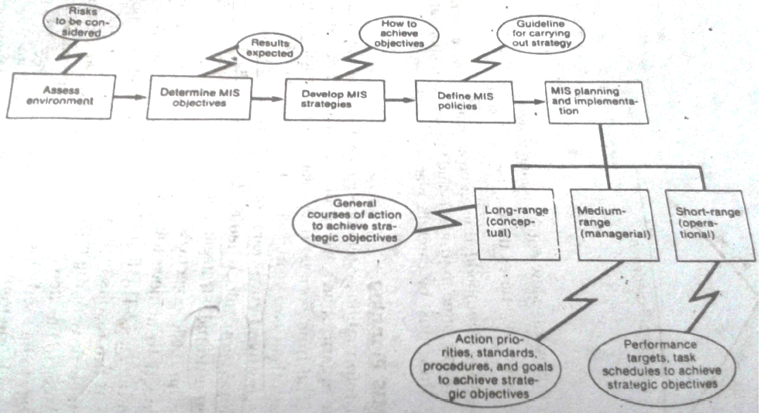
Strategic MIS planning

Slide 10
Managerial and operational MIS Planning
Managerial MIS planning integrates strategic with operational plans.
It is a process in which specific functional plans are related to a specific number of years to show how strategies are to be carried out to achieve long range plans.

Slide 11
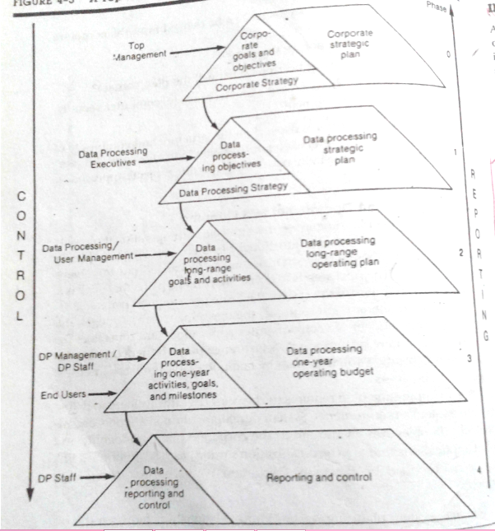
Top- down approach to system planning

Slide 12
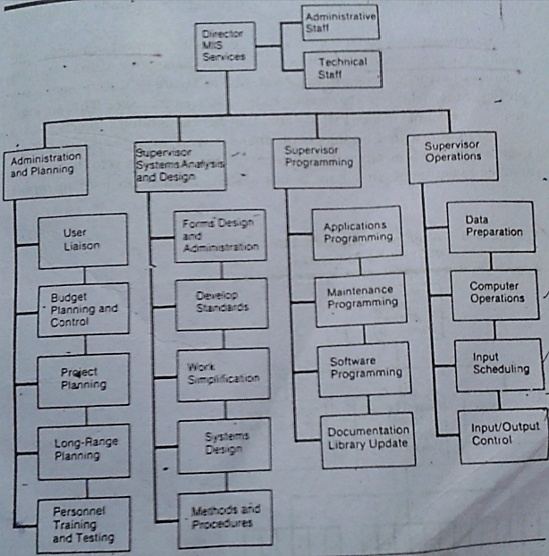
MIS Organization

Slide 13
Primary functions of an MIS Facility
Administration:
Handles user and user system relationship
Long range planning
Budget planning
Personnel administration
System analysis and design
Programing
Operations handling

Slide 14
System analysis and design may be organized as:
Project oriented structure
Pool oriented structure
Functional oriented structure

Slide 15
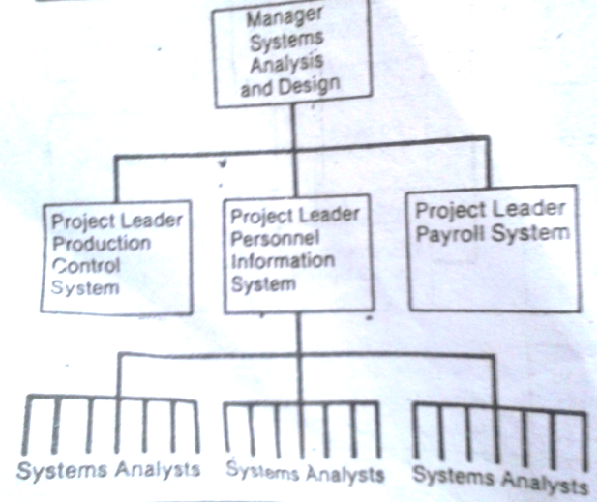
Project oriented structure

Slide 16
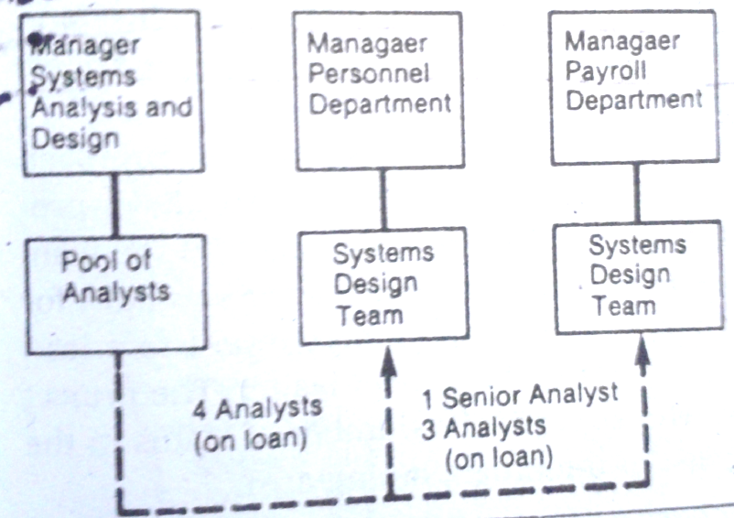
Pool oriented structure

Slide 17
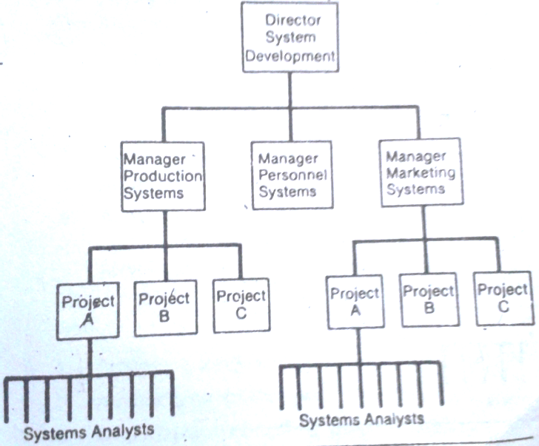
Functional Structure

Slide 18
Programming
Programming is structured around three areas:
Applications
Software
Maintenance
Team oriented structure of programmers
General structure of computer operations

Slide 19
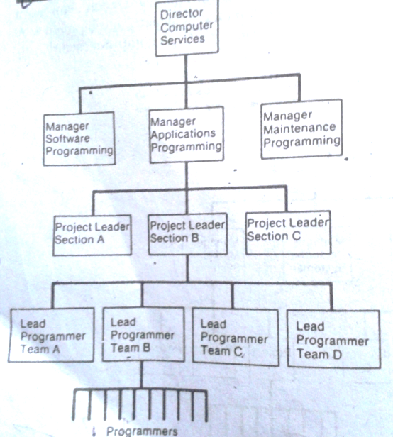
Team oriented structure of programmers

Slide 20
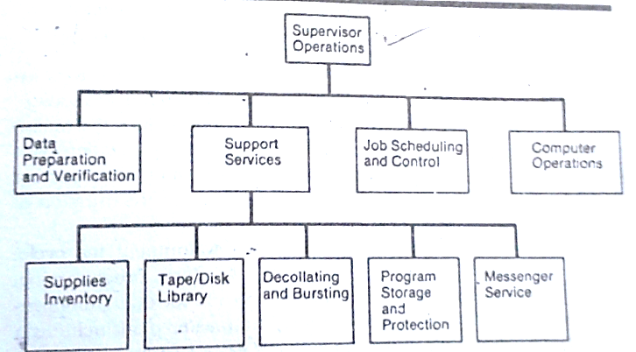
General structure of computer operations

Slide 21
Relative status and job levels in an MIS facility
See page no 79..
Home work

Slide 22
Initial investigation
The initial investigation is one way of handling or analysis existing system.
The user request form specifies the following:
User assigned title of work requested
Nature of work requested
Date request was submitted
Date job should be completed
Job objectives
Expected benefits
Input/output description
Requesters signature, title, department and phone number
Signature, title, department and phone number of person approving the request.

Slide 23
On-site observation
On-site observation is the most difficult fact-finding technique. It requires intrusion into the user’s area and can cause adverse reaction by the user’s staff if not handled properly.
The following questions should be precede a decision to use on-site observation:
1. what behaviour can be observed that cannot be described in others ways?
2. what data can be obtained more easily?
3. What assurances or the behaviour being observed?
4. What interpretation needs to be made on observation data to avoid being misled by the obvious?

