Slide 1
Chapter 5
Information Gathering

Slide 2
System analysis phases
Three phases:
Familiarity with the present system through available documentation, such as procedures, manuals, documents and their flow, interviews of the user staff, and on-site observation.
Definition of the decision making associated with managing the system.
Once decision points are identified, a series of interviews may be conducted.

Slide 3
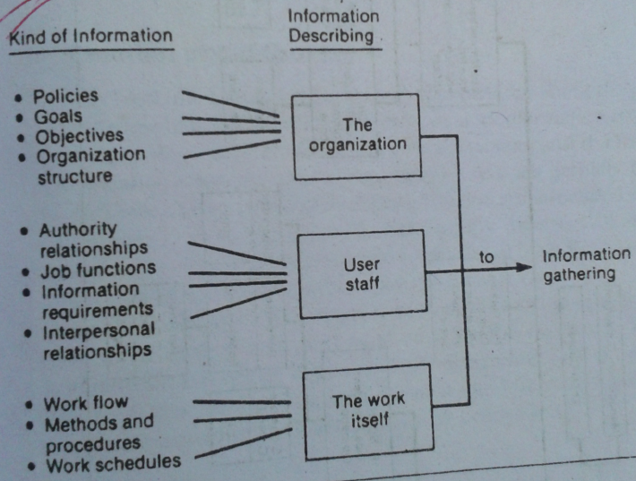
Categories of information

Slide 4
Where does information originate?
Two types:
Primary external sources:
vendors
Govt. documents
Newspapers and professional journals
Primary internal sources:
Financial report
Personnel staffs
Professional staffs and legal counsel, EDP
System documentation
User staff
Reports and transaction documents.

Slide 5
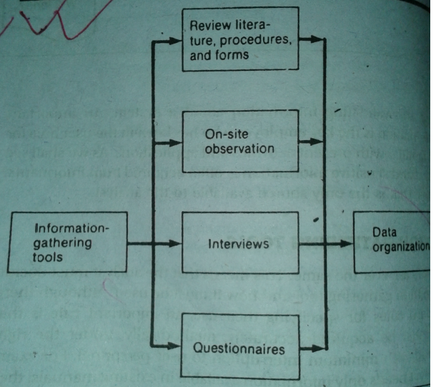
Information gathering tools

Slide 6
The following question s can serve as a guide for on site observation:
1. what kind of system is it? what does it do?
2. who run the system?
3. What is the history of the system?
4. Is it a primary or a secondary contributor to the organization?

Slide 7
Four alternative observation methods
1. natural or contrived: a natural observation occurs in a setting such as the employee’s place of work. A contrived observation is set up by the observer in a place like laboratory.
2. obtrusive or unobtrusive: an obtrusive observation takes place when the respondent knows he/she is being observed. An unobtrusive observation takes place in a contrived way such as behind a one way mirror

Slide 8
Four alternative observation methods
3. direct or indirect: in direct, analyst actually observes the subject. In indirect , analyst uses mechanical devices such as camera, tape recorder.
4. structured or unstructured: in a structured observation, the observer looks for and records a specific action. In unstructured, the observer in a situation to observe whatever might be pertinent at the time.

Slide 9
Interview
The interview is a face-to-face interpersonal role situation in which a person called the interviewer asks a person being interviewed questions designed to gather information about a problem area.

Slide 10
Advantages of interview
Four primary advantages:
Its flexibility
It offers a better opportunity than the questionnaire
It is an effective technique for eliciting information
Many people enjoy being interviewed , regardless of the subject.

Slide 11
Drawback of interview
Major drawback:
Need long preparation time
A lot of time to conduct
Loss money

Slide 12
Guides to a successful interview
In an interview the following steps should be taken:
Set the stage for the interview.
Establish rapport, put the interviewee at ease.
Phrase question clearly and succinctly.
Be a good listener , avoid arguments.
Evaluate the outcome of the interview.

Slide 13
Questionnaires
In contrast to the interview is the questionnaire, which is a term used for almost any tool that has questions to which individuals respond.
It is usually associated with self-administrated tools with items of the closed or fixed alternative type.

Slide 14
Questionnaires advantages
A questionnaires offers the following advantages:
It is economical
Requires less skill to administer than interview
Large number of individuals simultaneously
The standardized wording and order of the question
The respondents feet greater confidence in the anonymity of a questionnaire than in that of an interview.
The questionnaire places less pressure on subjects for immediate responds.

Slide 15
Questionnaires disadvantages
Principal disadvantage is:
low percentages of returns
Many people have difficulty expressing themselves in writing, especially when responding to essay questions.
Many dislike writing

Slide 16
Types of interview and questionnaires
Two types of interview:
Unstructured alternative
Structured alternative
Two types of questionnaire:
Open ended
Closed ended

Slide 17
Unstructured alternative
The unstructured interview is a relatively nondirective information gathering technique.
It allows respondents to answer questions freely in their own words.
The responses are spontaneous rather than forced.
They are self revealing and personal rather than general and superficial.

Slide 18
Structured alternative
In the structured approach the questions are presented with exactly the same wording and in the same order to all subjects.
Standardized questions improve the reliability of the responses by ensuring that all subjects are responding to the same questions.

Slide 19
Open ended questionnaire
An open ended question requires no response direction or specific response.
It is written with space provided for the response.
Example:
What is your opinion regarding the “ no smoking” policy in the hospital?

Slide 20
Closed ended questionnaire
Closed questions are those in which the response are presented as a set of alternatives.
There are five major varieties of closed questions:
Fill in the blanks type question
Dichotomous(yes/no) type question
Ranking scale type question
Multiple choice questions
Rating scales questions

Slide 21
Procedure for questionnaire construction
The procedure for constructing a questionnaire consists of six steps:
Decide what data should be collected
Decide what type of questionnaire should be used
Outline the topics for the questionnaire and then write the questions.
Edit the questionnaire for technical defects
Pre-test the questionnaire to see how wel it works.
Do a final editing to ensure that the questionnaire is ready for administration.

