Slide 1
상태(state, observation)
게임 AI
게임
액션(action)

Slide 2
빌드오더1
빌드오더2
전투력
t
게임 시간

Slide 3

Execute Trainer
State
Execute Actor_0
Action
State
Action
Execute Actor_1

Slide 4
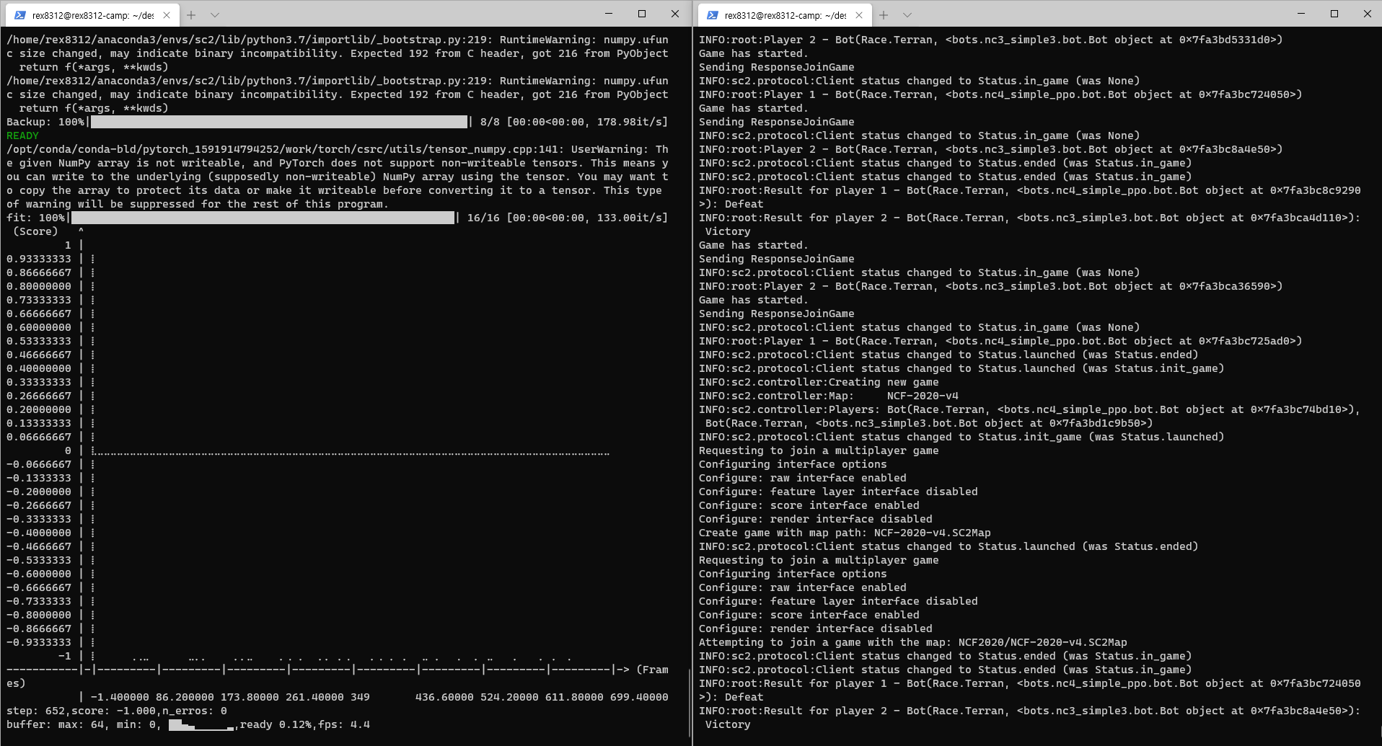

Slide 5
Execute Actor_0
Execute Learner
Execute Actor_0
Execute Actor_1
Execute Actor_2
…
Execute Learner
Execute Actor_1
Execute Actor_2
(1) 단일 학습 시스템
(2) 분산 학습 시스템

Slide 6
단일 학습 시스템
Actor_1
Actor_2
Learner
Actor_3

Slide 7
zmq client
Actor 1
zmq client
Actor 1
zmq client
Actor 1
Actor 1
PC 2
zmq client
Actor 2
Actor 1
단일 학습 시스템
PC 2
zmq client
Actor 2
Actor 1
PC 2
zmq client
Actor 2
Actor 1
Actor 2
PC 2
Actor 3
Actor 2
Learner
PC 2
Actor 3
Actor 2
Actor 3
Actor 2
zmq server
Actor 매니저
Actor 4
Actor 3
Actor 4
Actor 3
Actor 4
Actor 3
Actor 1
Actor 4
Actor 1
Actor 4
Actor 1
Actor 2
Actor 4
Actor 1
Actor 2
Actor 1
Actor 2
Actor 5
Actor 3
Actor 2
Actor 3
Actor 2
Actor 3
Actor 6
Actor 4
Actor 3
Actor 4
Actor 3
Actor 4
Actor 7
Actor 4
Actor 4
Actor 8

Slide 8
zmq client
Actor 1
zmq client
Actor 1
zmq client
Actor 1
Actor 1
PC 2
zmq client
Actor 2
Actor 1
단일 학습 시스템
PC 2
zmq client
Actor 2
Actor 1
PC 2
zmq client
Actor 2
Actor 1
Actor 2
PC 2
Actor 3
Actor 2
Learner
PC 2
Actor 3
Actor 2
Actor 3
Actor 2
zmq server
Actor 매니저
Actor 4
Actor 3
Actor 4
Actor 3
Actor 4
Actor 3
Actor 1
Actor 4
Actor 1
Actor 4
Actor 1
Actor 2
Actor 4
Actor 1
Actor 2
Actor 1
Actor 2
Actor 5
Test/Debug actor 매니저
Actor 3
Actor 2
Actor 3
Actor 2
zmq client
Test Actor
Actor 3
Actor 6
Actor 4
Actor 3
Actor 4
Actor 3
Actor 4
Actor 7
Debug Actor
Actor 4
Actor 4
Actor 8

Slide 9
Actor 구조
Actor
actor task
actor 함수
모델 큐
python-sc2
python API
로그 큐
s2client-api
C++ API
SC 2 process
StarCraft 2 게임

