Slide 1
Statistical Learning Project: Music Time
Period Classification!
Our Final Project
Search
Home
Library
Angelo Mandara Antonio Rocca
Claudiu Gheorghiu Tito Tamburini
G03

Slide 2
Table of contents
01
02
03
04
Introduction
The Dataset
Our goals, tools used and how we create the dataset
Brief explanation of the variables in our dataset
3:15min
2:15min
Model and Methods
Data Analysis
Exploring the distribution of musical features
Predict the decade of a song using various tecniques
5:25min
4:30min

Slide 3
01
Introduction
Our Music Playlists
Search
Home
Library
Our goals, tools used and how we create the dataset

Slide 4
Goals and Creation of Dataset
We believe a fundamental part of everyone’s life is music, also we believe that nostalgia is a very strong feeling, so the goal of the study is to create a machine learning model that can correctly classify songs by decade in order to improve the listener experience.
Specifically we want to help music industry to create playlists or recommendations systems, to provide a way to track the cultural and social influences that changed the music over time and to find recurring features to predict the next big music movement.
We’ll use a dataset built with the Spotify API via the Spotify Python library: Spotipy.

Slide 5
Using Spotipy
We need to obtain a CLIENT_ID and an SECRET_CLIENT_ID in order to connect to Spotify via the Spotipy library in Python.
Using our credentials we can connect to the Spotify API and we can retrieve the playlists that groups the song by each decade.
Now we have obtained a list of Spotify playlists and we need to get all the tracks from this playlists to extract from them the audio features.
Finally we can create from each song a row in our dataset, where each song is labelled with the decade of its release.

Slide 6
02
The Dataset
Our Music Playlists
Search
Home
Library
Brief explanation of the variables in our dataset

Slide 7
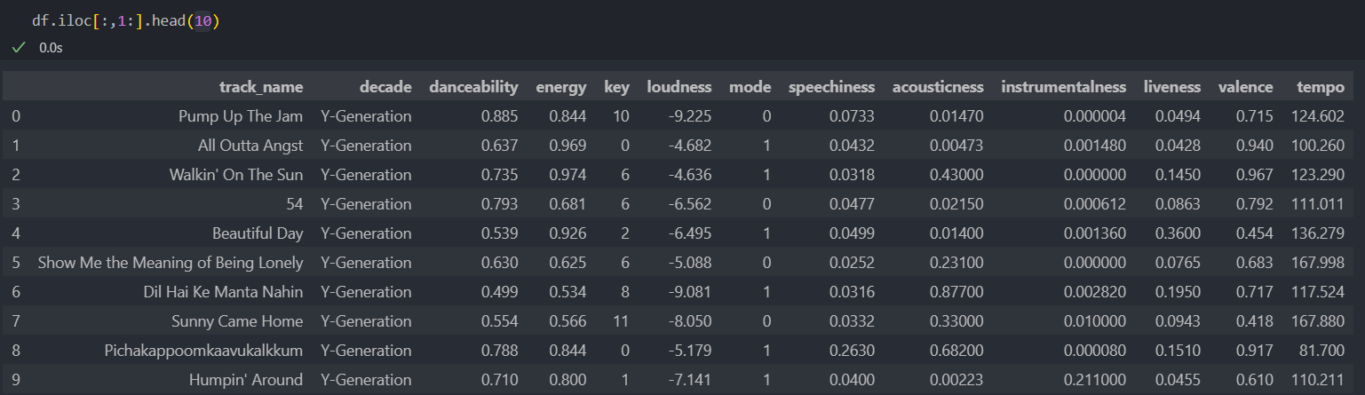
A look of the dataset
We are printing the first 10 rows of our dataset to get a quick glimpse of the data and understand its structure. Is important to say that we grouped two decades to have our final 3 classes:
X-Generation(60s-70s), Y-Generation(80s-90s) and Z-Generation(00s-10s)

Slide 8
A look at the dataset - Part 1
Order by
# | Variables |  | Meanings
1 |  | track_name | name or title of each track
2 |  | decade | target variable that we want to predict
3 |  | danceability | measures how suitable a song is for dancing
4 |  | energy | measure of intensity and activity in a song
5 |  | loudness | overall volume of a song in decibels
6 |  | speechness | presence of spoken words in the song
7 |  | acousticness | proportion of acoustic sounds in the song

Slide 9
A look at the dataset - Part 2
Order by
# | Variables |  | Meanings
1 |  | instrumentalness | likelihood that a song is instrumental, meaning it has no vocals
2 |  | valence | Valence represents the musical positiveness conveyed by a song
3 |  | key | key or tonality of the song
4 |  | mode | modality of the song
5 |  | track_uri | unique identifier for each track or song in our dataset
6 |  | liveness | probability that a song was recorded in a live concert setting or in a studio
7 |  | tempo | speed or pace of a song in beats per minute

Slide 10
03
Data Analysis
Our Music Playlists
Search
Home
Library
Exploring the distribution of musical features across different decades

Slide 11
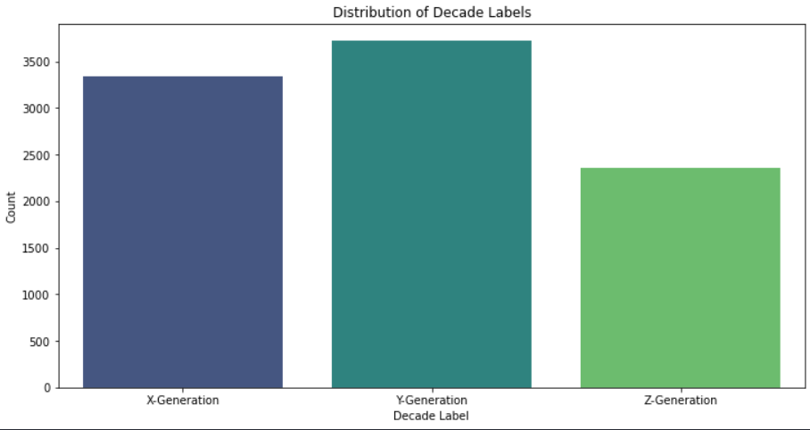
Distribution of Decade Labels
Counterplot that represents the frequency of songs from different decades in our dataset.

Slide 12
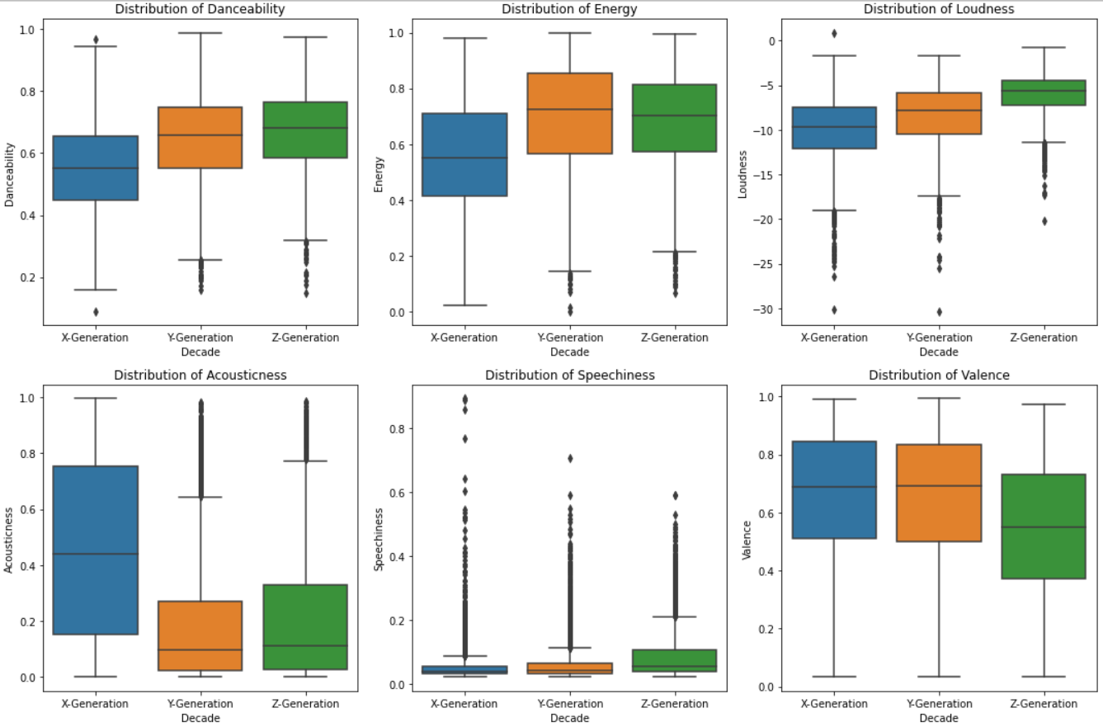
Distribution of features by decades
Z Generation (2000-2020): Songs are more danceable, likely due to the prevalence of dance-oriented genres also similar energy levels as the Y generation, known for dynamic and high-energy music..
X and Y Generations (60s-70s-80s-90s): Songs may be less danceable, offering a broader range of genres and the songs with lower loudness, aligned with the technology and production of those eras .

Slide 13
Distribution of features by decades
Z Generation (2000-2020): Lower acousticness, due to increased use of electronic and synthesized sounds. Higher speechiness, possibly due to the rise of rap and spoken-word genres.
X and Y Generations (60s-70s-80s-90s): Higher acousticness, as these decades emphasized acoustic instruments. Higher valence, with music often conveying positivity and happiness

Slide 14
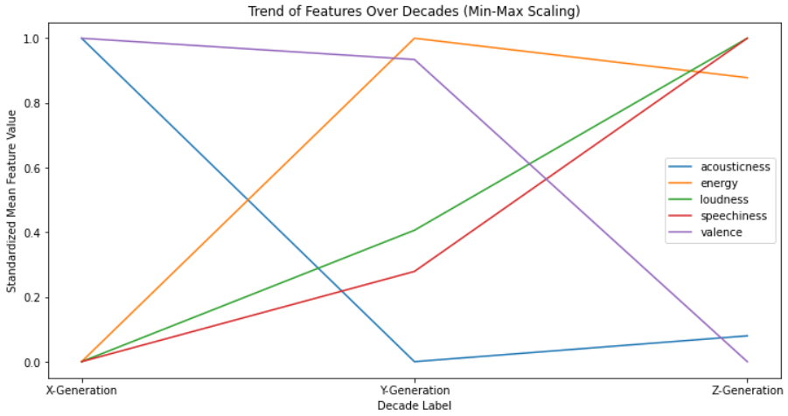
Trend of features over decades
To analyze how the distribution of a specific feature changes over time, we created line plots where each line represents the trend of the feature over the years or decades.

Slide 15
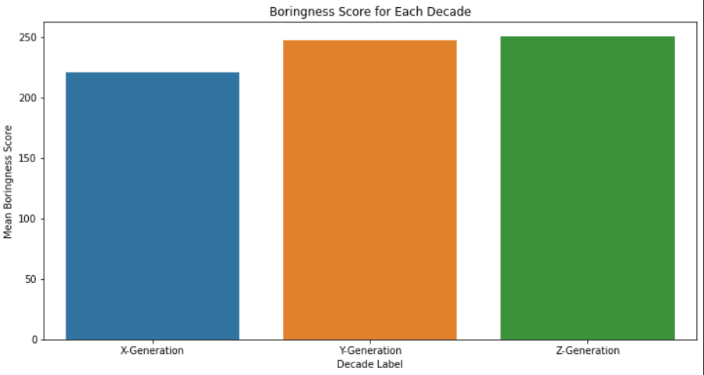
Boringness score
boringness = loudness + tempo + (energy100) + (danceability 100)
We have devised a simple equation to calculate the "boringness" score of a song, which helps assess how "boring" a period is.

Slide 16
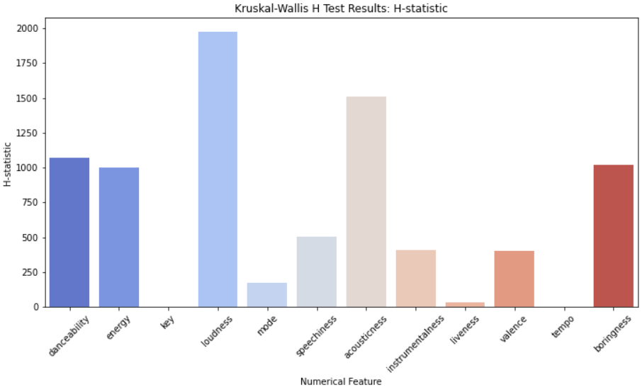
The Kruskal-Wallis H test
The Kruskal-Wallis H test can be used to determine how each numerical feature and the term "decade" are related to one another.
Each numerical feature will be subjected to the Kruskal-Wallis H test to determine whether the feature distribution varies noticeably between various decades.

Slide 17
04
Models and Methods
Our Music Playlists
Search
Home
Library

Slide 18
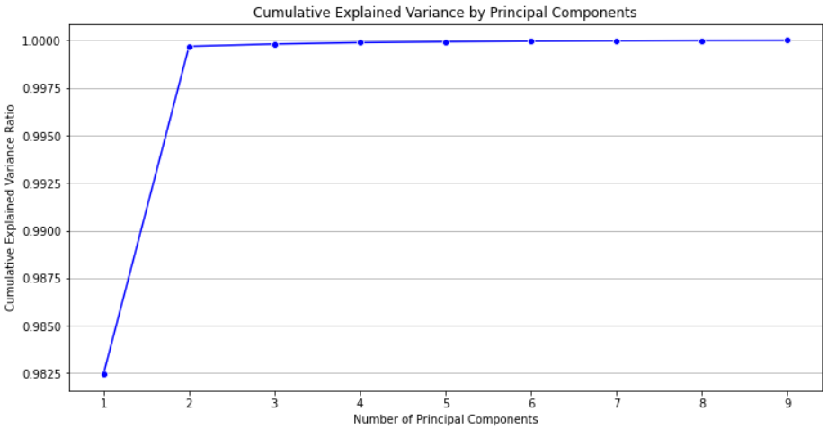
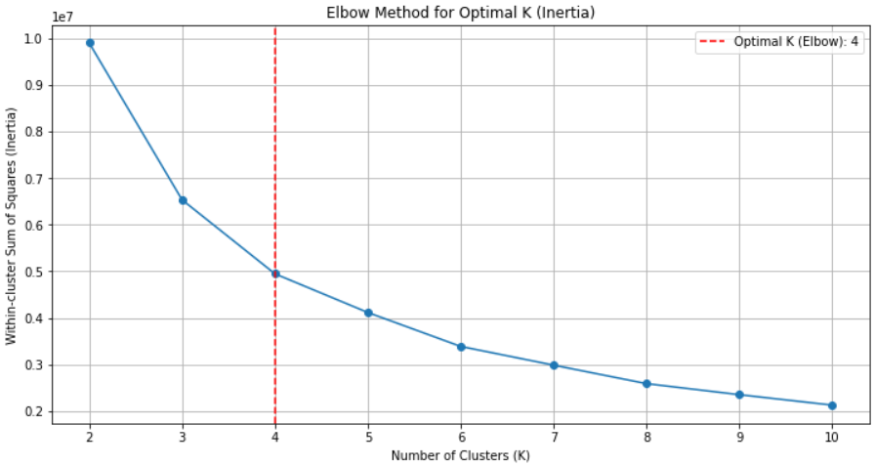
PCA
KMEANS++
You listened 4h35min
You listened 3h15min
We applied PCA to the dataset with the hope of reducing the dimensionality.However, in our case this technique was not helpful
After attempting unsupervised clustering with KMeans++, we discovered that the elbow method's recommended number of clusters was 4, and not 3 as we wanted

Slide 19
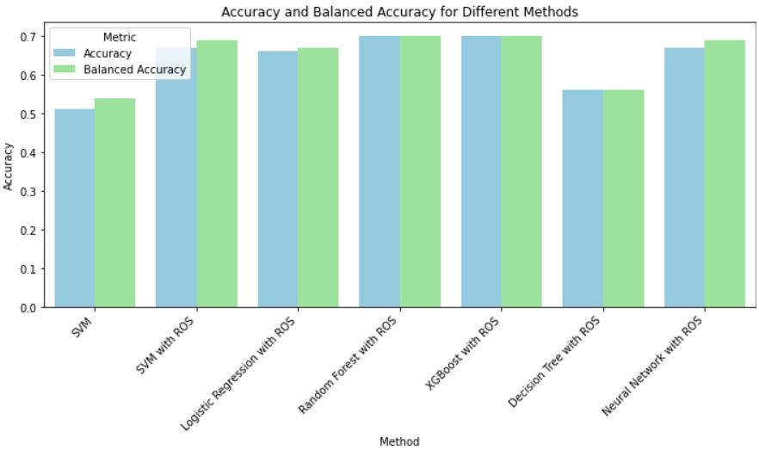
Models
In our analysis, we tackled the class imbalance issue by using Random Over-Sampling (ROS) We then tried different classification methods, evaluating their performance using both accuracy and balanced accuracy metrics. This approach helped us choose the best model, which turned out to be the Random Forest classifier.

Slide 20
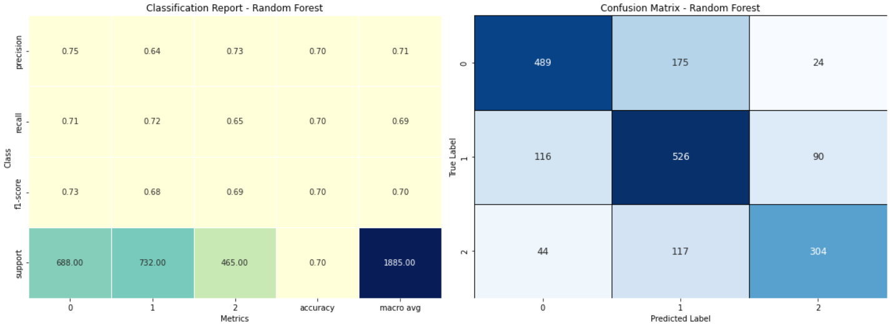
Our Results
We obtained the optimum hyperparameters by performing a Randomised Search on the Random Forest parameters to fine-tune the model and obtained an accuracy of 0.7

Slide 21
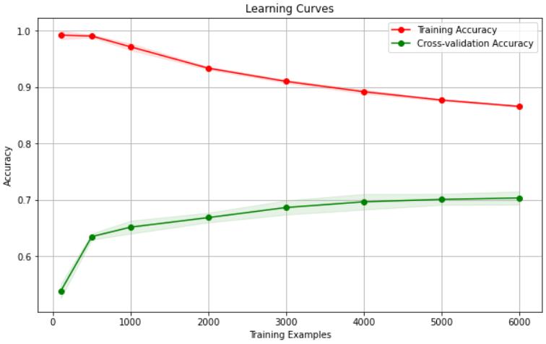
Learning Curves
A important technique for assessing a machine learning model's performance is its learning curve.
Our Random Forest classifier initially appeared to be overfitted.
To solve this problem, we carefully adjusted the hyperparameters max_depth, min_samples_split, and min_samples_leaf.

Slide 22
Interpretability(from the Random Forest classifier)
#1
#6
#2
#7
#3
#8
#4
#9
#5
#10
Loudness
Speechiness
Danceability
Boringness
Acousticness
Instrumentalness
Valence
Tempo
Energy
Liveness

Slide 23
Thanks for the attention
Our Music Playlists
Search
Home
Library

