Slide 1
Predicting MLB Game Attendance
Game to game prediction on attendance with Linear and CARTs /Gradient Boosting models.
Jun Won Kim
DSI PLUS 2
12/19/17
Notes:
How to implement predictive machine learning models in baseball venue?

Slide 2
Introduction
“Revenue - Cost = Profit”
Jim Collins, business writer, points Rubbermaid for illustration of failed revenue control.
"In How the Mighty Fall, Collins offers the example of household item manufacturer, Rubbermaid. The company took its much-admired levels of innovation to an extreme, aiming to introduce one new product to their range per day: a strategy that led it to create nearly 1,000 new products in just three years. But this innovation came at a cost: in pushing so hard for new products, Rubbermaid lost control of its costs and failed to meet orders. The lack of discipline undermined the innovations, and the company suffered a rapid decline until it was eventually taken over by a rival."
Read more at: https://www.blinkist.com/magazine/posts/the-10-commandments-of-business-from-jim-collins?utm_source=cpp"
Notes:
With limited supply with venue capacity, understanding the demand will
Help manage costs (#of people working per game, merchandize, food, beverage)
Quality control
Ticket pricing
Marketing (events within events)

Slide 3
Agenda
Problem Statement
Introducing the data
Team Sample Split
Explore Houston Astros data
Model fitting outline
Results

Slide 4
Problem Statement
With historical game log data, predict the attendance of today’s game.
Notes:
Let’s focus on today.
We are closely looking at game to game data. Yesterday’s data will be used.
Micro, approach that is applicable to use during the season. On going continuously.

Slide 5
The DATA (1990-2017)
Previous Game Data
Season Team Data
Time-specific Factors
Runs
Runs Allowed
# of Innings
Duration
Result
Attendance
Runs per game
5 games runs moving average
5 games runs allowed moving average
Winning %
Division Rank
Game back
Streak
Company
Weekday
Month
Opening game
Double Header
Day or Night
(baseball-reference.com)
Notes:
How does each collected item impacting the prediction? We can largely divide them into three groups. Which component would give the fans most anticipation?
Previous game data: game log will have its game results stats listed for that game.
Since the crowd is already gathered by the time the game is being played, don’t think the live results impact # of attendance much. Instead shifting these stats down,
Today’s results = Tomorrow's anticipation

Slide 6
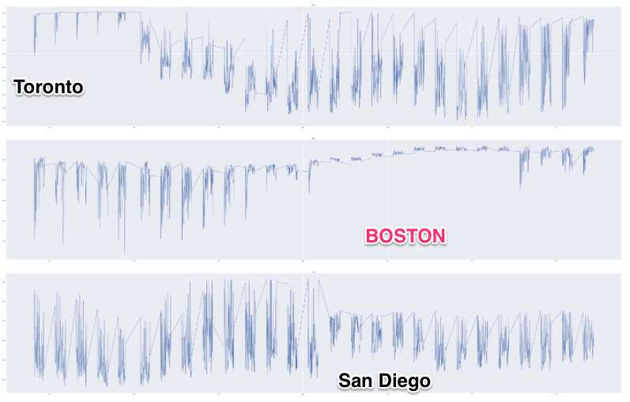
Data Split
Notes:
Why? Look at the mean and variance of that graph and sampling it such way randomly will generate such a discrepancy
Each team are too different. Their stadiums have different maximum capacity, team base and royalty, the essence and culture of team playing, and most importantly, they are in different cities with different population, income, weather, accessibility.. I can go forever how this should be treated. Let's see how their trend lines differ.

Slide 7
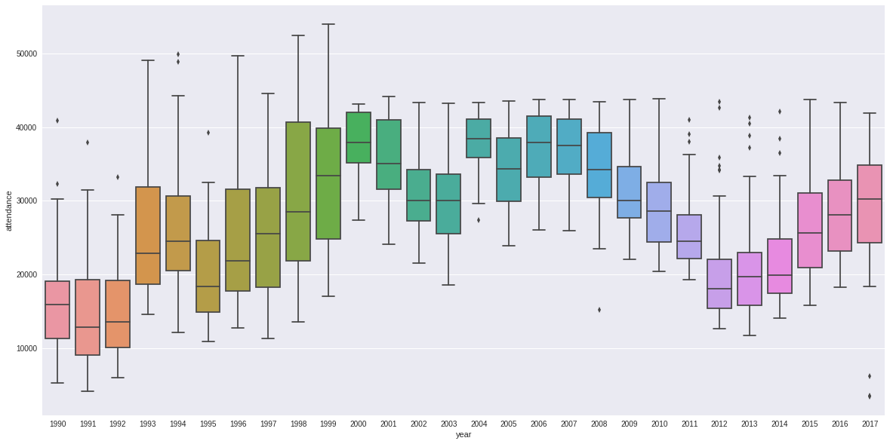
Astros Yearly Box Plot for attendance
Notes:
Within the same team, the year to year variance seems significant

Slide 8
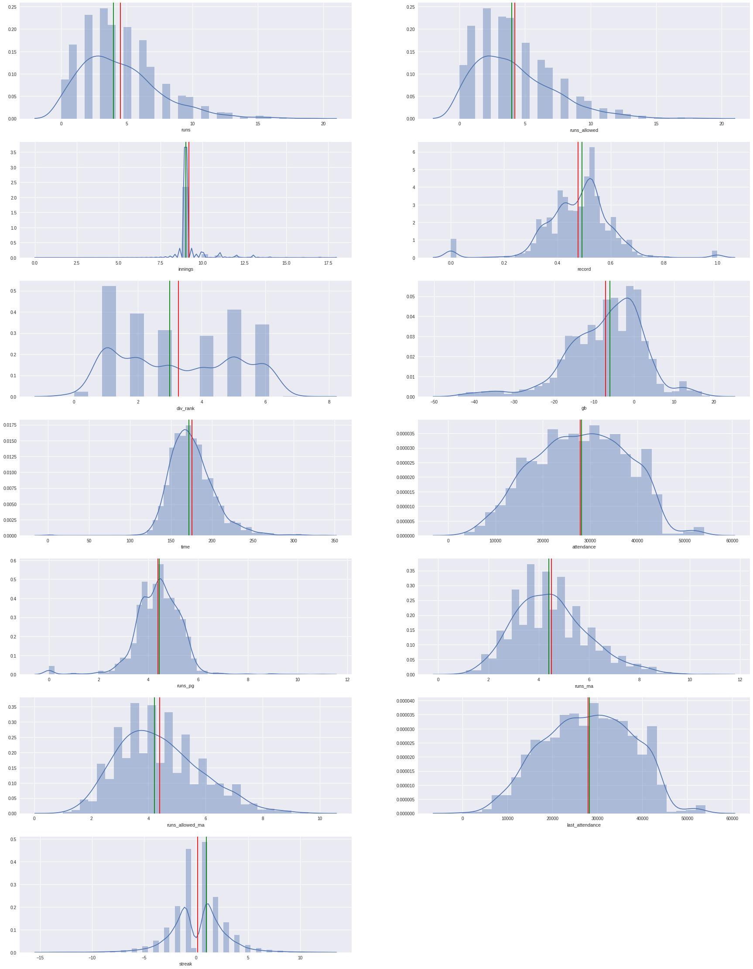
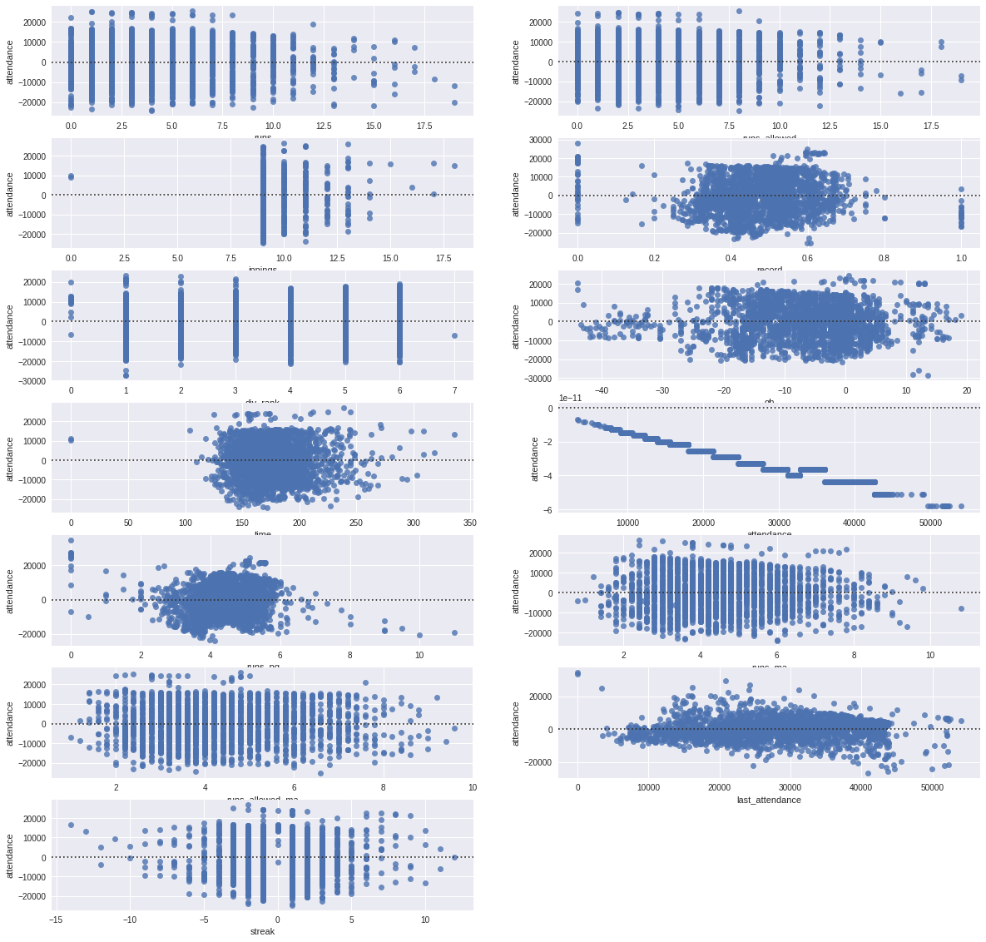
Numerical feature distribution and residual plot
Notes:
To detect skewness and what kind of transformation is needed, we ran distribution plot and residual plot of numerical features
Dist plot tells us the density, how many data points fall under corresponding value

Slide 9
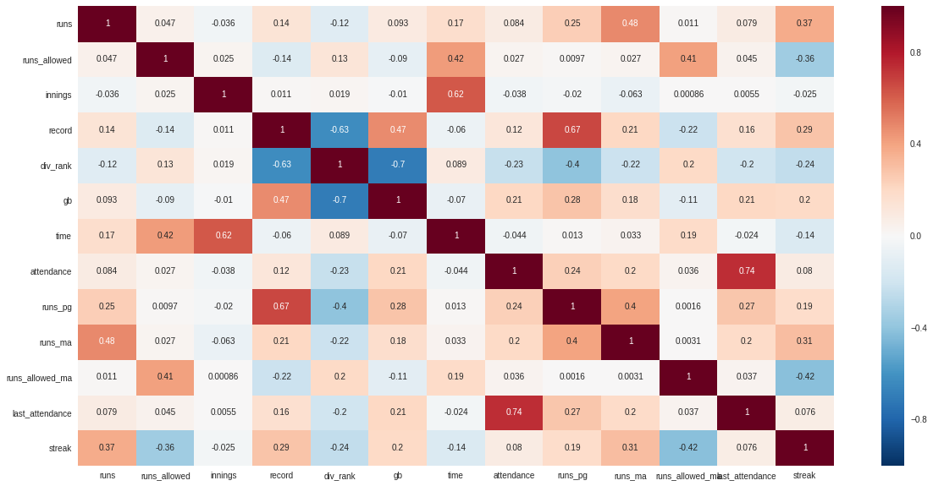
Notes:
Heatmap to see what characteristics of the game (feature) correlates with one another.
Ex. div_ranking, the root is the same and you can easily interpret that with domain knowledge which could be validated here

Slide 10
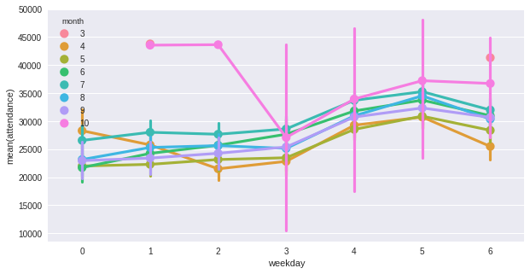
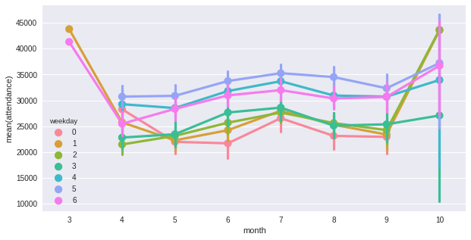
Point plot weekday v. attendance with month labeled
Point plot Month v. Attendance with weekday labeled
Notes:
Strong trend in the beginning and end of the year

Slide 11
Linear and CARTs
They are ways we can evaluate our prediction.
Performance Metric Accuracy
Duration of time needed
Domain knowledge dictates that all the features have nuances that they hold and should not be eliminated.
Let’s take both way.
Domain Knowledge or computational feature selection?
Notes:
Skewness in innings, clear outliers… CARTs?
Correlations and multicollinearity can be detected… Linear?
Feature eliminated.. We don’t know the individual factors importance.
Feature reduction.. We can’t interpret the result

Slide 12
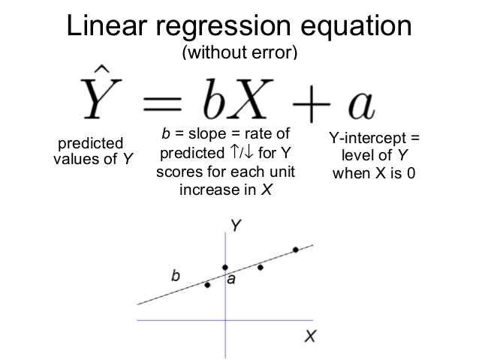
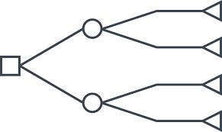
Linear and CARTs
Linear Algorithm
Tree Based Algorithm

Slide 13
Support Vector Machine w/ Variance inflation factor feature selection
Bagging Regressor
Gradient Boosting Regressor
0.682002
0.684849
0.712732
0.721027
0.728155
Random Forest Regressor
Support Vector Machine w/ ANOVA feature selection
Notes:
The R^2 (or R Squared) metric provides an indication of the goodness of fit of a set of predictions to the actual values. In statistical literature, this measure is called the coefficient of determination.
This is a value between 0 and 1 for no-fit and perfect fit respectively.
R-squared is a statistical measure of how close the data are to the fitted regression line. It is also known as the coefficient of determination, or the coefficient of multiple determination for multiple regression. 0% indicates that the model explains none of the variability of the response data around its mean

Slide 14
Important Features

Slide 15
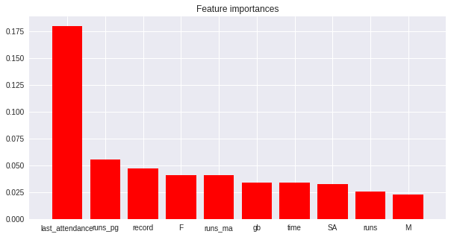

Slide 16
Impact
max growth
52% when using year average as a prediction.
Notes:
Both models were about the same in the performance metric. In a season where games are played day to day, pararmetric model will be able to be more flexible with the data. The model will be re-written with the newly acquired data that machine learns. If we were to use the same model again and again, it would be effecient to make prediction with Gradient Boosting. Moreover, the feature importance is also easily computed with the algorithm. With linear models, even though we will not have to suffer in performances right now, as season goes on and more games are played, the type of year to year variances that we can expect to see might not be able to captured. However, it is important to note that since with ANOVA testing feature selection and PCA together condensed down the feature to one principal component, the computation speed for prediction was instant. In a situation where short training time is required, this might serve as a good method to draw predictions.
Compared to simple averaging out, we will able to obtain in about 20% in accuracy in predicting attendance. Hopefully that would either capture 20% in potential revenue opportunity of cut out 20% in excess expenditure

