Slide 1
Efficient Estimation of Influence of a Training Instance
Sosuke Kobayashi Sho Yokoi Jun Suzuki Kentaro Inui
Tohoku University Preferred Networks, Inc.
Tohoku University RIKEN AIP
SustaiNLP 2020

Slide 2
Introduction
Goal: estimate the influence of a training instance z = “how a model prediction or loss would be changed IF was NOT used for training”
What for?
Interpretability: analyze bad training instances contributing to error prediction
Data filtering: ignore bad training instances contributing to high validation error

Slide 3
Introduction
Goal: estimate the influence of a training instance = “how a model prediction or loss would be changed IF was NOT used for training”
Naïve approach: leave-one-out retraining: train two models on two dataset with or without the instance → However, computation cost is high…
Our Approach: estimate the influence based on two dropout sub-networks, which learned or not

Slide 4
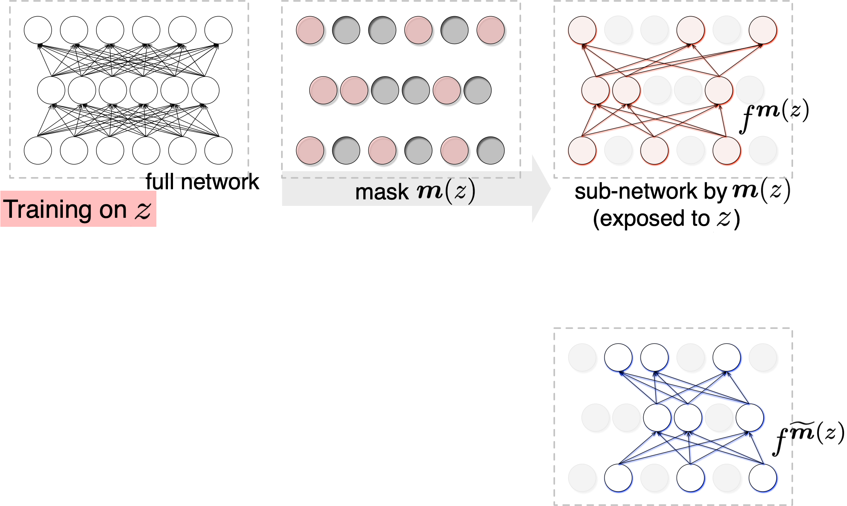
Idea: Dropout Makes Ignorant Sub-networks
A random set of parameters is zero-masked at each update
Insight: the hidden (pruned) sub-network with the zero-masked parameters does NOT learn the instance
If we deterministically use the same mask for an instance, its hidden sub-network NEVER learn the instance

Slide 5
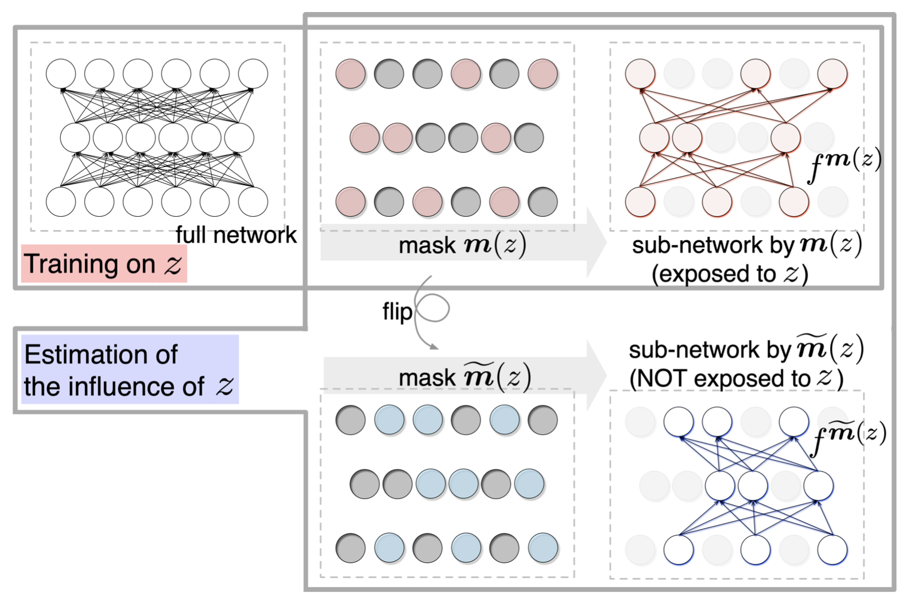
Proposed: Turn-Over Dropout
Make instance-specific dropout masks for each instance
Train a model with the instance-specific masks and dropout
Compare the outputs of the instance-specific hidden and exposed sub-networks
instead of

Slide 6
Challenge: Instance-specific Dropout Masks
Random mask for each instance z ∈ D → naively, it costs O(|D||θ|) to store…
However, instead of storing it, we can deterministically generate it from a random seed (e.g., we can set instance indices as the seeds) → reduced to O(1)
Thus, we can use turn-over dropout with minimum additional costs on top of the usual training of a single model

Slide 7
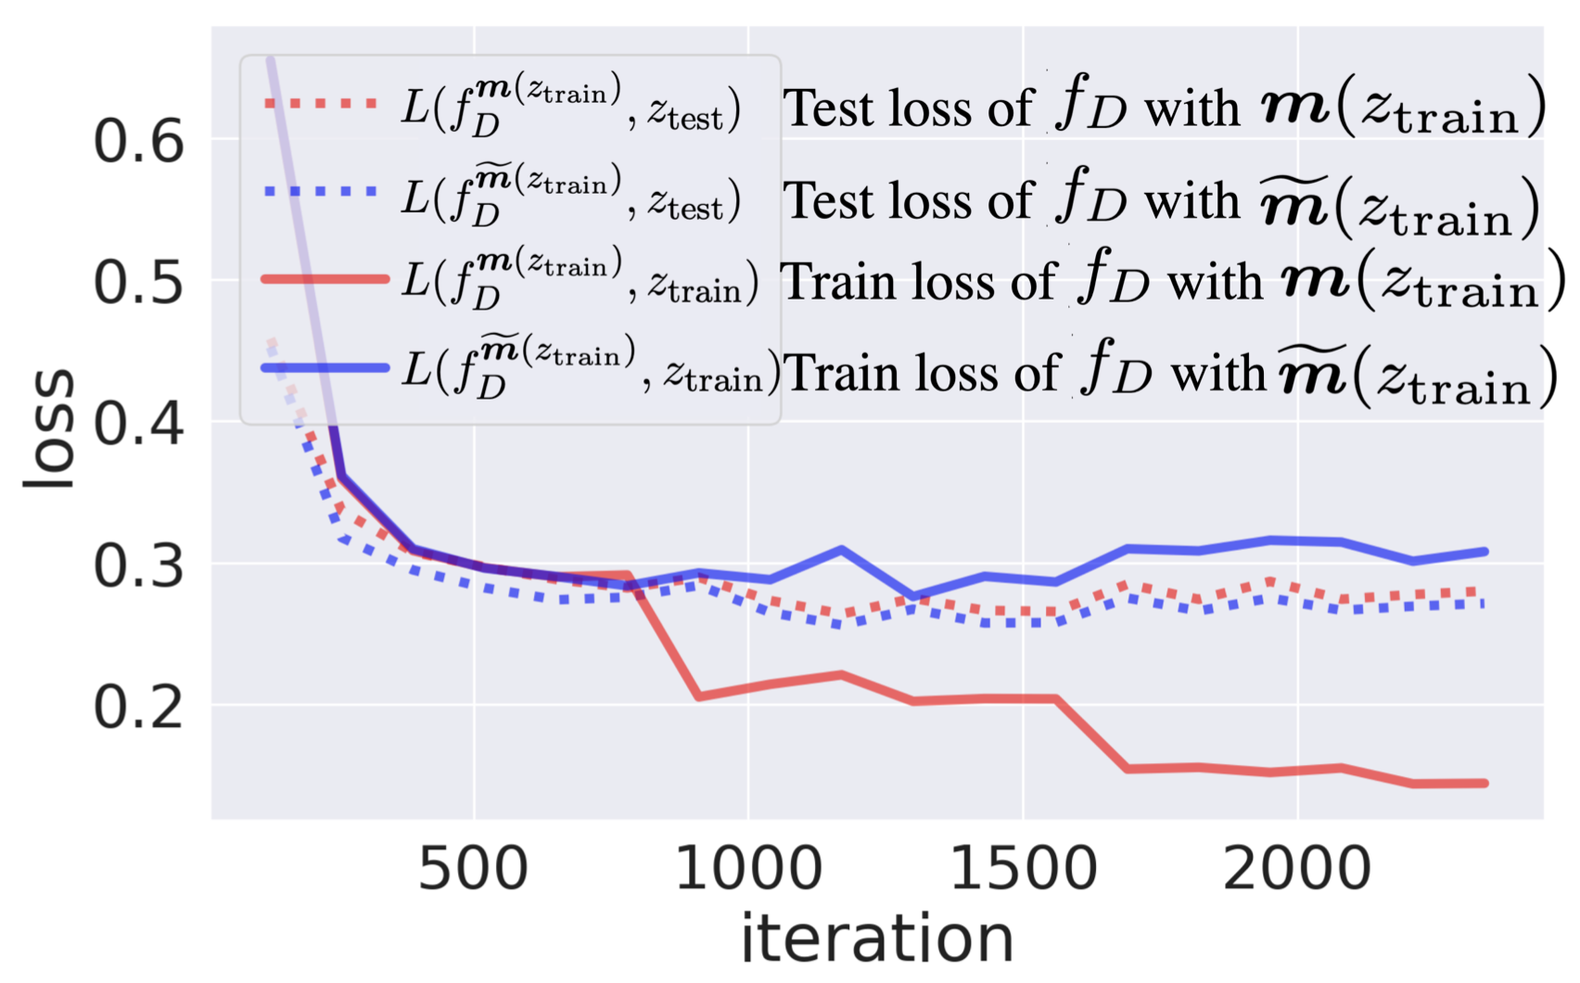
Experiment: Hidden Sub-networks Didn’t Learn the Corresponding Instances? → Actually, Yes!
Dotted: test loss Solid: training loss
Hidden sub-networks did NOT overfit to training dataset (blue solid)
Exposed sub-networks did overfit as usual (red solid)
Loss curve when finetuning BERT on SST-2 with turn-over dropout

Slide 8
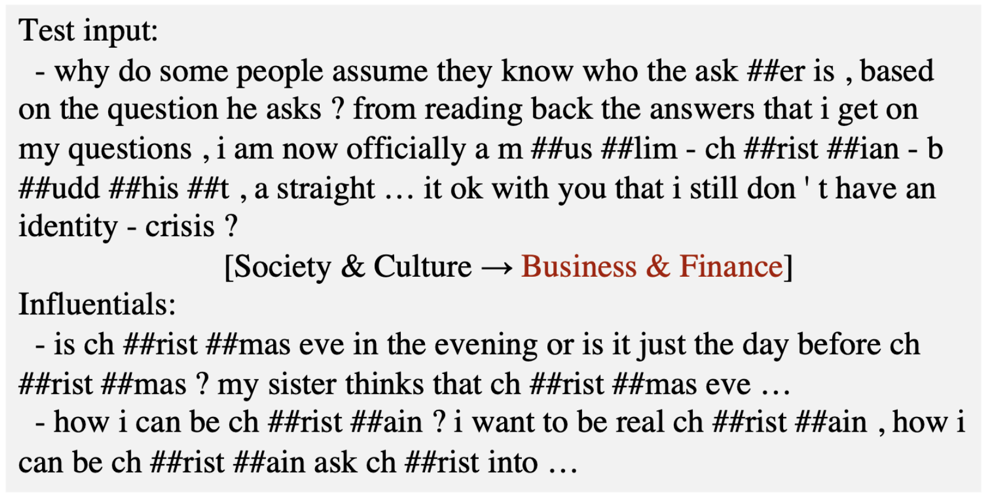
Experiment: Interpretation of Error Prediction
Analyze training instances with the largest influences for the misclassified label → we can guess the reason e.g.
The badly-influential training instances share the phrase “ch ##rist” with the test instance
Yahoo! Answers question topic classification

Slide 9
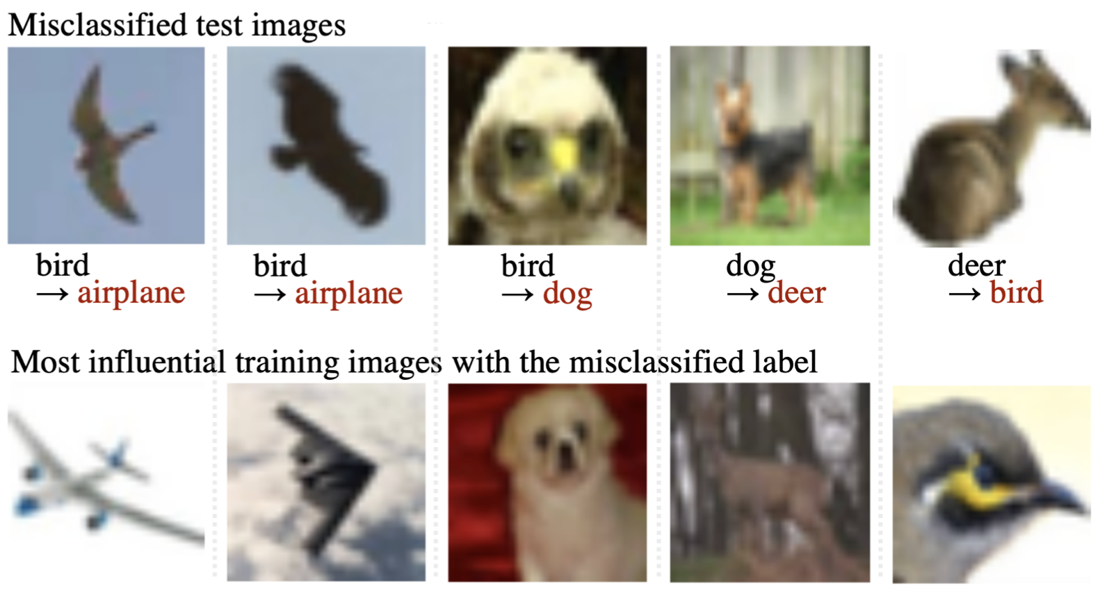
Experiment: Interpretation of Error Prediction
Analyze training instances with the largest influences for the misclassified label → we can guess the reason e.g.
The badly-influential training instances share the similar visual appearances (shape, color, layout) individually
CIFAR-10 object recognition

Slide 10
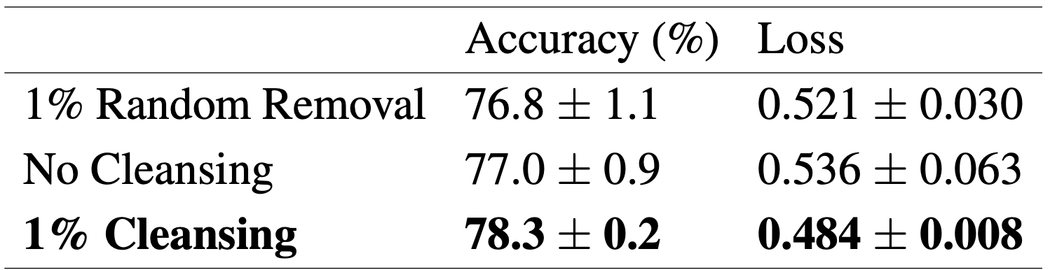
Experiment: Data Filtering for Domain Adaptation
Remove training instances with the largest negative influences on validation set → retraining on the filtered set is improved
Training set: Movie review (to be filtered) → Validation/Test set: Electronics product review

Slide 11
Conclusion
Goal: estimate the influence of a training instance = “how a model prediction or loss would be changed IF it was not used for training”
Our Approach: estimate it using dropout as generator of instance-specific ignorant sub-networks
worked for data filtering and model interpretation
is the most efficient ever (see the paper in detail)

