Slide 1

PRICAI 2022
APGKT: Exploiting Associative Path on Skills
Graph for Knowledge Tracing
Virtual Oral
Haotian zhang, Chenyang Bu*, Fei Liu*, Shuochen Liu, Yuhong Zhang, and Xuegang Hu
Key Laboratory of Knowledge Engineering with Big Data (the Ministry of Education of China),
School of Information Science and Computer Engineering, Hefei University of Technology
November 11th, 2022
Haotian Zhang
Notes:
Hello everyone.
I am zhanghaotian from hefei university of technology.
It is my great honor to speak here, and I am very glad to share my work with you.
APGKT: Exploiting Associative Path on Skills Graph for Knowledge Tracing
This work was supported by the Key Laboratory of Knowledge Engineering with Big Data.
For the next fifteen minutes，I am going to walk you through some of the best practices in our tech solution.
(Feel free to interrupt me if you have any questions during the presentation.)

Slide 2
01
Background
02
Proposed Model
CONTENTS
03
Experiments
04
Conclusion
Notes:
I have divided my presentation into four parts.

Slide 3
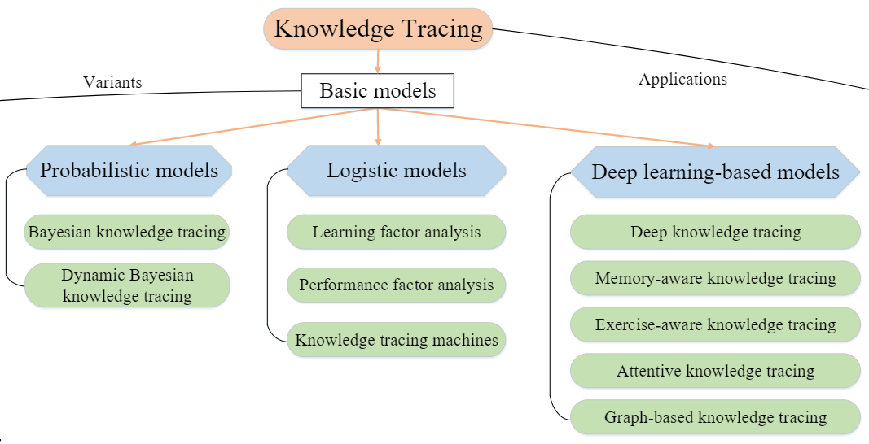
Background
Knowledge tracing (KT) is used to model students’dynamic mastery of skills based on their historical learning data and to infer their future answering performance.
Students could obtain the correct answer only if they mastered all the skills.
use the cognitive state of the skills to predict a student’s future answering performance.
Fig. 1. An overview of KT models [1]
[1] Q. Liu, S. Shen, Z. Huang, E. Chen, Y. Zheng, A survey of knowledge tracing,arXiv preprint arXiv:2105.15106 (2021).
Notes:
To start off, let’s see the background.
First of all, what’s the knowledge tracing? Knowledge tracing (KT) is used to model students’ dynamic mastery of skills based on their historical learning data and to infer their future answering performance.
KT as a student modeling technique has attracted extensive research work.
As we can see on this figure, existing KT models can be divided into three main categories: probabilistic(ˌpräbəbəˈlistik) models, logistic models, and deep learning-based models.
Most of the existing KT models assume(əˈsju:m) that students could obtain the correct answer only if they mastered all the skills; therefore, they use the cognitive state of the skills to predict a student’s future answering performance.

Slide 4
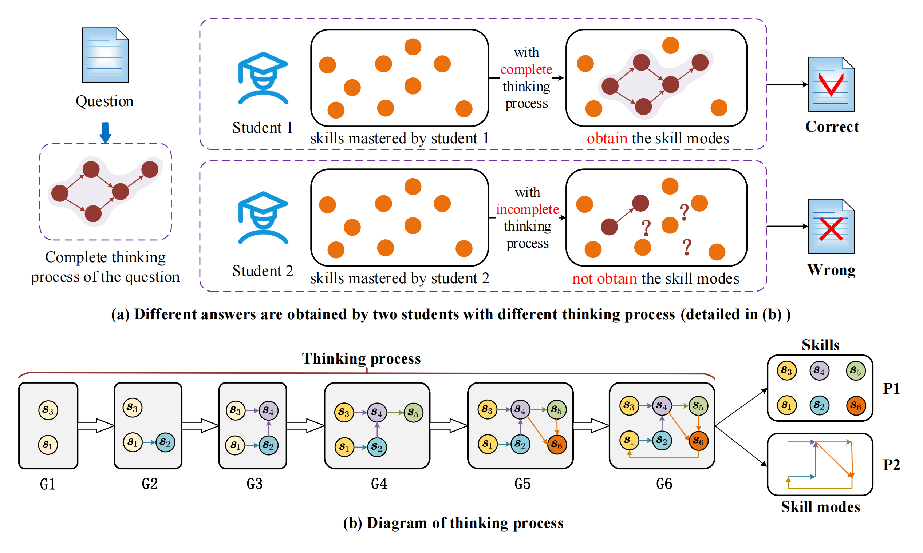
Background
The question-answering process of students can be regarded as a thinking process that considers the following two problems. One problem is which skills are needed to answer the question, and the other is how to use these skills in order.
If a student wants to answer a question correctly, the student should not only master the set of skills involved in the question but should also think and obtain the associative path on the skills graph, the nodes in which are the skills to be used, and the path showing the order of using them. Here, the associative path is referred to as the skill mode.
Fig. 2. Instance of students answering questions.
Notes:
However, they ignore the thinking process of students.
The question-answering process of students can be regarded as a thinking process that considers the following two problems. One problem is which skills are needed to answer the question, and the other is how to use these skills in order.
Let’s see a instance. As the figure2 shown. Given the same question, Assuming that the skills mastery of the two students is similar, the student who with incomplete thinking process cannot obtain the skill modes through thinking should have a higher probability of answering incorrectly.
Figure2(b) shows the detailed thinking process of a student. Gi represents every thinking state and the arrow represents a state transition, indicating a student’s thinking and associative behavior.
In other words, If a student wants to answer a question correctly, the student should not only master the set of skills involved in the question but should also think and obtain the associative path on the skills graph. The nodes in the graph are the skills to be used, and the path showing the order of using them. Here, the associative path is referred to as the skill mode.
Thus, obtaining the skill modes is the key to answering questions successfully.

Slide 5
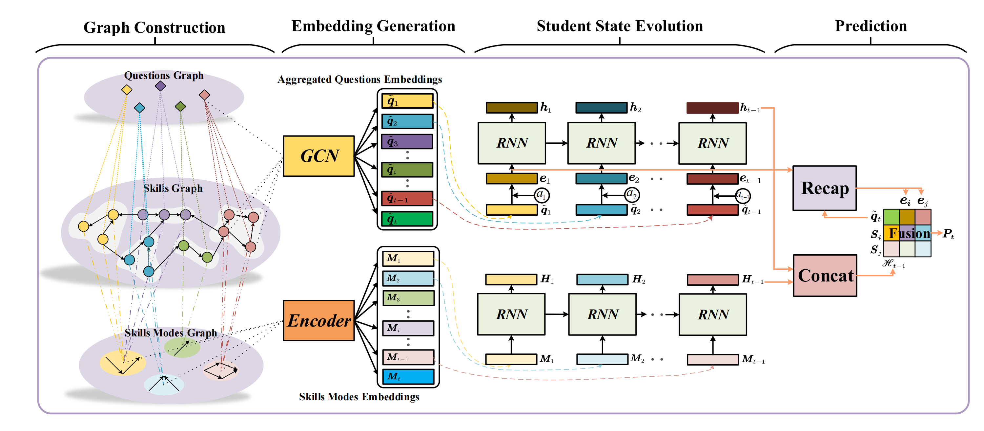
Proposed Model
APGKT is proposed considering skill modes (e.g., P2 in Fig. 2(b)) to improve performance of KT.
Fig. 3. Complete framework of the APGKT model.
Notes:
APGKT is proposed considering skill modes (e.g., P2 in Fig. 2(b)) to improve performance of KT.
In this part, I will introduce the framework of our model, which includes graph construction and representation, and student state evolution and prediction.

Slide 6
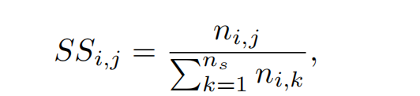
Proposed Model
Frequency-based method
Frequency-based method generates a connected graph according to the number of times two skills appear together in the same question and the number of times two skills appear separately in different questions.
Three layers
Skills Graph Construction
Three relations
where represents the times two skills appear together in the same question.
Fig. 3. Structure of the Graph.
Graph Construction and Representation
Notes:
Now let’s move to the first part of the model--graph construction and representation.
Figure3 shows the structure of the graph.
It includes three layers.The top layer is a question graph that contains all the questions from the student’s answer record.
The middle layer is a skills graph, which consists of the skills involved in all the questions.
And the bottom layer is a skill-mode graph, which contains all the obtained skill modes.
There are three relations between the questions, skills and skill modes as shown in the figure3.
For the Skills Graph Construction, a frequency-based method is proposed.
Frequency-based method generates a connected graph according to the number of times two skills appear together in the same question and the number of times two skills appear separately in different questions. This is calculated using the following equation.

Slide 7
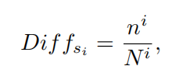
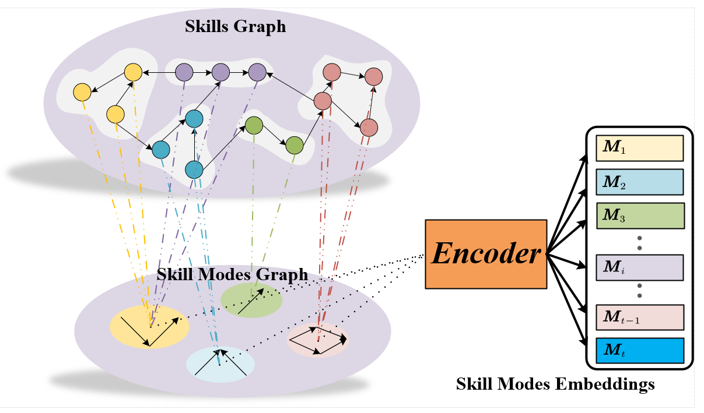
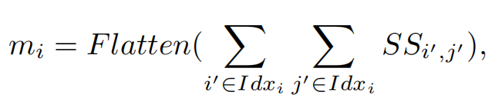
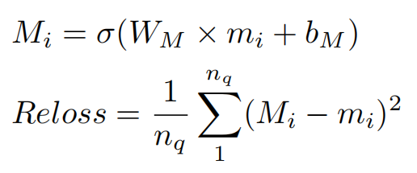
Proposed Model
Fig. 3. Skill Modes Generation and Representation.
Graph Construction and Representation
Notes:
Now let’s turn to the issue of Skill Modes Generation and Representation.
Considering that students usually have a thinking process from easy to difficult when answering questions, we obtain an effective representation of the skill modes using the encoded association paths and difficulty levels of skills.
Difficulty level of all the skills are obtained through statistical information.
The initial representation of the skill mode are obtained through extracted and flattened.
And finally, an effective representation of the skill modes are obtained by encoding the initial representation of the skill modes.
This may sound abstract.

Slide 8
Proposed Model
skills ids
Graph Construction and Representation
Notes:
Next I will explain the process with an example.
The skill matrix represents the relationship between skills, and the value represents the strength of the association. The sub-matrix of these skills are extracted here, so are this one.
Letting them flatten, it is not obvious that there is any relation, and when we visualize them, we will find that there seems to be a relation between them.
When we use the difficulty level of skills to first ordered. The results after extraction and flatten can clearly see that these two belong to the same skill mode.
Then encode it, which turns out to be a valid representation.

Slide 9
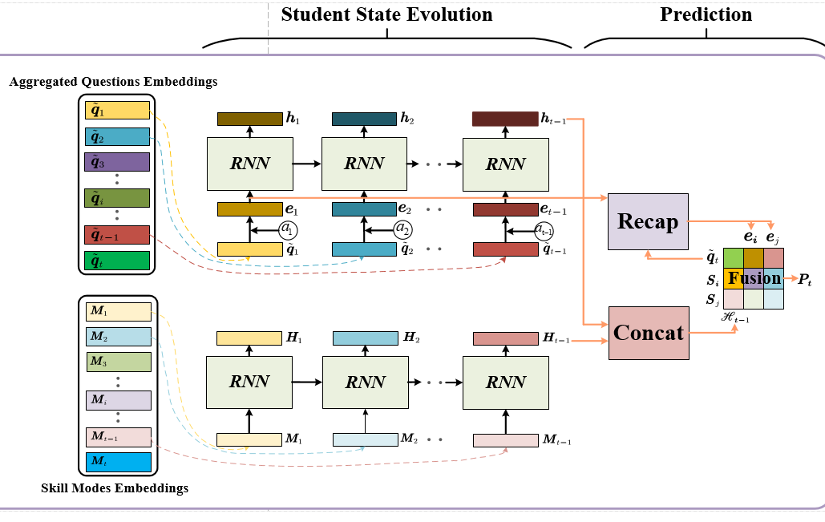
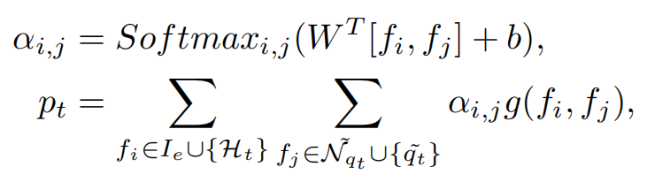

Proposed Model
Student State Evolution and Prediction
Notes:
In the student state evolution and prediction module, we concat the cognitive states of the student’s skills and skill modes through the concat module to obtain the student’s higher-order cognitive state. Finally, we incorporate the student’s higher order cognitive state to obtain the final prediction.

Slide 10
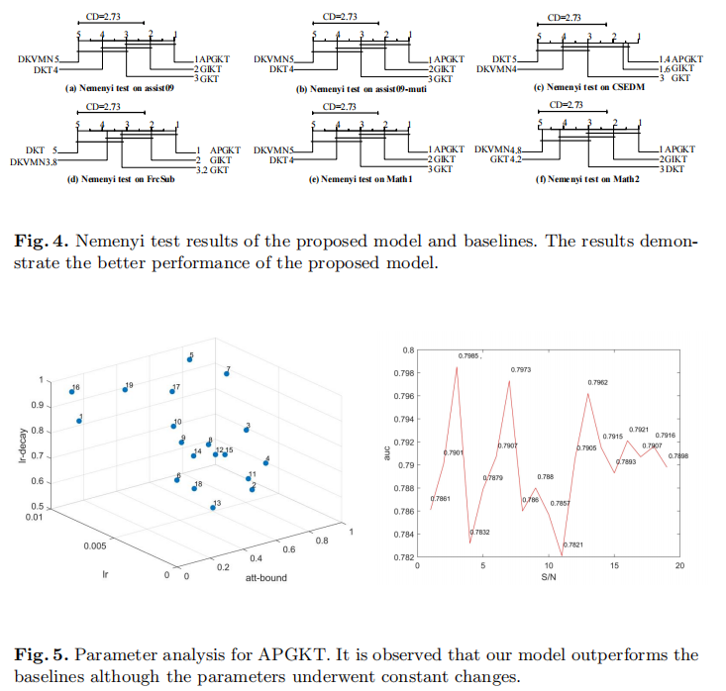
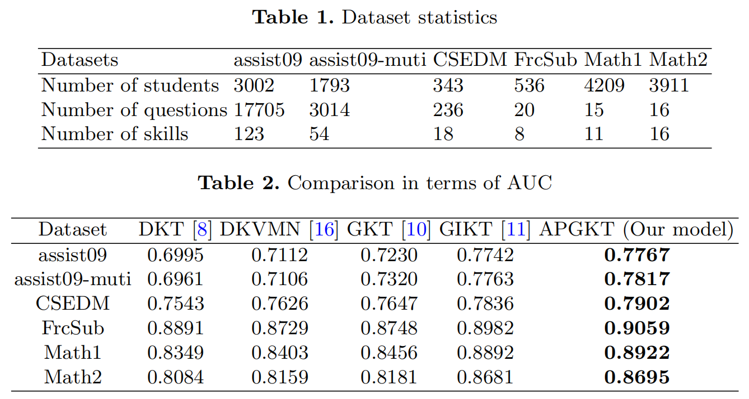
Experiments
Experiments are conducted on five real-world datasets to demonstrate the effectiveness of the proposed model. The comparing results and Nemenyi tests are presented. Finally, the parameters in the model are analyzed.
Notes:
Experiments are conducted on five real-world datasets to demonstrate the effectiveness of the proposed model. The comparing results and Nemenyi tests are presented. Finally, the parameters in the model are analyzed. The results are shown in the figures.

Slide 11
Conclusion
Main Contributions
This study exploits the associative path on the skills graph for knowledge tracing (KT). The thinking process (i.e., obtaining the associative path) has been demonstrated to be indispensable for achieving a correct answer (detailed in Fig. 1). However, most of the existing KT models only consider whether the set of skills involved in the question have been mastered when predicting a student’s future answering performance.
The proposed APGKT model includes the concept of skill modes and higher order cognitive states. Considering the dynamic process of students thinking and answering questions, the skills associated with a specific problem are considered as a whole to consider the organizational association. We combine the cognitive state of the skills and the skill modes into a higher-order cognitive state to accurately represent the cognitive processes of students.
Extensive experiments on five public datasets proved that the prediction results of our model are better than those of baseline models, owing to the consideration of the thinking process during KT.
Outlook
Since the thinking process of students is actually a complex cognitive process, which is affected by many factors such as psychology, in the future, we will further explore the representation and application of the thinking process to improve the model.
Notes:
In conclusion, The main contributions of this study are as follows briefly:
This study exploits the associative path on the skills graph for knowledge tracing (KT).The thinking process (i.e., obtaining the associative path) has been demonstrated（demənstreɪtɪd） to be indispensable for achieving a correct answer (detailed in Fig. 1). However, most of the existing KT models only consider whether the set of skills involved in the question have been mastered when predicting a student’s future answering performance.
The proposed APGKT model includes the concept of skill modes and higher order cognitive states.Considering the dynamic process of students thinking and answering questions, the skills associated with a specific problem are considered as a whole to consider the organizational association. We combine the cognitive state of the skills and the skill modes into a higher-order cognitive state to accurately represent the cognitive processes of students.
Extensive experiments on five public datasets proved that the prediction results of our model are better than those of baseline models, owing to the consideration of the thinking process during KT.
Since the thinking process of students is actually a complex cognitive process, which is affected by many factors such as psychology（saɪˈkɒlədʒi）, in the future, we will further explore the representation and application of the thinking process to improve the model.

Slide 12
PRICAI 2022
THANKS
Thanks!
The 19th Pacific Rim International Conference
on Artificial Intelligence
November 11th, 2022
Haotian Zhang
Notes:
Thank you for your listening,I would be glad to answer any questions you might have.

