Slide 1
3η Εργασία Αλγορίθμων CAD
Καραμέλλιος Σωτήριος
2237

Slide 2
Contents
One simple queue
read_graph
write_graph
draw_graph
graph_critical_path

Slide 3

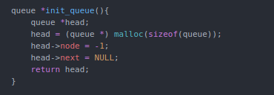
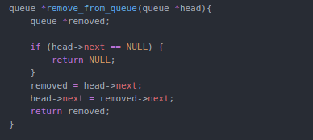
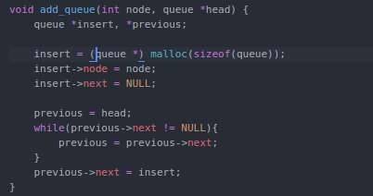

Simple queue

Slide 4
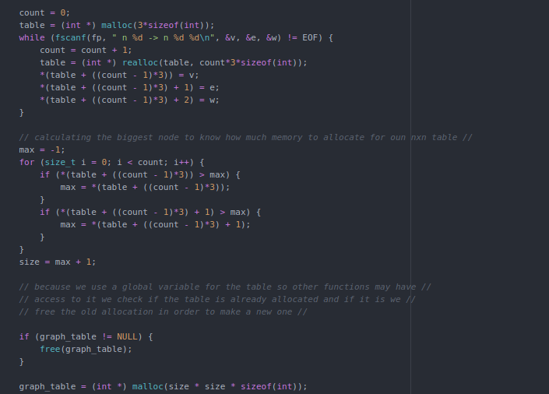
read_graph (1)

Slide 5
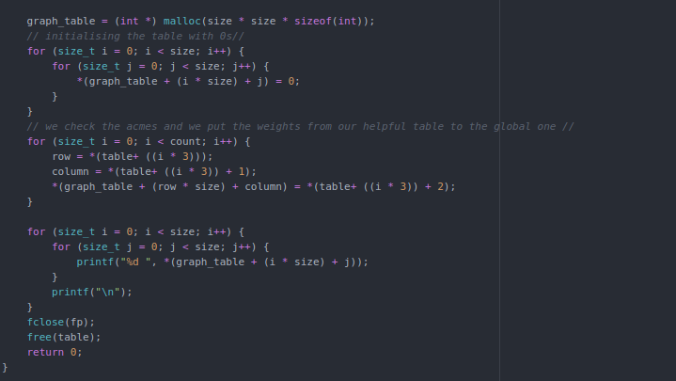
read_graph (2)

Slide 6
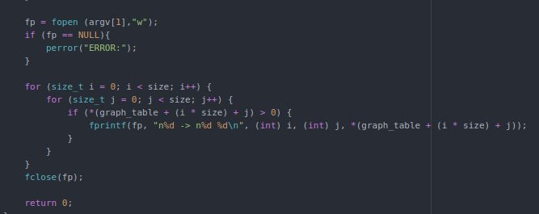
write_grap

Slide 7
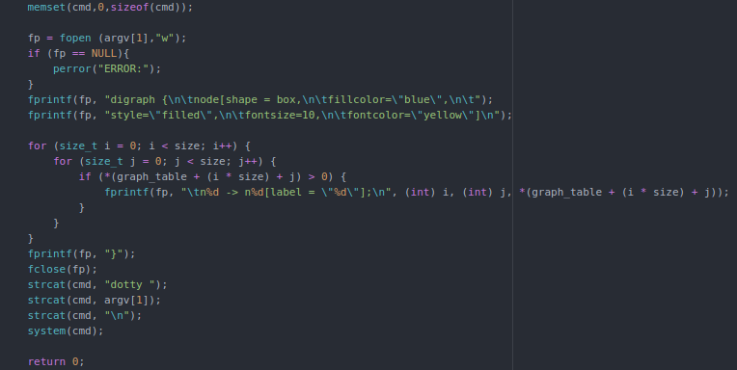
draw_graph

Slide 8
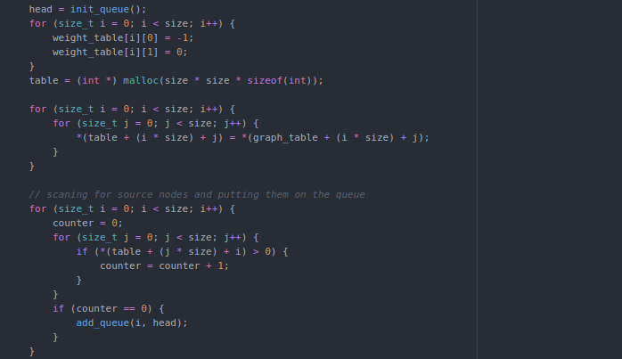
graph_critical_path (1)

Slide 9
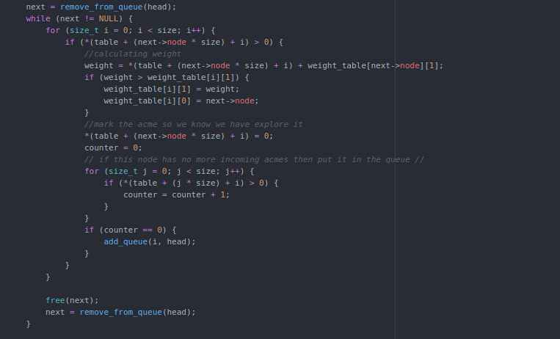
graph_critical_path (2)

Slide 10
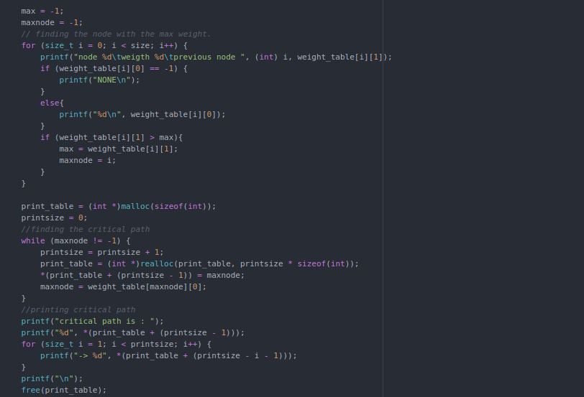
graph_critical_path (3)

Slide 11
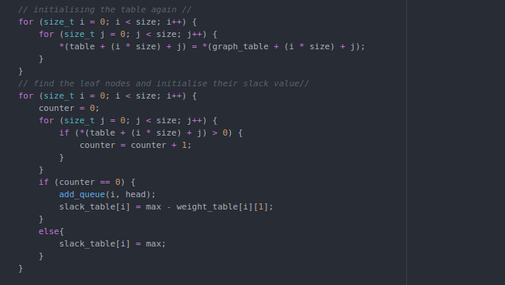
graph_slack (1)

Slide 12
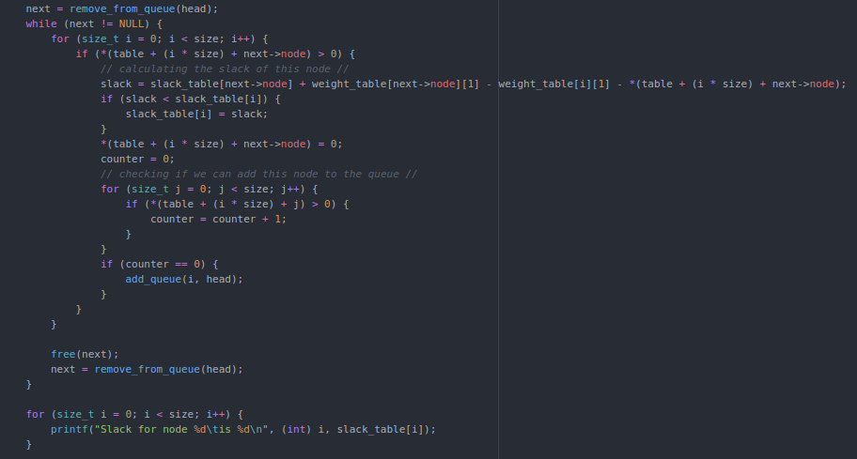
graph_slack (2)

