Slide 1
4η Εργασία Αλγορίθμων CAD
Καραμέλλιος Σωτήριος
2237

Slide 2
Contents
Upgrade of some old functions
Extra aux functions
alg_division
r_kernels

Slide 3
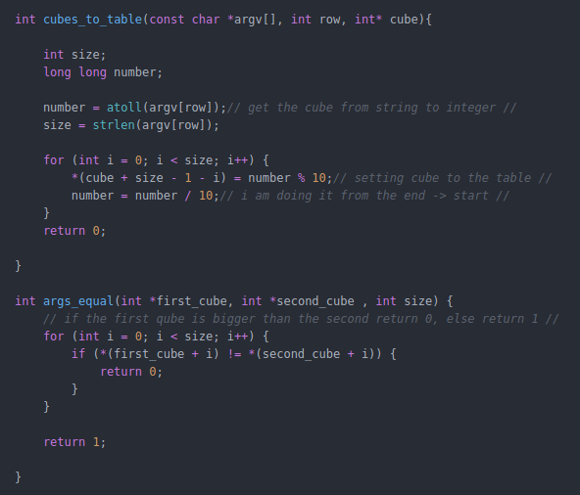
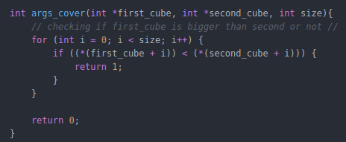
Upgrade of some old aux_functions

Slide 4
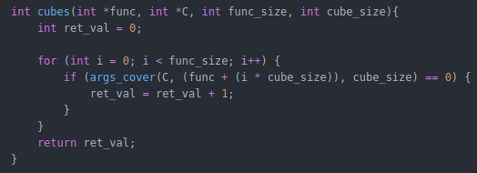
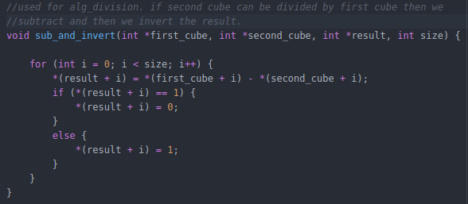
aux_functions

Slide 5
sub_and_invert
Παράδειγμα:
F = ac + ad + bc + bd + e, P = a + b
ac/a
Ac→ 0111011111 a→ 0111111111
Sub : a-ac → 0111111111 – 0111011111 = 0000100000
Invert the result → 1111011111 = c

Slide 6
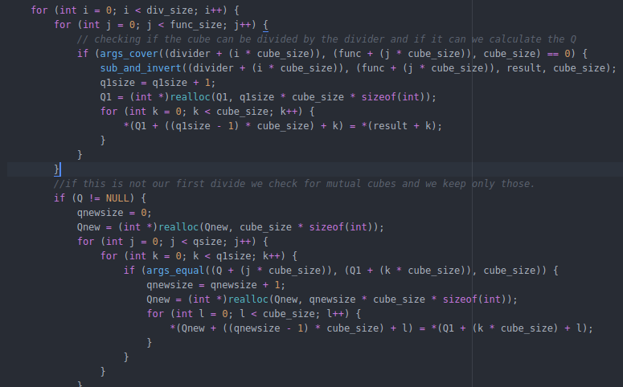
alg_division(1)

Slide 7
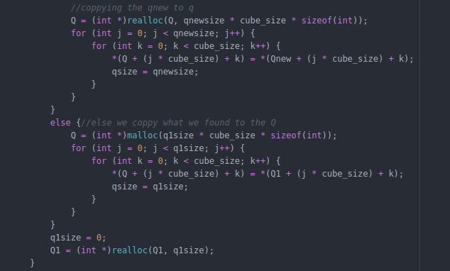
alg_division(2)

Slide 8
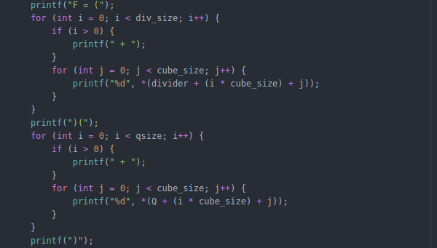
alg_division(3)
Printing the F = D * Q part of our division

Slide 9
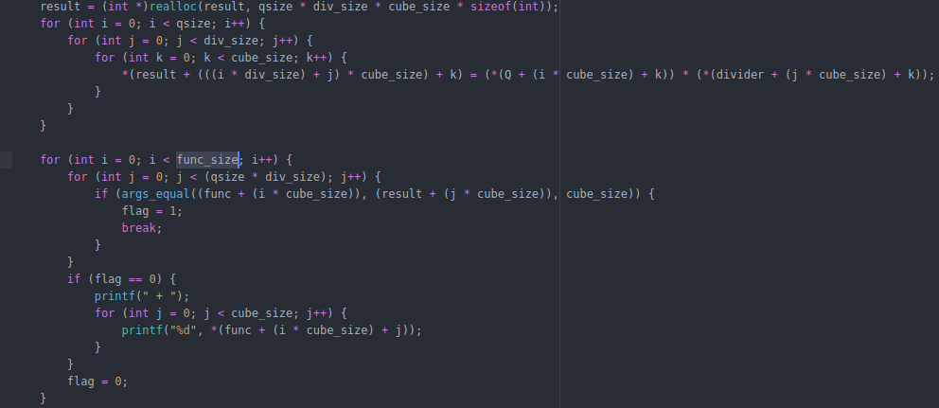
alg_division(4)
Calculating and printing R = F - D*Q

Slide 10
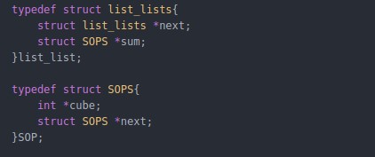
r_kernels(1)
Using a list of lists to save the results. Each iteration creates a list_list and returns the cubes contained in the F(input function) on a list of SOP

Slide 11
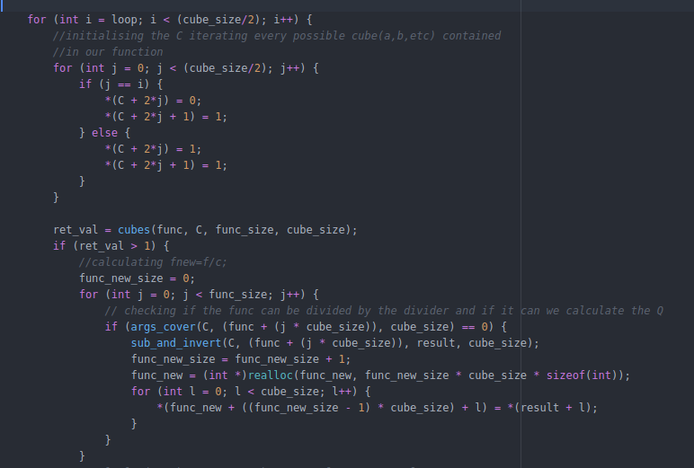
r_kernels(2)

Slide 12
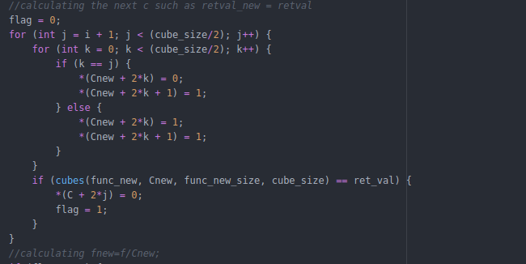
r_kernels(3)
Checking for every variable if it belongs to all our cubes in fnew and if it does we add it to C

Slide 13
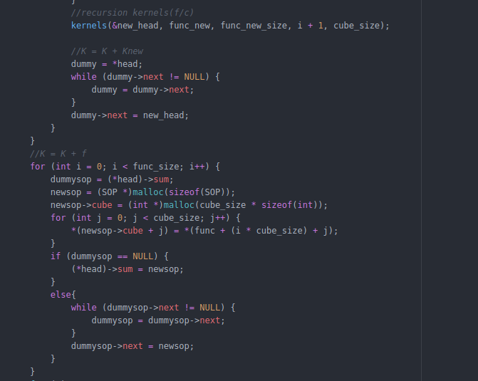
r_kernels(4)

