Slide 1
CAD Algorithms
1st assignment
Karamellios Sotirios
2237

Slide 2
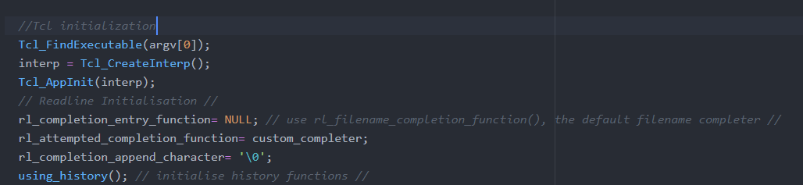
Here I create and initialize firstly the Tcl interpreter with
Tcl_FindExecutable which gets the absolute path for tcl’s internal use
Tcl_CreateInterp which is initializing an interpreter structure which is passed on the tcl commands
Tcl_AppInit which adds the custom commands to our interpreter
And after that I initialize the readline functions(tab completer and history)
The first line is for using the filename generator function
The second one is for using, before the filename generator, our own custom generator.
Third line is for When a single completion alternative matches at the end of the command line, this character is appended to the inserted completion text.
Finally we initialize history functions.

Slide 3
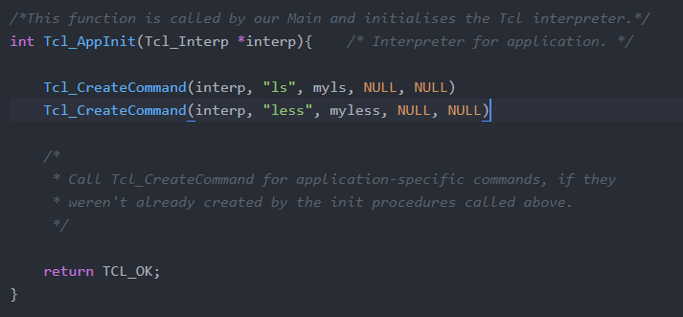
Tcl_AppInit is a function usually used by Tcl_main, but I kept the name for clarity purposes.
This function is normally used for initializing the Tcl interpreter and adding any extra custom commands.
Here I use Tcl_CreateCommand instead of the Tcl_CreateObjCommand because of the way I have implemented ls and less.
I need to pass the arguments on execv and I couldn’t do it with the Tcl_CreateObjCommand.

Slide 4
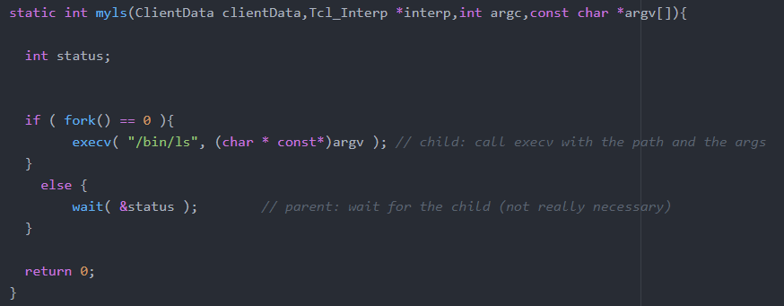
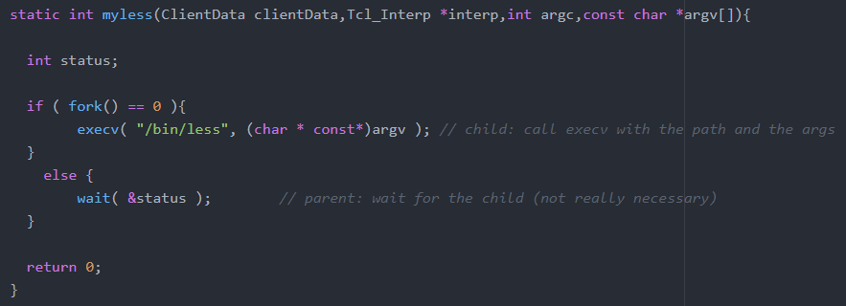

Slide 5
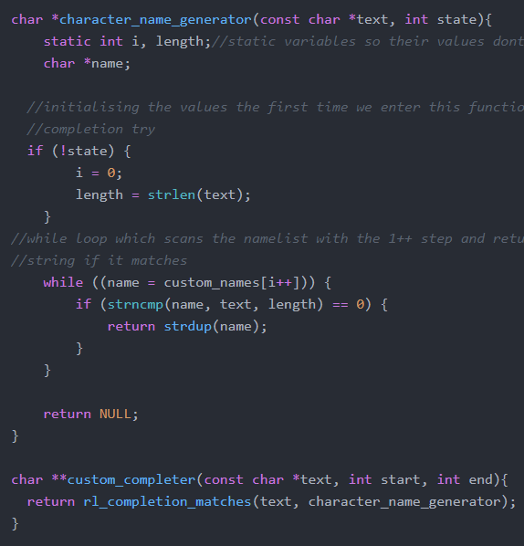
Custom completion works this way:
When we press tab custom_completer gets invoked which calls completion matches
This function creates a NULL terminated string which contains all the matching completions
The matching completions come from character name generator.
The first time character name generator is being invoked the argument state is 0, which allows us to initiate a static int variable, while every subsequent time state’s value is +1;
After the initialization we are scanning the list and we return all the matching completions.

Slide 6
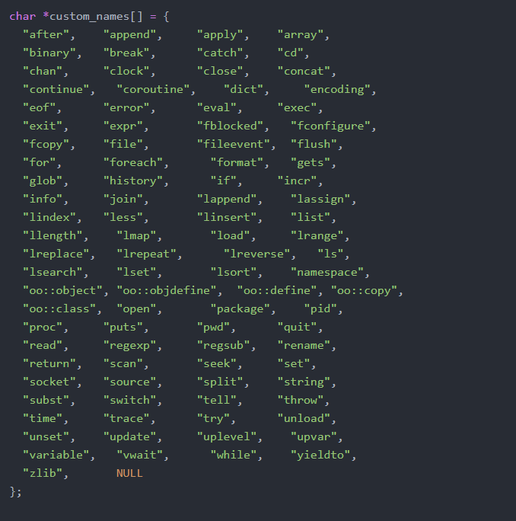

Slide 7
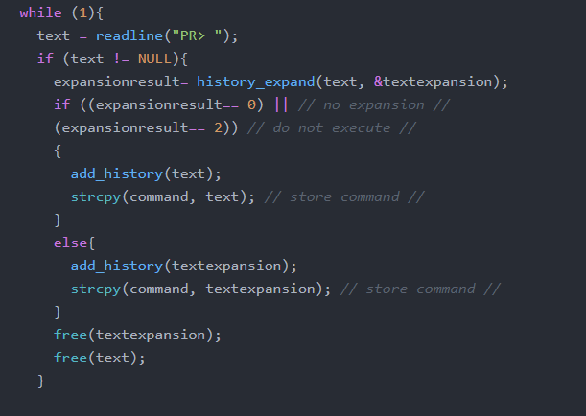
Here is my main api. Readline reads the command and tries to use history expand. If it is not an expandable command(with the use of !) it adds the normal command. Else it adds the expanded command in the history string.

Slide 8
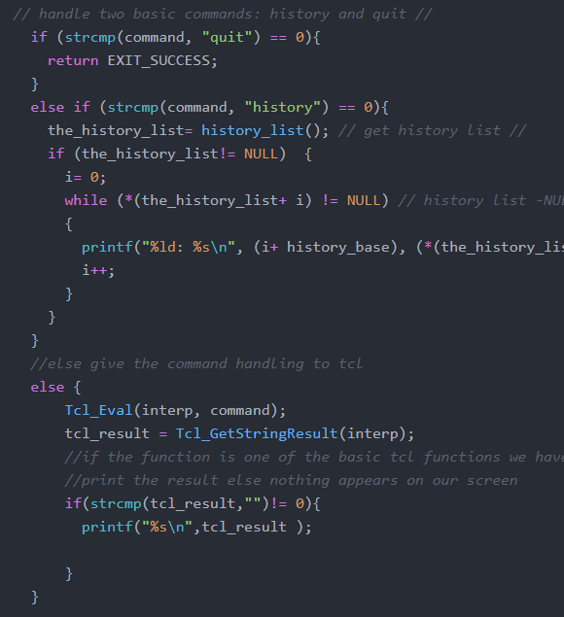
After readline gets the imput and adds it to the history list it checks if the input is one of the 2 custom commands it supports, quit or history, and if it is it is executed.
If the command is not one of those 2 it is being send to Tcl_Eval to be processed by the tcl interpreter. After it has been processed we extract the return value with the help of Tcl_GetStringResult and we print it if its not empty.

