Slide 1
ZKP
OVERALL (Part 1)
Harry Nguyen

Slide 2
CONTENT
01
WHAT IS ZKP?
02
APLLICATION
03
HOW TO DO IT?
04
ZK VS OPTIMISTIC ROLLUPS
05
PERFORMANCE COMPARISON
06
PROBLEMS

Slide 3
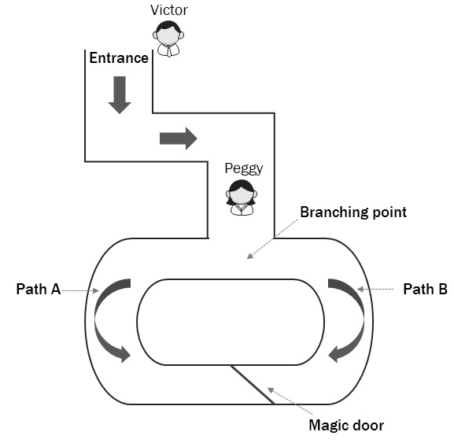
What is ZKP?
Section 1

Slide 4
APpLICATION
Section 2
Proving statement on private data:
Person A has more than X in his bank account
In the last year, a bank did not transact with an entity Y – Matching DNA without revealing full DNA
One has a credit score higher than Z

Slide 5
APpLICATION
Section 2
Anonymous payments:
Payment with full detachment from any kind of identity
Paying taxes without revealing one’s earnings

Slide 6
APpLICATION
Outsourcing computation:
Outsource an expensive computation and validate that the result is correct without redoing the execution; it opens up a category of trustless computing
Changing a blockchain model from everyone computes the same to one party computes and everyone verifies
Section 2

Slide 7
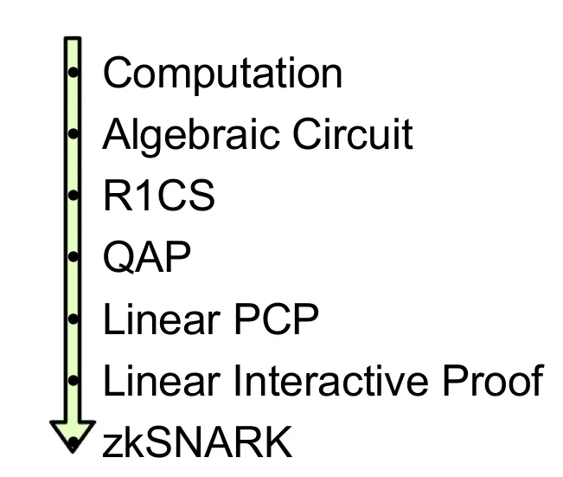
How to do it?
Section 3

Slide 8
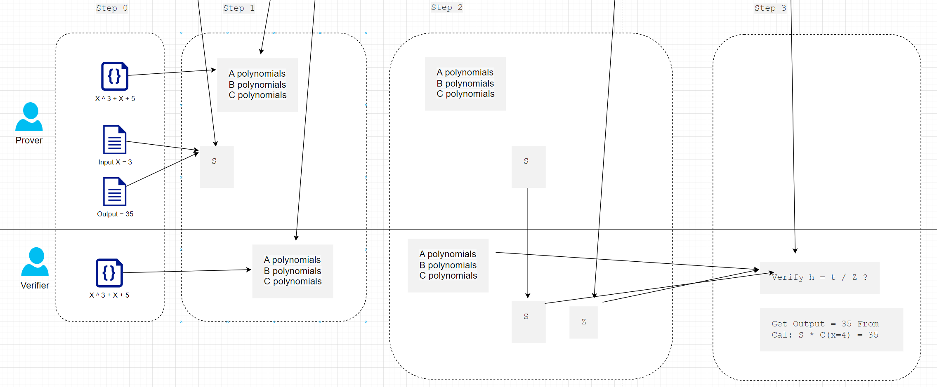
How to do it?

Slide 9
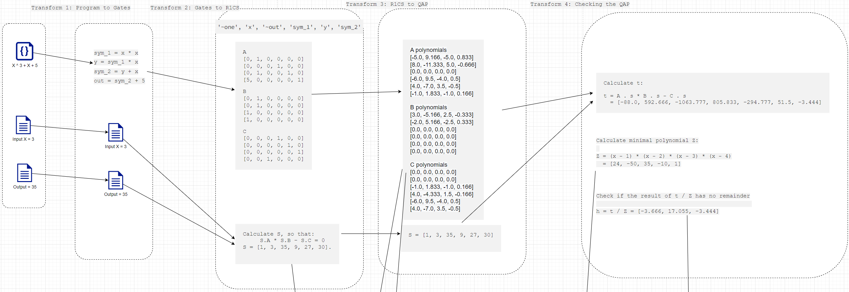
How to do it?

Slide 10
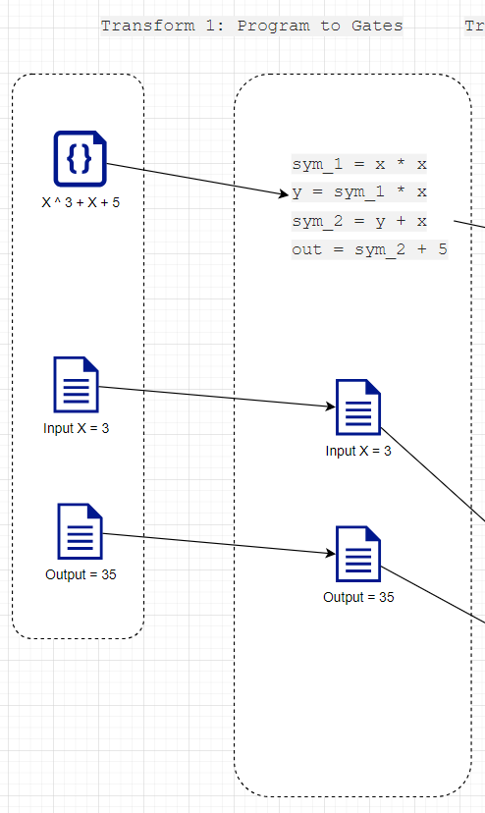
Transform 1: Program to Gates
19 ^ 3 + 19 + 5 = ?
19 * 19 = 361
361 * 19 = 6859
6859 + 19 = 6878
6878 + 5 = 6883

Slide 11
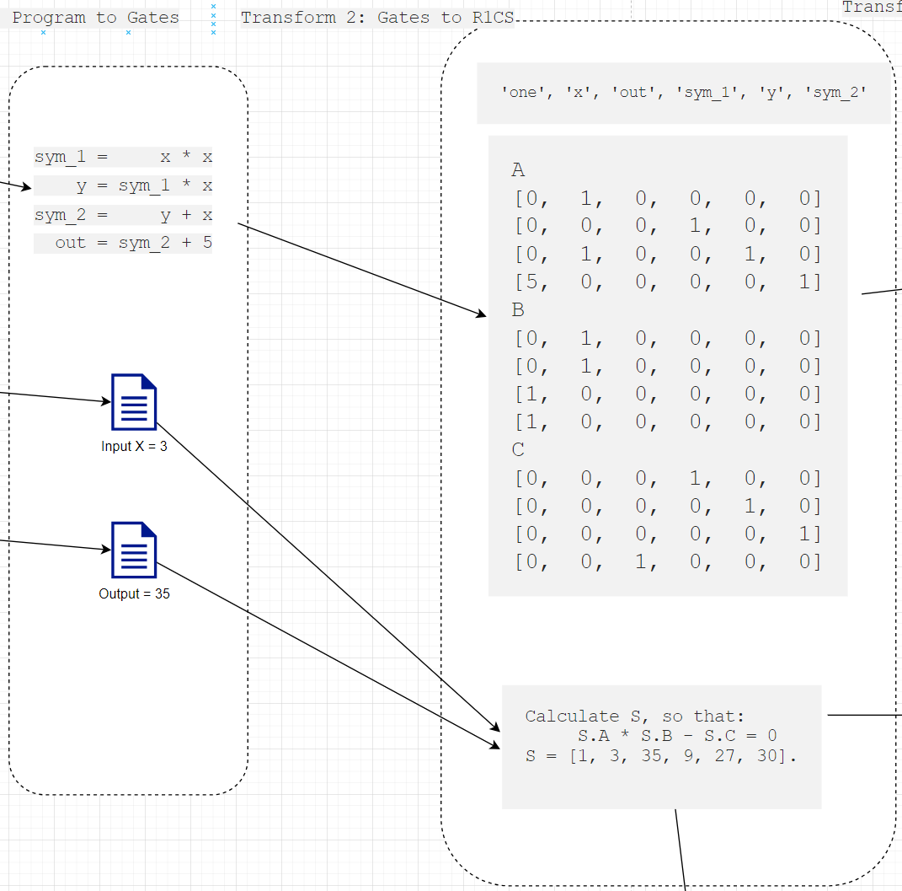

Transform 2: Gates to R1CS

Slide 12
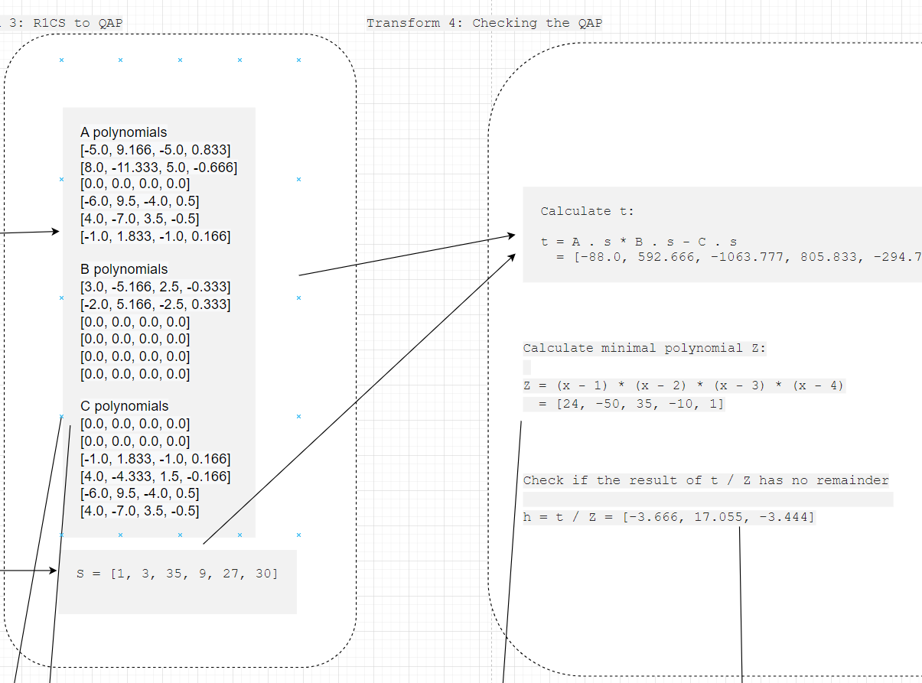
Transform 4: Checking the QAP
The whole process is done correctly if we can find suitable (h)

Slide 13
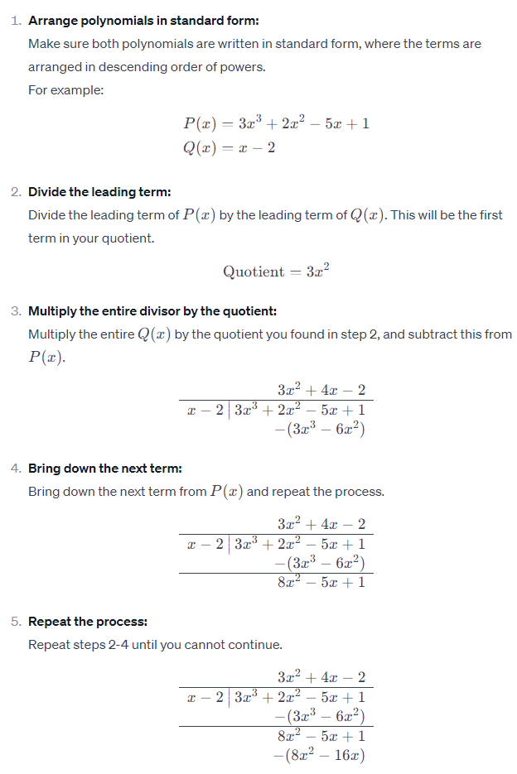
APPENDIX: How TO DIVIDE 2 POLYNOMIALS

Slide 14
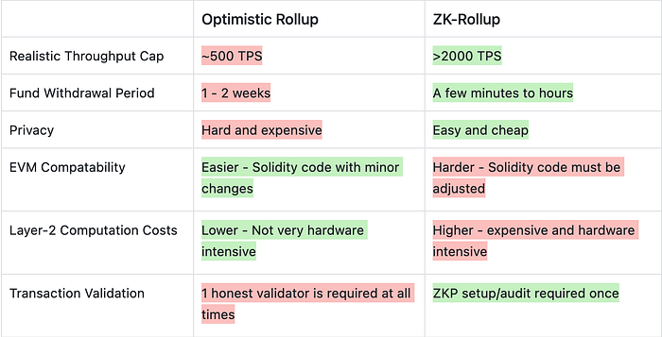
ZK vs Optimistic Rollups
Section 4

Slide 15
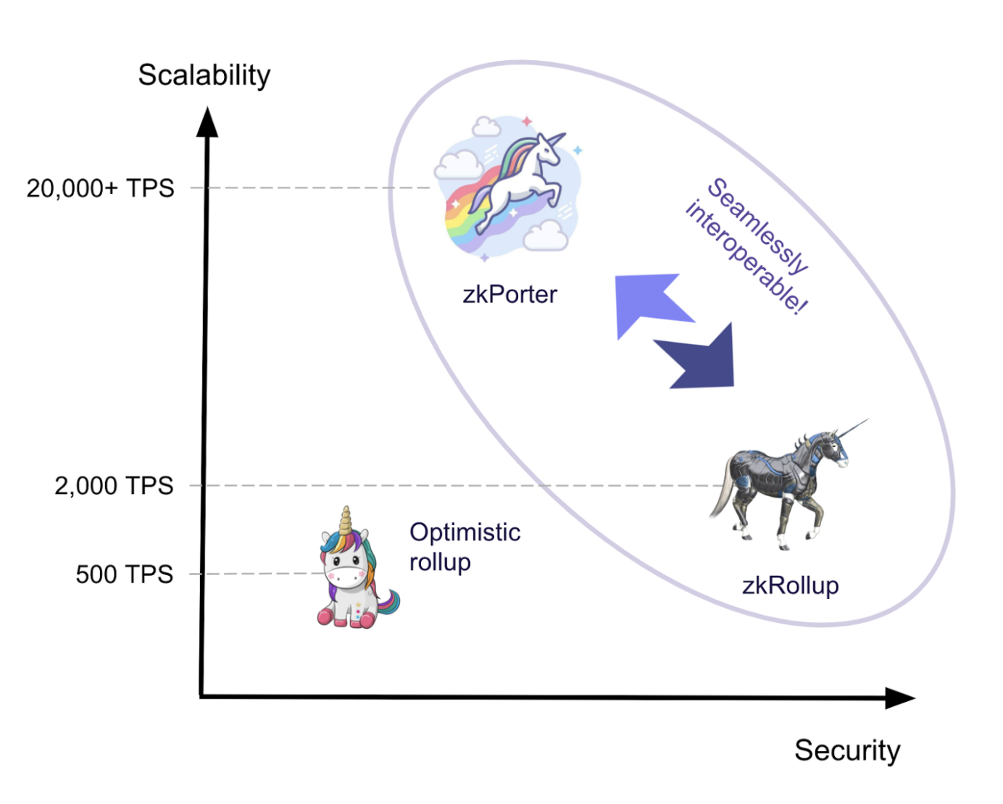
Performance COMPARISON
Section 5

Slide 16
Problems
Section 6
Proof size => Block size
Prover time
Verifier time
Trusted setup
EVM compatibility / Community

Slide 17
THANKS
FOR LISTENING!

