Slide 1

ZKP FOr GAMING
SOTA ZK LAB

Slide 2
Content
1
Challenges
2
Current Solutions
3
Our platform

Slide 3
1
Challenges

Slide 4
Challenges
Where does the game logic be executed?
Off-chain solutions:
Fast
Highly customizable
Trusted
On-chain solutions:
Decentralized
Limited execution logic
Slow

Slide 5
2
Current Solutions

Slide 6
L2
Game Engine

Slide 7
2.1 L2 Solution
Mainly support game assets management
Increase transaction throughput
Not applicable to run game logic fully on-chain
Immutable
Arbitrum Nova
Oasys

Slide 8
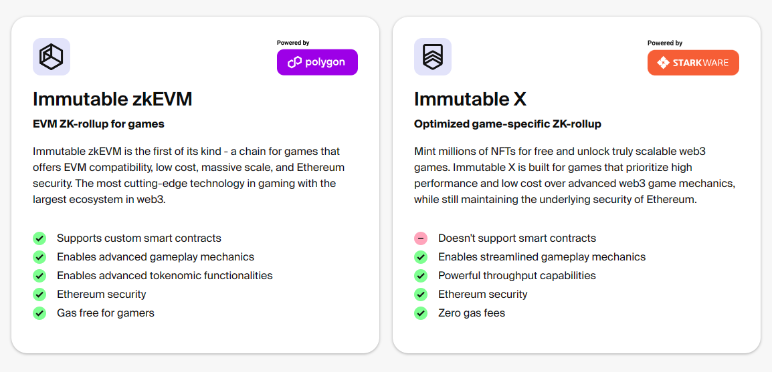
Immutable

Slide 9
Arbitrum Nova
Plasma (Optimistic rollup with offchain data availability)
Higher transaction throughput than Arbitrum

Slide 10
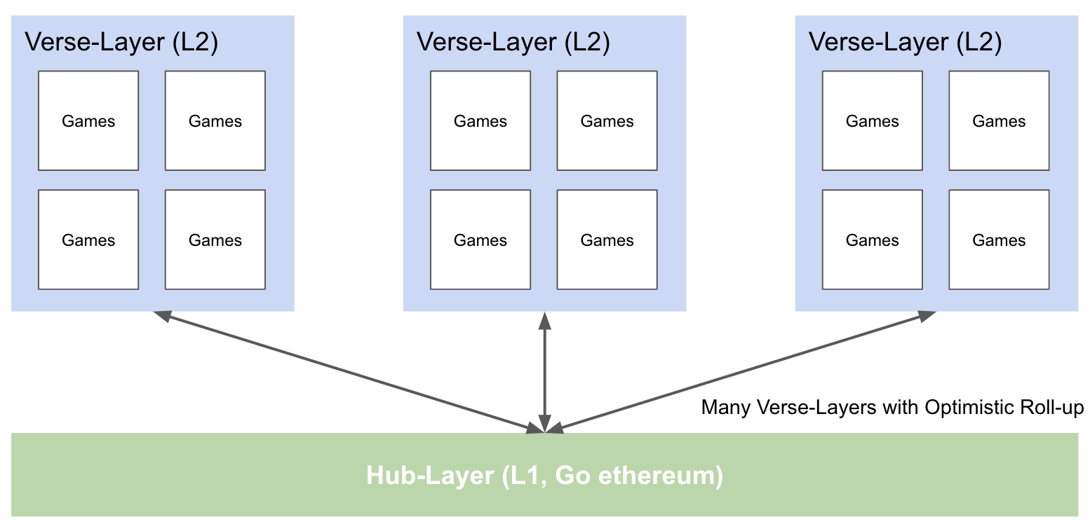
Oasys
L1 (Hub Layer) combine with optimistic rollup L2s (Verse Layer)
One or more games can live on an explicit Verse
High throughput, optimized

Slide 11
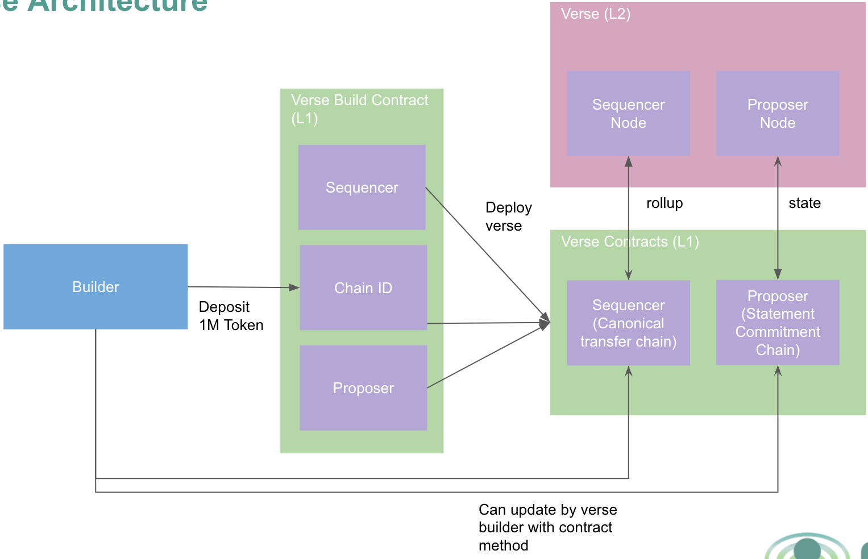
Oasys

Slide 12
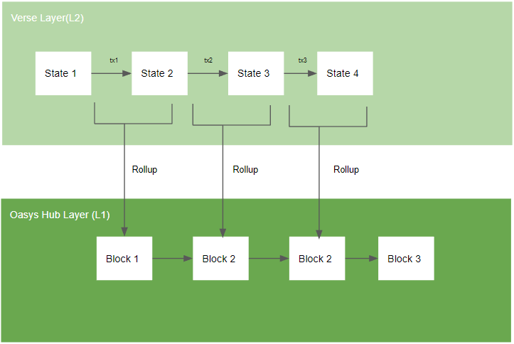
Oasys

Slide 13
2.2 Game Engine
Support Fully On-chain game (FOG)
Don’t need to trust game server
MUD
Argus
Dojo

Slide 14
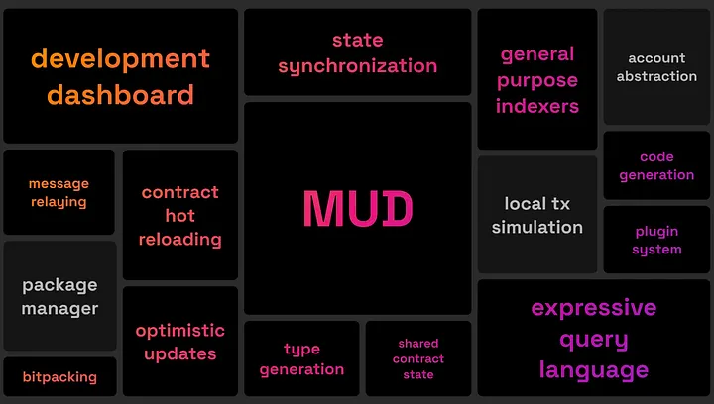
MUD
ECS game engine lives on EVM
EVM limitations

Slide 15
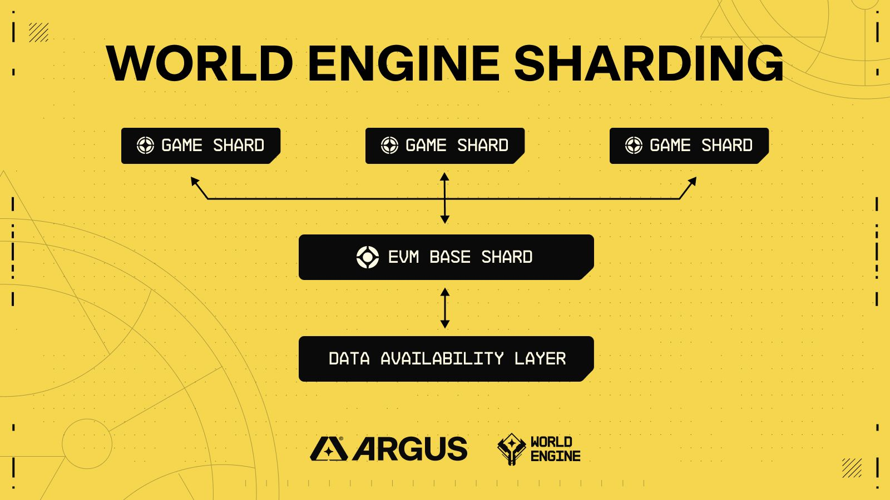
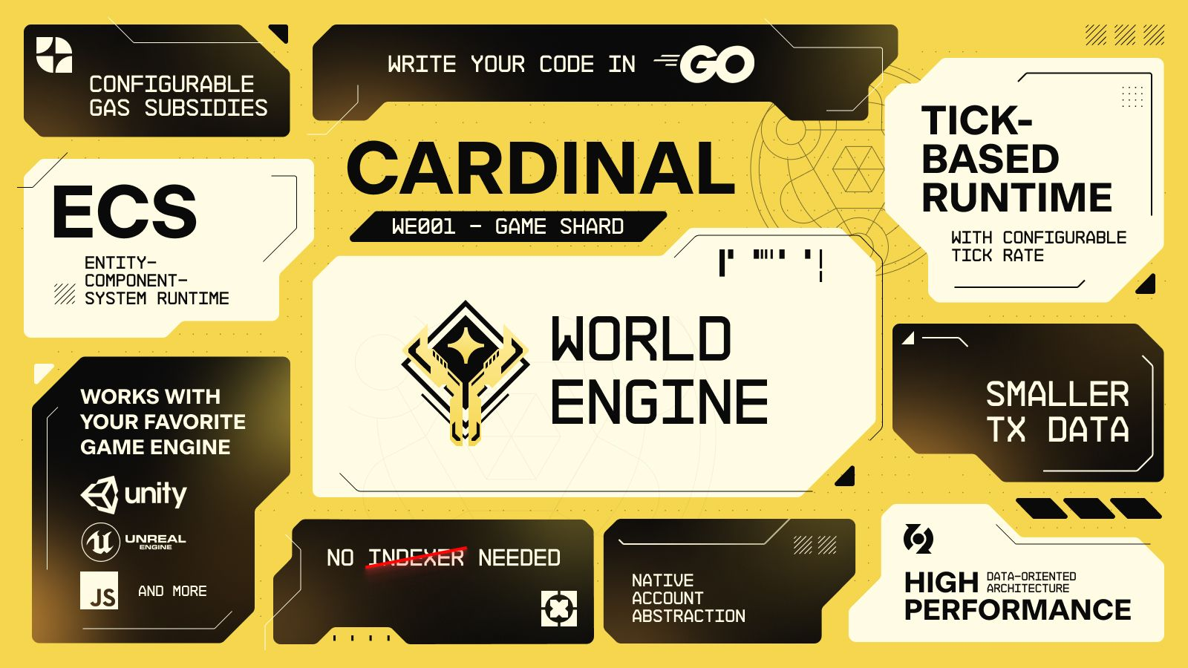
Argus
World engine
A sharded layer 2 blockchain SDK
Game execution (game shard) to be decoupled from smart contract execution (EVM shard)

Slide 16
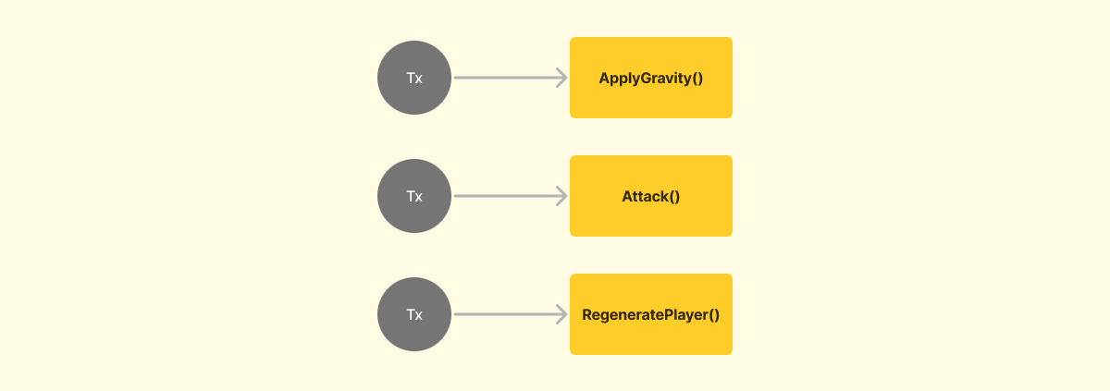
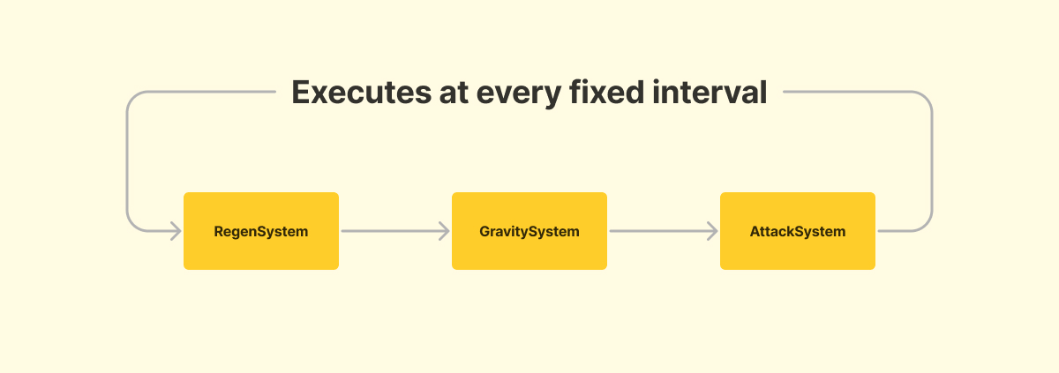
Argus
Cardinal
ECS
Loop-driven runtime
Game logic is written in Go
Event-driven
Loop-driven

Slide 17
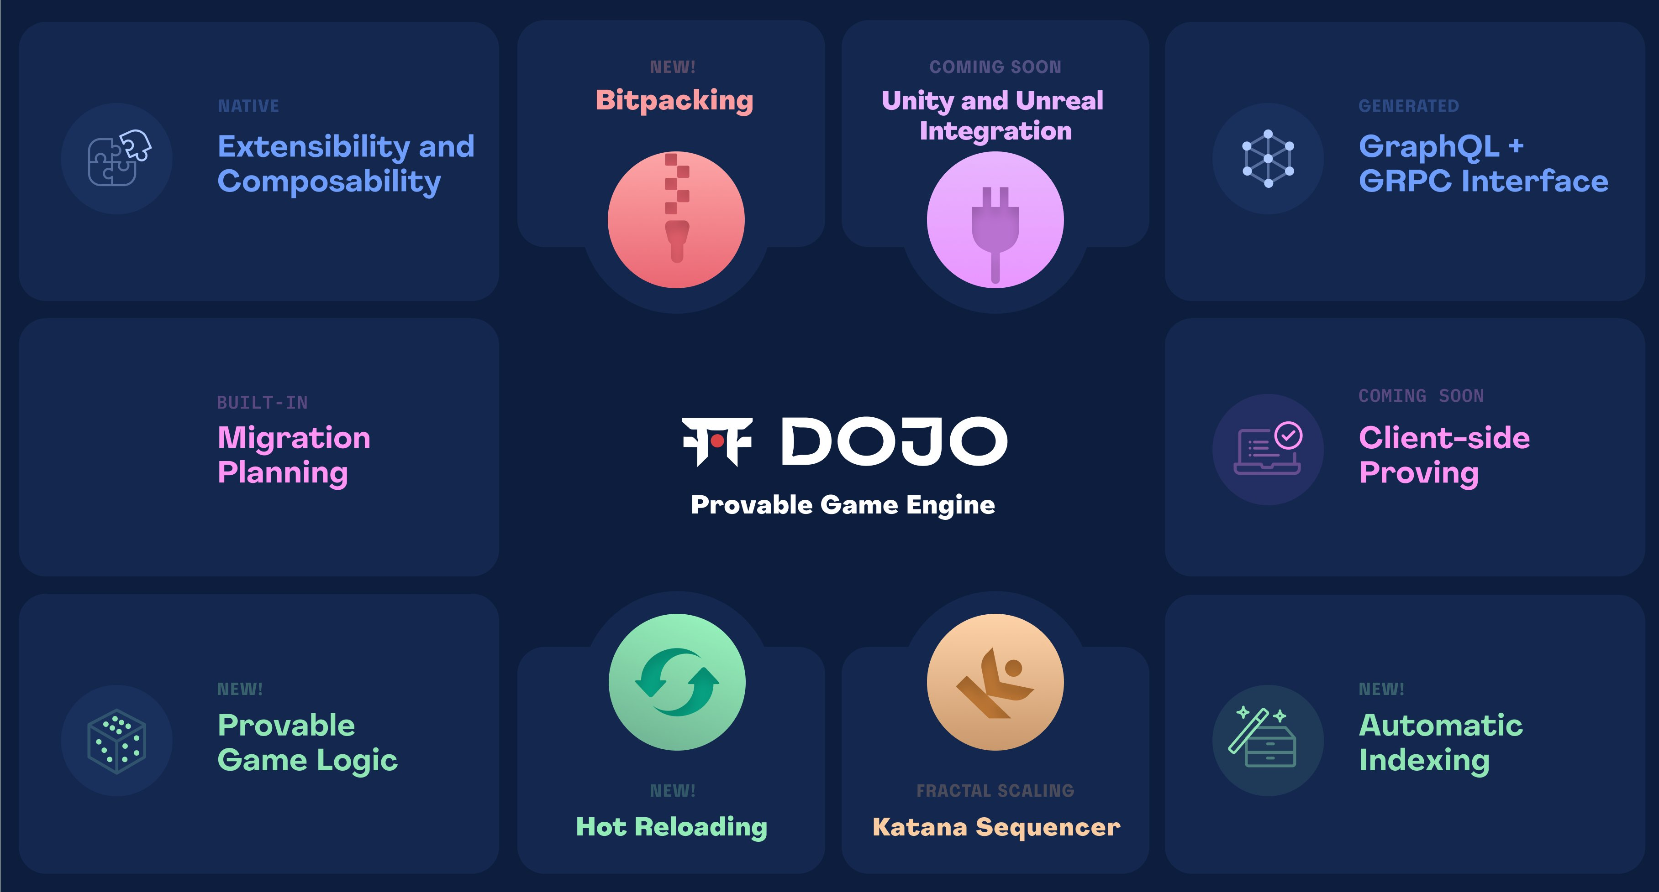
Dojo
Based on Starknet
ECS
Provable On-Chain Engine written in Cairo

Slide 18
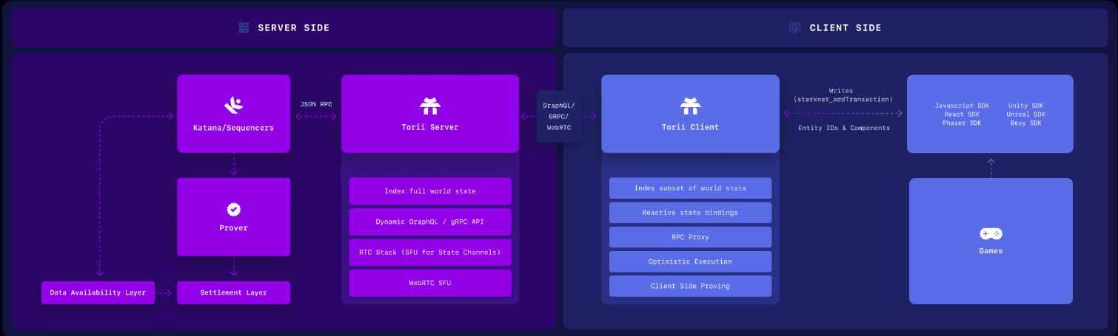
Dojo Architecture

Slide 19
Our Platform
3

Slide 20
Our Goal
ZKP
Game Engine
Aptos
High throughput
Resolve trust issue
Scalability

Slide 21
Our Platform
Using Dojo?
Modify Starknet with Aptos Data availability layer

Slide 22
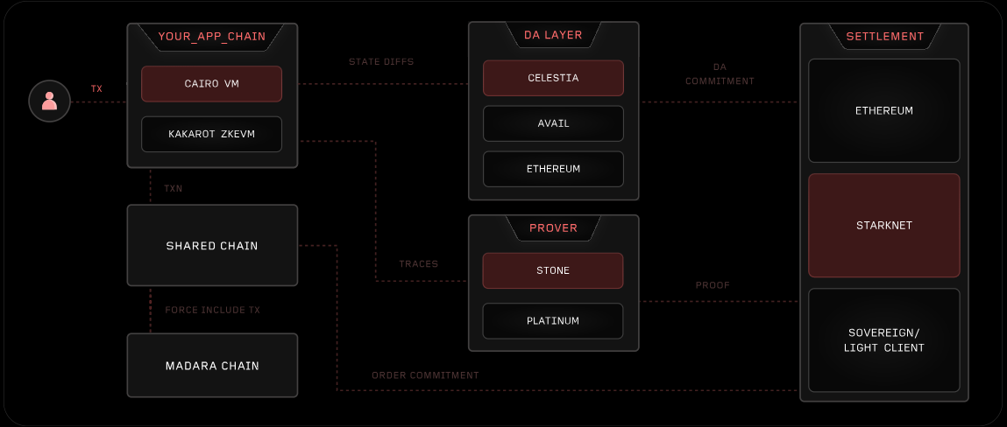
Our Platform
Madara: A Modular Starknet Stack

Slide 23
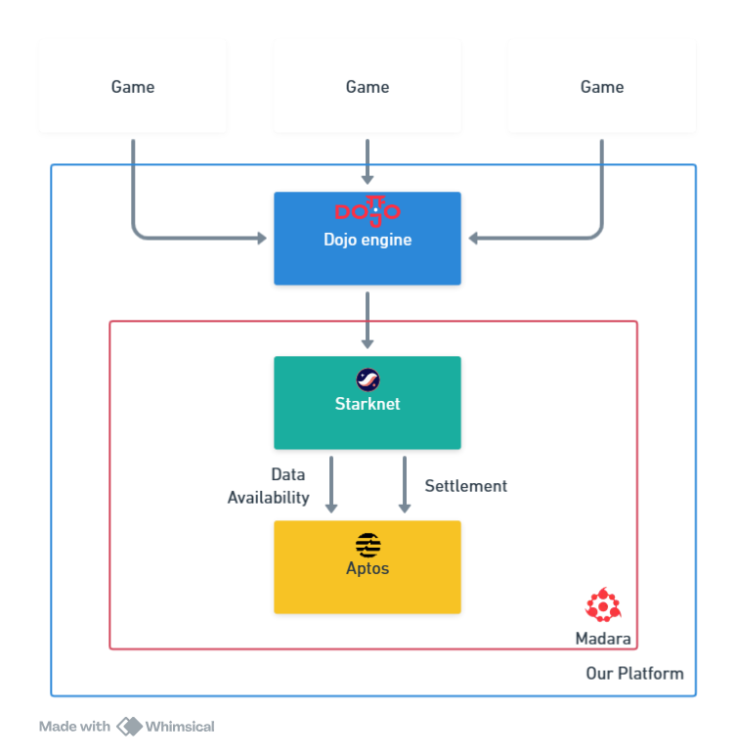
Our Platform

Slide 24
Our Platform
Or new engine?
Using General zkVM? (zkm.io, risc0 zkVM, etc)
Batching proof and operation?
Event-driven or

Slide 25
Thank you!
SOTA ZK LAB

