Slide 1

ZKLogin
SOTA ZK LAB

Slide 2
Content
1
Web3
Social Login
2
Web 3 ZK
Social Login

Slide 3
1
Web3 Socical Login

Slide 4
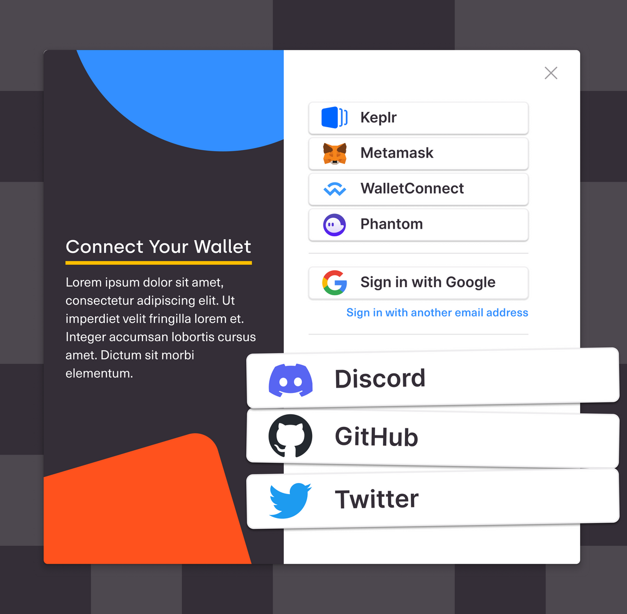
Web3 Social Login
Based on OAuth and OpenID Connect.
Help Web2 user onboard Web3 easier without overhead about key management, gas fee, etc.
Integrate account abstraction, DID, ZKP, etc.

Slide 5
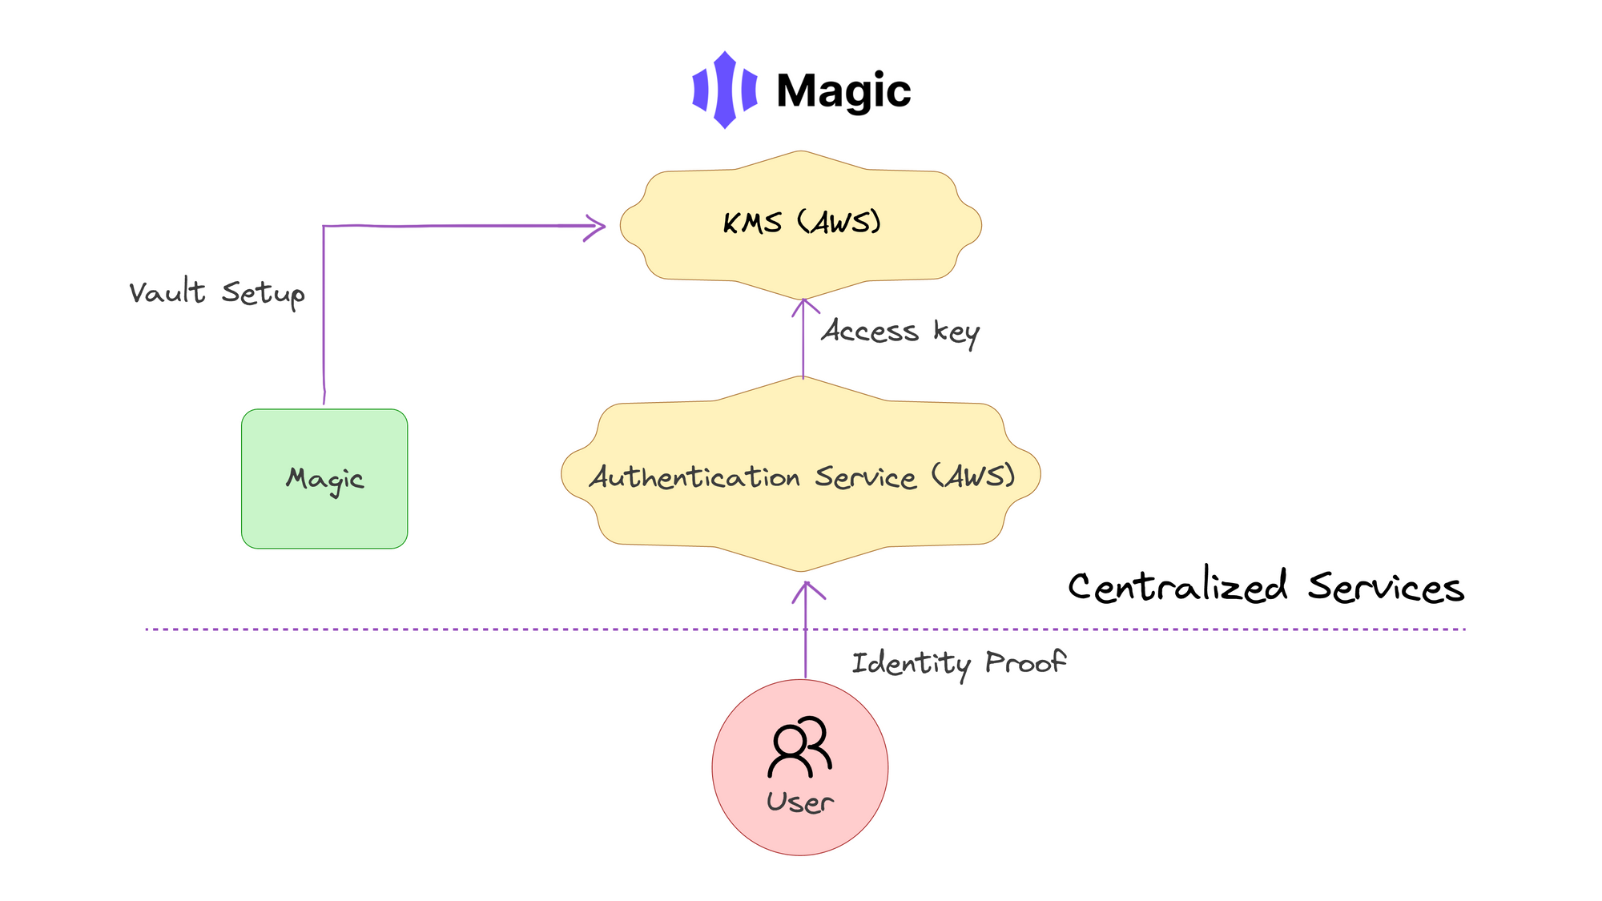
Magic (Key management service - KMS)

Slide 6
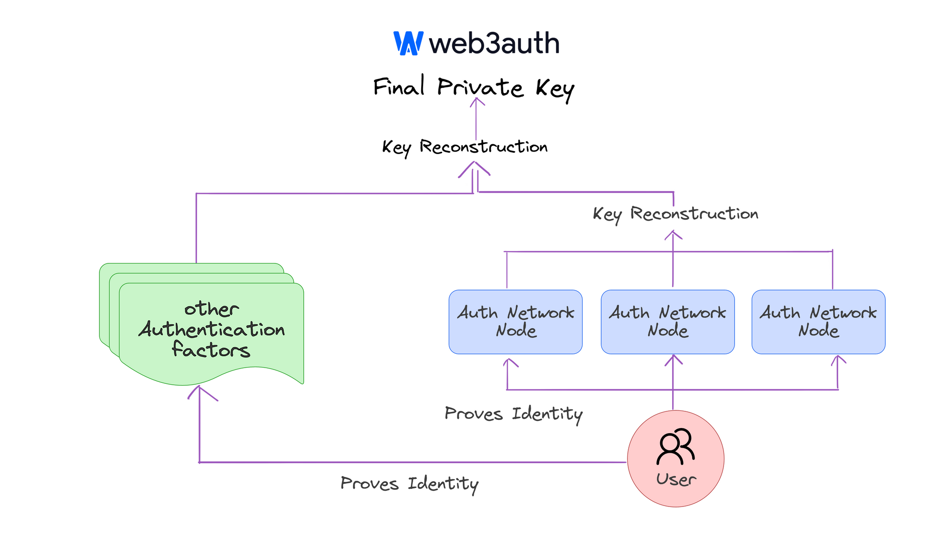
Web3auth (Multi party computation-Shamir secret shares – MPC-SSS)

Slide 7
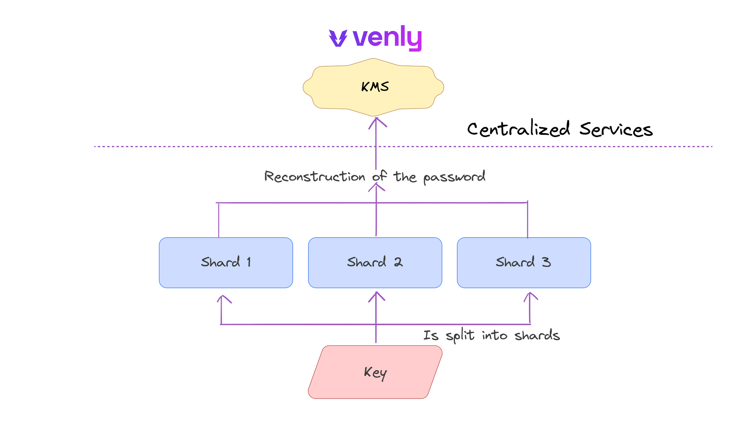
Venly (MPC-SSS + KMS)

Slide 8
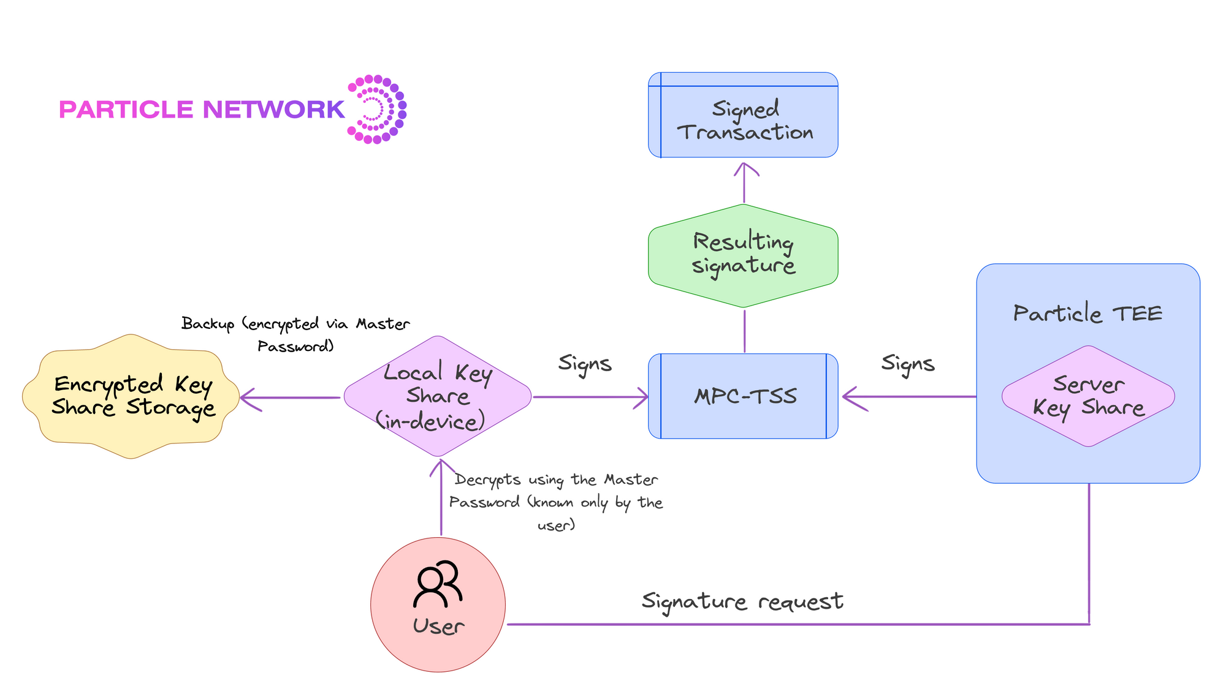
Particle (MPC–Threshold Signature Scheme – MPC-TSS)

Slide 9
Current Web3 Social login providers
Provider | Key management Infrastructure | Account Abstraction supported | ZKP supported
Magic | KMS
Privy | MPC - SSS
Web3auth | MPC - SSS (also MPC - TSS)
Venly | MPC – SSS + KMS
Dynamic | Plugable (built-in KMS)
Particle | MPC – TSS + KMS

Slide 10
2
ZK Social Login

Slide 11
Current social Login cons
Linked user’s identity to wallet
Still required an EOA for each user, even AA is supported

Slide 12
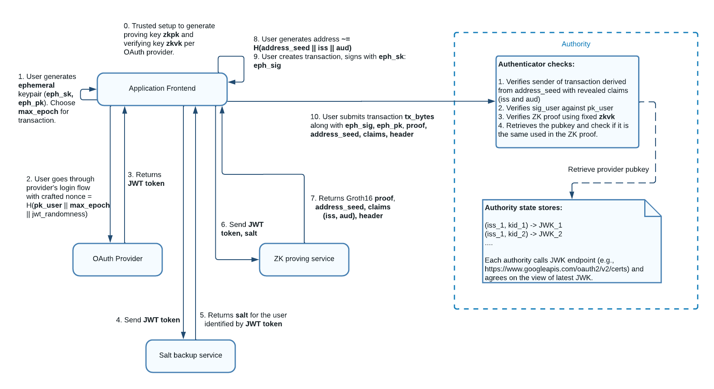
Sui zkLogin

Slide 13
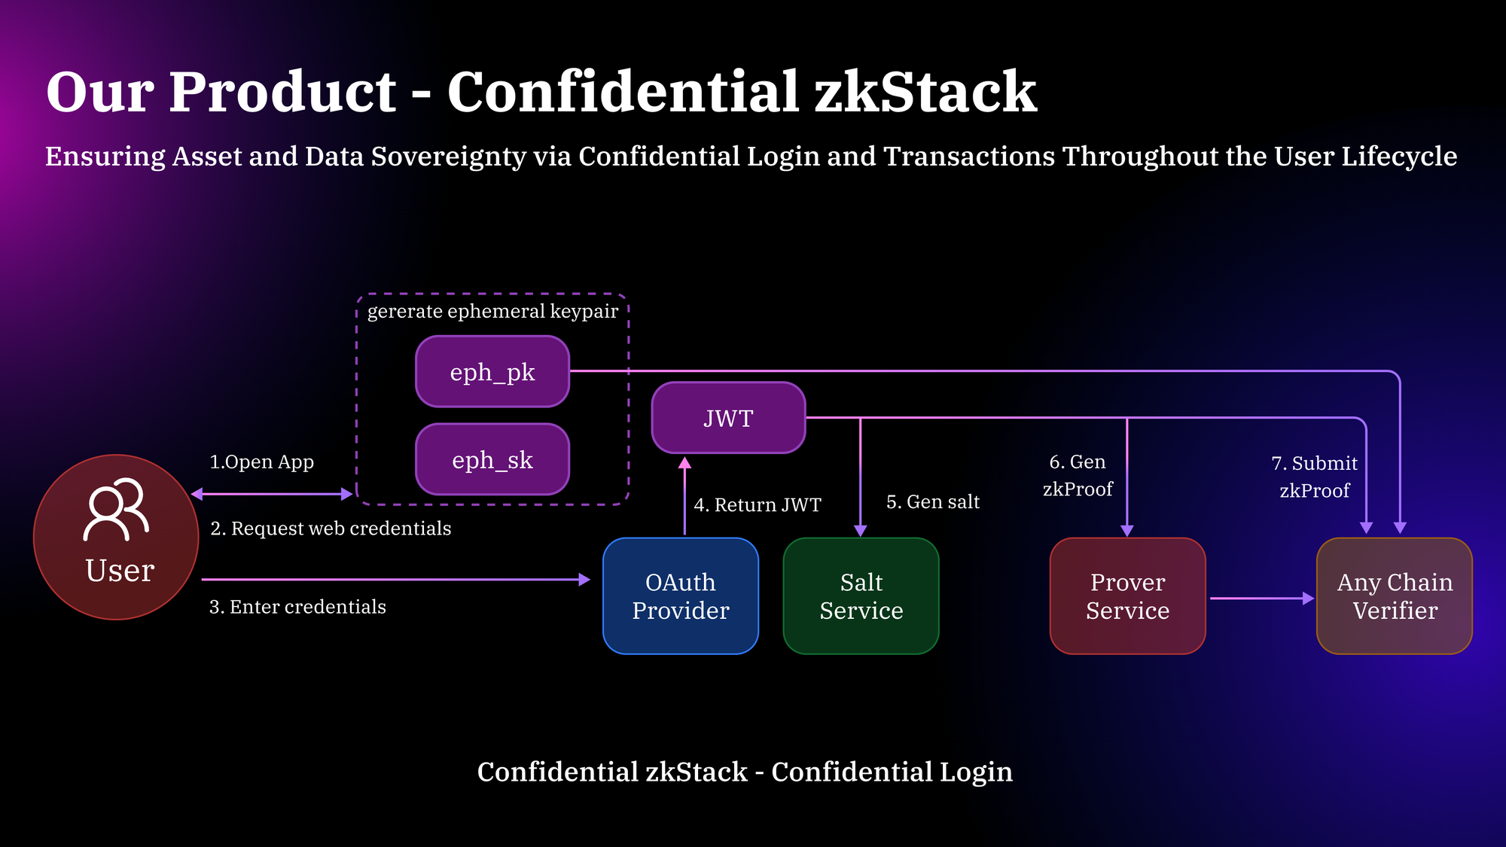
Particle

Slide 14
Thank you!
SOTA ZK LAB

