Slide 1
ZK
in
MACHINE LEARNING
Harry Nguyen

Slide 2
CONTENT
01
WHAT IS ZKML?
02
ZKML APLLICATION
03
ZKML TIMELINE
04
BENCHMARKING PROOF SYSTEMS
05
HOW TO GET INVOLVE?
06
CONCLUSION

Slide 3
CITATION
What is ZKML and how can Devs get involved
by Antalpha Labs:
https://www.youtube.com/watch?v=GYWkRIZeANE&t=1519s

Slide 4
WHAT IS ZKML?
Section 1

Slide 5


WHAT IS ZKML?
Input
ZKP Circuit
for NN
Output
Model
Weights

Slide 6

USE CASE 1
PRIVATE
Input
ZKP Circuit
for NN
Output
PUBLIC
Model
Weights

Slide 7
USE CASE 2
PUBLIC
Input
ZKP Circuit
for NN
Output
PRIVATE
Model
Weights

Slide 8
USE CASE 3
PUBLIC
Input
ZKP Circuit
for NN
Output
PUBLIC
Model
Weights

Slide 9
ZKML APPLICATION
Section 2

Slide 10
ZKML APPLICATION
ML as a Service (MLaaS)
ZK anomaly/fraud detection onchain
Biometric authentication
Decentralized Kaggle

Slide 11
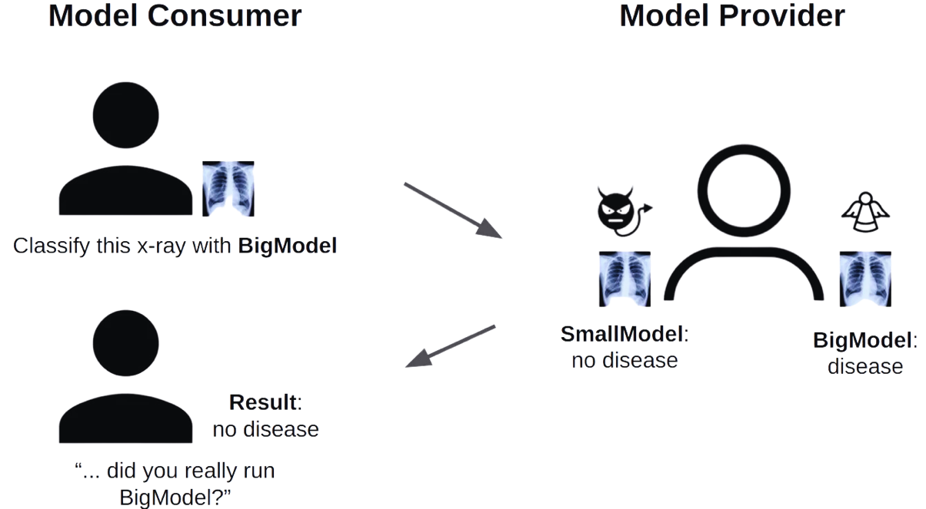
Doctor AI service – Problem?

Slide 12
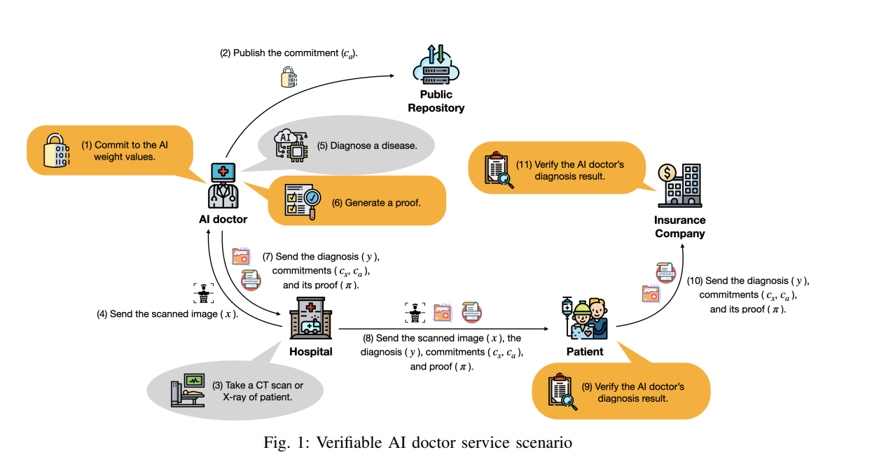
Doctor AI service – Solution

Slide 13
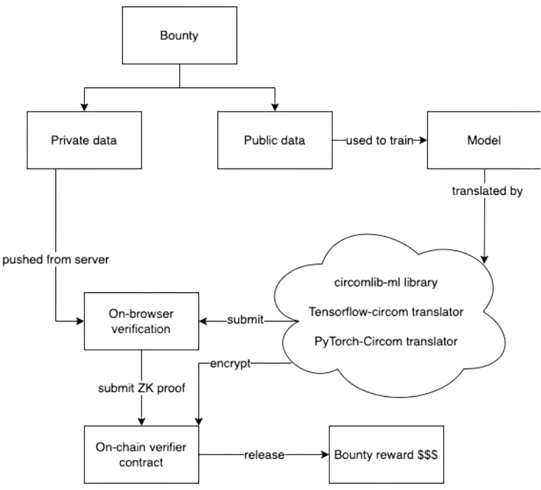
A ZKML POC
circomlib-ml
A comprehensive Circom library containing circuits that compute common layers in TensorFlow Keras.
keras2circom
A user-friendly translator that converts ML models in Python into Circom circuits.
ZKaggle
A decentralized bounty platform for hosting, verifying, and paying out bounties, with the added benefit of privacy preservation.

Slide 14

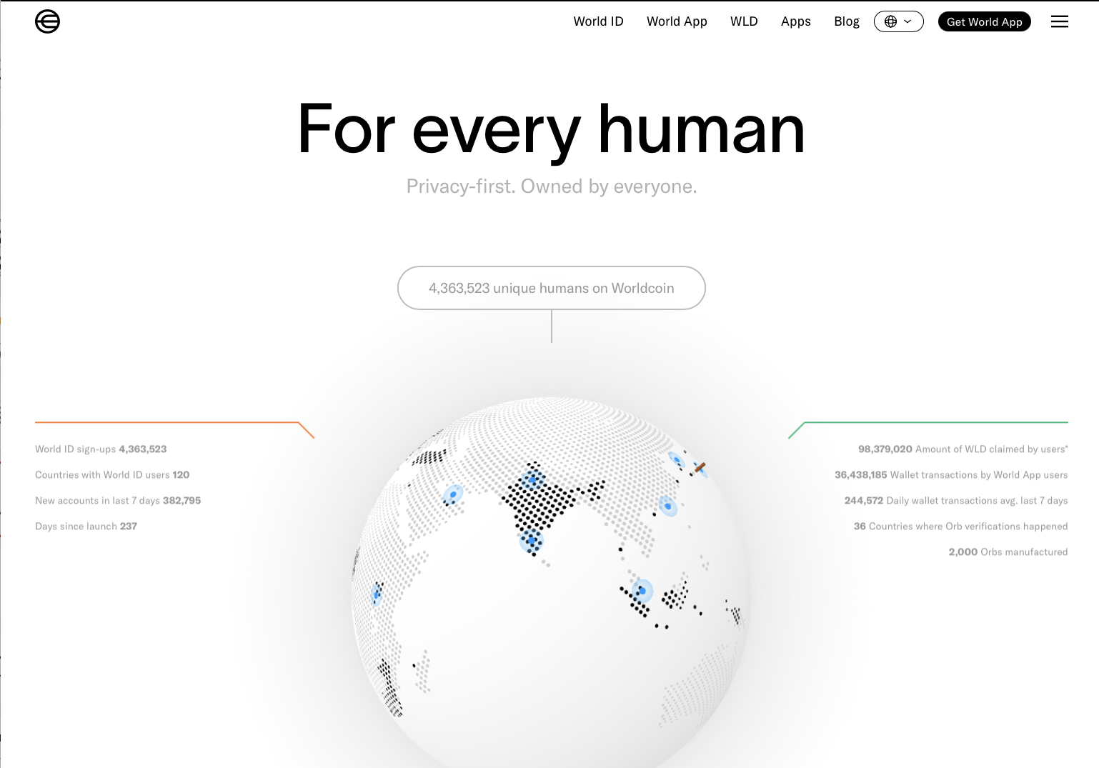
WORLDCOIN
Biometric authentication service

Slide 15
ZKML TIMELINE
Section 3
Challenges to transpile NNs into ZKP circuits:
Floating-point weights -> Fixed-point arithmetic
Model size/depth

Slide 16

ZKML TIMELINE
2,5
years
ago
2
years
ago
1,5
years
ago
zk-ml/linear-regression-demo
OxZkML/zk-mnist
socathie/zkML
By Peiyuan Liao @LinearA
Written in circom
LR only
By OxZKML@OxPARC
Written in Circom
Final dense layer only
By Cathie So @PSE
Written in circom
Full CNN for MNIST dataset

Slide 17
ZKML TIMELINE
1
years
ago
on-
going
on-
going
zk-ml/uchikoma
zkonduit/ezkl
ddkang/zkml
By Peiyuan Liao @LinearA
Written in circom
Transpiler for non-fp runtime
AI generated content as NFTs
By Jason & Dante
@ ZKonduit
Written in halo2
Major update: model with 100M params
By Daniel Kang @ Linear A
Written in halo2
GPT2, Bert, and Diffusion models

Slide 18
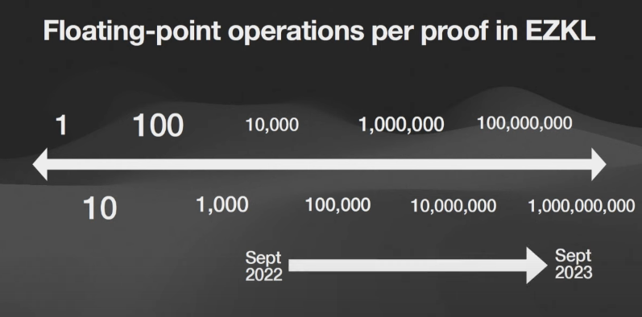
ZKML TIMELINE
Sep 2022:
MNIST model, EVM verifier
12.000 flops
Hard-coded circuit
30mins
500 GB RAM
Sep 2023:
Model X, EVM verifier
1.000.000.000 flops
Use Python with EZKL
<1s
<100MB RAM

Slide 19
BENCHMARKING PROOF SYSTEMS
Section 4

Slide 20
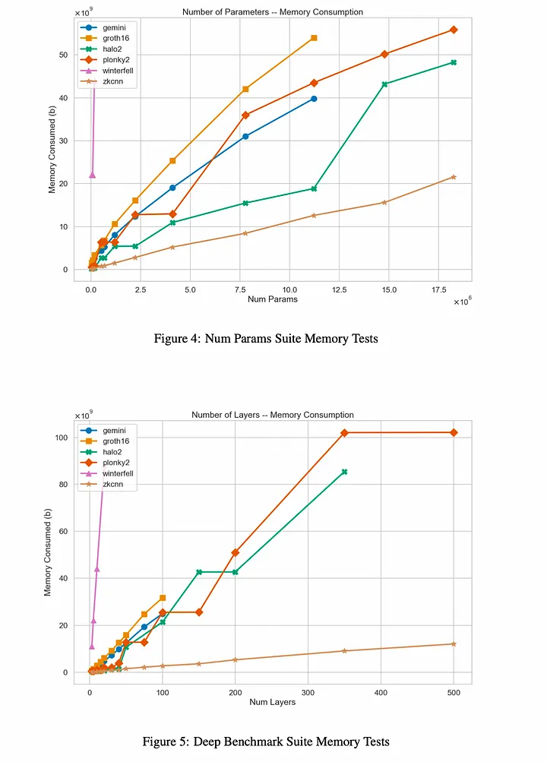
BENCHMARK PROOF SYSTEMS
halo2
zkcnn

Slide 21
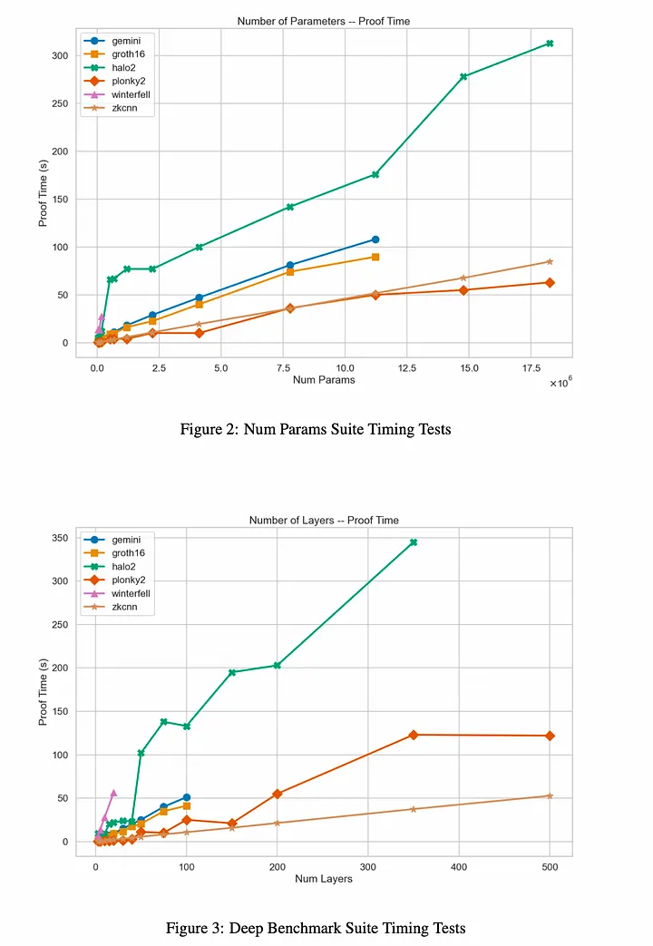
BENCHMARK PROOF SYSTEMS
halo2
zkcnn

Slide 22
WHY USING HALO2 INSTEAD OF ZK-CNN?
Opensource => Greater docs, support, long term project
Parallellism => Can solve bigger models

Slide 23
POPULAR PROJECTS COMPARISON
 | EZKL | Orion | RISC Zero
Proof system | Halo2 | Cairo | FRI, DEEP-ALI, HMAC-SHA-256 based PRF
Setup | User friendly | Complicated | Complicated
Proving time | EZKL: 66x faster than RISC Zero, 3x faster than Orion
Memory usage | EZKL: 63.95% less than Orion, 98.13% less than RISC Zero
Model accuracy | Allow configuration for flexibity | Allow configuration for flexibity | Restricted

Slide 24
HOW TO GET INVOLVE?
Section 5

Slide 25
HOW TO GET INVOLVE?
Circomlib-ml/ezkl ZK circuit library for machine learning operations
Benchmarking – folding
Improve ZKP protocols

Slide 26
CONCLUSION
Section 6

Slide 27
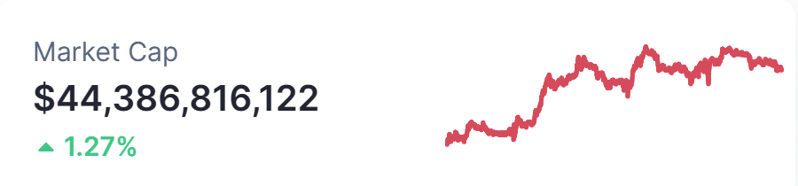
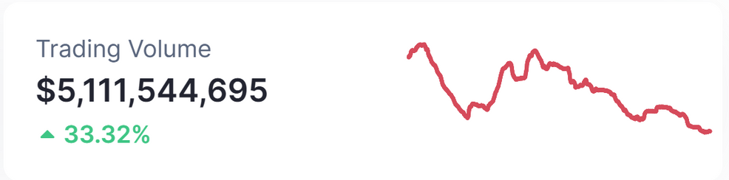
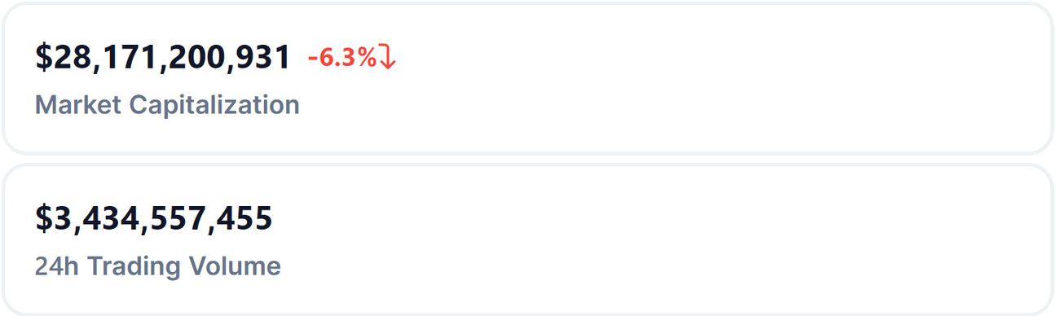
CONCLUSION
Grow exponentially: +3% per day
Still can't handle large models: GPT-3.5, GPT-4, etc.
Requires significant investment
Involves substantial commitment
Difficult to implement
=> This field presents both challenges and opportunities.
AI
ZK

Slide 28
THANKS
FOR LISTENING!

