Slide 1
PLONK
IMPLEMENTATION
VanhGer

Slide 2
Contents
Explain the steps
Demo

Slide 3
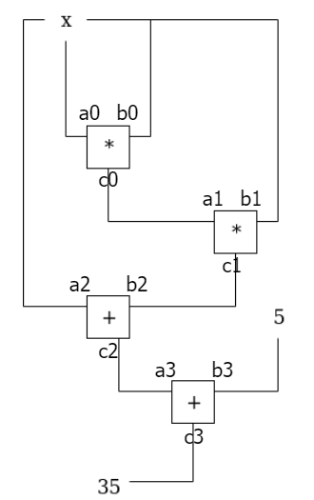
Explain the steps
Gate constraints
Copy constraints

Slide 4
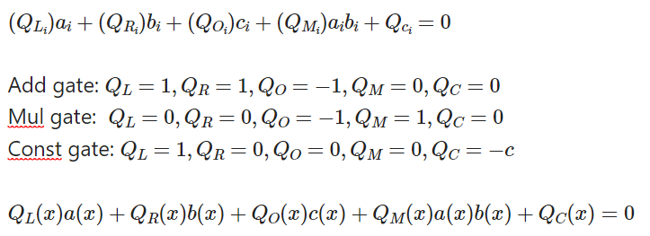
Explain the steps
Gate constraints

Slide 5
Explain the steps
Copy constraints
We see all the wires as a list L.
Create L’ by replacing each wires in L by its copied wire.
Check if L’ and L are prescribed permutations.

Slide 6
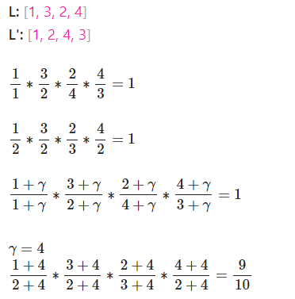
Explain the steps
Copy constraints
Check if L’ and L are permutations.

Slide 7
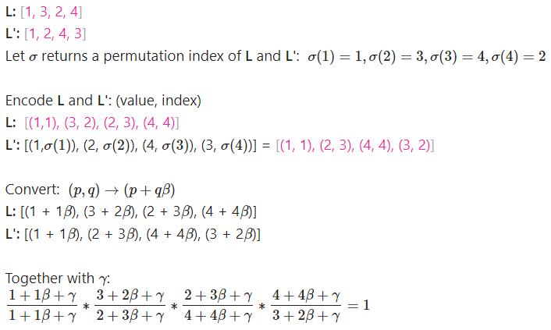
Explain the steps
Copy constraints
Check if L’ and L are prescribed permutations.

Slide 8
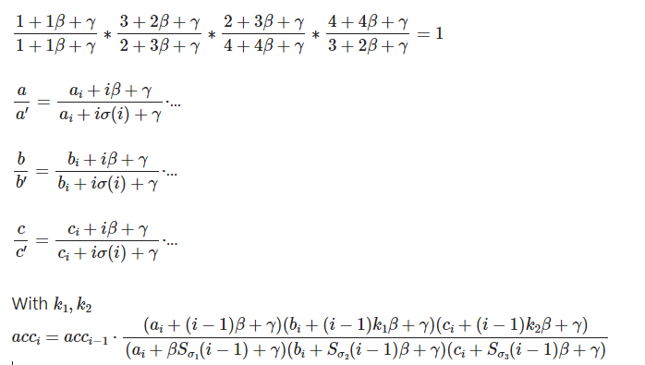
Explain the steps
Copy constraints
Check if L’ and L are prescribed permutations.

Slide 9
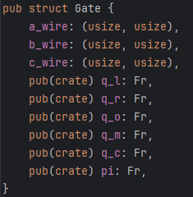

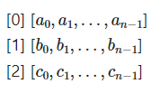
Explain the steps
Step1: Create circuit
Circuit is a list of Gates and their value.
Gates: Circuit

Slide 10
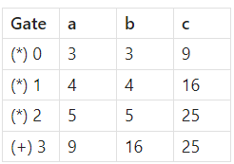
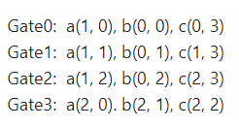
Explain the steps
Step1: Create circuit
Circuit is a list of Gates and their value.
Gates: Circuit

Slide 11
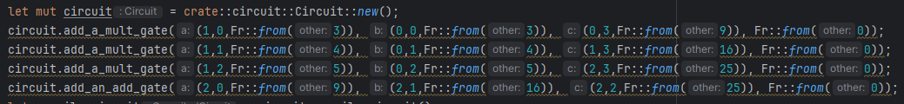
Explain the steps
Step1: Create circuit

Slide 12
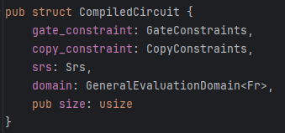
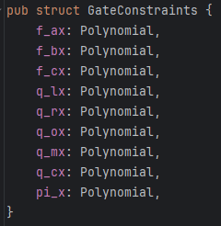
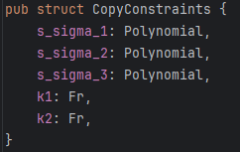
Explain the steps
Step2: Compile circuit CompiledCircuit struct:
Gate constraint: Copy constraint:

Slide 13
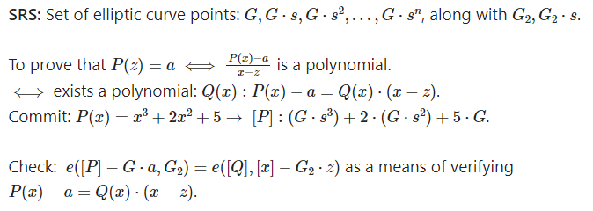
Explain the steps
Step2: Compile circuit KZG commitment

Slide 14
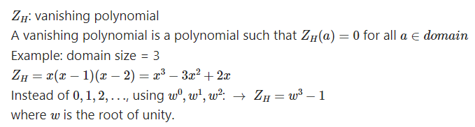
Explain the steps
Step2: Compile circuit Domain

Slide 15
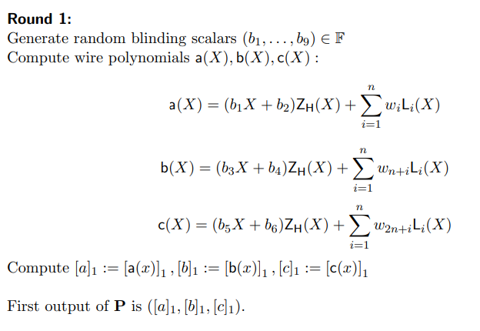
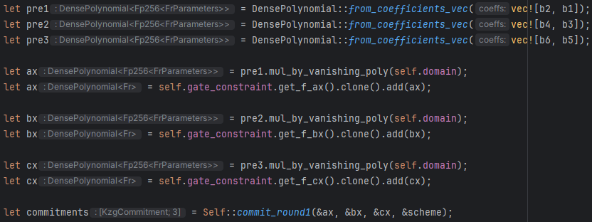
Explain the steps
Step3: Generate proof Round 1: Hide & commit gate wire polynomial

Slide 16
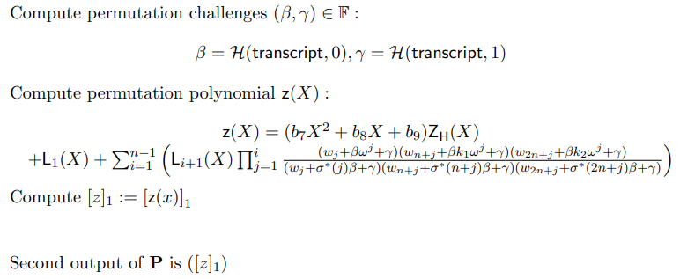

Explain the steps
Step3: Generate proof Round 2: compute & commit permutation polynomial
To compute permutation challenges, use Fiat-Shamir with SHA256 hash function.

Slide 17
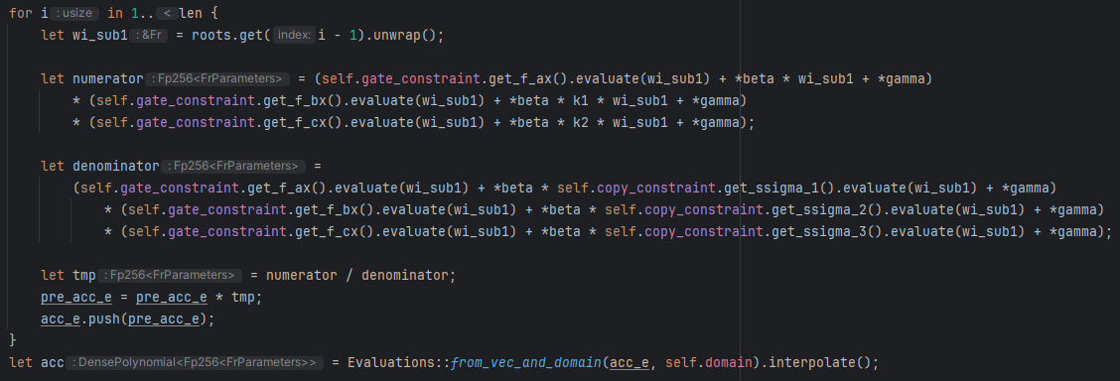
Explain the steps
Step3: Generate proof Round 2:

Slide 18
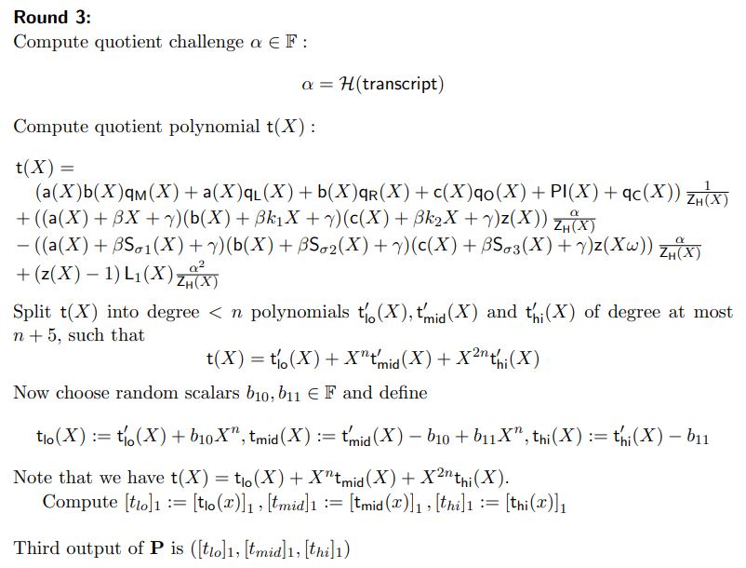
Explain the steps
Step3: Generate proof Round 3:
Compute quotient polynomial

Slide 19
Explain the steps
Step3: Generate proof Round 3:
Compute quotient polynomial

Slide 20
Explain the steps
Step3: Generate proof Round 3:
Compute quotient polynomial

Slide 21
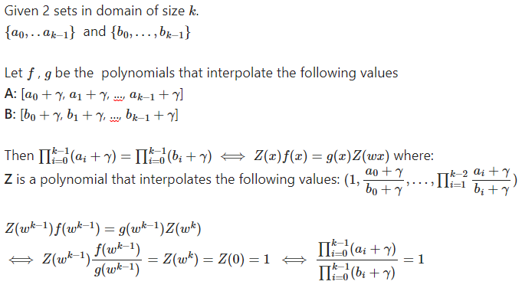
Explain the steps
Step3: Generate proof Round 3:

Slide 22
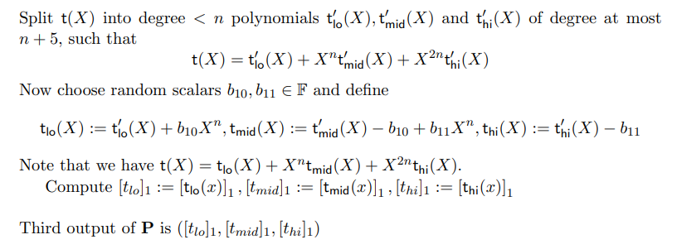
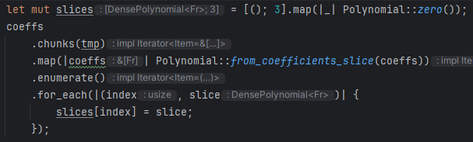
Explain the steps
Step3: Generate proof Round 3:

Slide 23
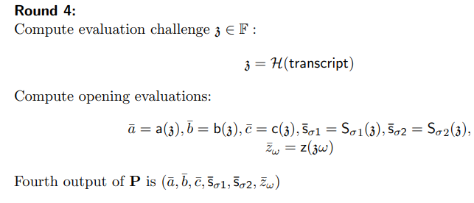
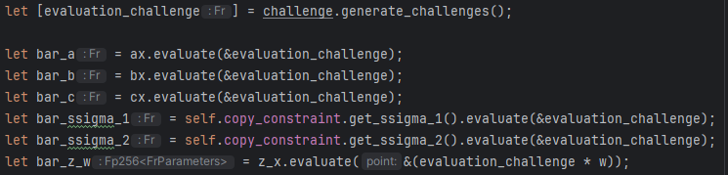
Explain the steps
Step3: Generate proof Round 4: compute opening evaluations

Slide 24
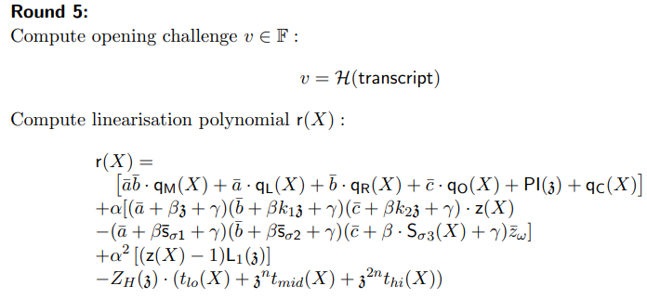
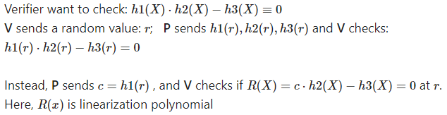
Explain the steps
Step3: Generate proof Round 5:

Slide 25
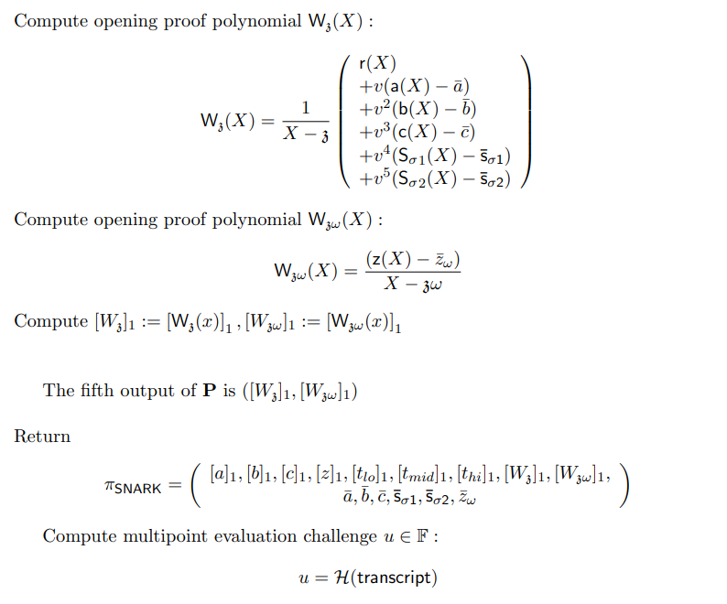
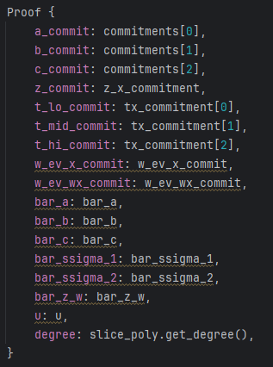
Explain the steps
Step3: Generate proof Round 5: Here, we create opening in the KZG polynomial scheme.

Slide 26
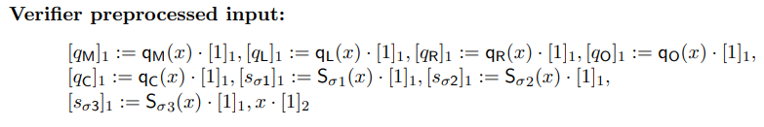
Explain the steps
Step4: Verify proof Preprocess:

Slide 27
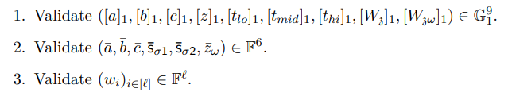
Explain the steps
Step4: Verify proof Validate type:

Slide 28
Explain the steps
Step4: Verify proof Verify challenges:

Slide 29
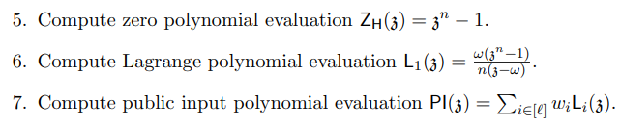

Explain the steps
Step4: Verify proof Compute evaluations:

Slide 30
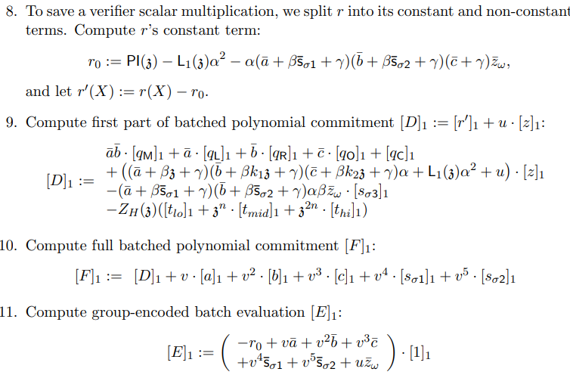
Explain the steps
Step4: Verify proof Compute polynomial commitments
Here, we prepare for pairing check

Slide 31
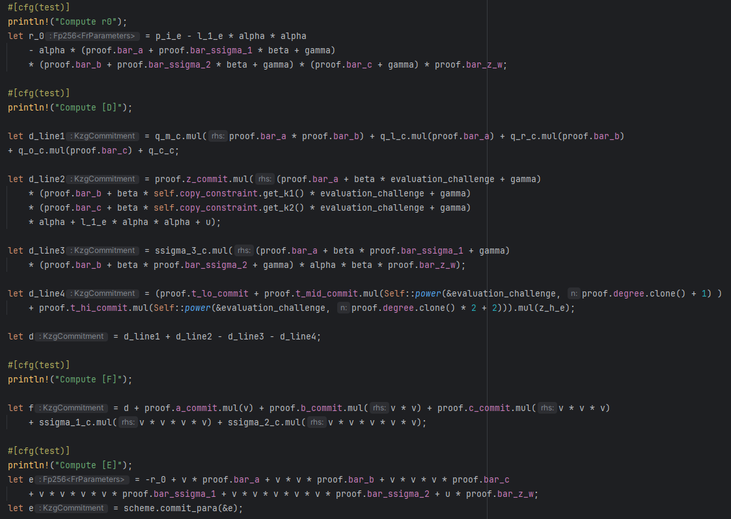
Explain the steps
Step4: Verify proof Compute polynomial commitments

Slide 32
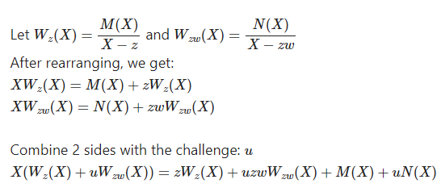
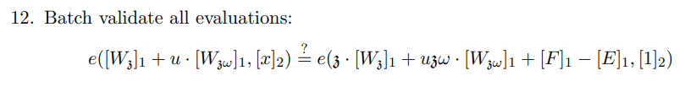
Explain the steps
Round 5
Step4: Verify proof Verify paring
Verify

Slide 33
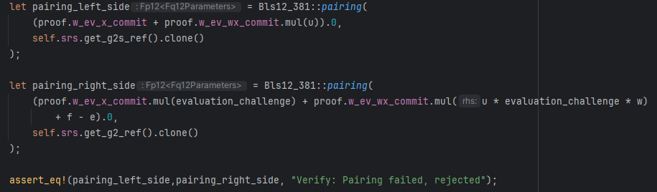
Explain the steps
Step4: Verify proof Verify paring

Slide 34
Demo

Slide 35
Thank for your listening

