Slide 1
ZKP Overall

Slide 2
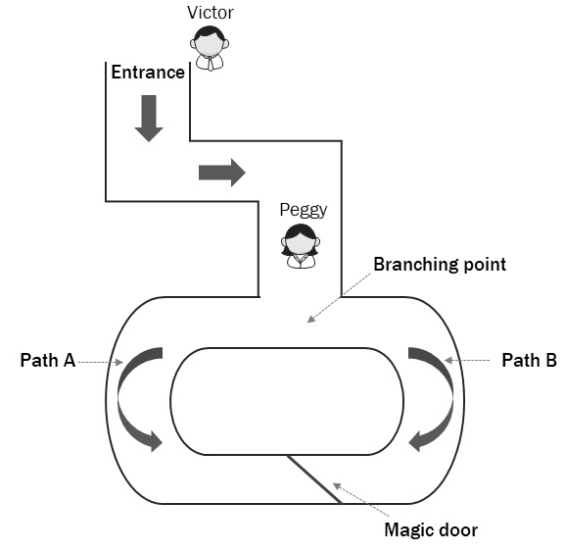
What is ZKP??

Slide 3
Applications
Proving statement on private data:
– Person A has more than X in his bank account
– In the last year, a bank did not transact with an entity Y – Matching DNA without revealing full DNA
– One has a credit score higher than Z

Slide 4
Applications
Proving statement on private data:
– Person A has more than X in his bank account
– In the last year, a bank did not transact with an entity Y – Matching DNA without revealing full DNA
– One has a credit score higher than Z

Slide 5
Applications
Anonymous payments:
- Payment with full detachment from any kind of identity
- Paying taxes without revealing one’s earnings

Slide 6
Applications
Outsourcing computation:
- Outsource an expensive computation and validate that the result is correct without redoing the execution; it opens up a category of trustless computing
- Changing a blockchain model from everyone computes the same to one party computes and everyone verifies

Slide 7
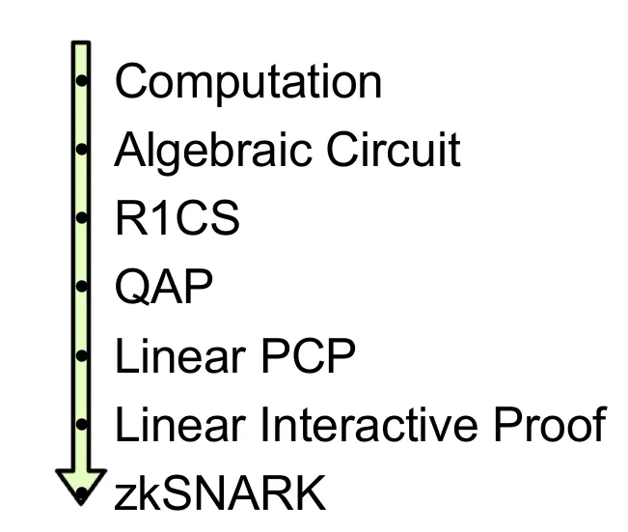
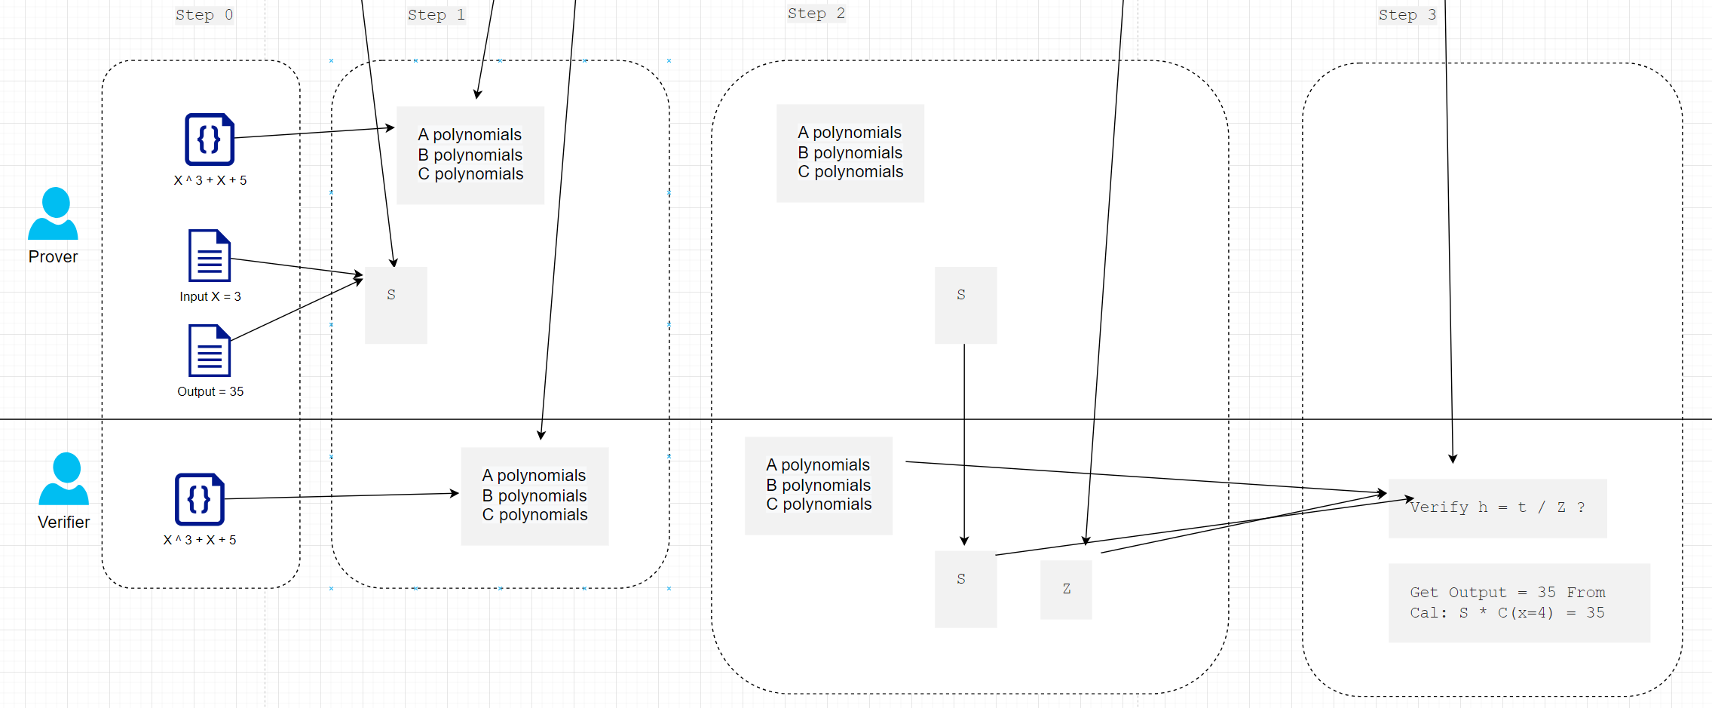
How to do it?

Slide 8
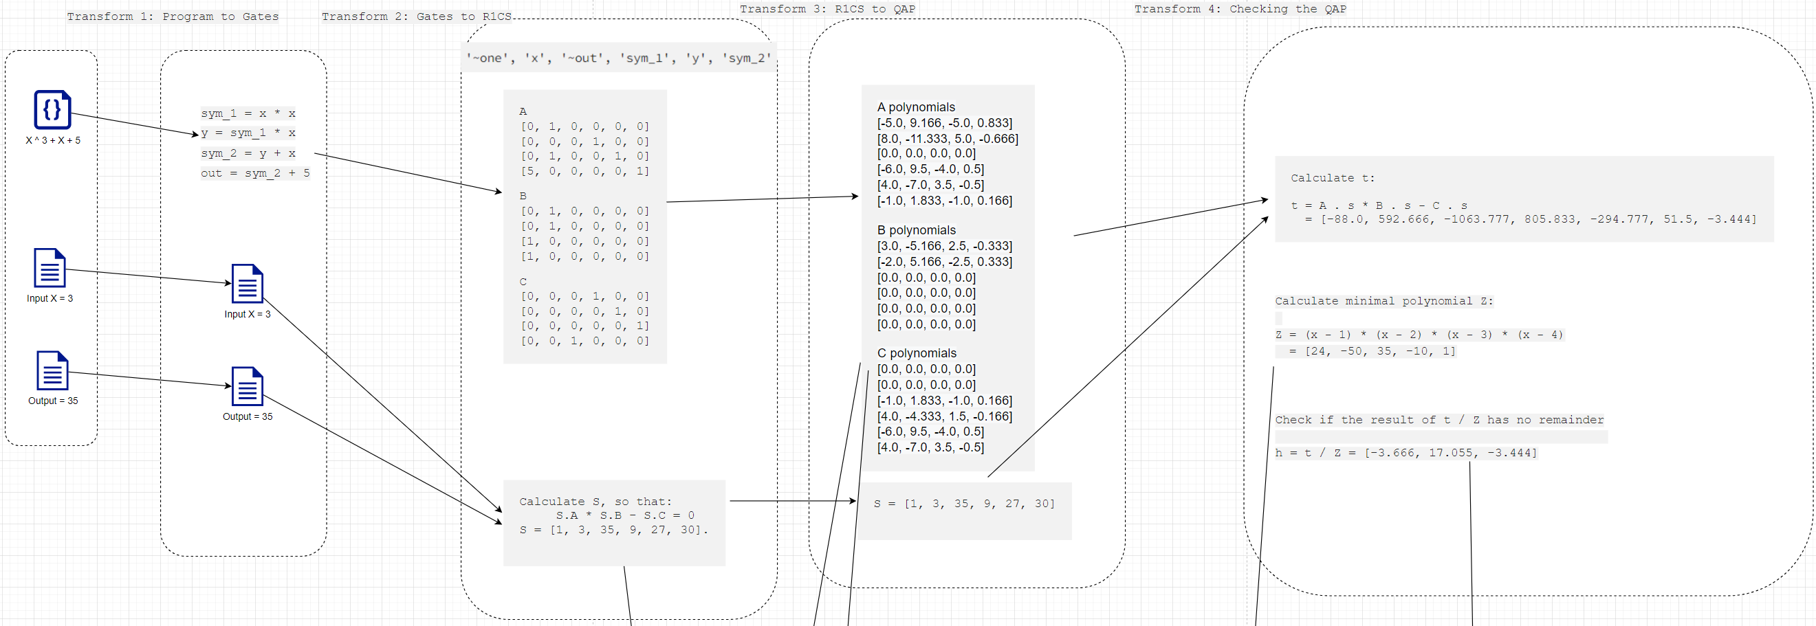
How to do it?

Slide 9
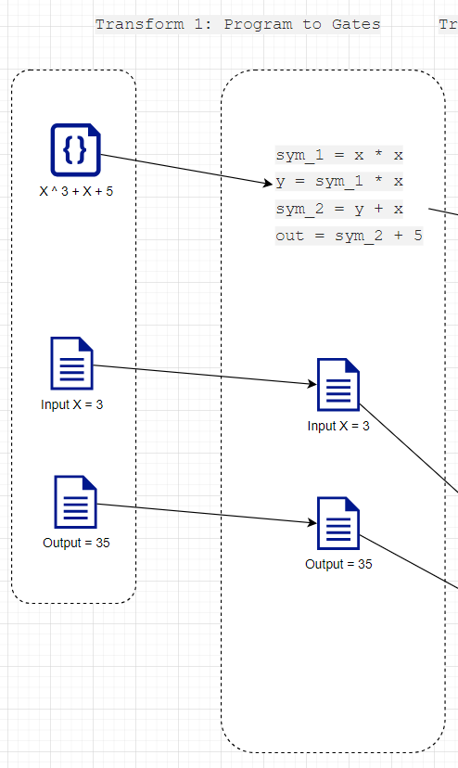
Transform 1: Program to Gates
19 ^ 3 + 19 + 5 = ?
19 * 19 = 361
361 * 19 = 6859
6859 + 19 = 6878
6878 + 5 = 6883

Slide 10
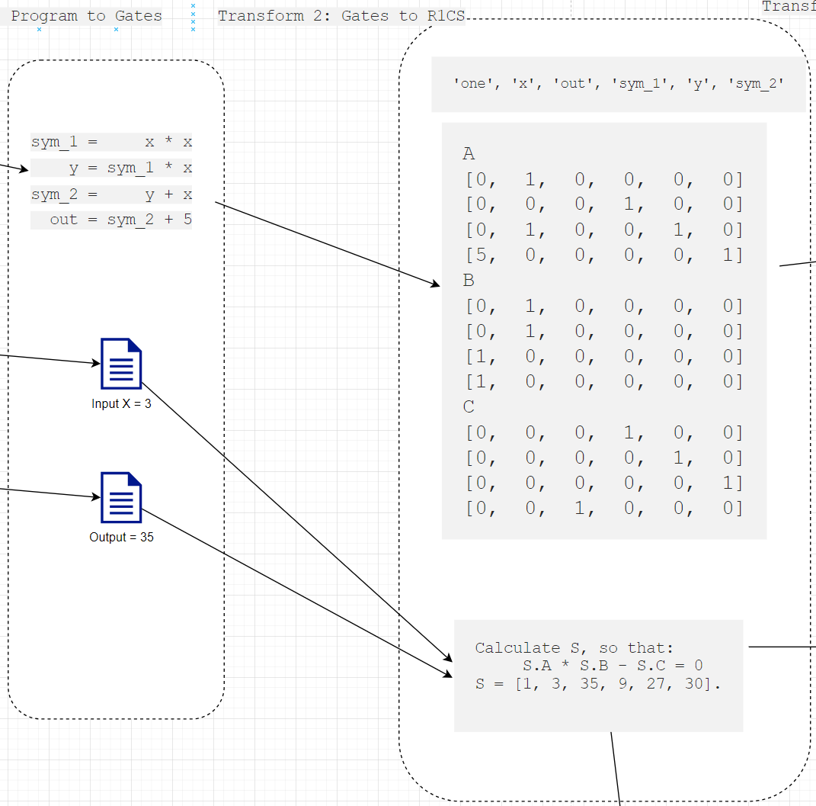

Transform 2: Gates to R1CS
C
A
B

Slide 11
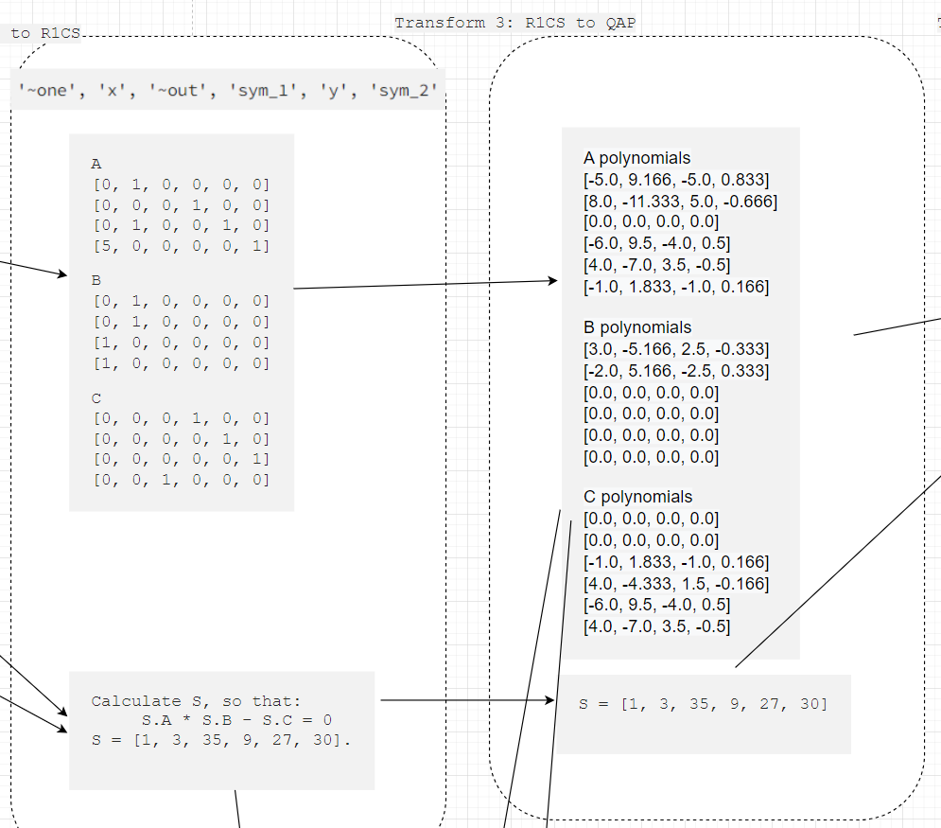
Transform 3: R1CS to QAP
F(x) = -5 + 9.166x – 5x² + 0.833x³
x = 1 => F(x) = 0
x = 2 => F(x) = 0
x = 3 => F(x) = 0
x = 4 => F(x) = 5

Slide 12
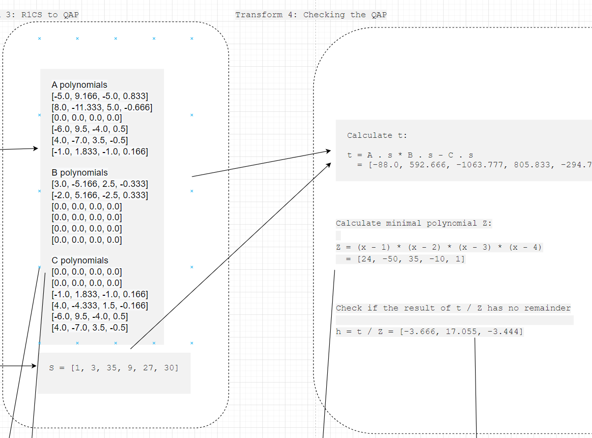
Transform 4: R1CS to QAP

Slide 13
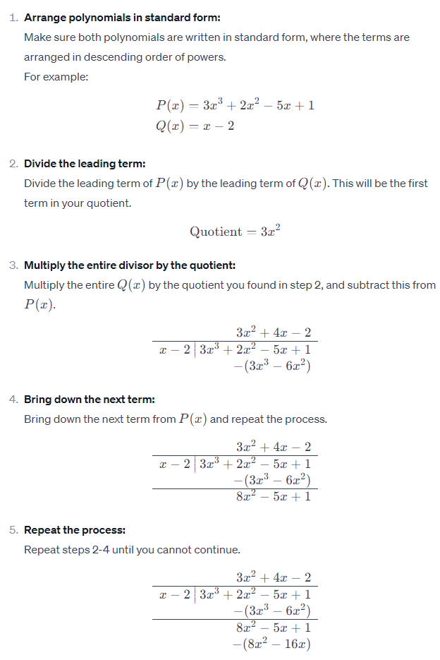

Slide 14
How to do it?

Slide 15
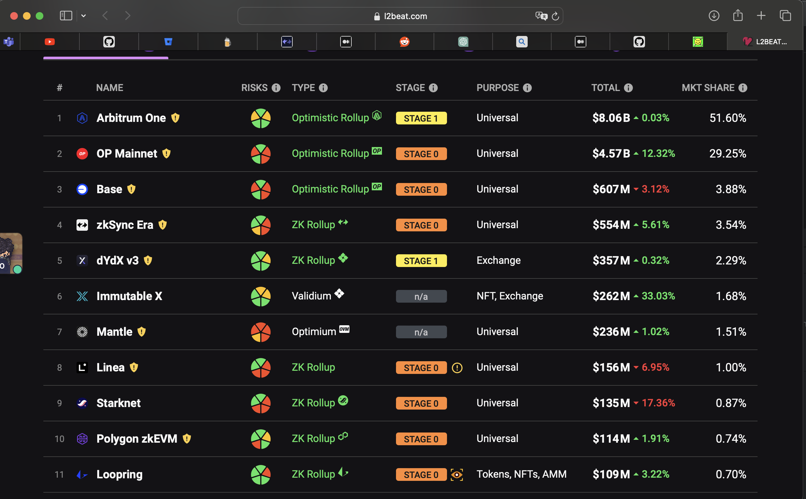
Current Status

Slide 16
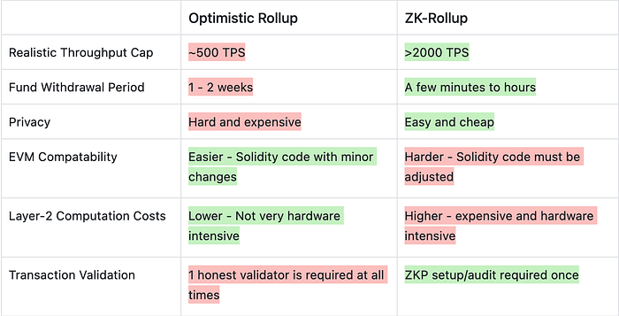
ZK vs Optimistic Rollups

Slide 17
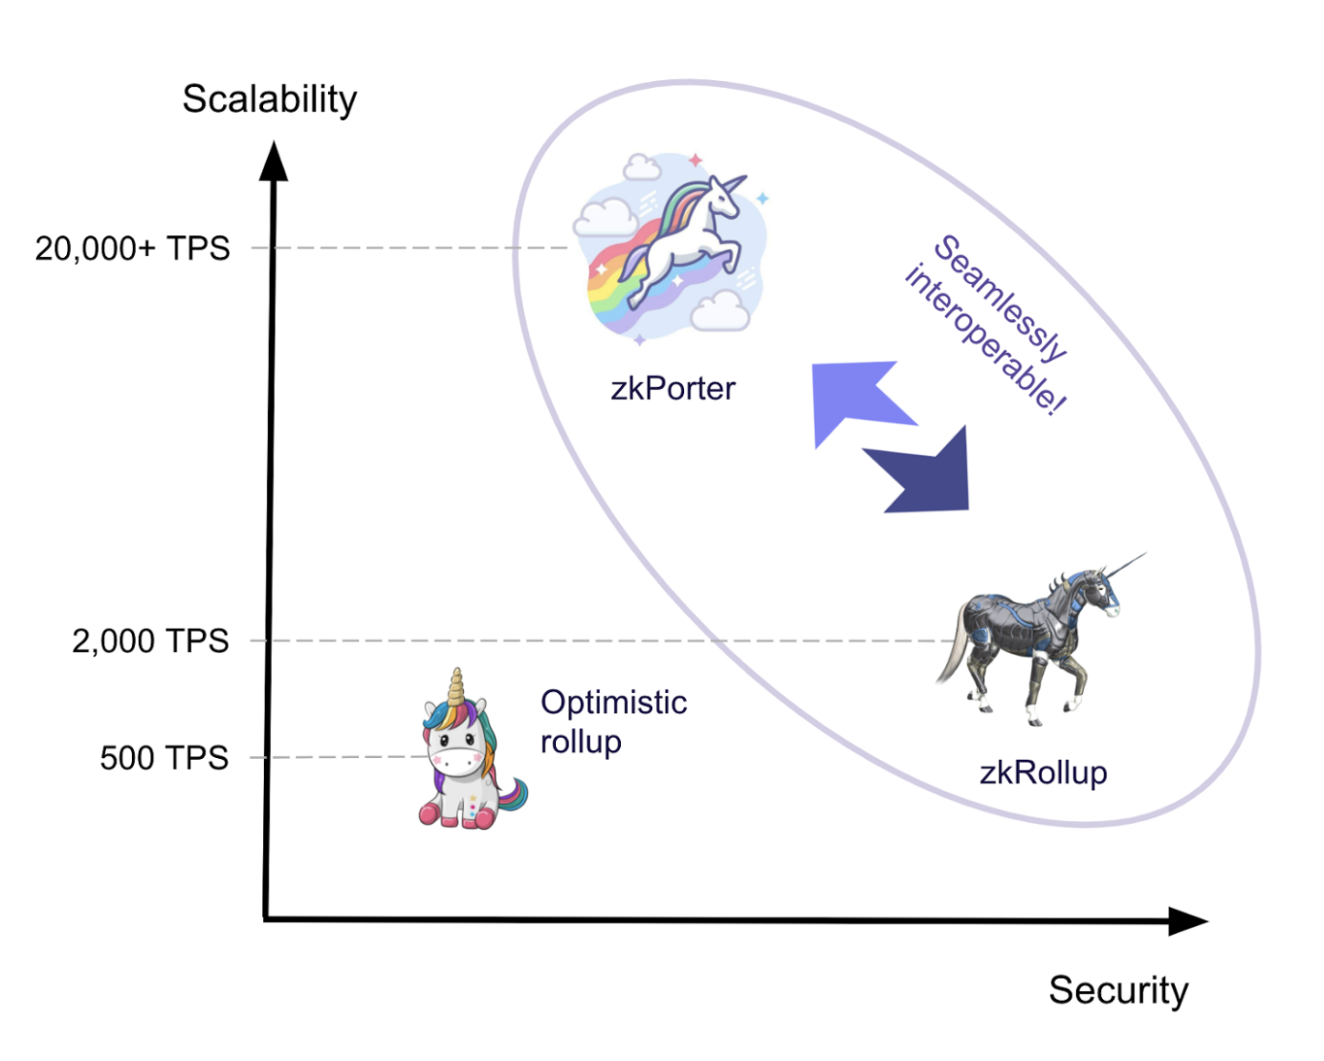
Performance
zkPorter

Slide 18
Problems
Proof size => Block size
Prover time
Verifier time
Trusted setup
EVM compatibility / Community

