Slide 1
Nova Folding Scheme
VanhGer

Slide 2
Contents
IVC
Folding Scheme
R1CS variants
Homomorphic Encryption
Folding Scheme for R1CS
Implementation of Folding Scheme

Slide 3
IVC
Incrementally Verifiable Computation

Slide 4
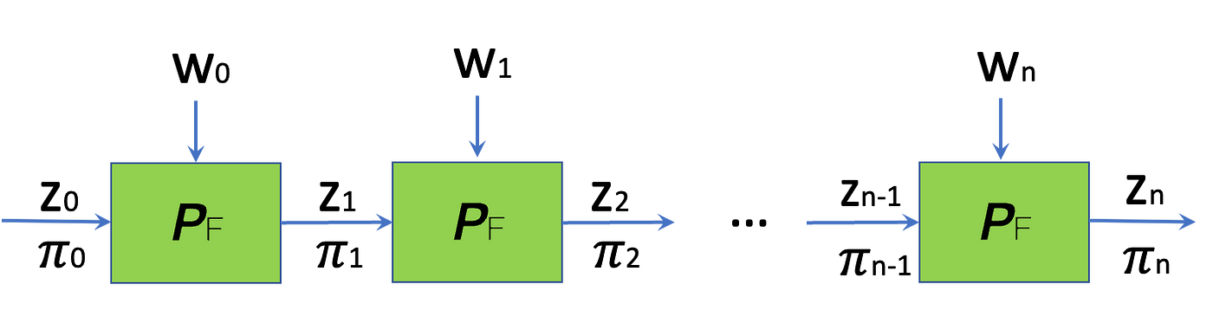
IVC
Allows us to do proofs for long computations with relatively little memory.
A function F is iterated for many times.
Generate a proof for each time that proves the computation to this point is correct.

Slide 5
IVC
Note that: z_{i} = F^{(n)}a(z₀ ) is the output of IVC.
Succinctness: Proof does not grow with the number of applications n.

Slide 6
Folding Scheme

Slide 7
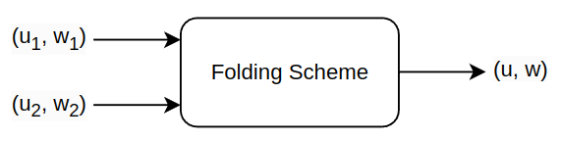
Folding Scheme
Def: folding scheme for a relation R is a protocol that reduces the task of checking two instances in R to the task of checking a single instance in R.
For example:

Slide 8
Homomorphic Encryption

Slide 9

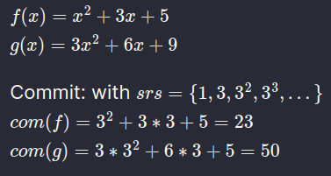
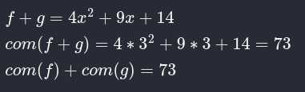
Homomorphic Encryption
Def: Homomorphic Encryption allows computations to be performed on ciphertext, resulting in an encrypted result that, when decrypted, matches the result of the operations performed on the plaintext.
Some homomorphic commitment: KZG, Pedersen.
Example: with a simple version of KZG

Slide 10
R1CS Variants

Slide 11
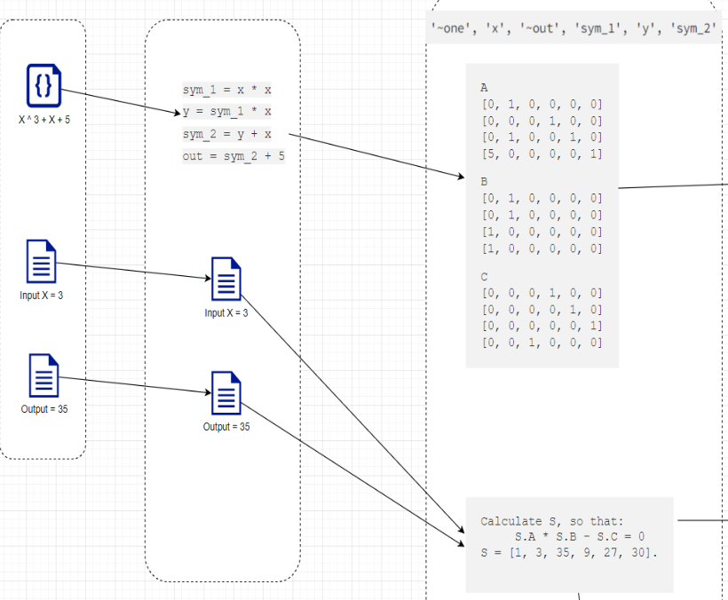

R1CS variants
R1CS:
Structure: 3 matrices A, B, C
Instance: (x): public IO, witness W
Satisfaction requirement:

Slide 12
R1CS variants
Relaxed R1CS:
Structure: 3 matrices A, B, C
Instance: (E, u, x), witness W
Satisfaction requirement:

Slide 13
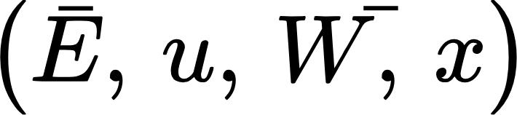
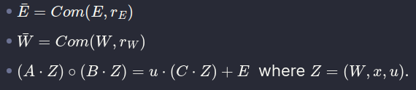
R1CS variants
Committed Relaxed R1CS:
Structure: 3 matrices A, B, C
Instance: ,witness (E, rE, W, rW)
Satisfaction requirement:

Slide 14
Homomorphic Encryption
Def: Homomorphic Encryption allows computations to be performed on ciphertext, resulting in an encrypted result that, when decrypted, matches the result of the operations performed on the plaintext.
Some homomorphic commitment: KZG, Pedersen.
Example: with a simple version of KZG

Slide 15
Folding Scheme for R1CS

Slide 16
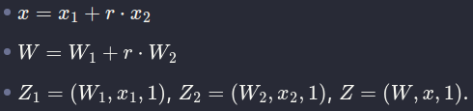
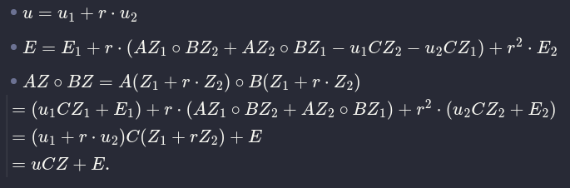
Folding Scheme for R1CS
Folding Scheme for Committed Relaxed R1CS
2 instances:
With witnesses:
We will compress them into a single instance with a single witness by using Random linear combination r:

Slide 17
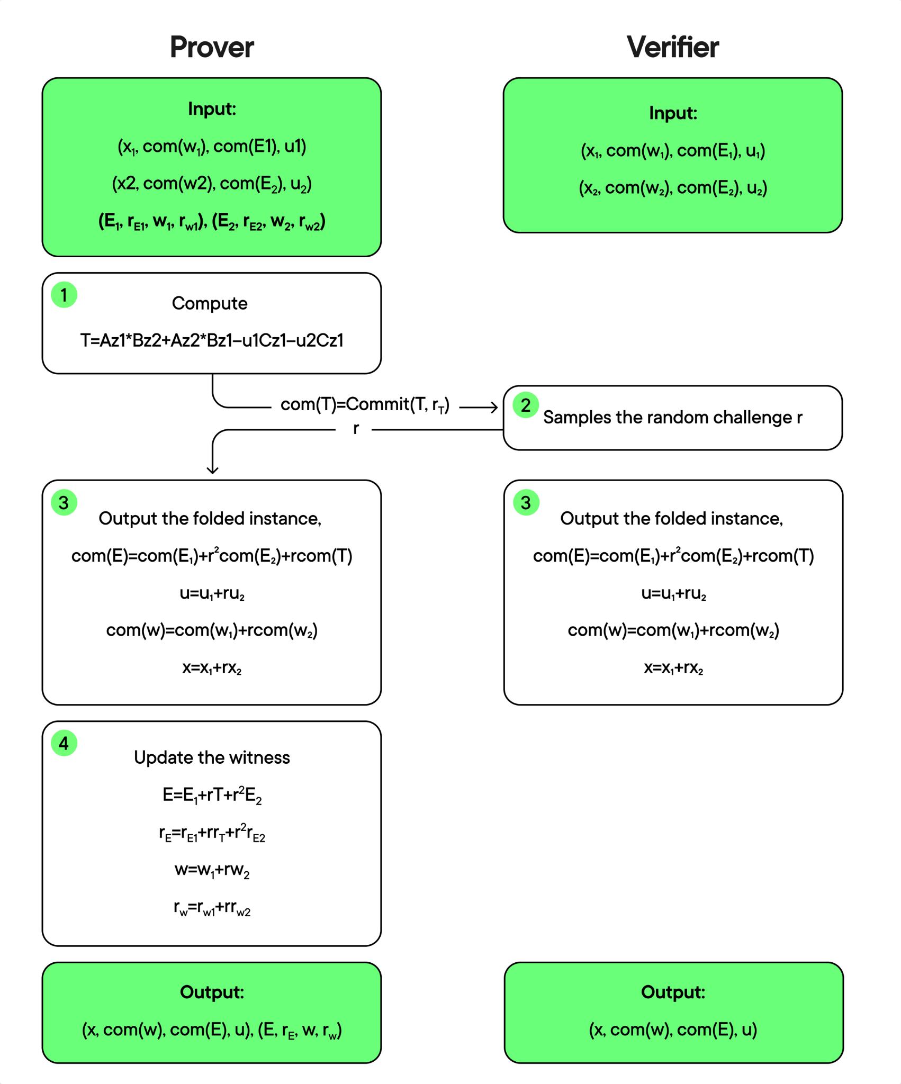

Folding Scheme for R1CS
Folding Scheme for Committed Relaxed R1CS
Protocol:
T: cross term
rT, r: random
Using Fiat-Shamir:

Slide 18
Implementation of Folding Scheme

Slide 19
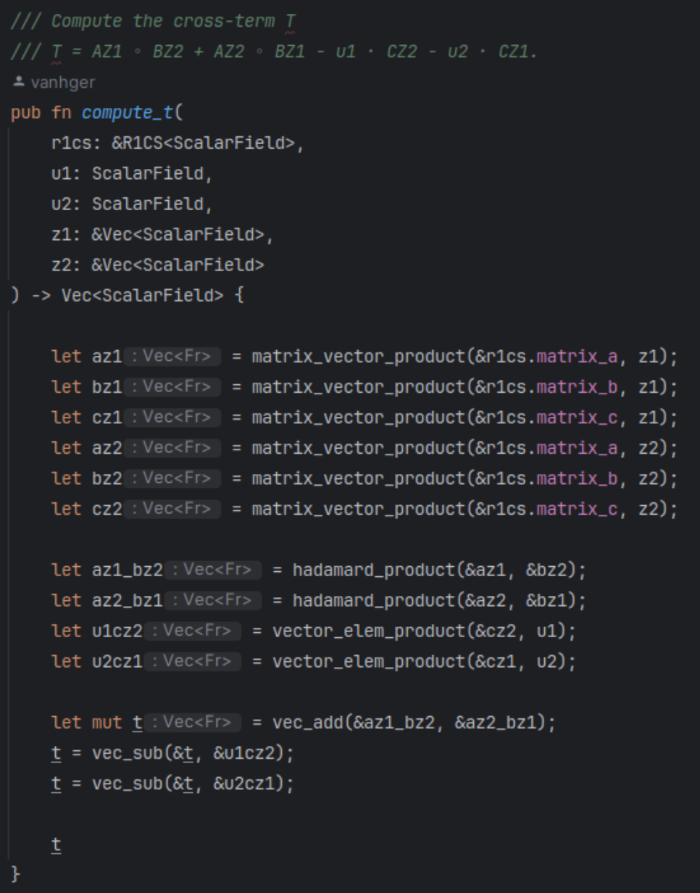
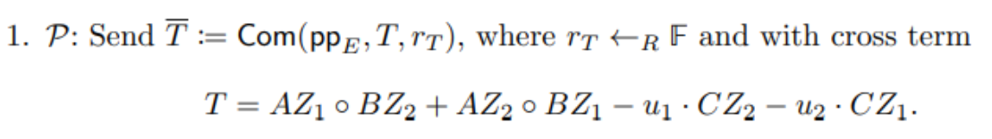
Implementation of Folding Scheme
Compute cross-term T

Slide 20
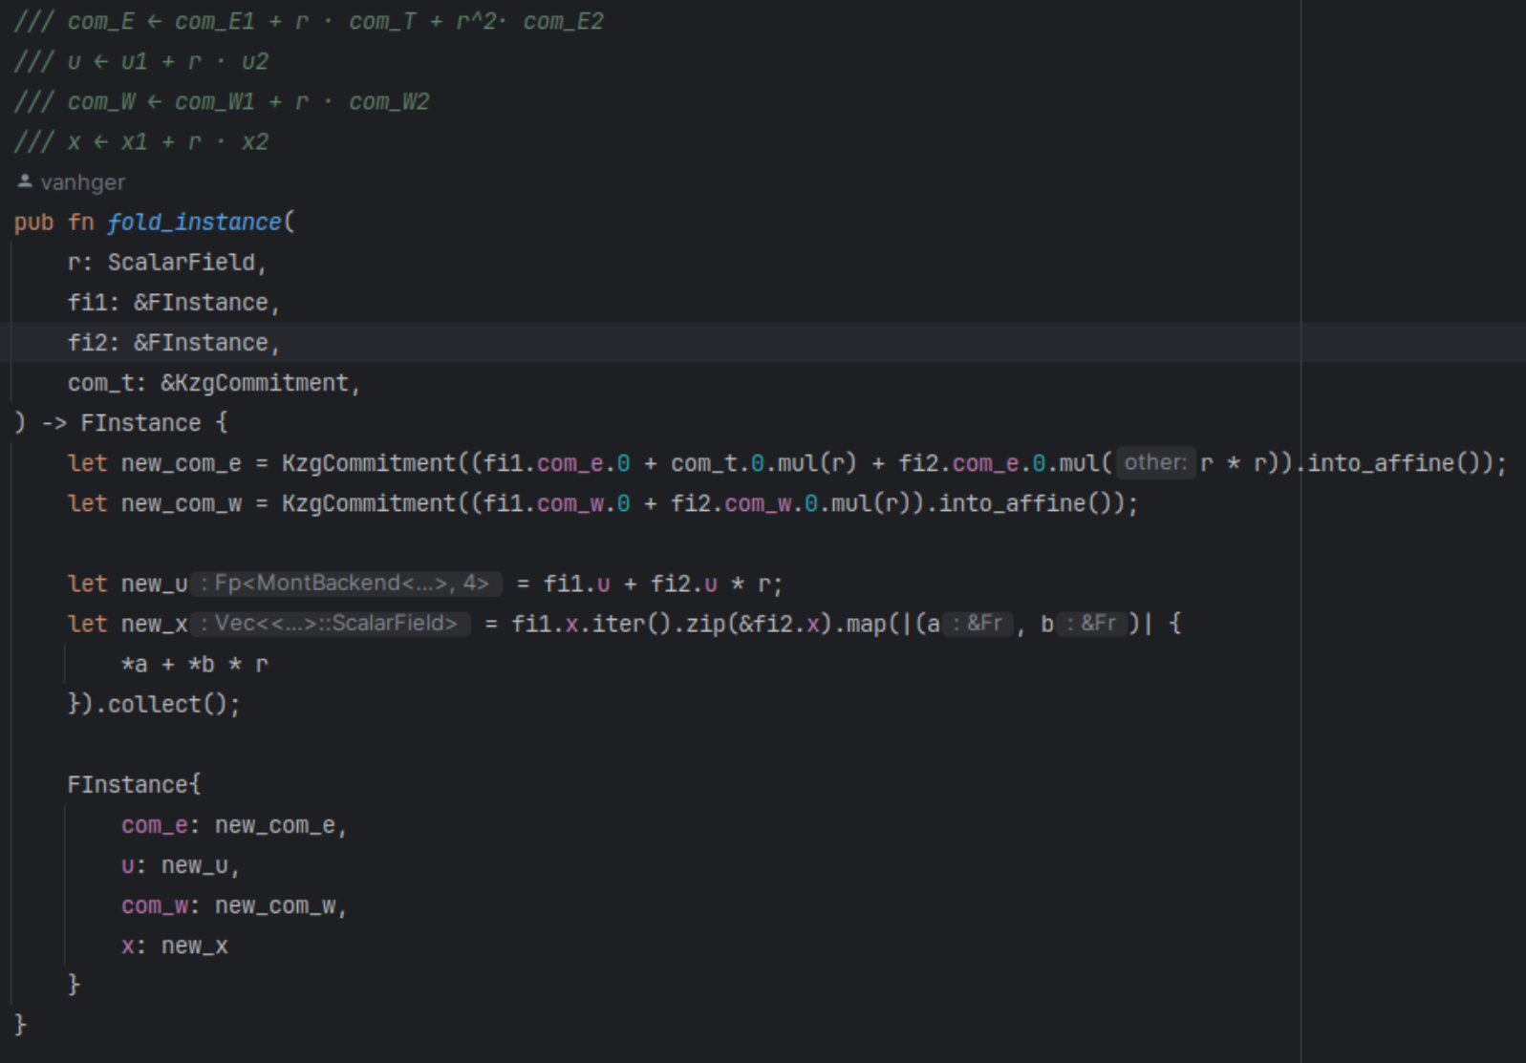
Implementation of Folding Scheme
Folding 2 instances

Slide 21
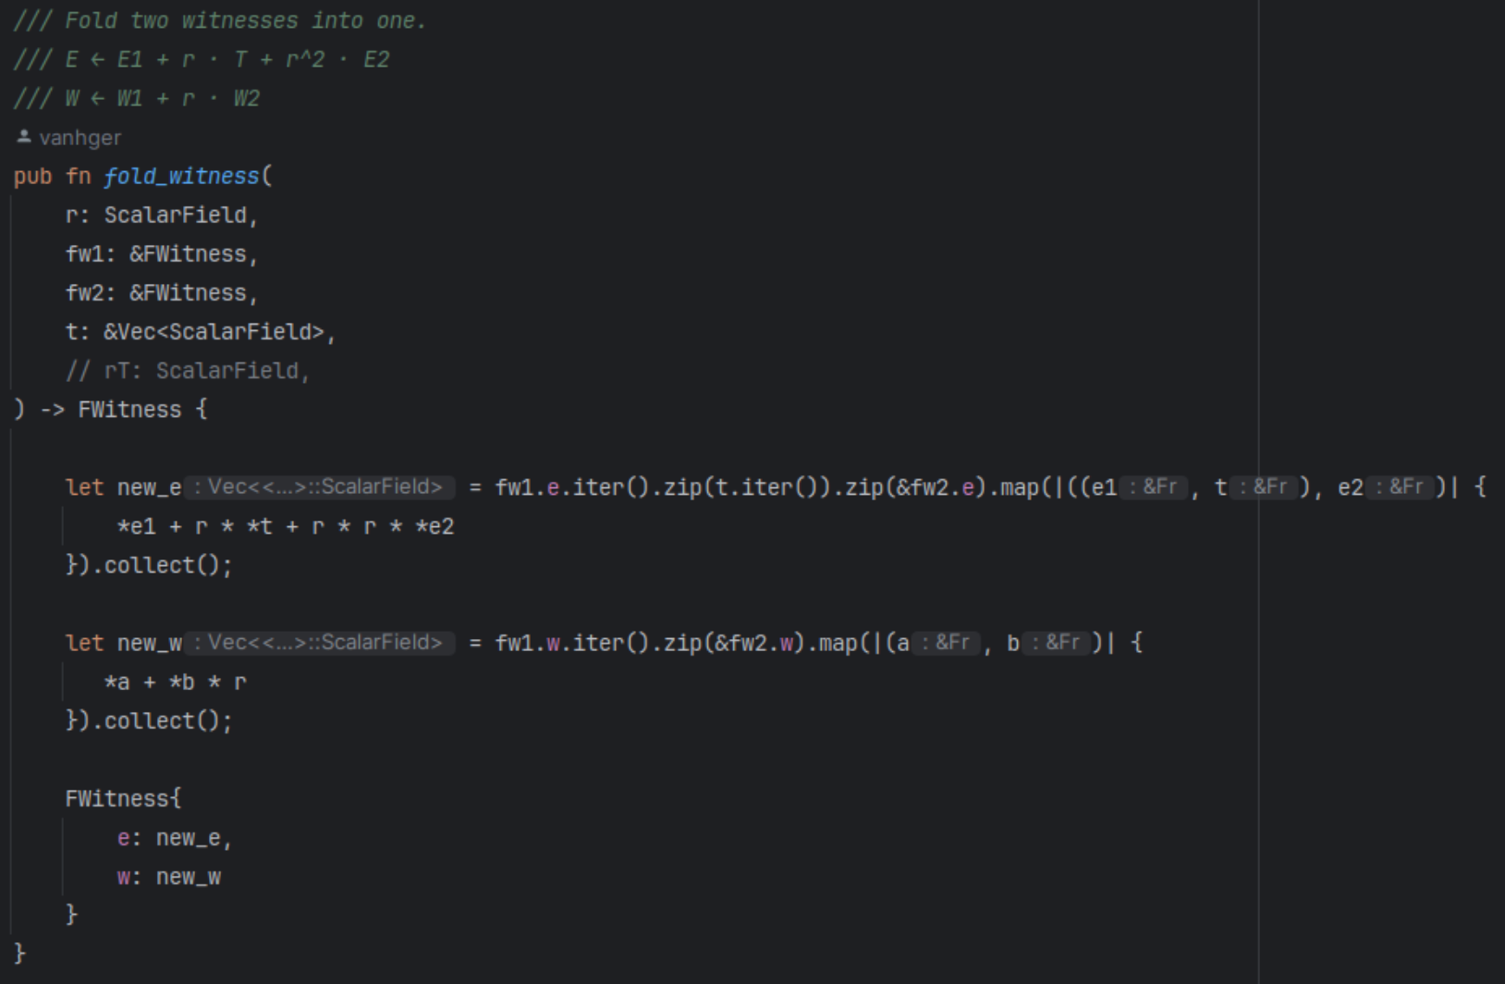
Implementation of Folding Scheme
Folding 2 witnesses

Slide 22
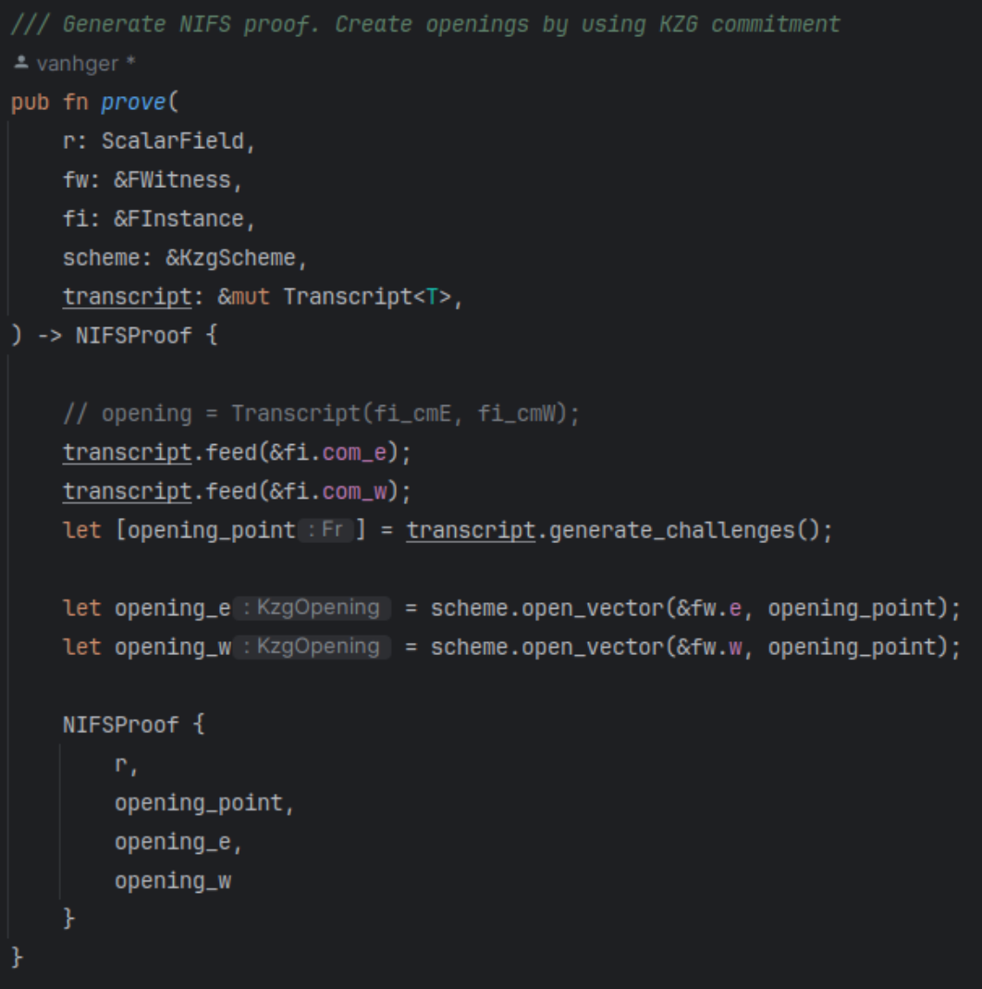
Implementation of Folding Scheme
Generate Proof

