Slide 1
Nova IVC Scheme
VanhGer

Slide 2
Contents
IVC
Folding Scheme
Constructing IVC from a Folding Scheme
Implementation

Slide 3
IVC
Incrementally Verifiable Computation

Slide 4
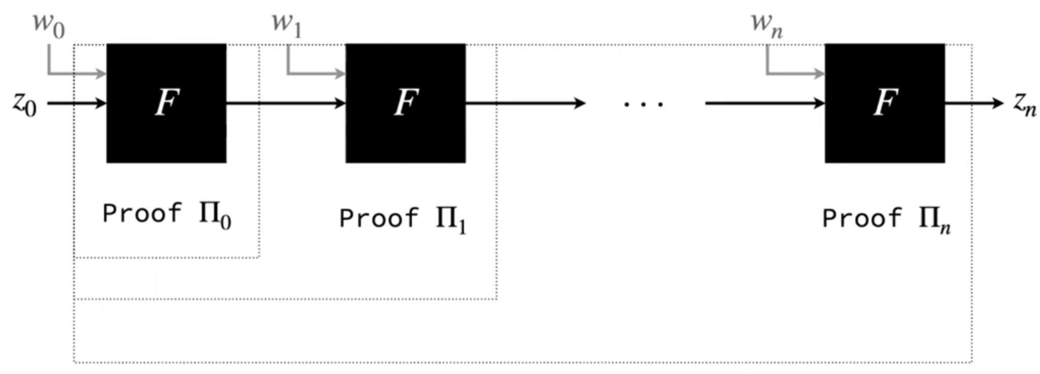
IVC
Allows us to do proofs for long computations with relatively little memory.
A function F is iterated for many times.
Generate a proof for each time that proves the computation to this point is correct.

Slide 5
IVC
Note that: z_{i} = F^{(n)}a(z₀ ) is the output of IVC.
Succinctness: Proof does not grow with the number of applications n.

Slide 6
Folding Scheme

Slide 7
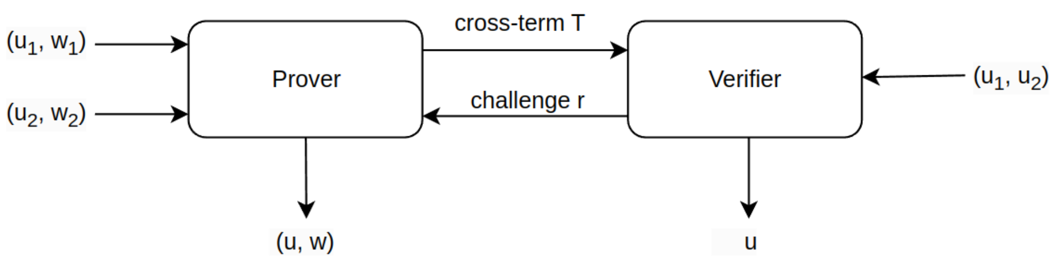
Folding Scheme
Def: folding scheme for a relation R is a protocol that reduces the task of checking two instances in R to the task of checking a single instance in R.
For example:

Slide 8
Constructing IVC from a Folding Scheme

Slide 9
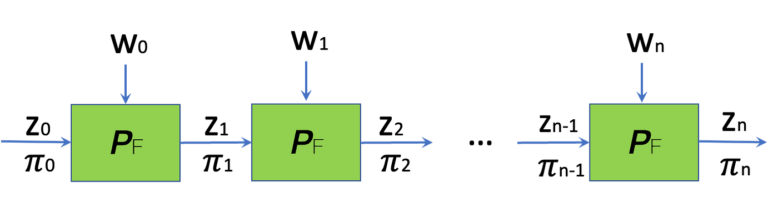
IVC from a Folding Scheme
Idea: at step i
Prover proves that the step i was computed correctly
Instead of verifying a proof for step i − 1, treats the computation at step i-1 as an R1CS instance and folds that into a running relaxed R1CS

Slide 10


IVC from a Folding Scheme
Idea: at step i
Prover proves that the step i was computed correctly
Instead of verifying a proof for step i − 1, treats the computation at step i-1 as an R1CS instance and folds that into a running relaxed R1CS
Consider:
Fresh instance u_i: represents the correct execution of invocation i of F’:
Running instance U_i: represents the correct execution of invocations: 1,..,i-1 of F’:

Slide 11

IVC from a Folding Scheme
Idea: at step i
Prover proves that the step i was computed correctly
Treats the computation at step i-1 as an R1CS instance and folds that into a running relaxed R1CS
Using an augmented function F’ that executes 2 tasks:
Executes a step of the incremental computation:
Invokes the verifier of folding scheme to fold the task of checking u_i and U_i into checking a single instance U_i+1

Slide 12
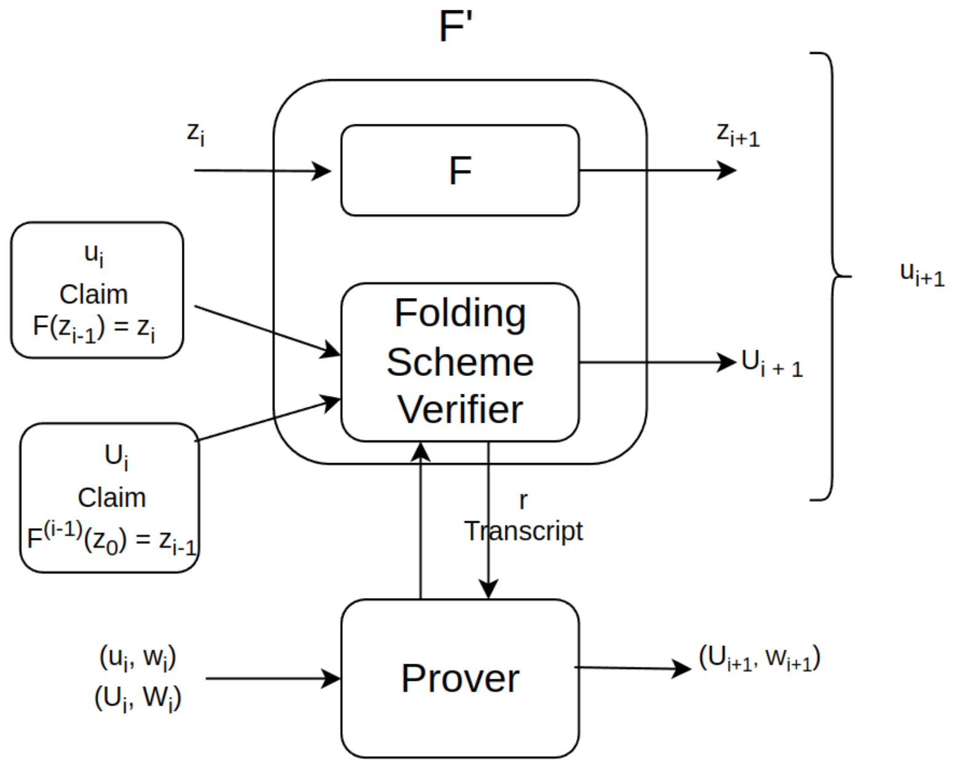
IVC from a Folding Scheme
IVC from a Folding Scheme
Idea: at step i
Prover proves that the step i was computed correctly
Treats the computation at step i-1 as an R1CS instance and folds that into a running relaxed R1CS

Slide 13
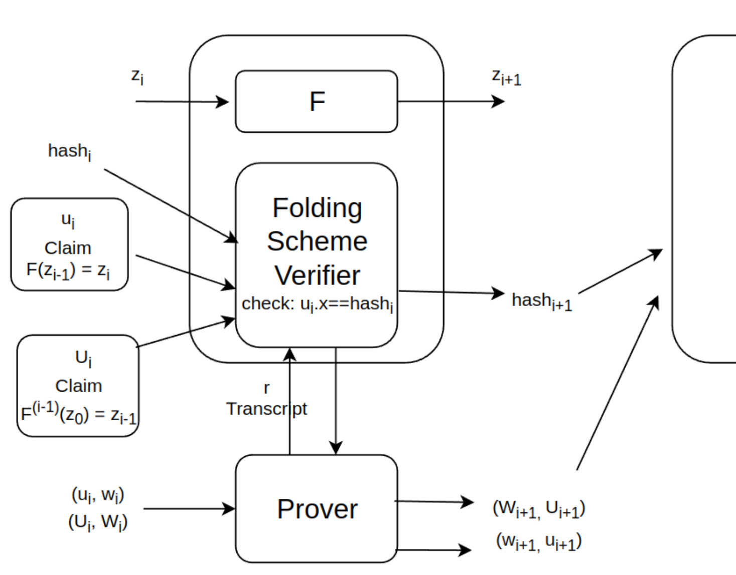
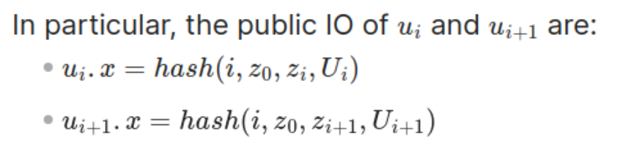
IVC from a Folding Scheme
IVC from a Folding Scheme
Hash the public IO of instance to avoid the linear growth of its size.
The next invocation of F’ will takes the preimage of this hash via the proof.

Slide 14
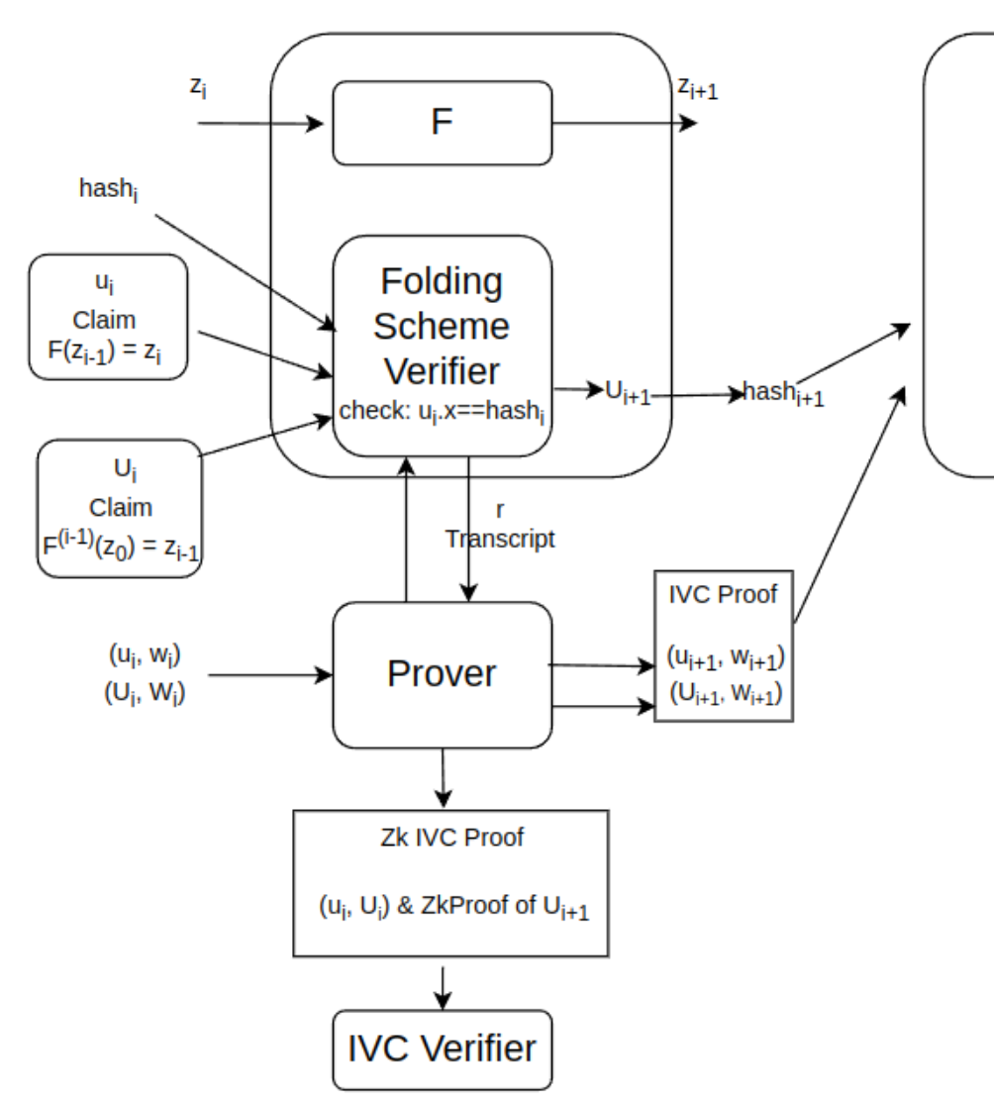
IVC from a Folding Scheme
IVC from a Folding Scheme
Use zk-SNARKs to make the proof zk and succinct.
Proof claims the knowledge of witness W’ such that:

Slide 15
IVC from a Folding Scheme
IVC from a Folding Scheme
Use zk-SNARKs to make the proof zk and succinct.
Proof claims the knowledge of witness W’ such that:
Note: Using an off-the-shelf SNARK requires encoding a linear number of group scalar multiplications in the programming model of zkSNARKs.
=> interpret commitments to vectors as polynomial commitments

Slide 16
Implementation

Slide 17
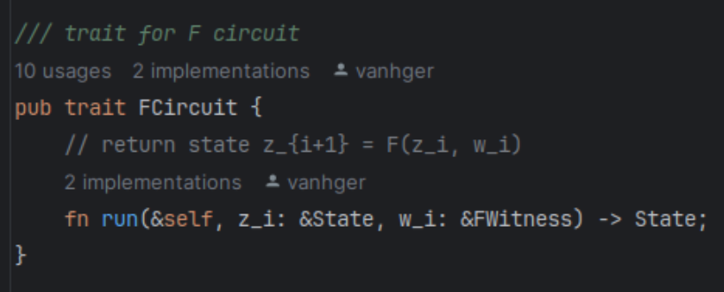
Implementation
F function and F’ function

Slide 18
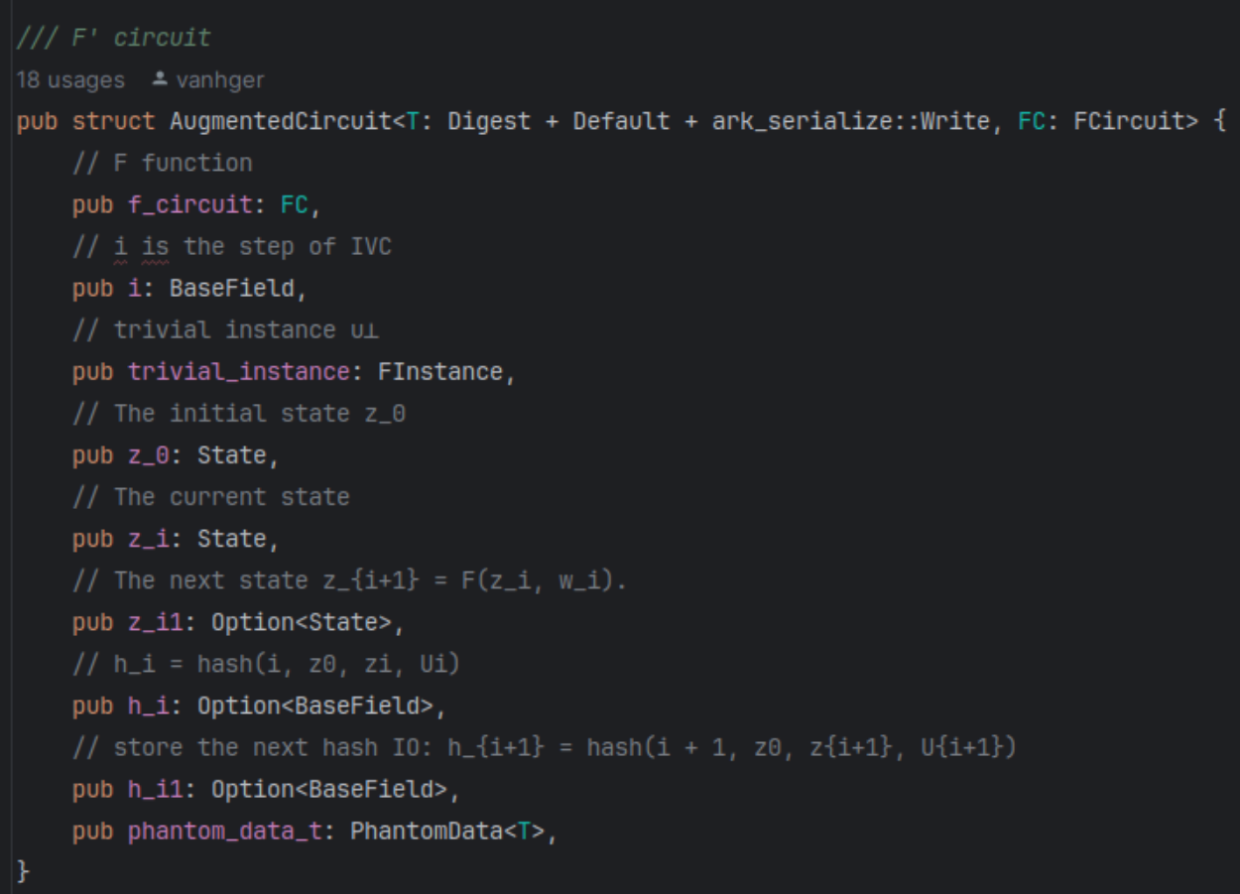
Implementation
F function and F’ function

Slide 19
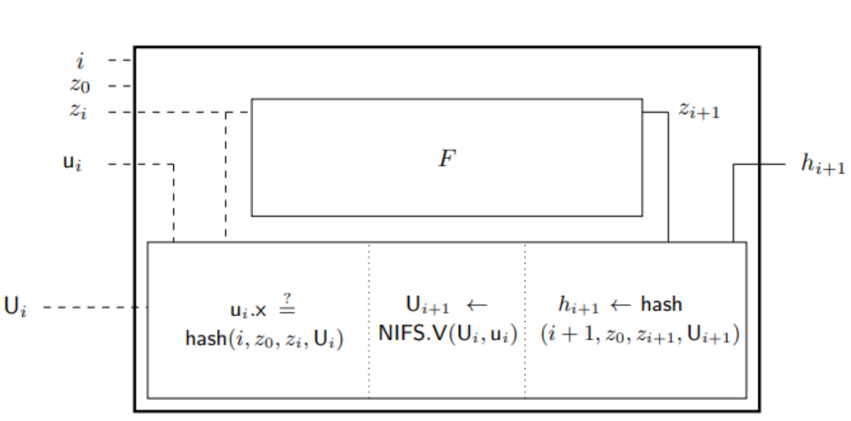
Implementation
F function and F’ function

Slide 20
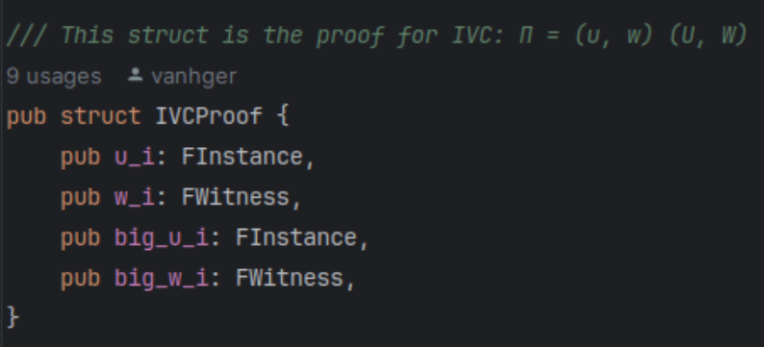
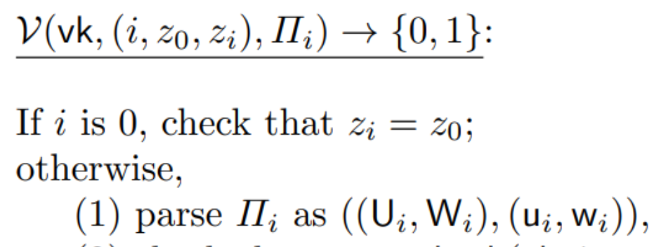
Implementation
IVC proof and zkSNARK proof

Slide 21
Implementation
IVC proof and zkSNARK proof

Slide 22
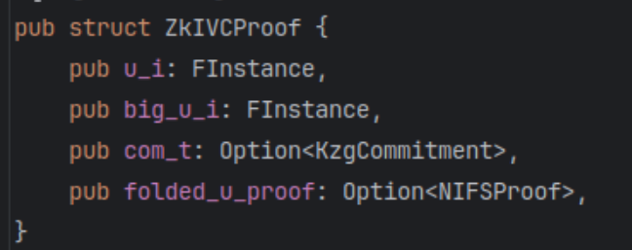
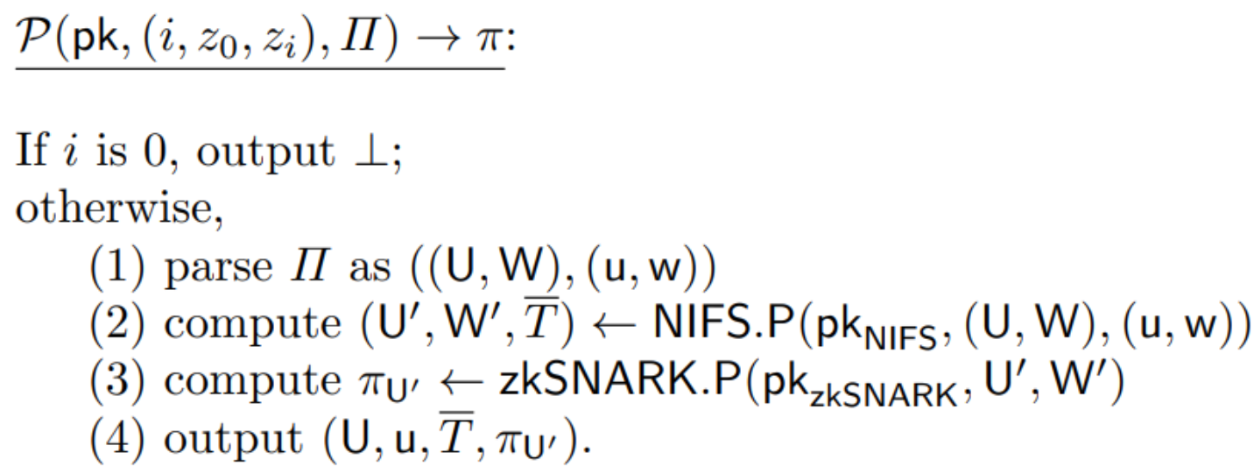
Implementation
IVC proof and zkSNARK proof

Slide 23
Polynomial IOP for Idealized Relaxed R1CS

Slide 24
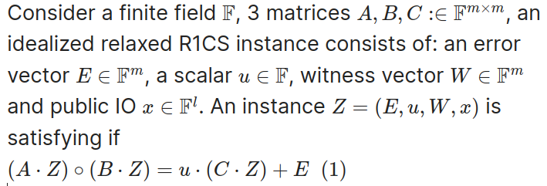
Polynomial IOP for Idealized Relaxed R1CS
Idealized Relaxed R1CS:

Slide 25
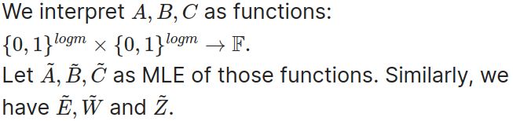


Polynomial IOP for Idealized Relaxed R1CS
So, instead of checking:
We check that:

Slide 26
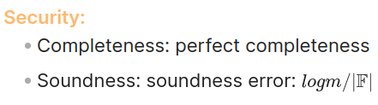
Polynomial IOP for Idealized Relaxed R1CS
The size of proof: O(log(F)).
Neither requires a trusted setup nor FFTs.

Slide 27
SuperNova

Slide 28
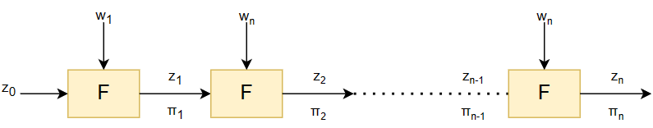
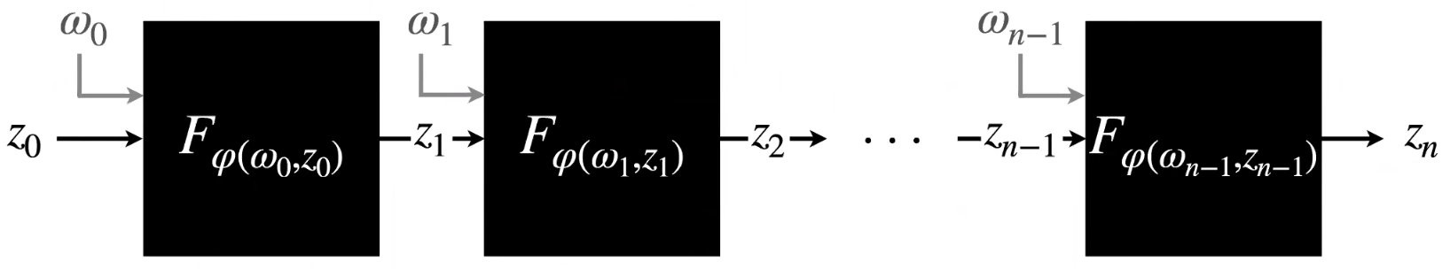
SuperNova
NIVC: Non-uniform IVC
IVC:
NIVC:

Slide 29
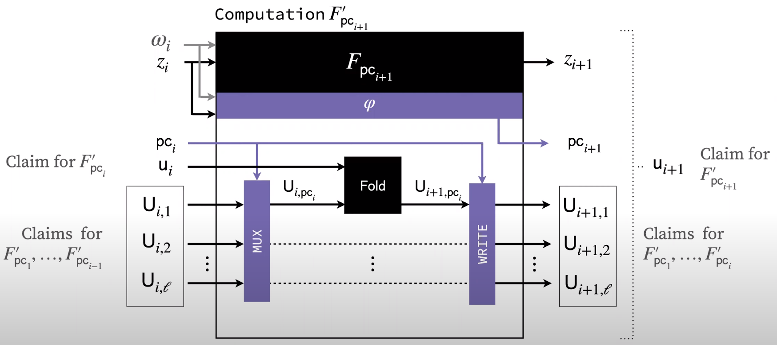
SuperNova
SuperNova
F’j takes a list of running instance U_i, where U_i[j] attests to all prior iterations of F’j from steps: 1 to i-1.

Slide 30
SuperNova
SuperNova
F’j runs:
F_j on input (z_i, w_i) to compute z_{i+1}.
A verifier circuit

