Slide 1
STARK Engine
Seminar
VanhGer ZKP Researcher

Slide 2
Table of contents
01
02
03
04
05
Introduction
Review STARK
STARK Engine
Future Work
Q & A

Slide 3
01
Introduction

Slide 4
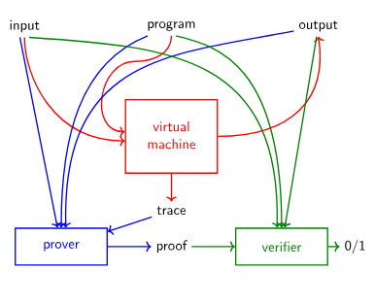
Introduction
This presentation is about how to design a Turing-complete zk-STARK engine, consisting of a virtual machine, prover, and verifier.

Slide 5
02
Review STARK

Slide 6
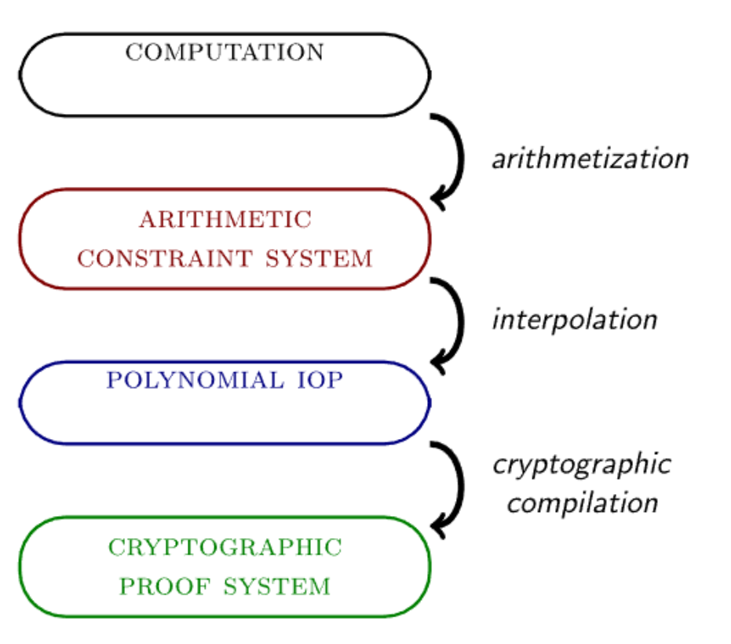
Review STARK
The computation includes: a program, an input and an output.
This computation is transformed into a set of equations or tuples, including various constraints.
They are then represented in terms of univariate polynomials.
Use a proof system to commit and verify.

Slide 7
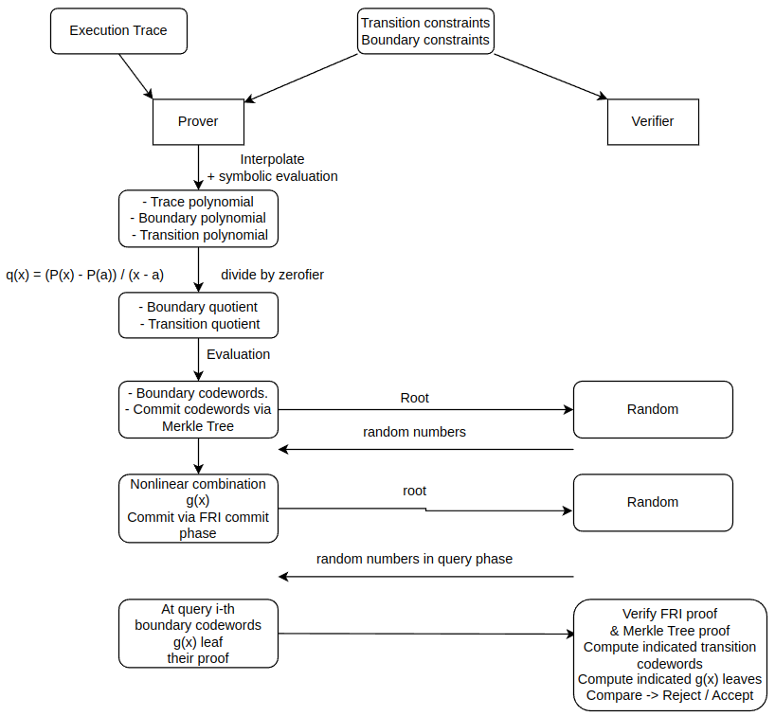
Review STARK

Slide 8
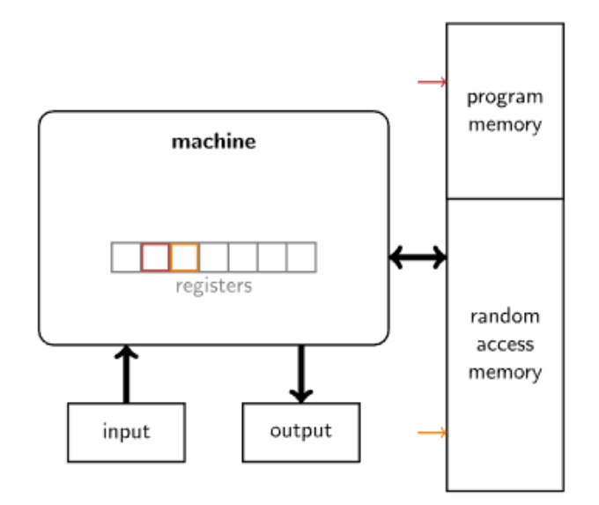
STARK Engine
read the next instruction from memory and decode it;
(possibly) read a word from memory or standard input;
update the register set in accordance with the instruction;
(possibly) write a word to memory or standard output.
The difference between a STARK and a STARK Engine is that the latter comes with a virtual machine and is capable of proving and verifying arbitrary computations

Slide 9
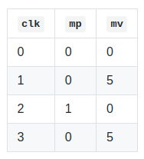
STARK Engine
Table
Example problem: The processor writes something to RAM and then later reads it We need to check the consistency of memory:
The initial value of all memory cells is zero.
When the memory pointer register mp is reset to a previous value, the memory value register mv changes.
Its new value must be consistent with the value it had the last time the memory pointer pointed to it.
clk, mp, mv are base columns

Slide 10
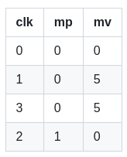
STARK Engine
Table
We first sort the table by the memory pointer mp and then by the clock cycle clk.
Transition constraint:
Whenever the mp changes, the mv is zero.
mp remains unchanged, clk jumps by more than 1, mv cannot change.

Slide 11
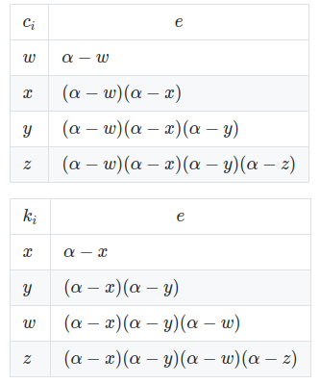
STARK Engine
Permutation Argument
Assume that prover has access to random scalars: 𝑎,𝑏,𝑐,..., 𝛼,… supplied by verifier.
Prover uses 𝑎,𝑏,𝑐,... to compress multiple column into one.
Let the elements in these column be (𝑐𝑖) and (𝑘𝑖).
Both tables now are extended with a new column 𝑒 that computes the products ∏(𝛼−𝑐_𝑖) and ∏(𝛼−𝑘_𝑖)
Transition constraint: 𝑒_{𝑖−1} * (𝛼−𝑐_𝑖) = 𝑒_𝑖.
e is extended column.

Slide 12
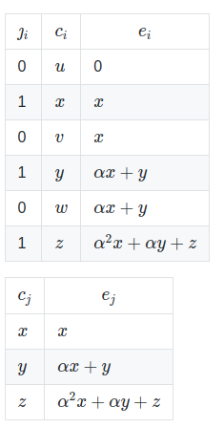

STARK Engine
Evaluation Argument: one table’s list of rows appears in order as a sublist of another table’s list of rows.
For instance, when the processor reads input from a designated input tape.
Prover:
Compresses all columns into one.
The larger table must have column J_i that equals to 1 if row i is in the smaller table and 0 if it is not.

Slide 13
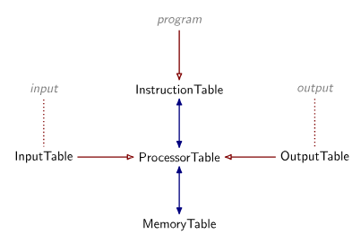
STARK Engine
Workflow
In the STARK virtual machine, several tables must be created, including:
Processor table: contains all states of registers in chronological order
Instruction table: contains all instructions in the program
Memory table: records all changes to memory.
Input / Output table: captures input and output data.
*blue: permutation argument, red: evaluation argument

Slide 14
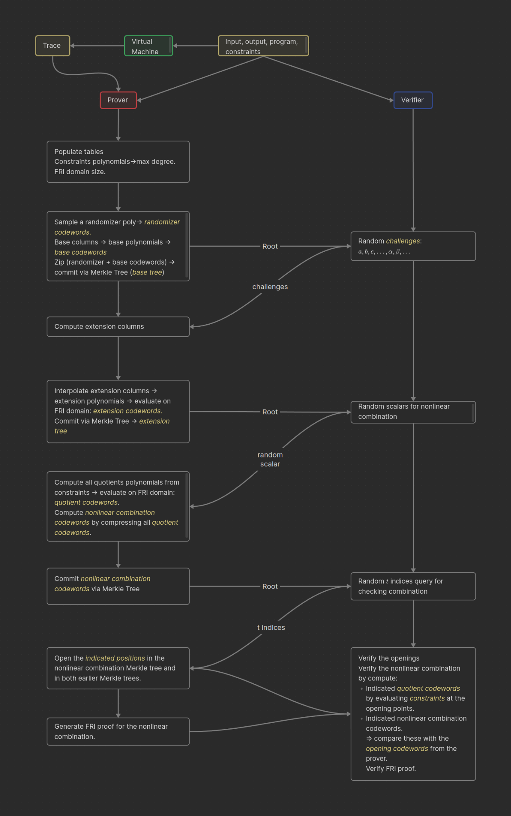
STARK Engine
Workflow
Here is the workflow of STARK Engine.
You should see the Brainfuck VM depiction version of this workflow from Ferdinand here.

Slide 15
04
Future work

Slide 16
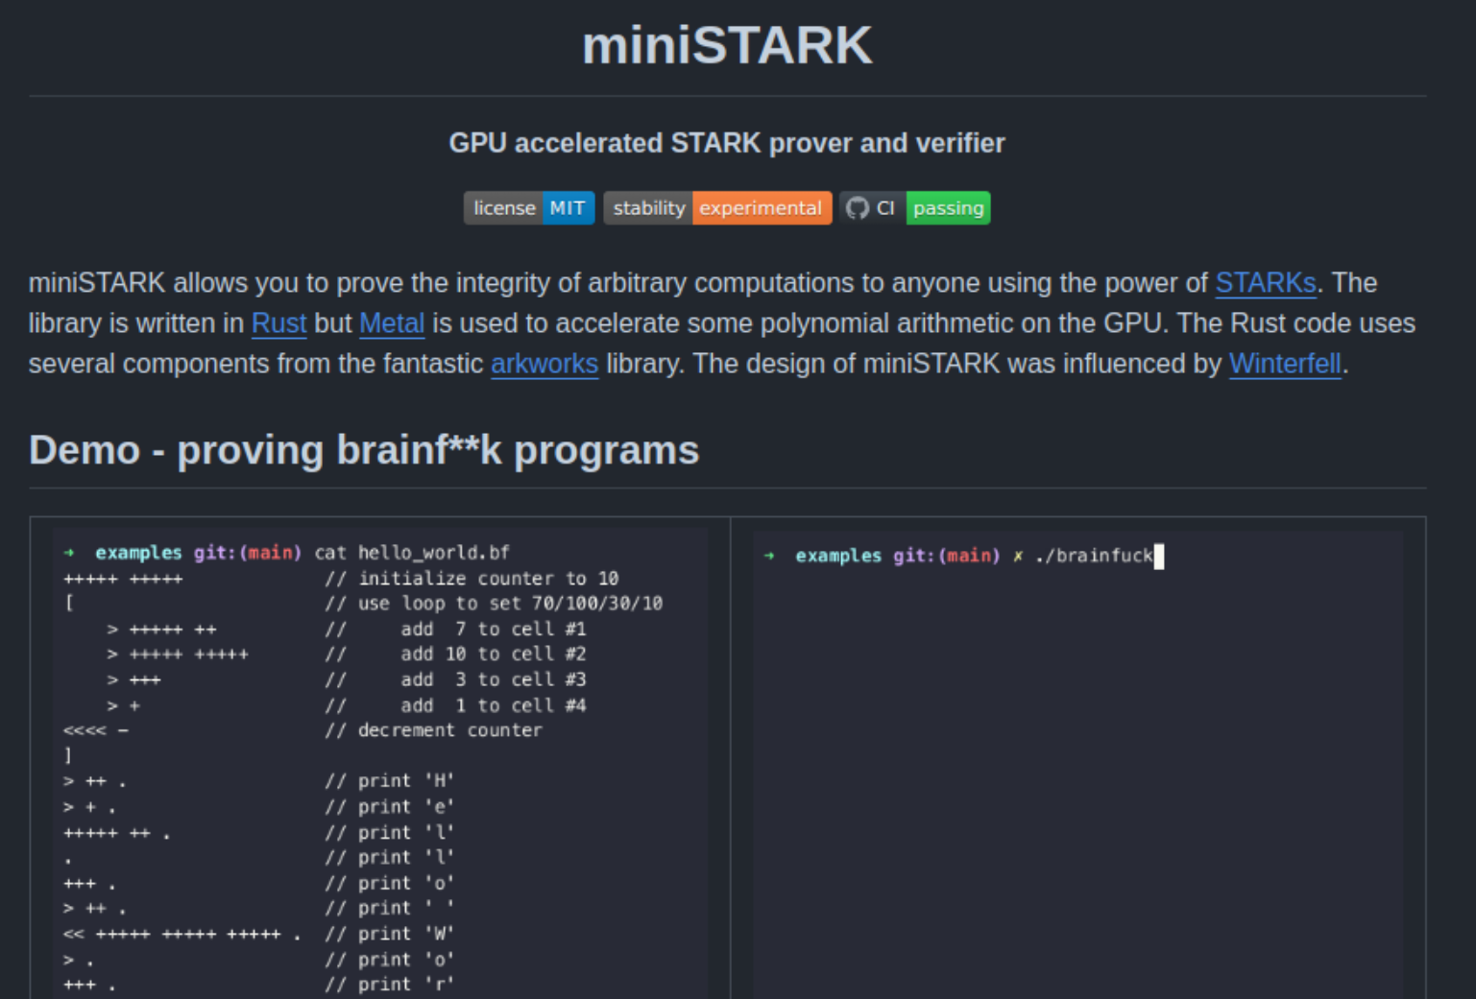
Future works
Dive into miniStark codebase.

Slide 17
05
Q & A
references:
BrainSTARK: https://aszepieniec.github.io/stark-brainfuck/
STARK Dex: https://medium.com/starkware/starkdex-deep-dive-the-stark-core-engine-497942d0f0ab

