Slide 1
Derivation of formula for transparency converter
https://github.com/sotanmochi/TransparencyConverter
2022/04/24
Soichiro Sugimoto

Slide 2
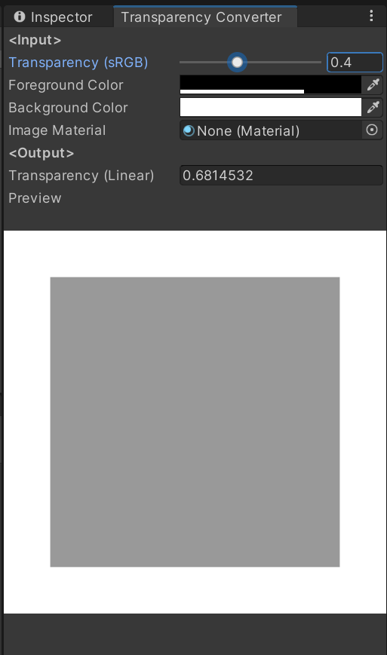
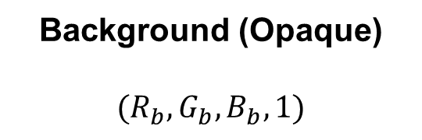
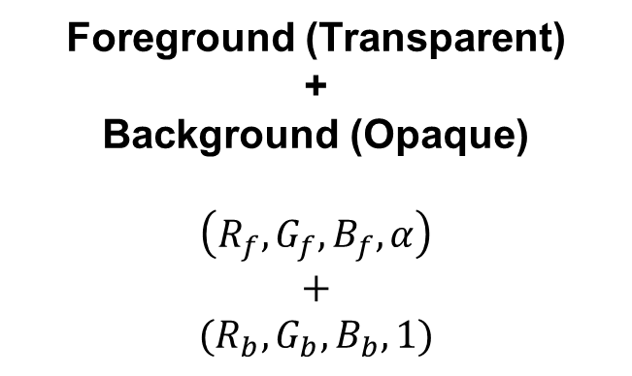
Transparency conversion from sRGB color space to linear color space
Foreground (Transparent)
+
Background (Opaque)
$$\left(R_{f}, G_{f}, B_{f}, α\right)$$
$$+$$
$$(R_{b}, G_{b}, B_{b}, 1)$$
Background (Opaque)
$$(R_{b}, G_{b}, B_{b}, 1)$$

Slide 3


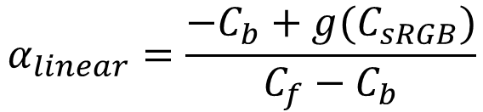



Transparency conversion from sRGB color space to linear color space
$$C_{output}=C_{f}α+C_{b}(1−α)$$
where $C$ is $R$, $G$, and $B$.
$$C_{linear}=C_{f}α_{linear}+C_{b}(1−α_{linear})$$
$$C_{sRGB} =C_{f}α_{sRGB} +C_{b}(1−α_{sRGB})$$
$$C_{linear}=g(C_{sRGB})$$
where $g(x)$ is conversion function from sRGB color space to linear color space.
$$C_{f}α_{linear}+C_{b}(1−α_{linear})=g(C_{sRGB})$$
$$α_{linear}=\frac{−C_{b}+g(C_{sRGB})}{C_{f}−C_{b}}$$
where $C_{f}≠C_{b}$and $C_{sRGB} =C_{f}α_{sRGB} +C_{b}(1−α_{sRGB})$.

Slide 4

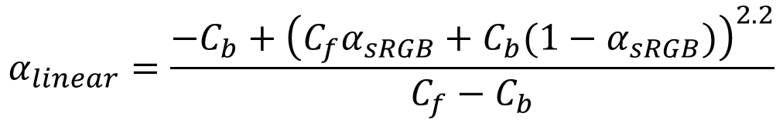


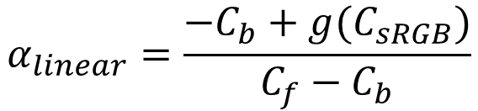



Transparency conversion from sRGB color space to linear color space
$$α_{linear}=\frac{−C_{b}+g(C_{sRGB})}{C_{f}−C_{b}}$$
where $C_{f}≠C_{b}$and $C_{sRGB} =C_{f}α_{sRGB} +C_{b}(1−α_{sRGB})$.
For $g\left(x\right)=x^{2.2}$,
$$α_{linear}=\frac{−C_{b}+{\left(C_{f}α_{sRGB}+C_{b}(1−α_{sRGB})\right)}^{2.2}}{C_{f}−C_{b}}$$
where $C_{f}≠C_{b}$.
Special cases
$$α_{linear}=1−{\left(1−α_{sRGB}\right)}^{2.2}$$
for $C_{f}=0$ (black), $C_{b}=1$ (white)
$$α_{linear}=α_{sRGB}^{2.2}$$
for $C_{f}=1$ (white), $C_{b}=0$ (black)

Slide 5
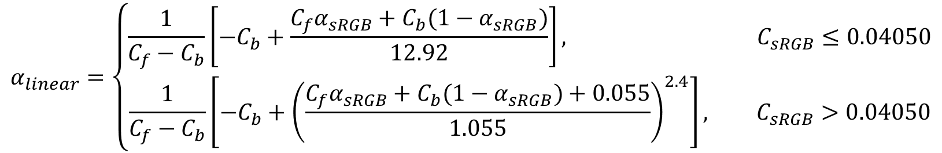
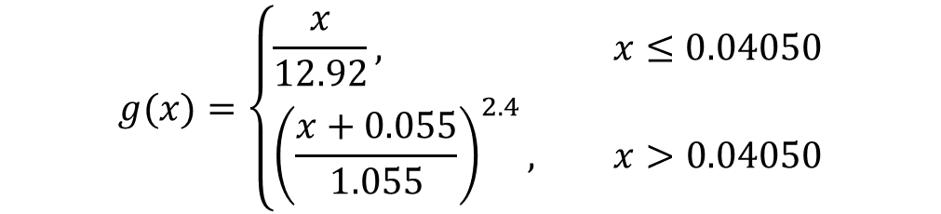
Transparency conversion from sRGB color space to linear color space
$$α_{linear}=\frac{−C_{b}+g(C_{sRGB})}{C_{f}−C_{b}}$$
where $C_{f}≠C_{b}$and $C_{sRGB} =C_{f}α_{sRGB} +C_{b}(1−α_{sRGB})$.
For the following $g\left(x\right)$ (Refer to https://en.wikipedia.org/wiki/SRGB#Transformation)
$$g(x)=\left\{\begin{aligned}\frac{x}{12.92}, x≤0.04050 \\ {\left(\frac{x+0.055}{1.055}\right)}^{2.4}, x>0.04050\end{aligned}\right.$$
$$α_{linear}=\left\{\begin{aligned}\frac{1}{C_{f}−C_{b}}\left[−C_{b}+\frac{C_{f}α_{sRGB}+C_{b}(1−α_{sRGB})}{12.92}\right], C_{sRGB}≤0.04050 \\ \frac{1}{C_{f}−C_{b}}\left[−C_{b}+{\left(\frac{C_{f}α_{sRGB}+C_{b}(1−α_{sRGB})+0.055}{1.055}\right)}^{2.4}\right], C_{sRGB}>0.04050\end{aligned}\right.$$

Slide 6

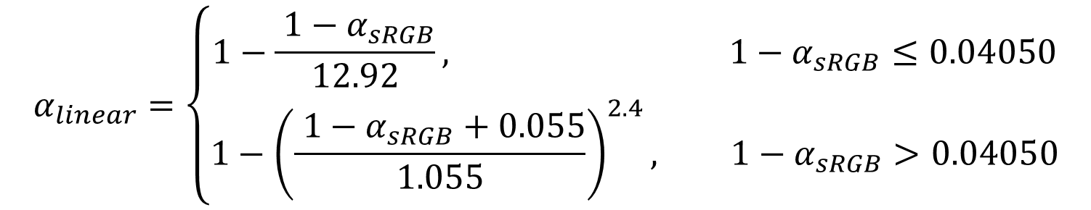
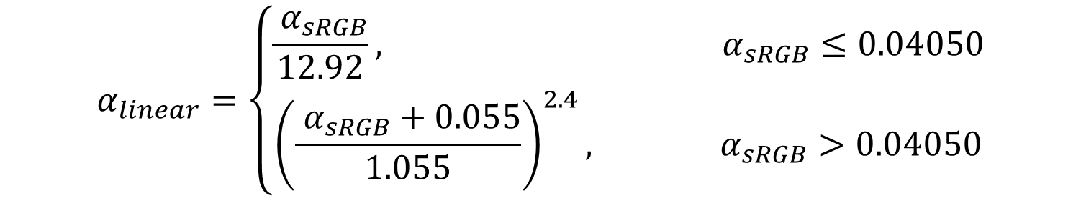

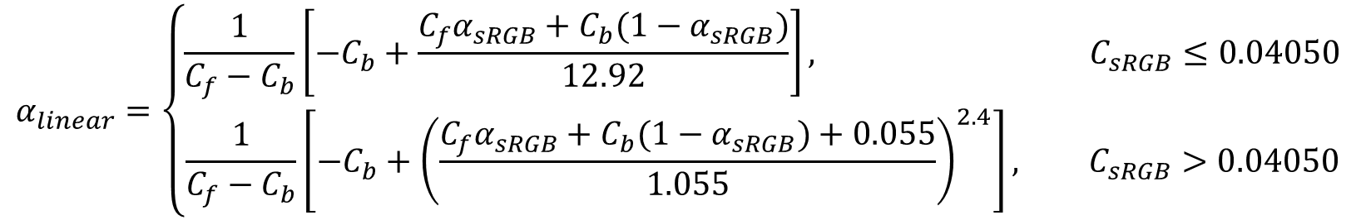
Transparency conversion from sRGB color space to linear color space
$$α_{linear}=\left\{\begin{aligned}\frac{1}{C_{f}−C_{b}}\left[−C_{b}+\frac{C_{f}α_{sRGB}+C_{b}(1−α_{sRGB})}{12.92}\right], C_{sRGB}≤0.04050 \\ \frac{1}{C_{f}−C_{b}}\left[−C_{b}+{\left(\frac{C_{f}α_{sRGB}+C_{b}(1−α_{sRGB})+0.055}{1.055}\right)}^{2.4}\right], C_{sRGB}>0.04050\end{aligned}\right.$$
where $C_{f}≠C_{b}$and $C_{sRGB} =C_{f}α_{sRGB} +C_{b}(1−α_{sRGB})$.
Special cases
For $C_{f}=0$ (black) and $C_{b}=1$ (white),
$$α_{linear}=\left\{\begin{aligned}1−\frac{ 1−α_{sRGB}}{12.92}, 1−α_{sRGB}≤0.04050 \\ 1−{\left(\frac{ 1−α_{sRGB}+0.055}{1.055}\right)}^{2.4}, 1−α_{sRGB}>0.04050\end{aligned}\right.$$
For $C_{f}=1$ (white) and $C_{b}=0$ (black),
$$α_{linear}=\left\{\begin{aligned}\frac{ α_{sRGB}}{12.92}, α_{sRGB}≤0.04050 \\ {\left(\frac{ α_{sRGB}+0.055}{1.055}\right)}^{2.4}, α_{sRGB}>0.04050\end{aligned}\right.$$

